Slide 1
Local government procurement and why we love it
April 2014

Slide 2

Who are the FSB?
http://www.youtube.com/v/jP9yuK_TFK0&feature=youtu.be

Slide 3
FSB and lobbying
5 key asks to Government on:
  Business rates
  Local Enterprise Partnerships or LEPs
  Procurement and Late payment
  Town centres; parking, regeneration etc
  Skills and education

Slide 4
FSB wins
5 recent wins for small business owners
  £2,000 Employment Allowance won
  Access to finance to be investigated
  Rollover energy contracts scrapped
  EU Ergonomics directive scrapped
  Cost of fuel hike postponed

Slide 5
Why is local procurement
so important?

Slide 6


Slide 9
Procurement and why we love it
‘Public procurement can be used as a lever to tackle economic and social challenges.’*
*Ref: ‘Local Procurement - Making the most of small businesses, one year on’
by Peter Connell, Policy Advisor, Local Government, FSB

Slide 10
Procurement: The research
‘58% more of the money spent by local authorities with small firms is re-spent in the local economy compared to that spent with large businesses in the same area.’
The FSB has worked closely with the Centre for Local Economic Strategies (CLES) to survey local authorities UK-wide and find out more about how they procure goods. This is the second year this research has been undertaken.

Slide 11
Procurement: The research
For every £1 spent with a small or medium-sized business (SME) 63p was re-spent in the local area compared to 40p in every £1 spent with a larger business.

Slide 12
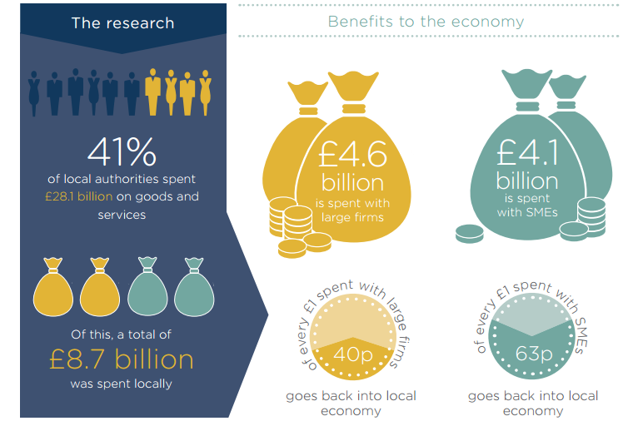
The research and benefits

Slide 13
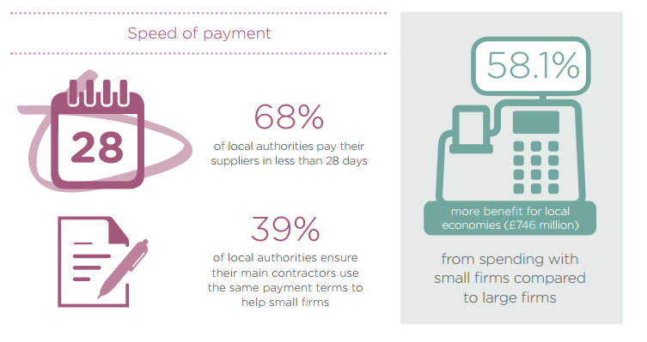
Procurement speed

Slide 14
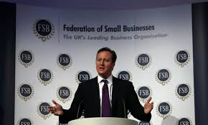
The PM’s procurement promise

Slide 15
The PM’s procurement promise
25%
of all Government procurement will be local

Slide 16
Medway Council’s challenge
We fully support Medway’s bold target of 40% local procurement with SME’s

Slide 17
What will we do?
Encourage small businesses to pitch for local government work
Lobby local authorities with the evidence that shows local procurement works
Make more use of:
  Smaller Lots
  Prior Information Notices
  Innovative solutions / variant bids

Slide 18
Thank you

