Slide 1
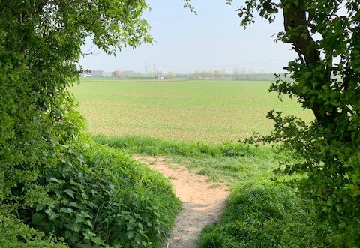
Rights of Way Improvement Plan -
Action Plan Update 2020-2022

Slide 2
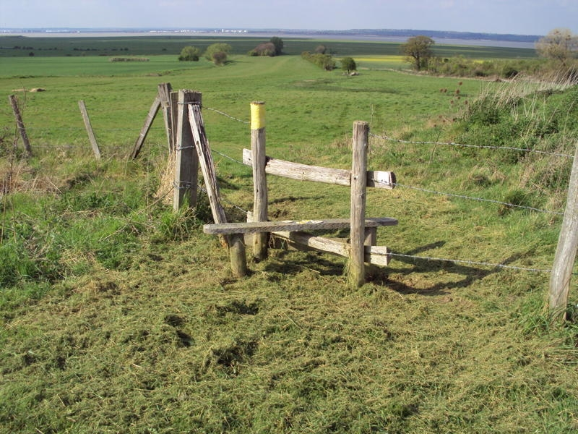
Theme 1 – A well maintained network
Work so far…..
Now have a Priority Path Clearance contract funded by LTP
One off Winter clearance contract funded by DfT – widening well used paths
Ongoing removal of stiles especially on the ECP and as part of new developments
GIS survey almost finished
mapping the true lines of paths
Surveying the path surface type and conditions
Compiling a database of assets and their conditions
Objectives
All about the network:
condition
assets
prioritising safety
areas of greatest need

Slide 3
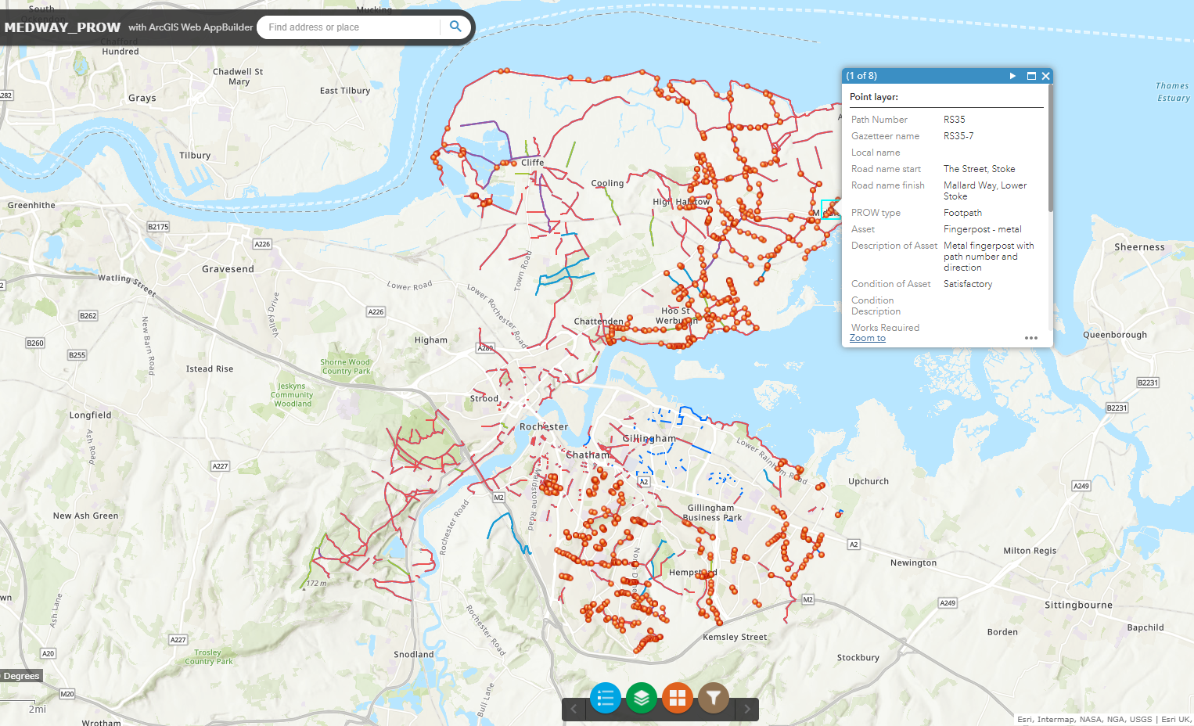
Map showing footpath from The Street, Stoke to Mallard Way, Lower Stoke

Slide 4
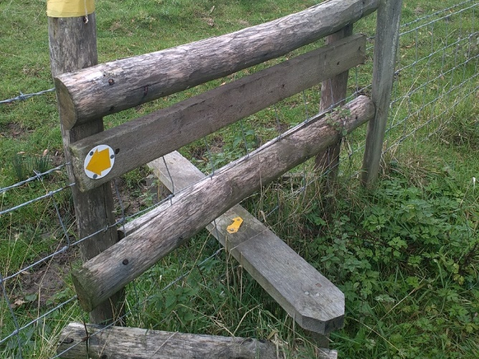
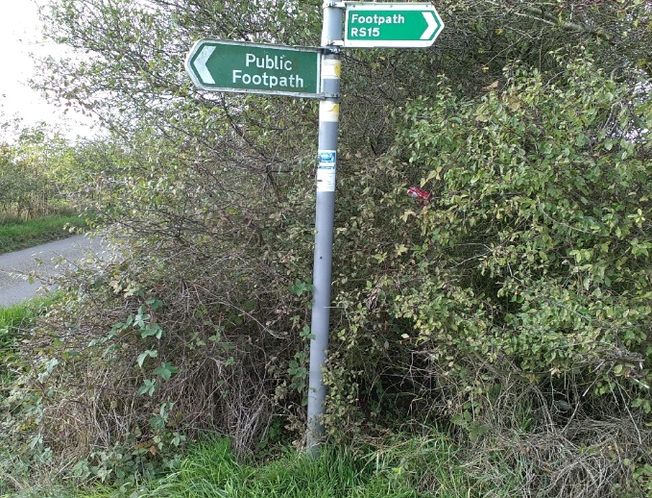
Images of gate styles

Slide 5
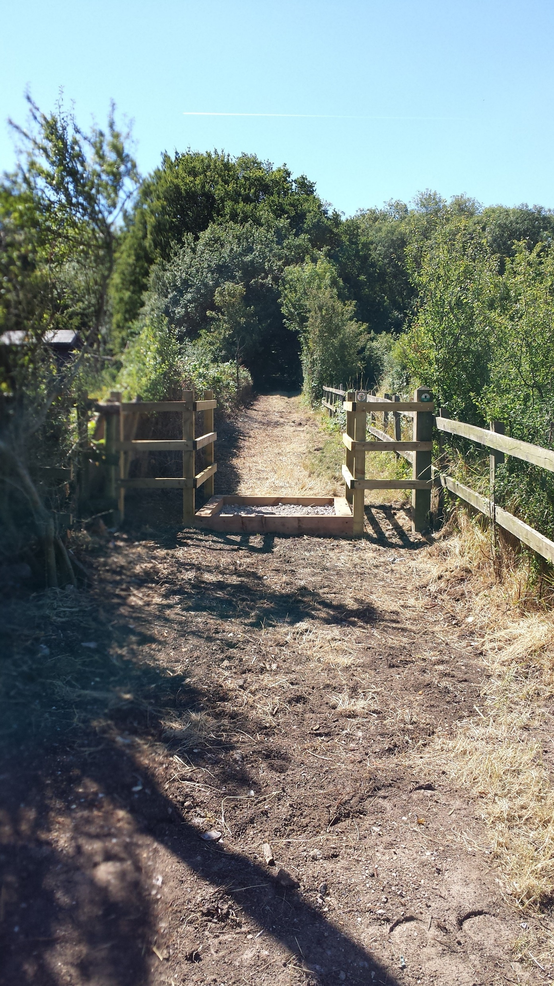
Theme 2 – An evolving network
Work to date….
Working with the HIF team to ensure PRoW access is retained, improved and expanded, especially for equestrians
Looking to identify missing links and dead end paths and work with wards, parishes and landowners to solve them
Discovering and compiling a list of where people have walked during the last year to better identify popular and new routes
Actively seeking improvements to path through and near new developments
Objectives
All about :
Connectivity
Improvements through development

Slide 6
Theme 3 – Serving Medway’s needs
Achievements so far
We have updated the PRoW webpages ensuring the site is accessible, has more links, more downloads and most importantly a direct link to report problems on the network
We have worked with Waste Services and external partners to organise beach cleans near PRoW and more dog bins in Allhallows
We have worked with Bird wise to produce signage to educate users of the sensitivities of locations on the ECP
Objectives
These are all about:
Accessible resources
Environmental partnerships

Slide 7
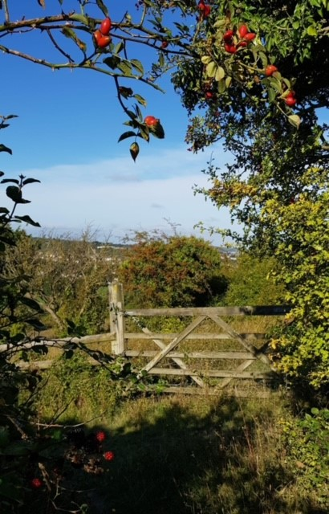
Theme 4 – Effective delivery
Work so far…..
We are compiling a list from the Ramblers and BHS to allow us to look into any missing ways before 2026 cut off date
We have added new categories to our online reporting system so we can analyse our most common issues, where they are and develop a priority matrix for dealing with complaints
With the help of our Technical Officer we have improved our Face book offering and quadrupled engagement on the site
We have helped the LAF develop a new website and logo but we do need your ongoing help in keeping it current and engaging
We have been busy providing new tools, replacing tools and looking for other ways to help and increase our volunteer base.
Objectives
Are all about:
Updating Definitive Map and Statement
A customer focused service
Maximising efficiency
Partnerships

