Slide 1
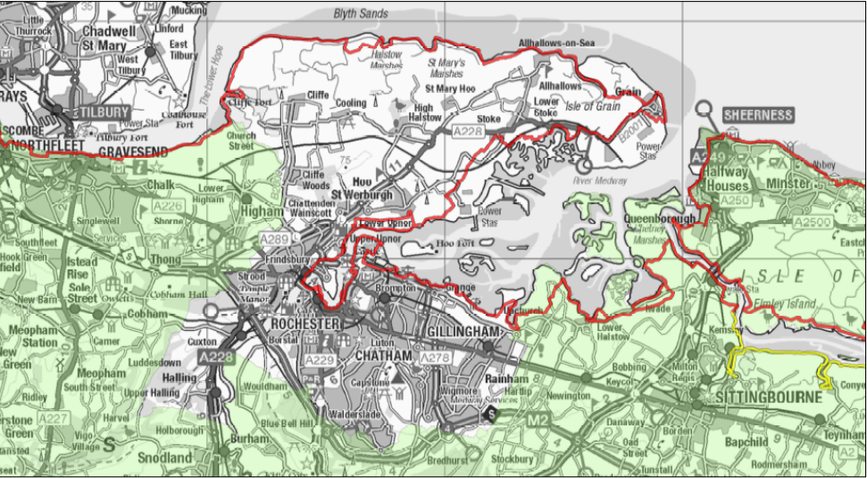
The England Coastal Path Once completed, it will be the longest, continuous, coastal trail in the world

Slide 2
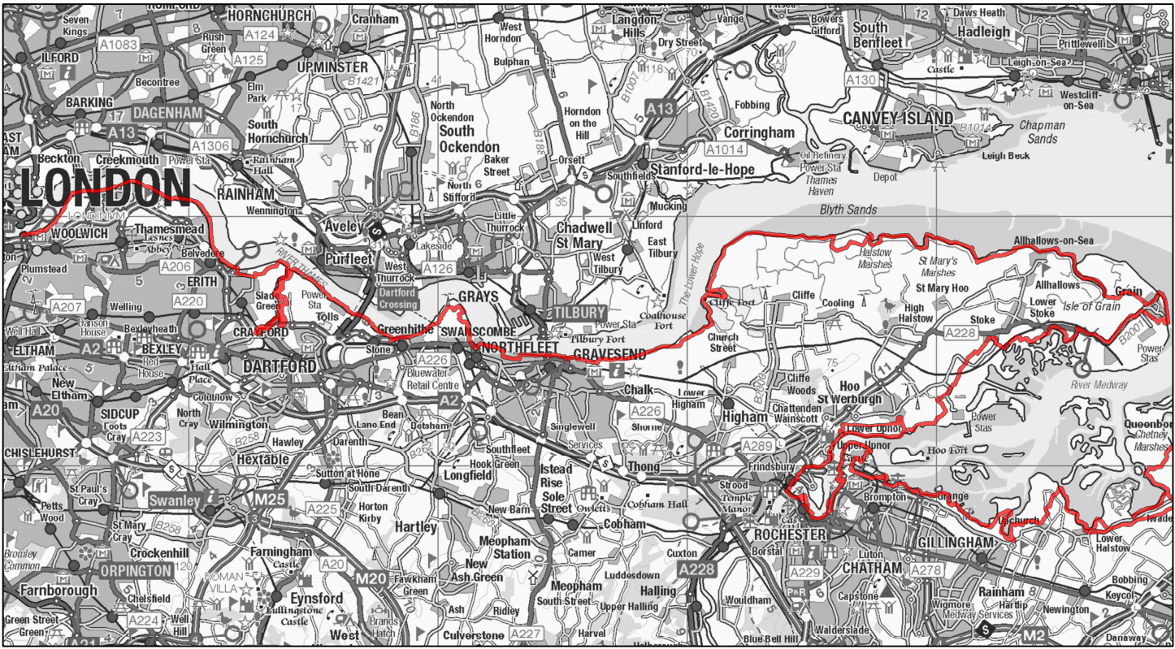
Thames Path Extension

Slide 3
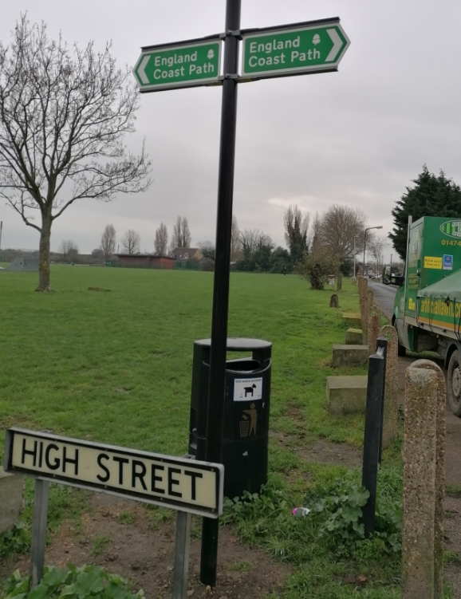
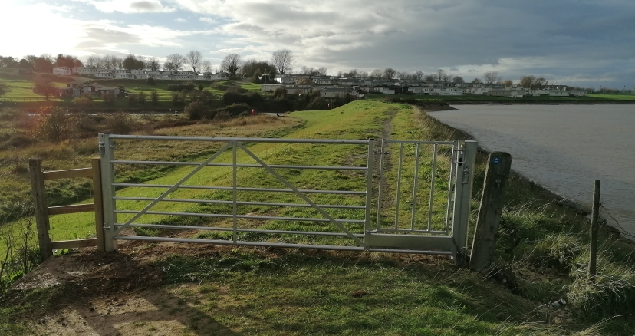
England Coast Path Grain to Cliffe

