Slide 1
West Kent
Version 5
Health and Care Partnership profile
Created by Medway Council Public Health Intelligence Team

Slide 2
Summary: West Kent
2
Version 5.0 © Medway Council, Public Health Intelligence Team, 26/04/2024
Indicator | Compared to England
School readiness | Better
Average Attainment 8 score | Better
Pupil absence | Better
Unemployment | Better
Children living in relative poverty | Better
Fuel poverty | Not compared
Homelessness | Better
Violent crime | Lower
Life expectancy (male) | Better
Life expectancy (female) | Better
Smoking prevalence | Better
Adult excess weight | Similar
Year 6 excess weight | Better
Physical inactivity | Better
Alcohol admissions | Better
Air pollution | Not compared
Prescribed antibiotics | Similar
Breast cancer screening | Better
Indicator | Compared to England
Cervical cancer screening | Better
Bowel cancer screening | Better
Infant mortality | Better
Low birth weight | Better
AE attendances (0-4 yrs) | Worse
Dental decay (5 yrs) | Better
Under 18s conceptions | Similar
Asthma admissions (<19 yrs) | Better
Epilepsy admissions (<19 yrs) | Better
Diabetes admissions (<19 yrs) | Similar
Mental health admissions (0-17 yrs) | Similar
Self-harm admissions (10-24 yrs) | Worse
Substance misuse adms (15-24 yrs) | Worse
Hypertension prevalence | Higher
Diabetes prevalence | Lower
CHD prevalence | Lower
CKD prevalence | Higher
Stroke prevalence | Similar
Indicator | Compared to England
Circulatory mortality (<75 yrs) | Better
Cancer mortality (<75 yrs) | Better
ACSC admissions | Better
Depression prevalence | Higher
Serious mental illness prevalence | Lower
Suicide (persons) | Worse
Suicide (male) | Similar
Dementia diagnosis rate | Not compared
Falls admissions (>65 yrs) | Worse
Hip fracture admissions (>65 yrs) | Worse
Osteoporosis prevalence | Higher

Slide 3
Contact details
3
Version 5.0 © Medway Council, Public Health Intelligence Team, 26/04/2024
If you have any questions or would like further information about these profiles, please contact:
Dr Eluned Broom
Senior Public Health Intelligence Manager
Public Health
Medway Council
eluned.broom@medway.gov.uk
01634 334111

Slide 4
Purpose
4
Version 5.0 © Medway Council, Public Health Intelligence Team, 26/04/2024
Profiles have been created for each of the Health and Care Partnerships (HCPs) in the Kent and Medway (KM) Integrated Care System (ICS).
1) Dartford, Gravesham and Swanley (DGS)
2) East Kent (EK)
3) Medway and Swale (MS)
4) West Kent (WK)
The aim of the profiles is to allow comparison between each of the HCPs and identify priority areas to focus work.

Slide 5
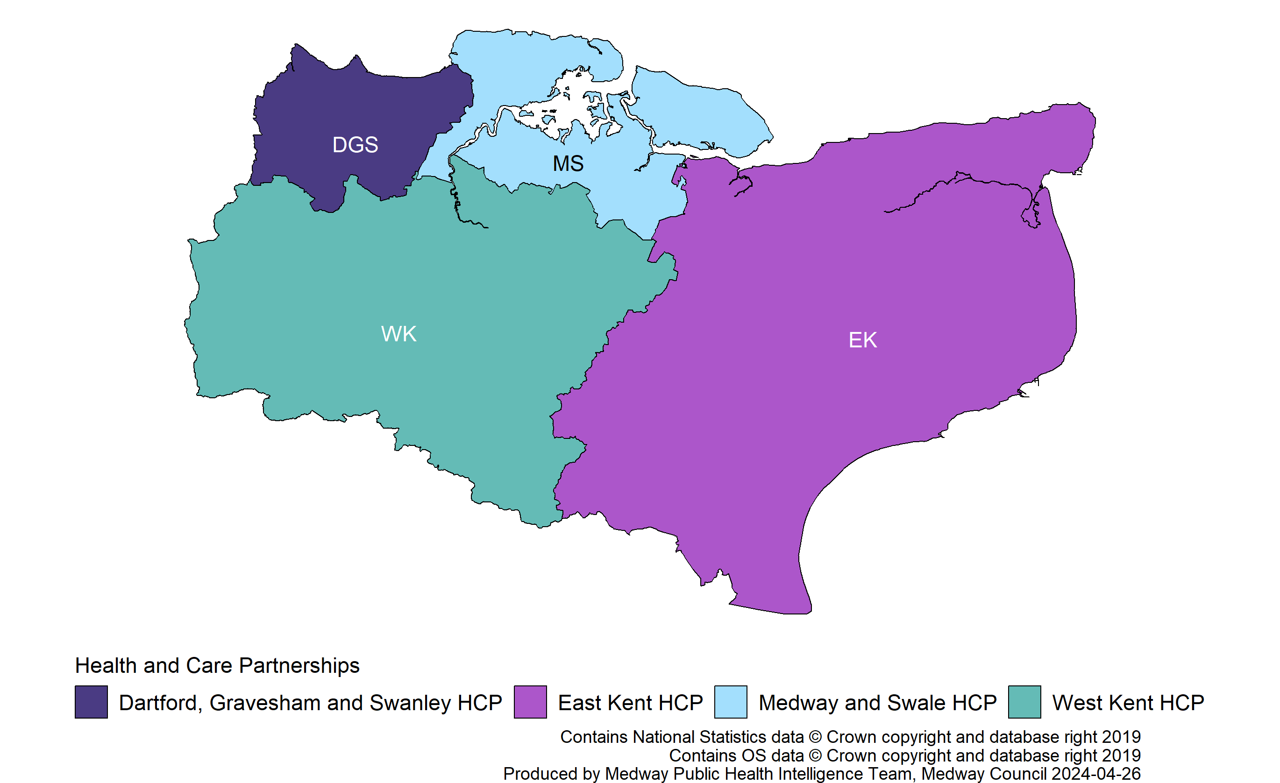
Kent and Medway HCPs
5

Slide 6
Rationale
6
Version 5.0 © Medway Council, Public Health Intelligence Team, 26/04/2024
The profiles contain six sections, which are based on key themes identified in the NHS Long Term Plan.
1) Demographics
2) Wider Determinants
3) Prevention and Health Inequalities
4) Best Start in Life
5) Major Health Conditions
6) Ageing Well
Key stakeholders were consulted to identify the indicators that should be included.
Due to limitations in the available data, some indicators could not be included for all the priorities identified at this time.

Slide 7
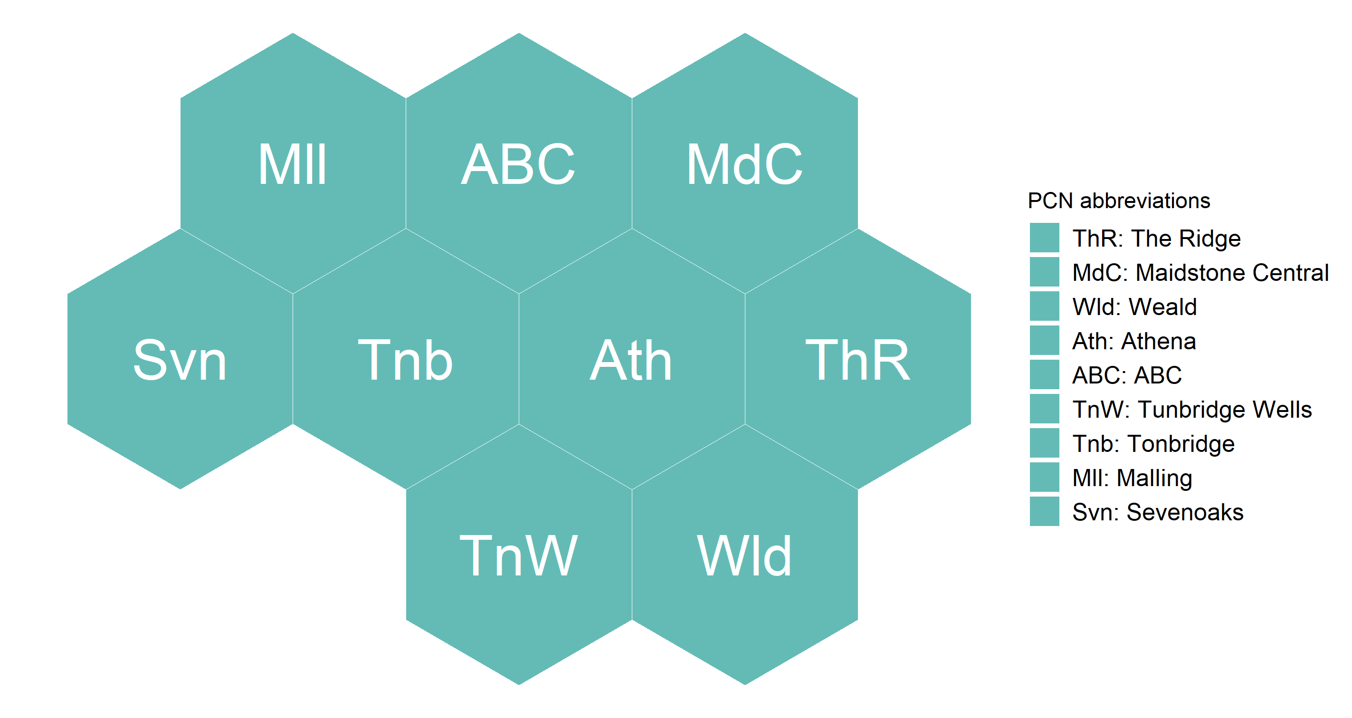
PCN hex map explained
7
Version 5.0 © Medway Council, Public Health Intelligence Team, 26/04/2024
Some slides contain a hex map, which displays the indicator value at PCN level.
Each hexagon represents a PCN, arranged according to its relative geography within the HCP.

Slide 8
Number grid explained
8
Version 5.0 © Medway Council, Public Health Intelligence Team, 26/04/2024
Some slides contain a number grid, which displays the indicator value at different levels of geography.
England, Kent and Medway ICS, HCP, and small area.
The small area type displayed depends on the data available for the indicator.
Either District & Unitary Authority (UA) or former Clinical Commissioning Group (CCG).

Slide 9
Small areas
9
Version 5.0 © Medway Council, Public Health Intelligence Team, 26/04/2024
District & UA and former CCG data have been mapped to the HCP boundaries as per the table below.
Caveat: District & UA data does not align with the HCP areas exactly.
For the purpose of this profile, data for whole District & UAs have been assigned to the HCP where the majority of residents reside.
Health and Care Partnership | District & Unitary Authority | Former Clinical Commissioning Group
Dartford, Gravesham and Swanley | Dartford; Gravesham | Dartford, Gravesham and Swanley CCG
East Kent | Ashford; Canterbury; Dover; Folkestone and Hythe; Thanet | Ashford CCG; Canterbury and Coastal CCG; South Kent Coast CCG; Thanet CCG
Medway and Swale | Medway; Swale | Medway CCG; Swale CCG
West Kent | Maidstone; Sevenoaks; Tonbridge and Malling; Tunbridge Wells | West Kent CCG

Slide 10
Small areas continued
10
Version 5.0 © Medway Council, Public Health Intelligence Team, 26/04/2024
Data at several small area levels has been used as building blocks to calculate the PCN values: 2011 Lower Super Output Area (LSOA), 2020 wards, general practice and school.
LSOAs have a defined geographical boundary. On average the population is about 1,700 people so they can be thought of as representing a neighbourhood. There are 1,065 2011 LSOAs within Kent and Medway.
LSOAs and wards were assigned to PCNs on a first passed the post basis, e.g. LSOAs or wards were mapped to PCNs based on which PCN has the highest count of registered patients living in that LSOA/ward.
School level data was assigned to PCNs based on the ward the school was located in. Only primary and nursery school data was used as this more likely reflects the child profile of the local area due to the larger catchment areas of secondary schools.

Slide 11
HCP value and comparison
11
Version 5.0 © Medway Council, Public Health Intelligence Team, 26/04/2024
The HCP values have been calculated from either LSOA, ward, general practice, school, District & UA or CCG level data using one of two methods:
1) Aggregated data: HCP values are created from aggregated counts and denominators, where data is available.
2) Population weighted average: HCP values are created by averaging values from smaller areas, considering each group's population size.
A RAG rating (red, amber, green) has been applied to the majority of indicators to show how well an area is performing compared to a benchmark (England). The RAG rating is assigned by comparing an area's value to a reference range, which was created using either confidence intervals (CIs) or a range around the England average (usually 5%). Green corresponds to a value that is better than England, red to a value that is worse, and amber indicates that there is no difference.
Where it is inappropriate to label high or low values as 'better' or 'worse', for example osteoporosis prevalence, the terms 'higher' and 'lower' have been used with neutral colouring: magenta and aqua. Such labelling does not imply that high values of these indicators, for example, are 'worse'.
An indicator is shaded grey where it is inappropriate to apply a RAG rating due to the methods used in the calculation or the count is less than 10.

Slide 12
Accessibility
12
Version 5.0 © Medway Council, Public Health Intelligence Team, 26/04/2024
All plots contain alternative text (alt text), which describes the plot and, where possible, includes values. To access the alt text: Right-click an image, and then select View Alt Text. This will open the Alt Text pane.
Shapes have been used to communicate meaning when the colour palette may not be accessible. For instance, a RAG rating (red, amber, green) is used for most indicators to show how well an area is performing compared to a benchmark. Green represents better performance, amber represents similarity, and red signifies worse performance. Additionally, shapes are also used to communicate this information, where a circle signifies better performance, a square represents similarity, a triangle indicates worse, and a diamond signifies there has been no comparison.

Slide 13
Demographics
13
Version 5.0 © Medway Council, Public Health Intelligence Team, 26/04/2024

Slide 14
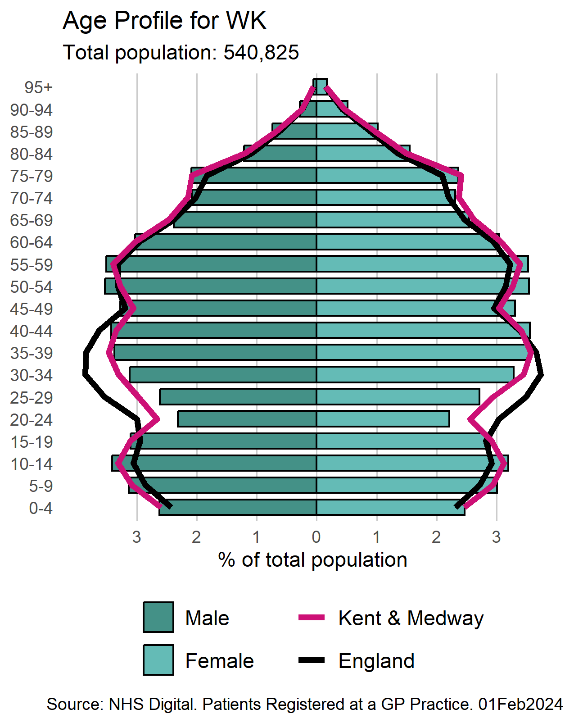
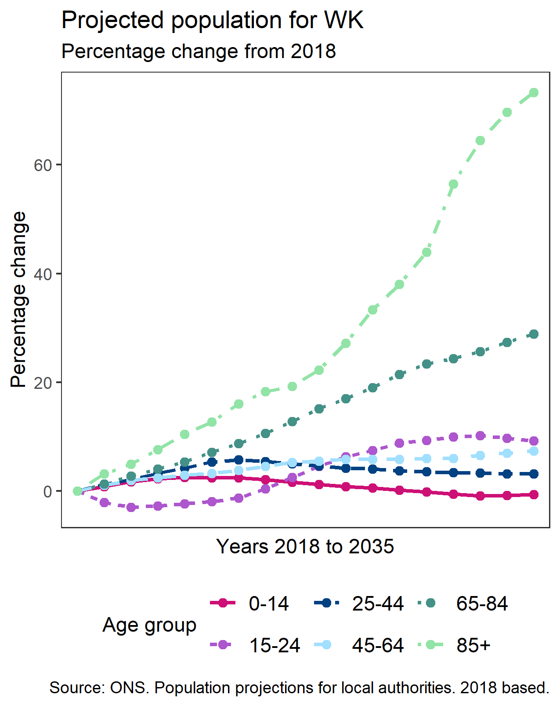
Population
14
Version 5.0 © Medway Council, Public Health Intelligence Team, 26/04/2024
Note: Population projections have been calculated by aggregating the local authority districts assigned to the HCP.

Slide 15
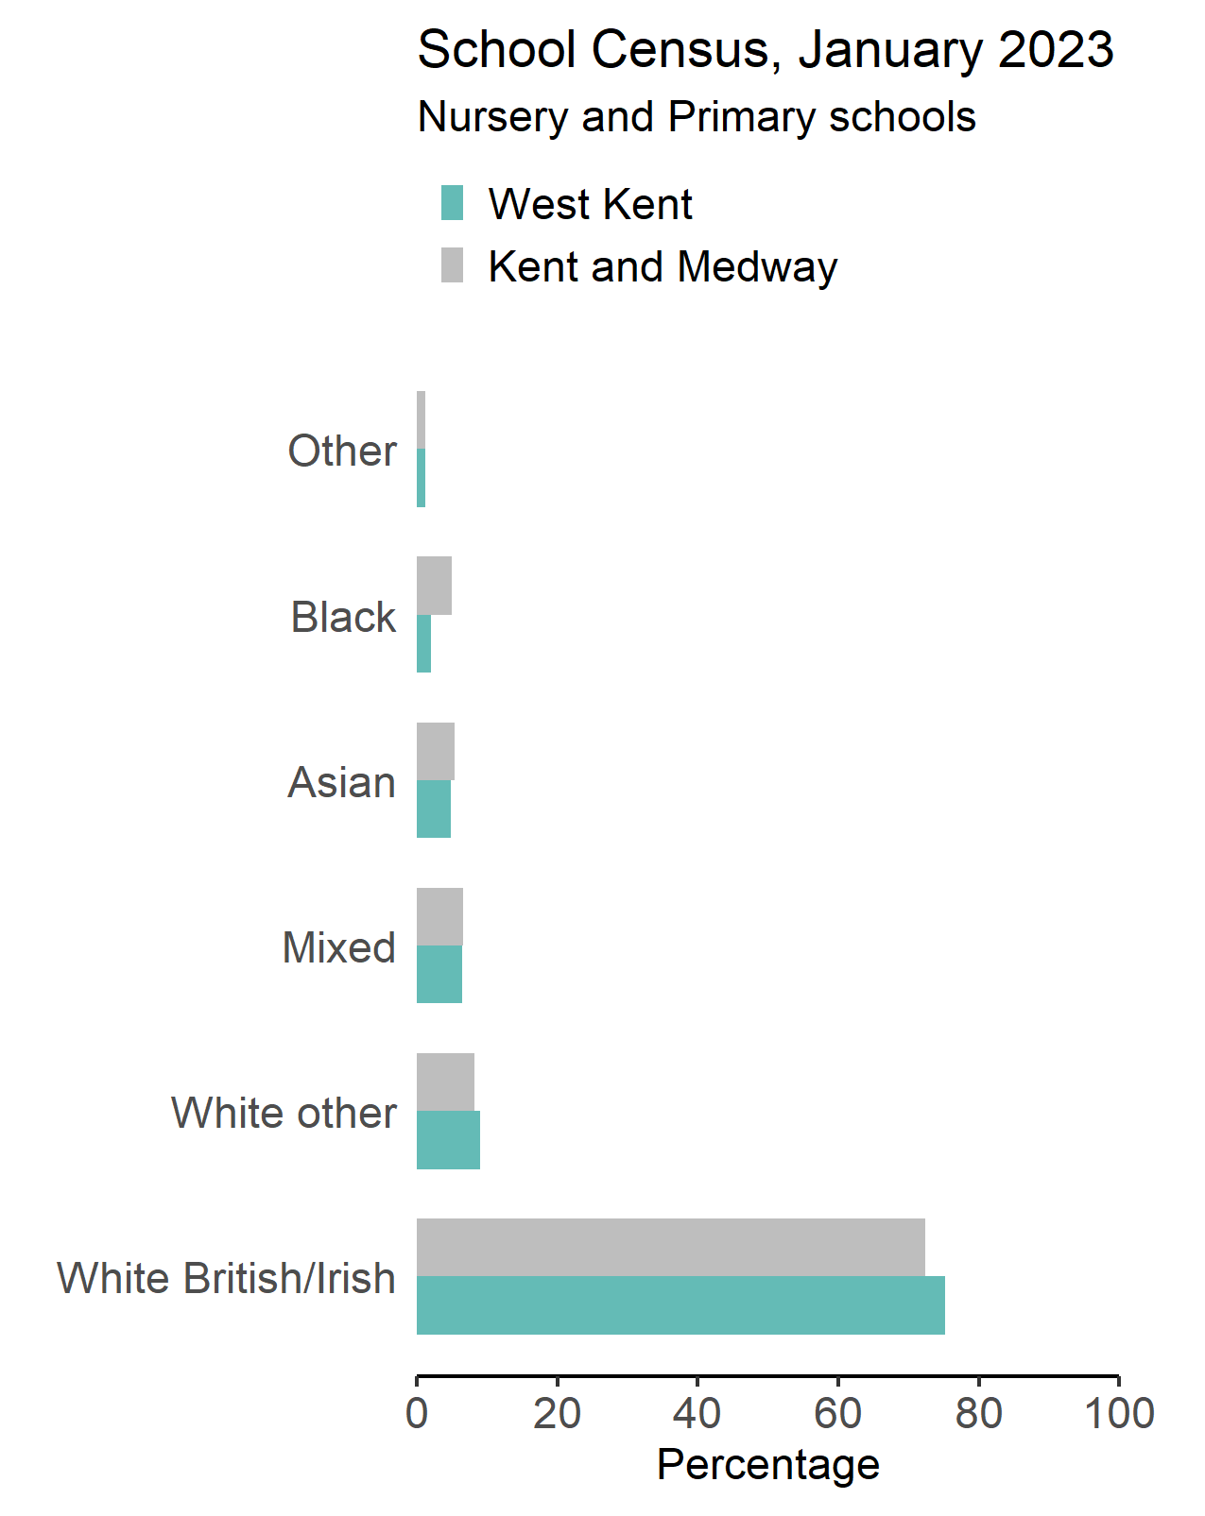
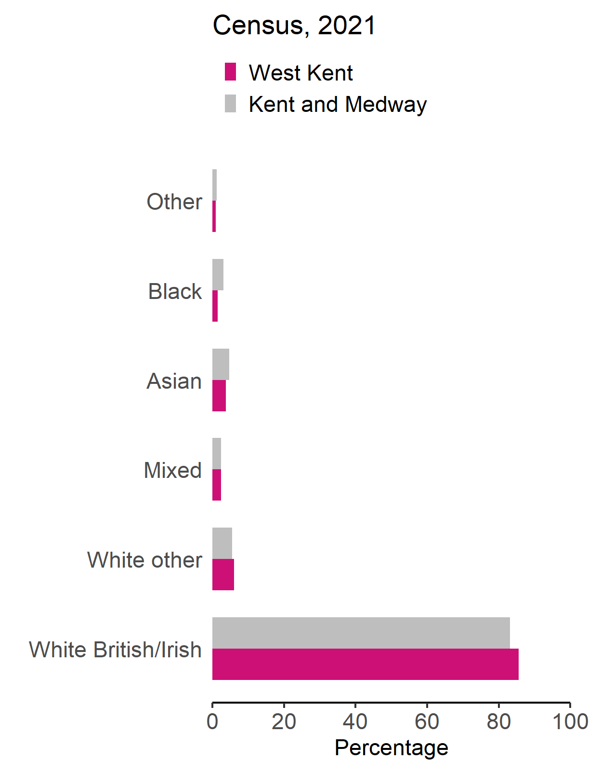
Ethnicity
15
Version 5.0 © Medway Council, Public Health Intelligence Team, 26/04/2024
Census source: NOMIS. 2021 Census. TS021 - Ethnic group.
School Census source: GOV.UK. Department for Education. Schools, pupils and their characteristics: January 2022.

Slide 16
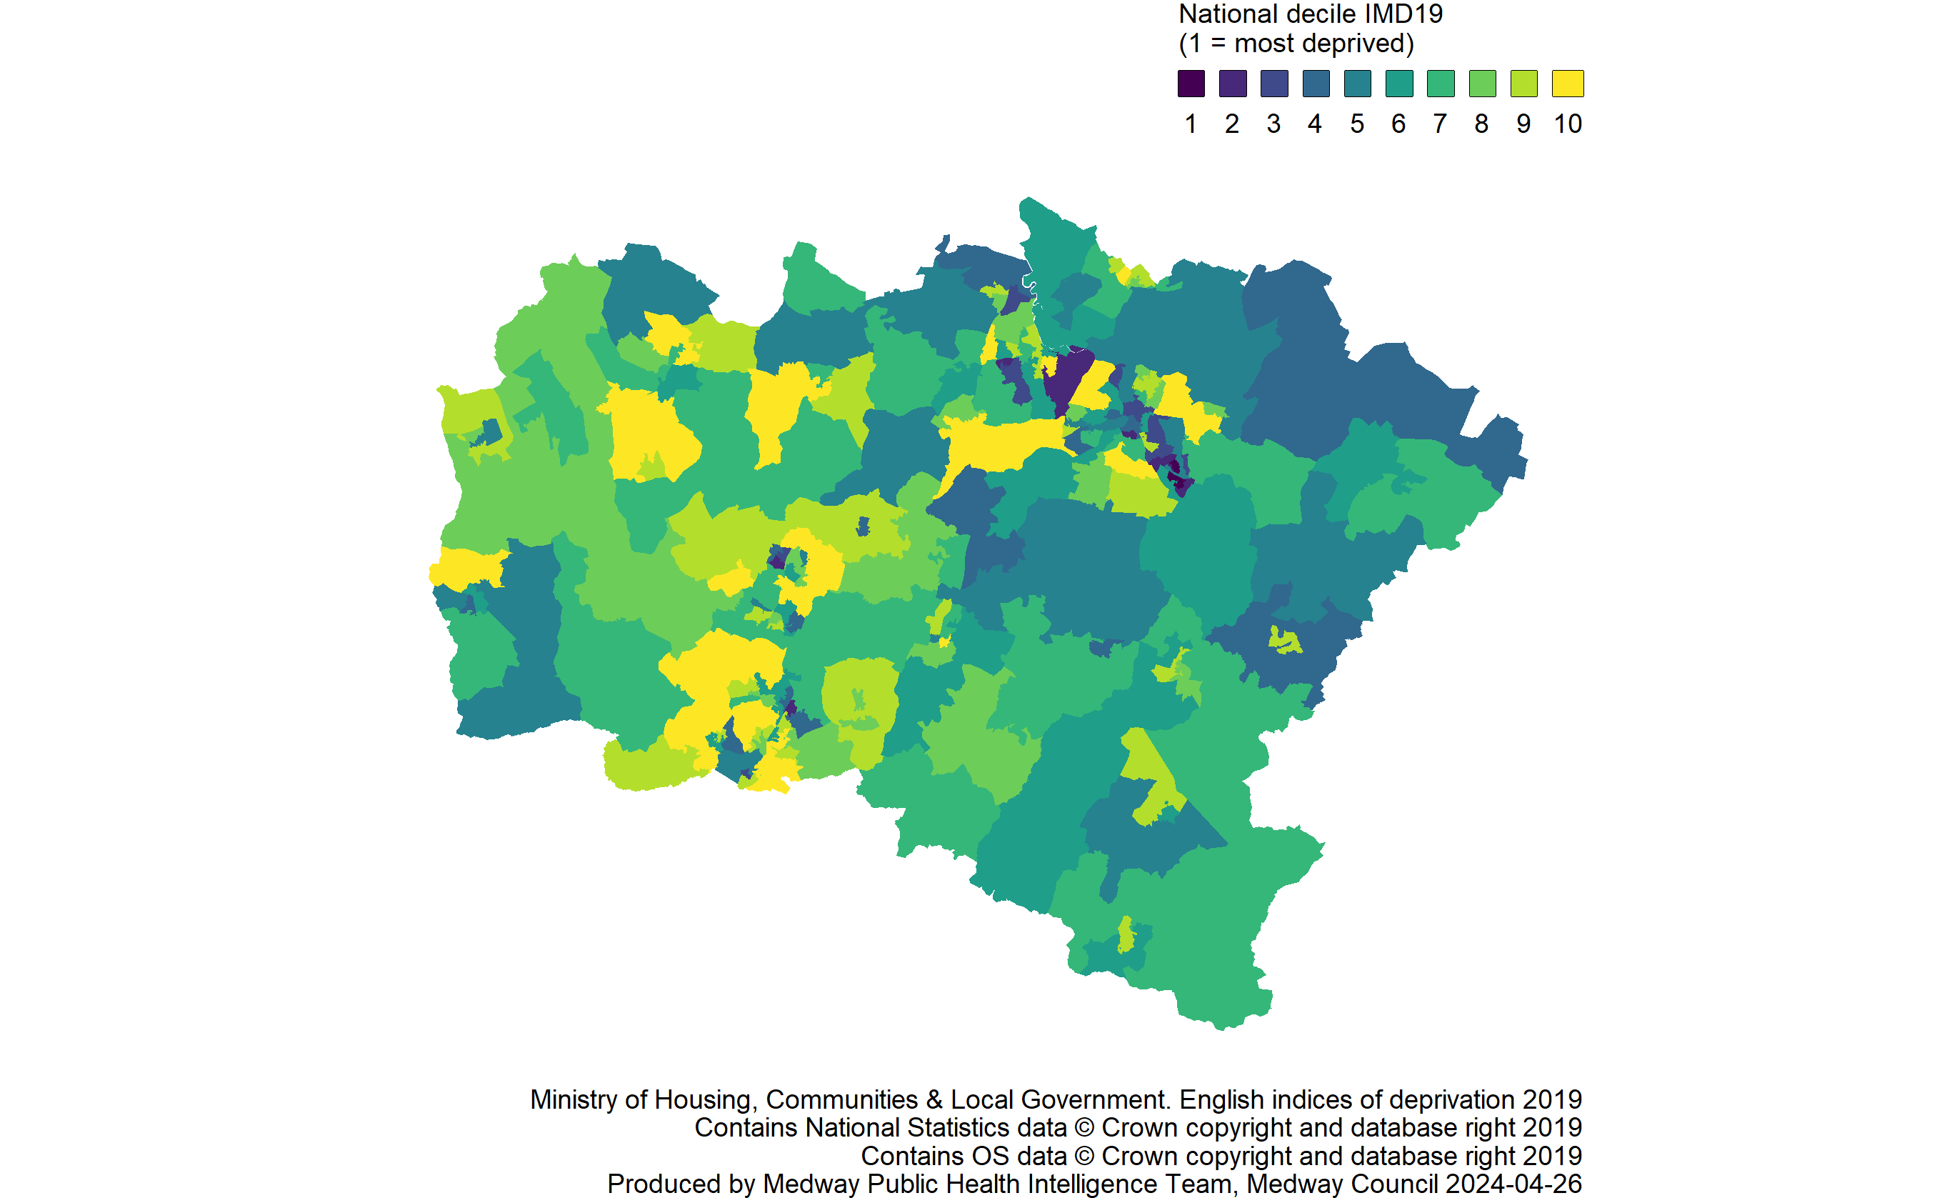
Deprivation
16
Version 5.0 © Medway Council, Public Health Intelligence Team, 26/04/2024

Slide 17
Wider determinants
17
Version 5.0 © Medway Council, Public Health Intelligence Team, 26/04/2024

Slide 18
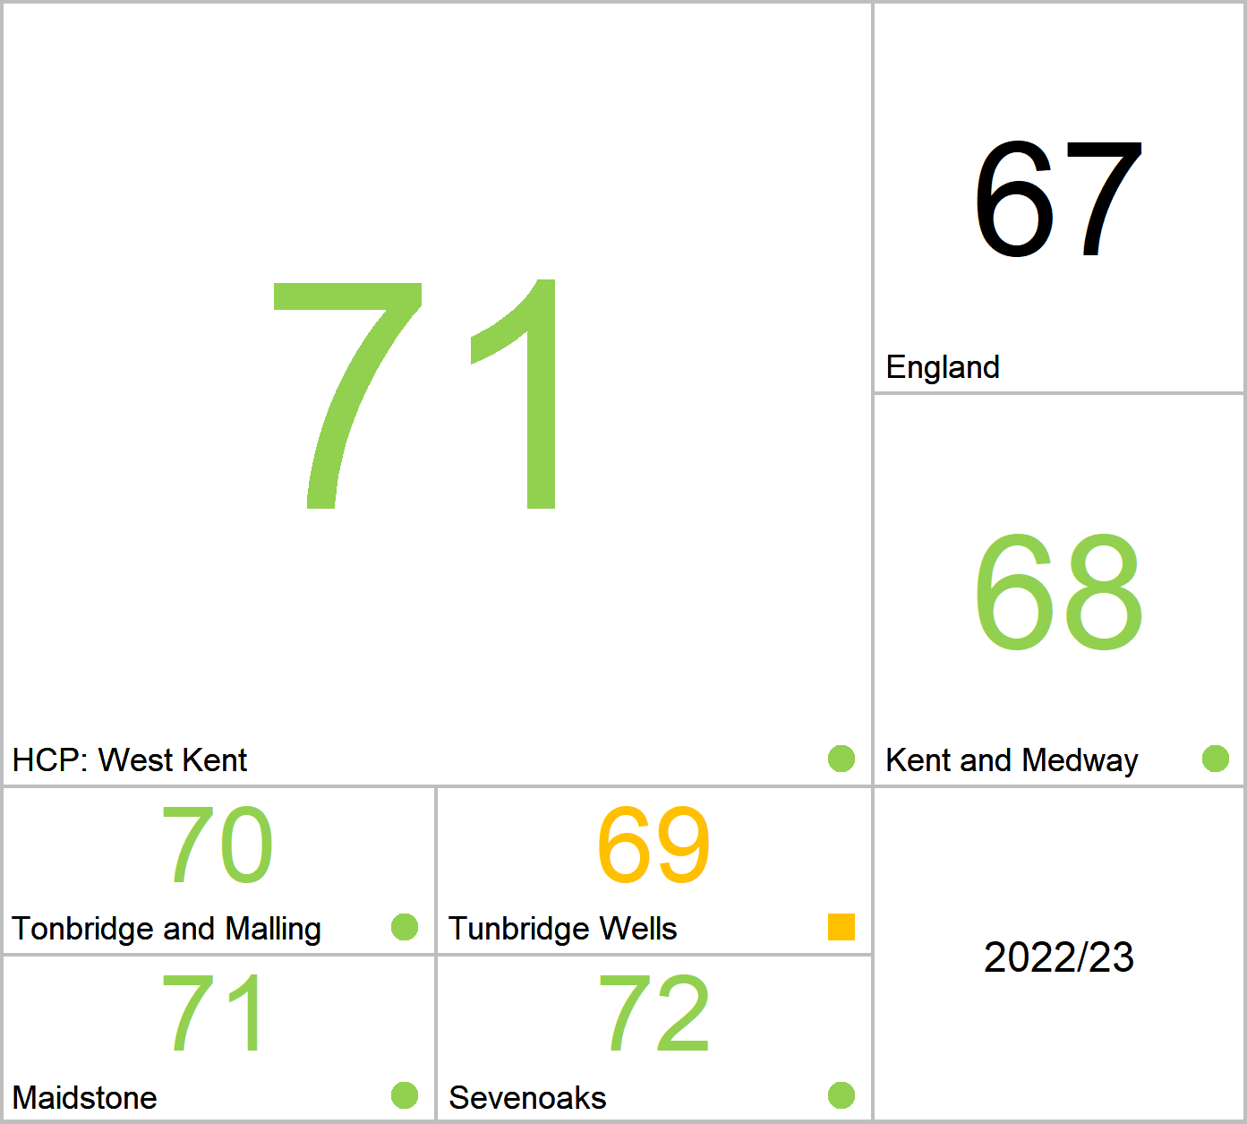
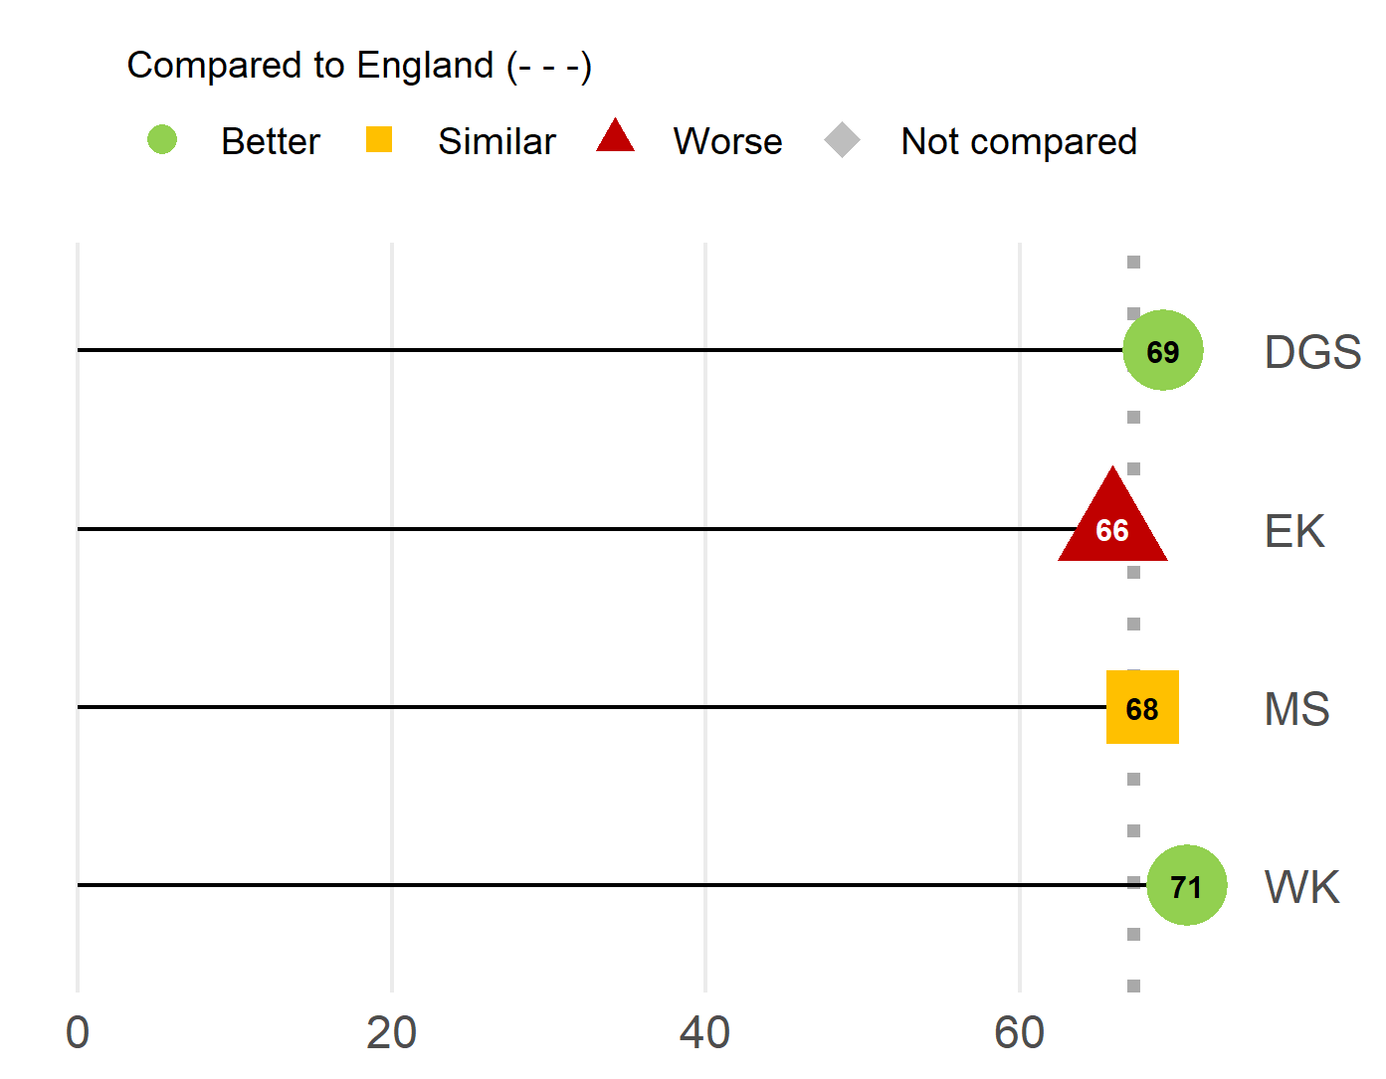
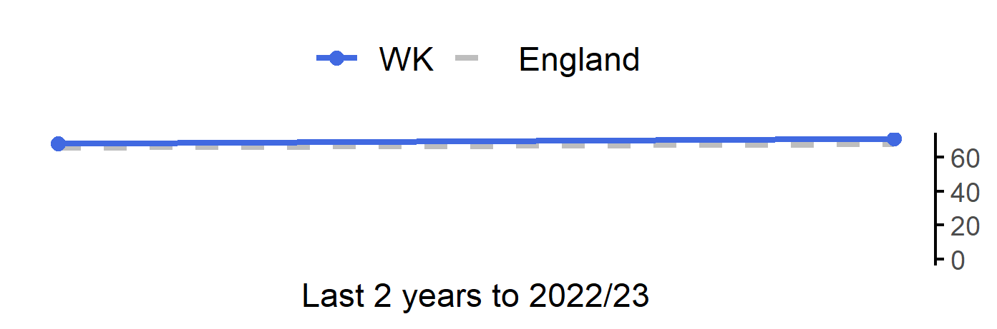
School readiness: Children achieving a good level of development at the end of Reception
18
Version 5.0 © Medway Council, Public Health Intelligence Team, 26/04/2024
The rate in West Kent is better than England.
Value type: Proportion - %.
Latest time period: 2022/23.
Source: Department for Education, EYFS Profile.
Value calculation: Aggregated data.
Small area type: Local authority district.
RAG method: Confidence interval (95%) - Wilson Score method.

Slide 19
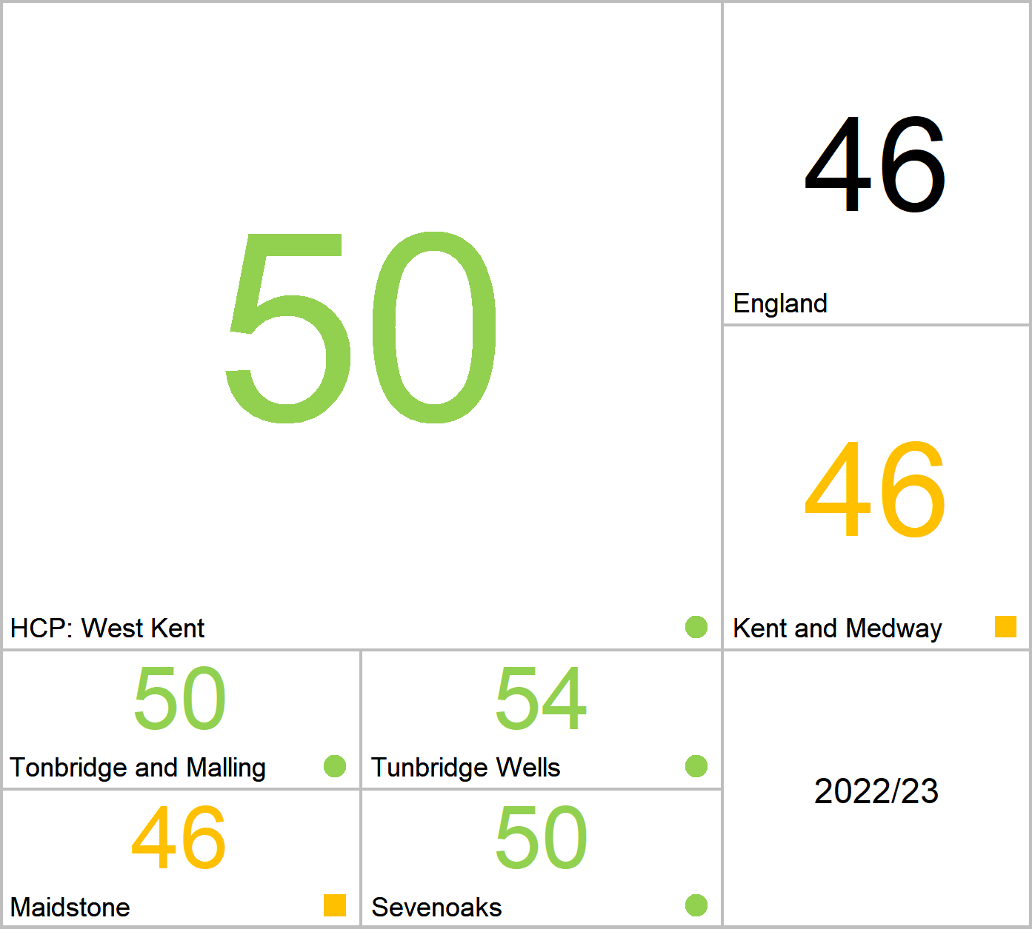
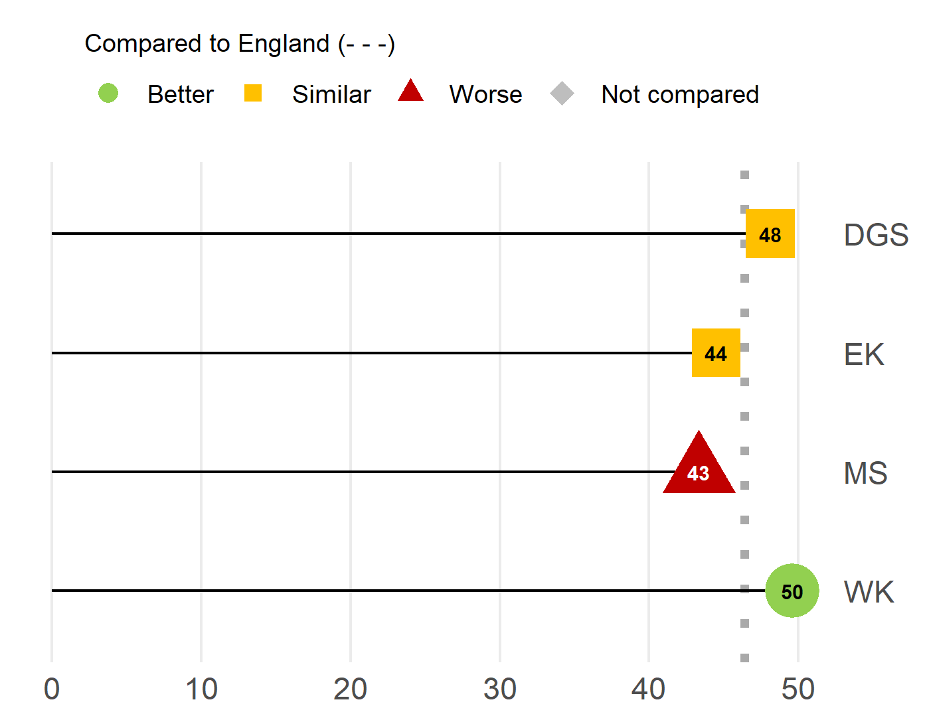
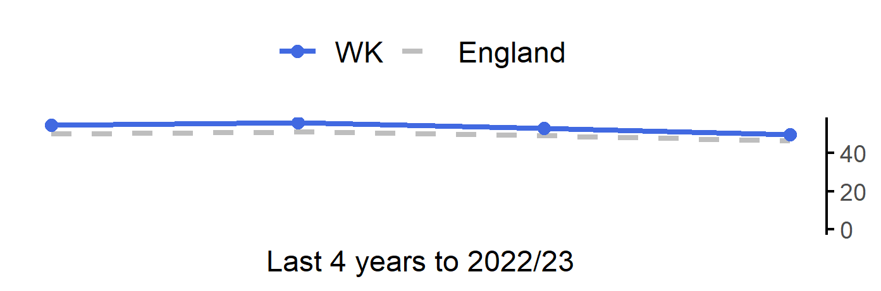
Average Attainment 8 score
19
Version 5.0 © Medway Council, Public Health Intelligence Team, 26/04/2024
The rate in West Kent is better than England.
Value type: Mean score.
Latest time period: 2022/23.
Source: Department for Education, Key stage 4 performance.
Value calculation: Aggregated data.
Small area type: Local authority district.
RAG method: England plus/minus 5%.

Slide 20
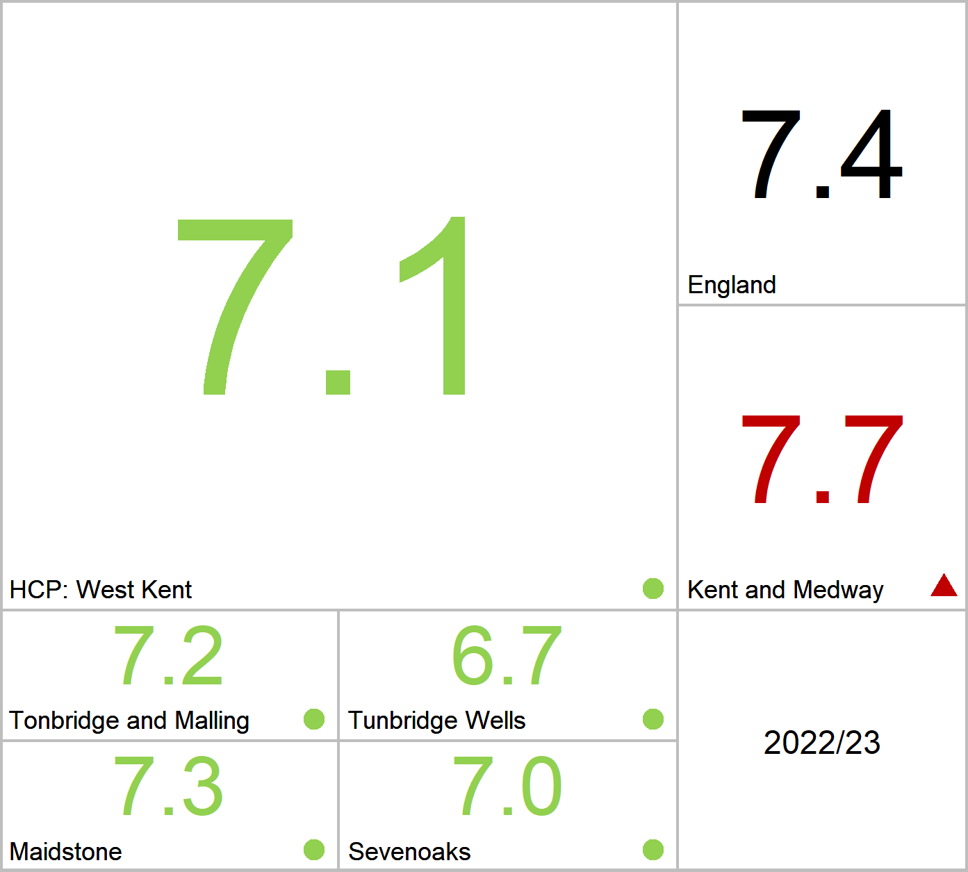
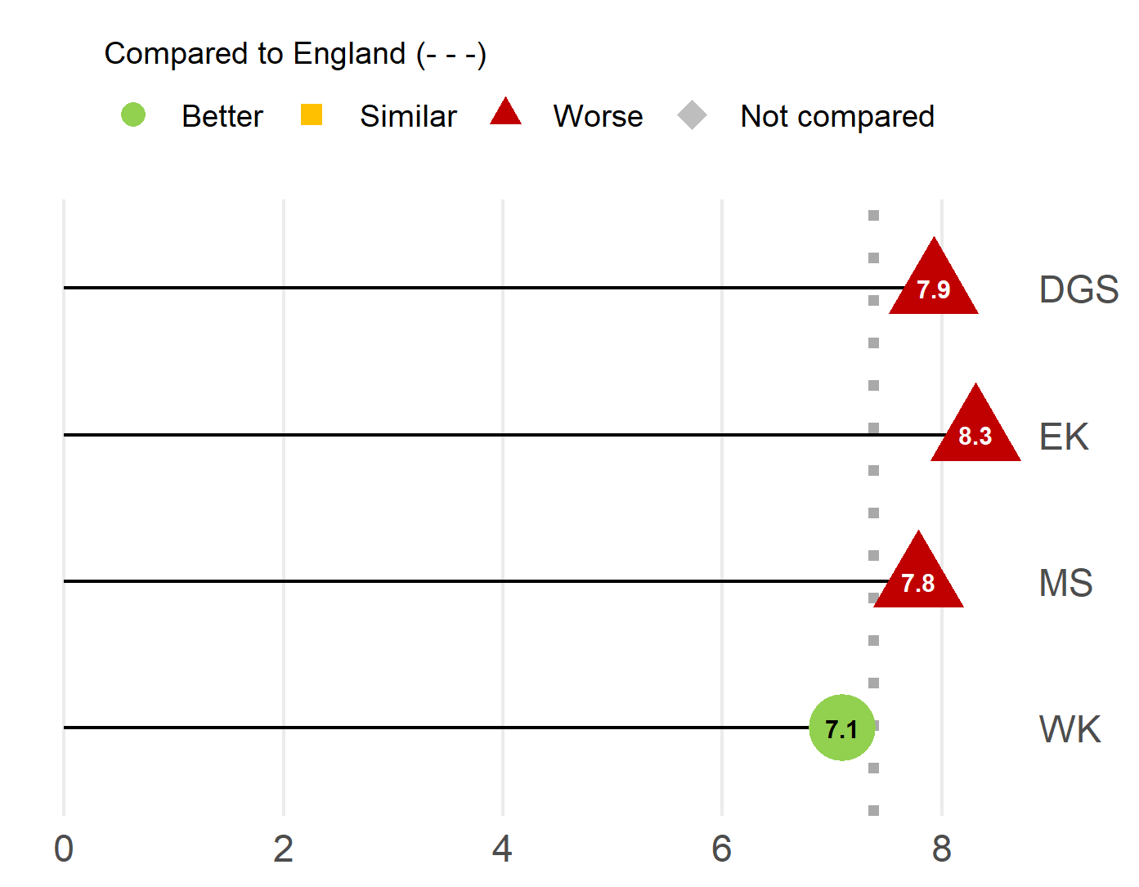
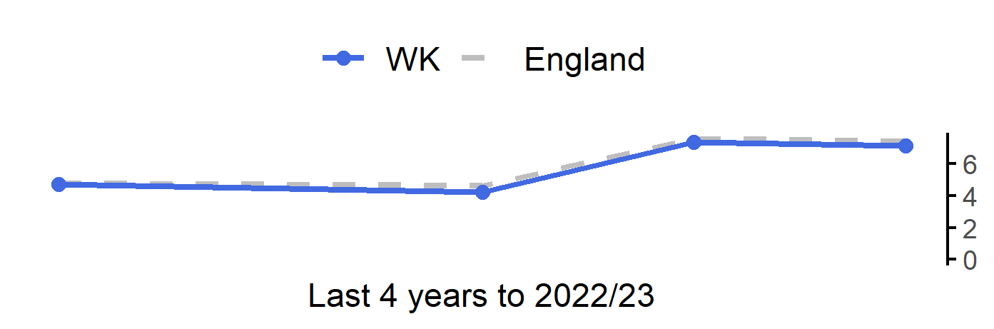
Pupil absence
20
Version 5.0 © Medway Council, Public Health Intelligence Team, 26/04/2024
The rate in West Kent is better than England.
Value type: Proportion - %.
Latest time period: 2022/23.
Source: Department for Education, Pupil abscence.
Value calculation: Aggregated data.
Small area type: Local authority district.
RAG method: Confidence interval (95%) - Wilson Score method.

Slide 21
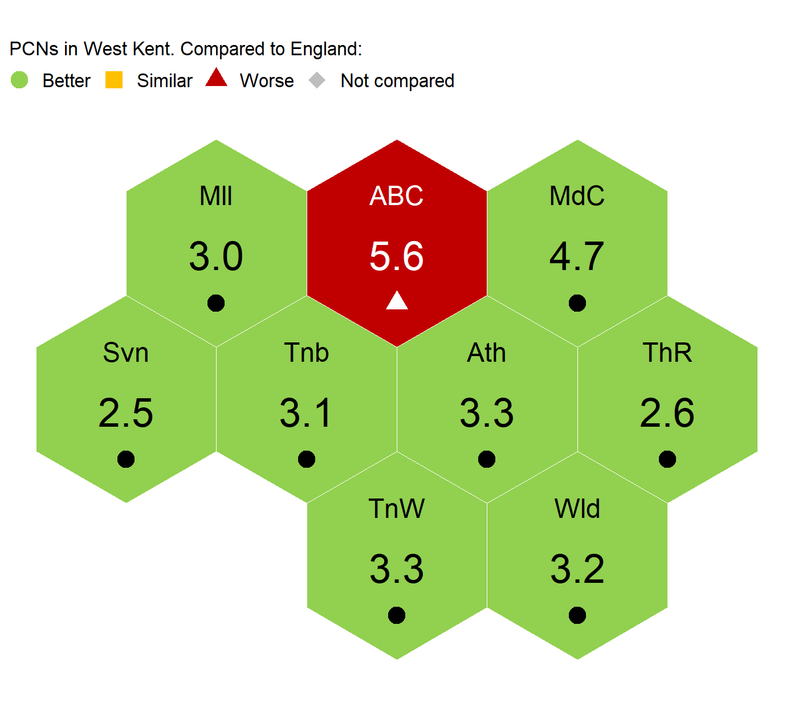
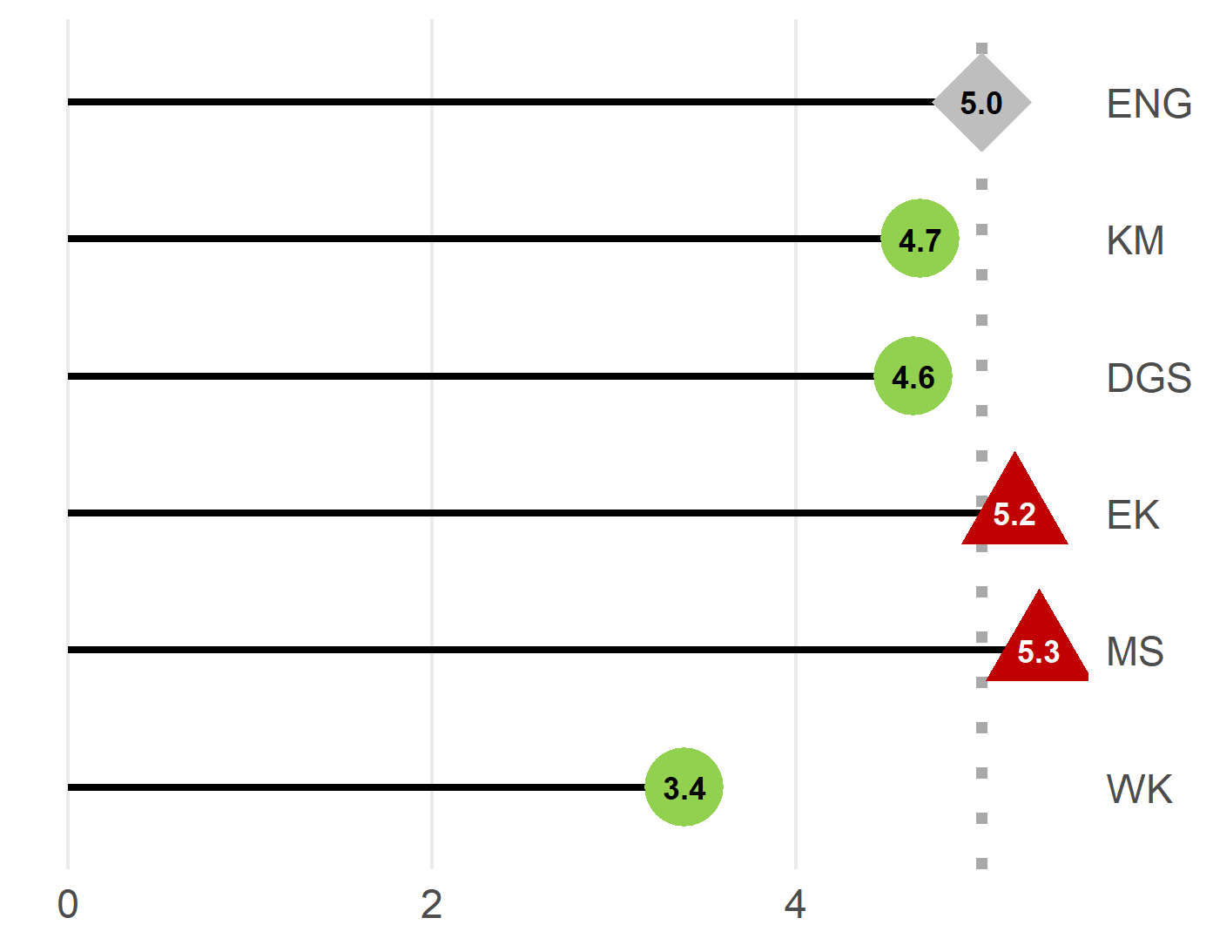
Unemployment (Percentage of the working age population claiming out of work benefit)
21
Version 5.0 © Medway Council, Public Health Intelligence Team, 26/04/2024
The rate in West Kent is better than England.
Value type: Proportion - %.
Latest time period: 2021/22.
Source: OHID, Fingertips, Indicator ID: 93097.
Value calculation: Aggregated data.
Small area type: Ward to PCN.
RAG method: Confidence interval (95%) - Wilson Score method.
Trend data not available.
* Due to difficulties with the varied geographies covered by the practices in Aspire Medical PCN, it is not possible to estimate values for this PCN using ward level data at this time.

Slide 22
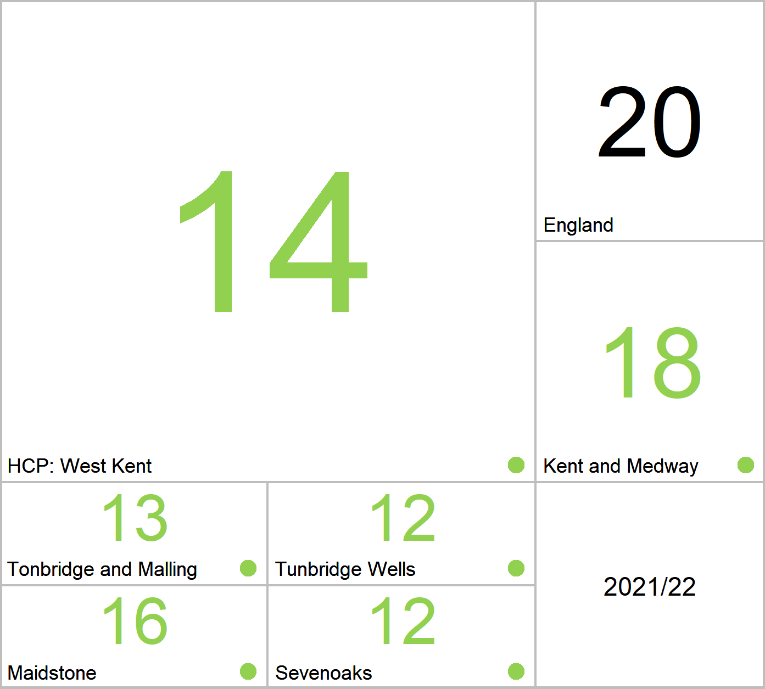
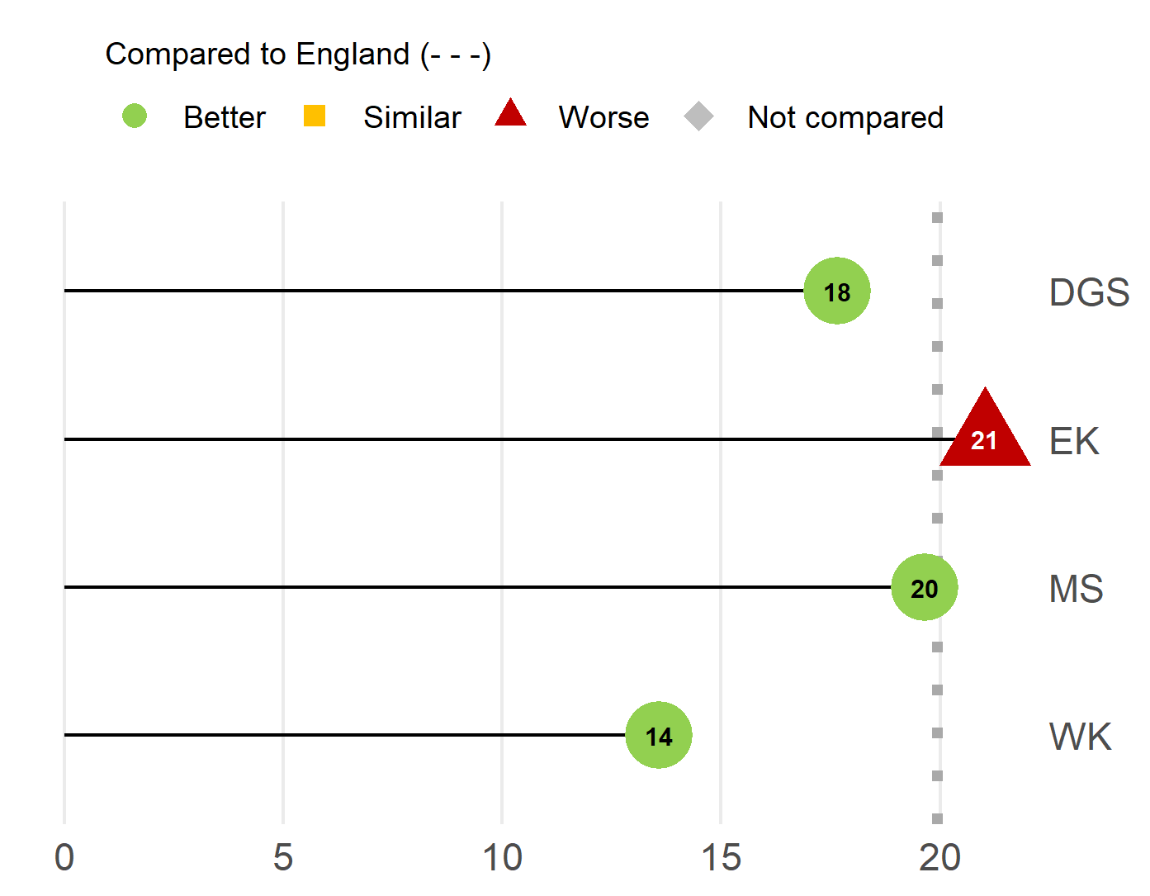
Children in relative low income families (under 16s)
22
Version 5.0 © Medway Council, Public Health Intelligence Team, 26/04/2024
The rate in West Kent is better than England.
Value type: Proportion - %.
Latest time period: 2021/22.
Source: OHID, Fingertips, Indicator ID: 93700.
Value calculation: Aggregated data.
Small area type: Districts & UAs (from Apr 2023).
RAG method: Confidence interval (95%) - Wilson Score method.
Trend data not available.

Slide 23
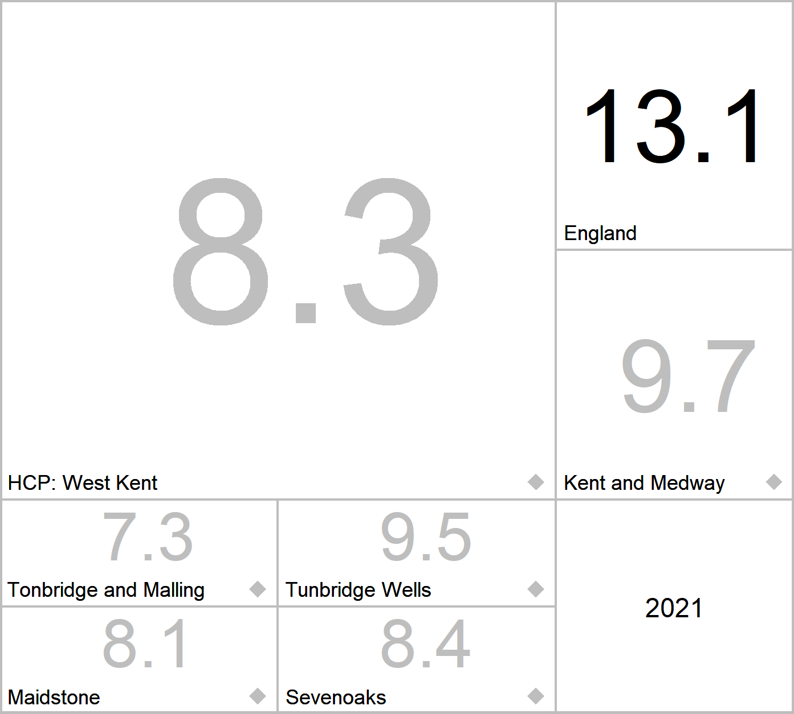
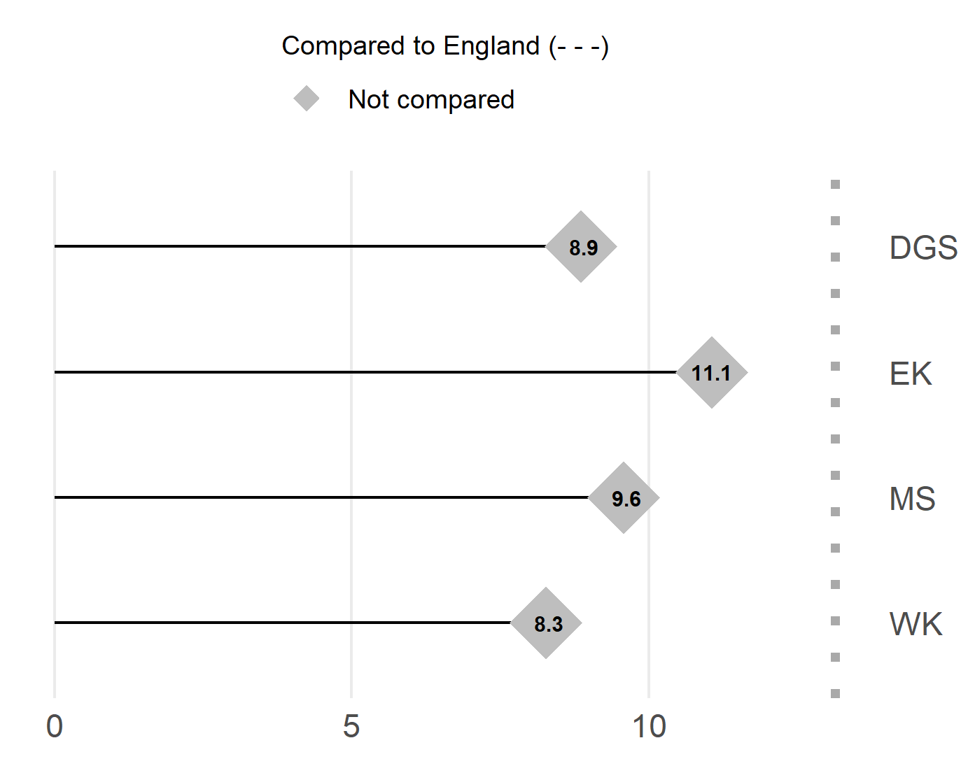
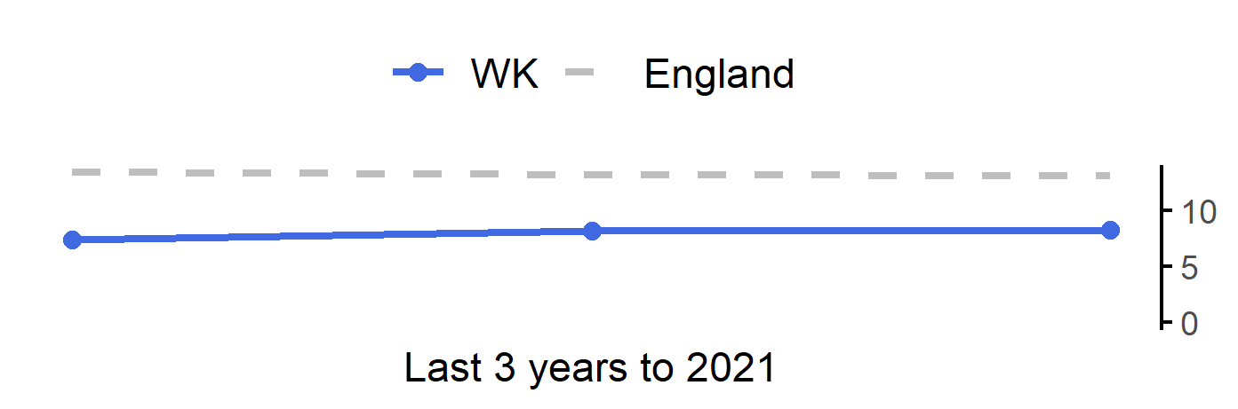
Fuel poverty (low income, low energy efficiency methodology)
23
Version 5.0 © Medway Council, Public Health Intelligence Team, 26/04/2024
West Kent cannot be compared to England statistically.
Value type: Proportion - %.
Latest time period: 2021.
Source: OHID, Fingertips, Indicator ID: 93759.
Value calculation: Aggregated data.
Small area type: Districts & UAs (from Apr 2023).
RAG method: None applied.

Slide 24
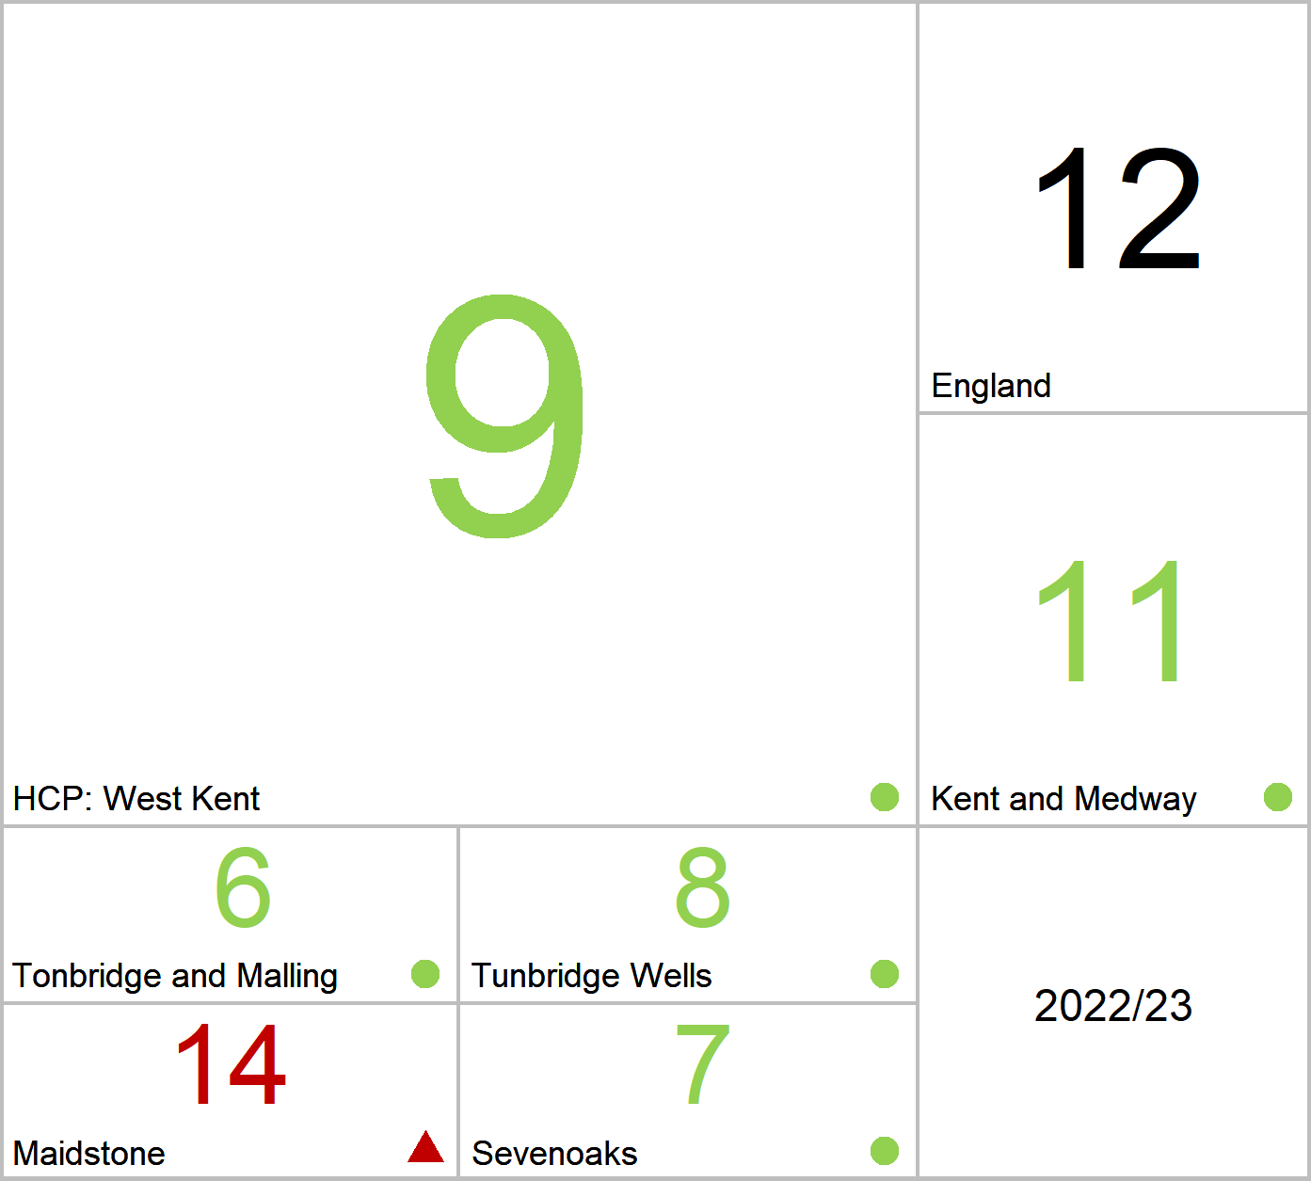
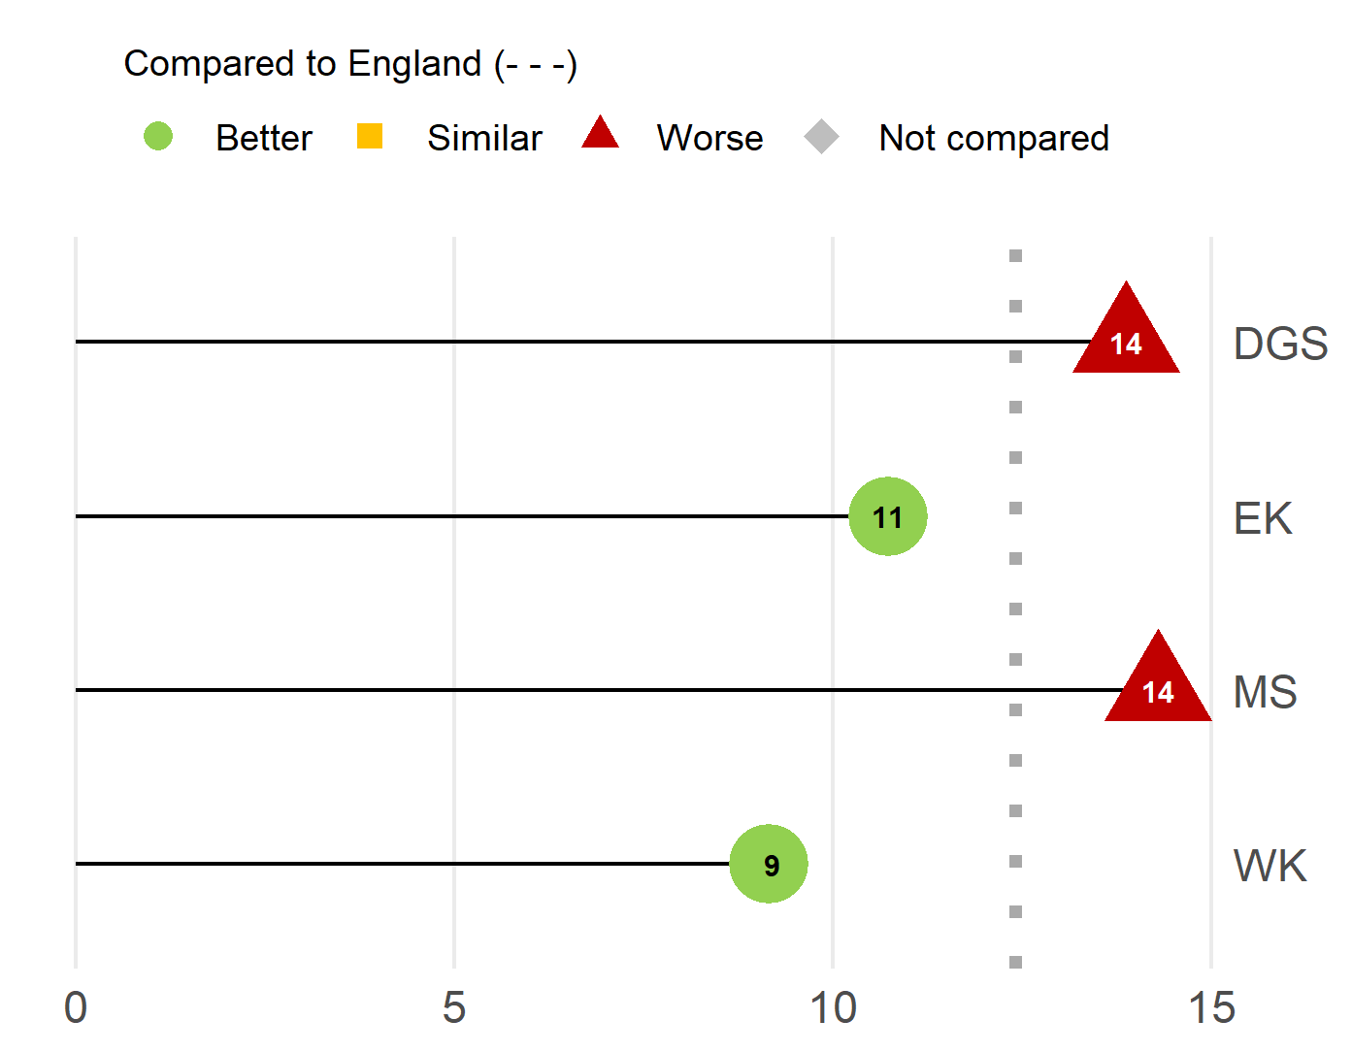
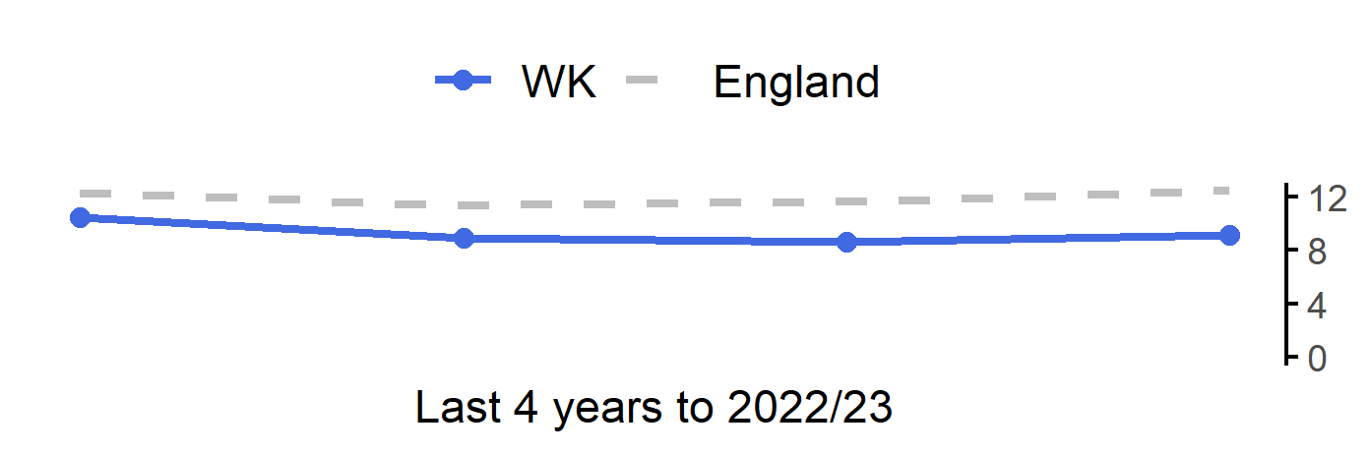
Homelessness: households owed a duty under the Homelessness Reduction Act
24
Version 5.0 © Medway Council, Public Health Intelligence Team, 26/04/2024
The rate in West Kent is better than England.
Value type: Crude rate - per 1,000.
Latest time period: 2022/23.
Source: OHID, Fingertips, Indicator ID: 93736.
Value calculation: Aggregated data.
Small area type: Districts & UAs (from Apr 2023).
RAG method: Confidence interval (95%) - Byar's method.

Slide 25
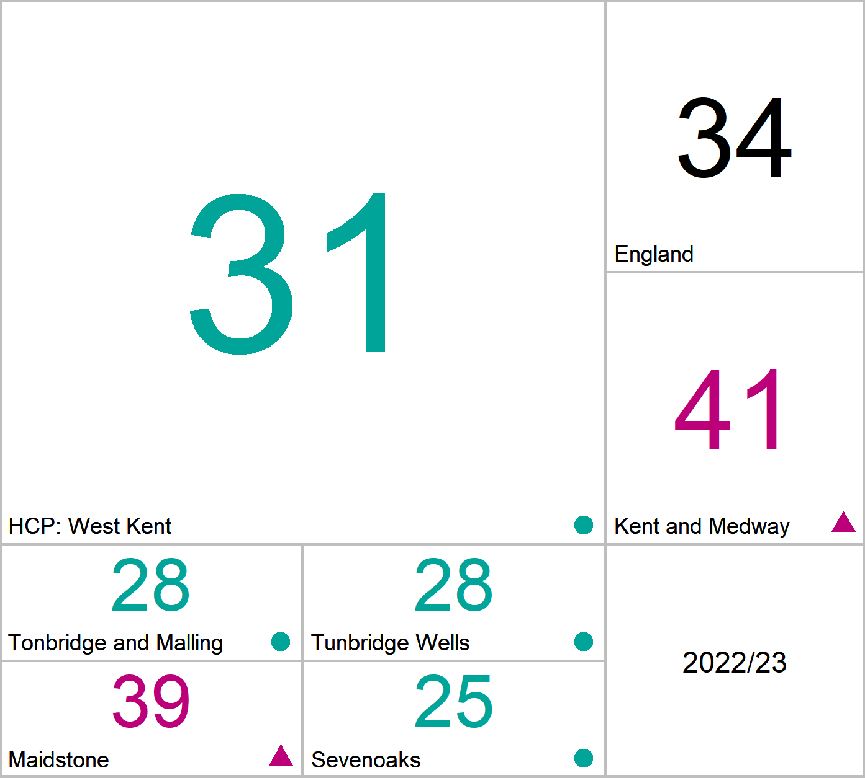
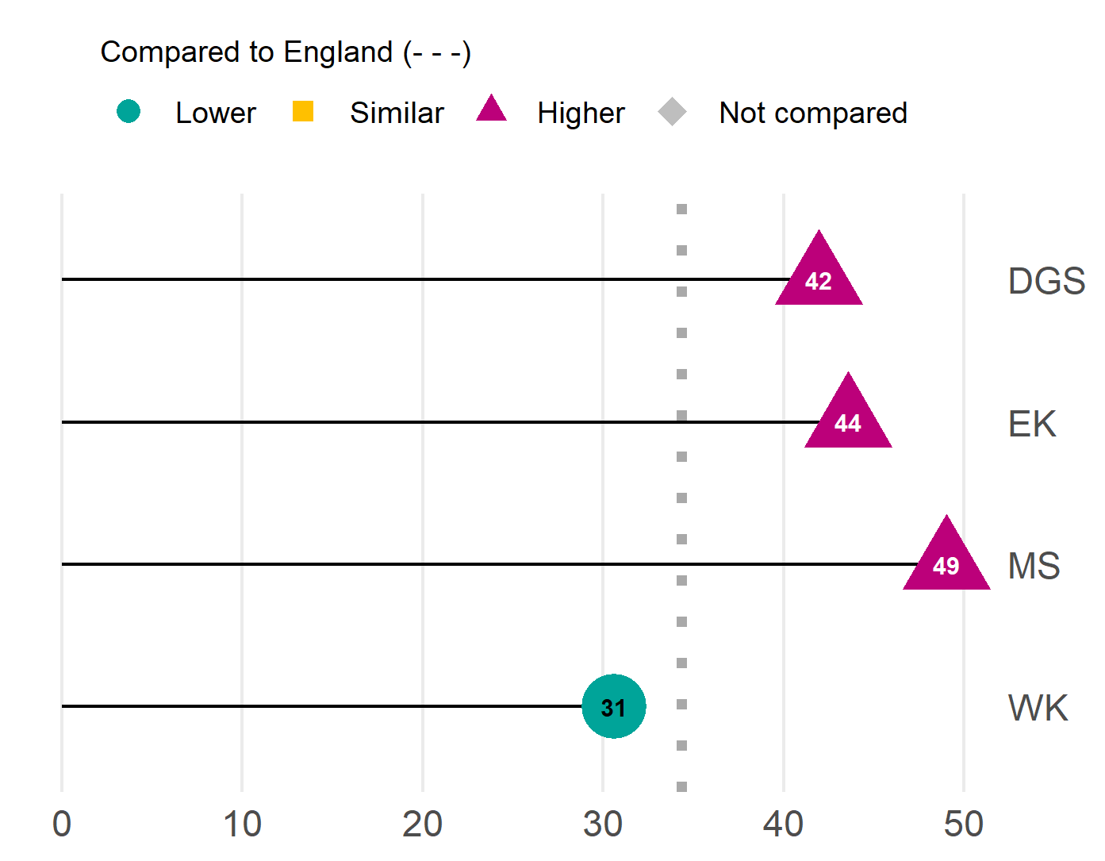
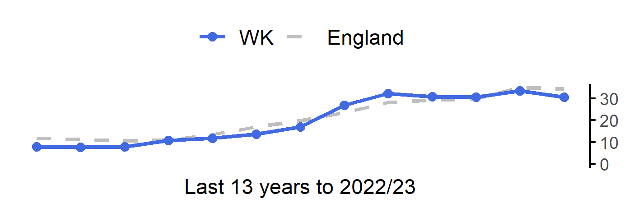
Violent crime - violence offences per 1,000 population
25
Version 5.0 © Medway Council, Public Health Intelligence Team, 26/04/2024
The rate in West Kent is lower than England.
Value type: Crude rate per 1,000.
Latest time period: 2022/23.
Source: OHID, Fingertips, Indicator ID: 11202.
Value calculation: Population weighted average.
Small area type: Districts & UAs (from Apr 2023).
RAG method: England plus/minus 5%.

Slide 26
Prevention and Health Inequalities
26
Version 5.0 © Medway Council, Public Health Intelligence Team, 26/04/2024

Slide 27
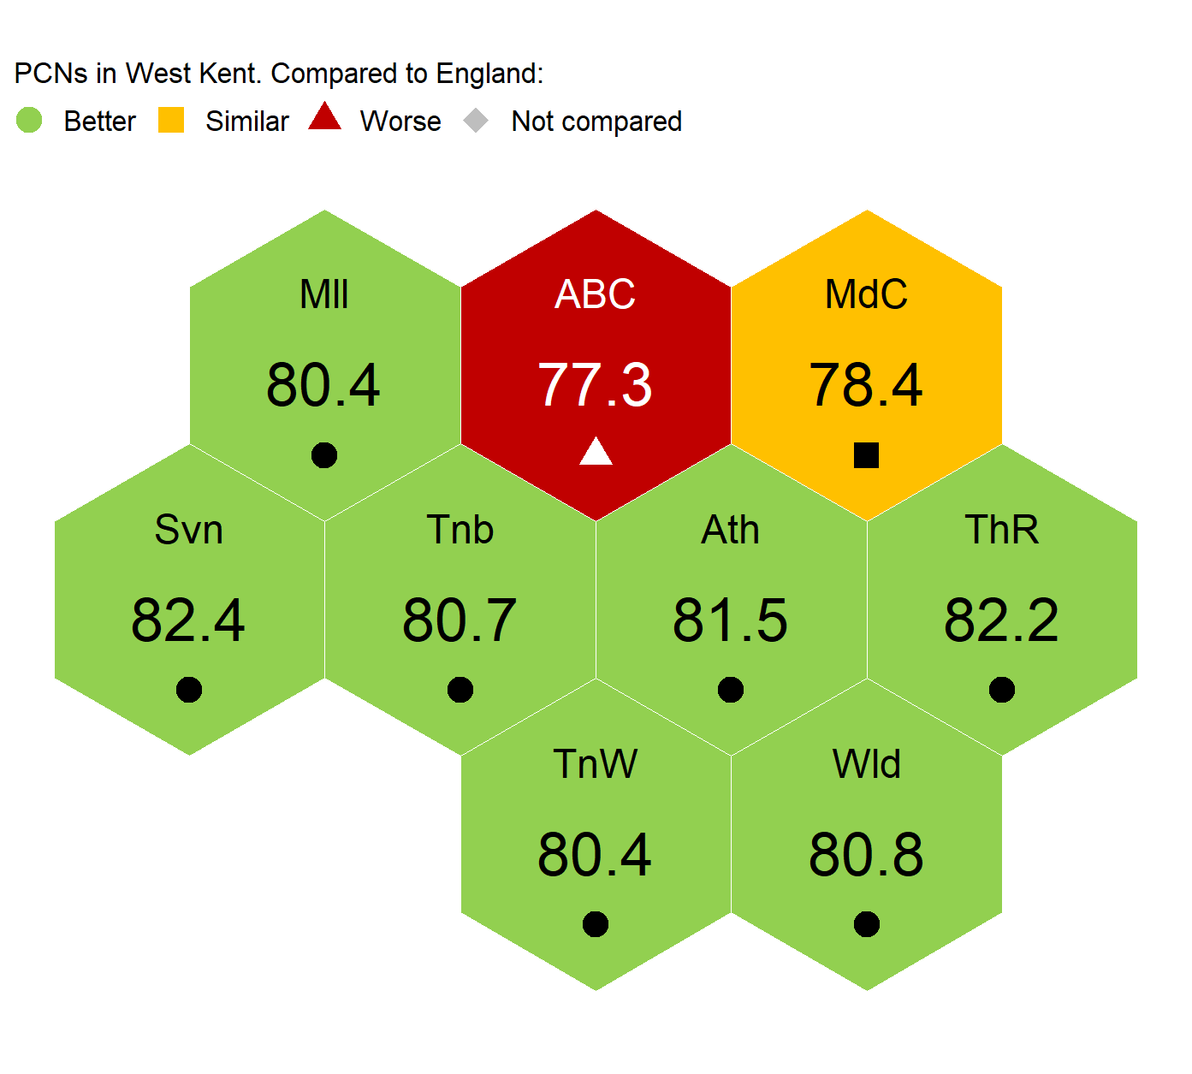
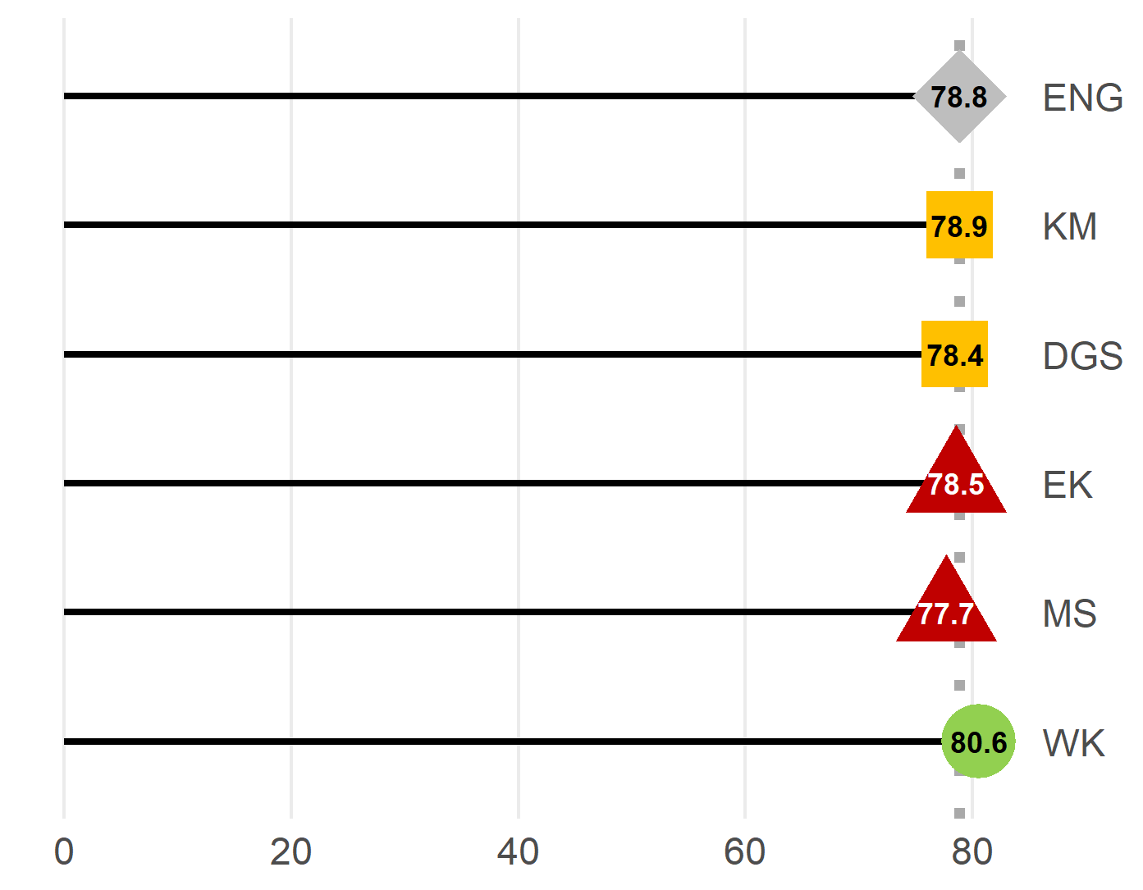
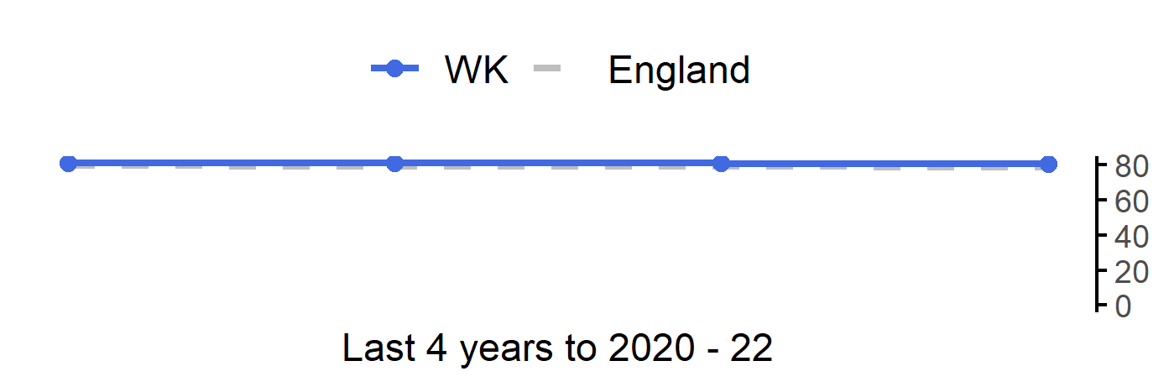
Life expectancy at birth (Male)
27
Version 5.0 © Medway Council, Public Health Intelligence Team, 26/04/2024
The rate in West Kent is better than England.
Value type: Years.
Latest time period: 2020 - 22.
Source: Primary Care Mortality Database (PCMD), Indicator ID: 90366.
Value calculation: Aggregated data.
Small area type: Ward to PCN.
RAG method: Confidence interval (95%) - Chiang method.

Slide 28
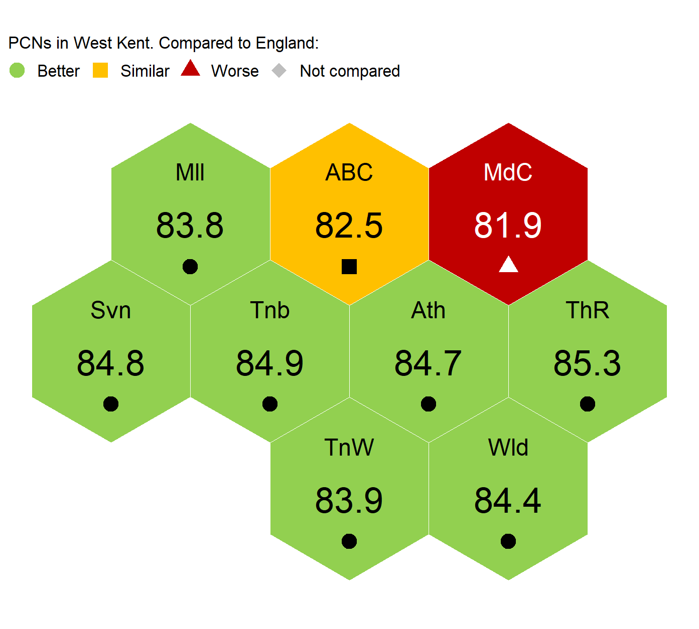
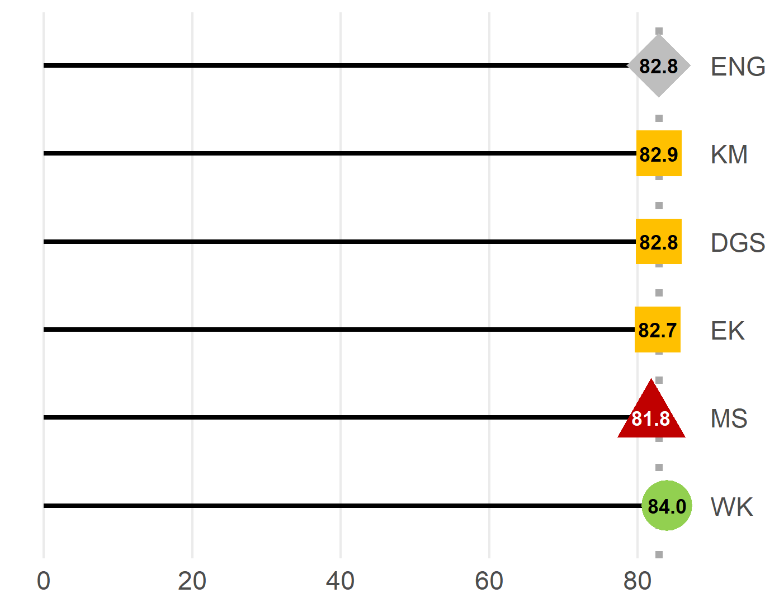

Life expectancy at birth (Female)
28
Version 5.0 © Medway Council, Public Health Intelligence Team, 26/04/2024
The rate in West Kent is better than England.
Value type: Years.
Latest time period: 2020 - 22.
Source: Primary Care Mortality Database (PCMD), Indicator ID: 90366.
Value calculation: Aggregated data.
Small area type: Ward to PCN.
RAG method: Confidence interval (95%) - Chiang method.

Slide 29
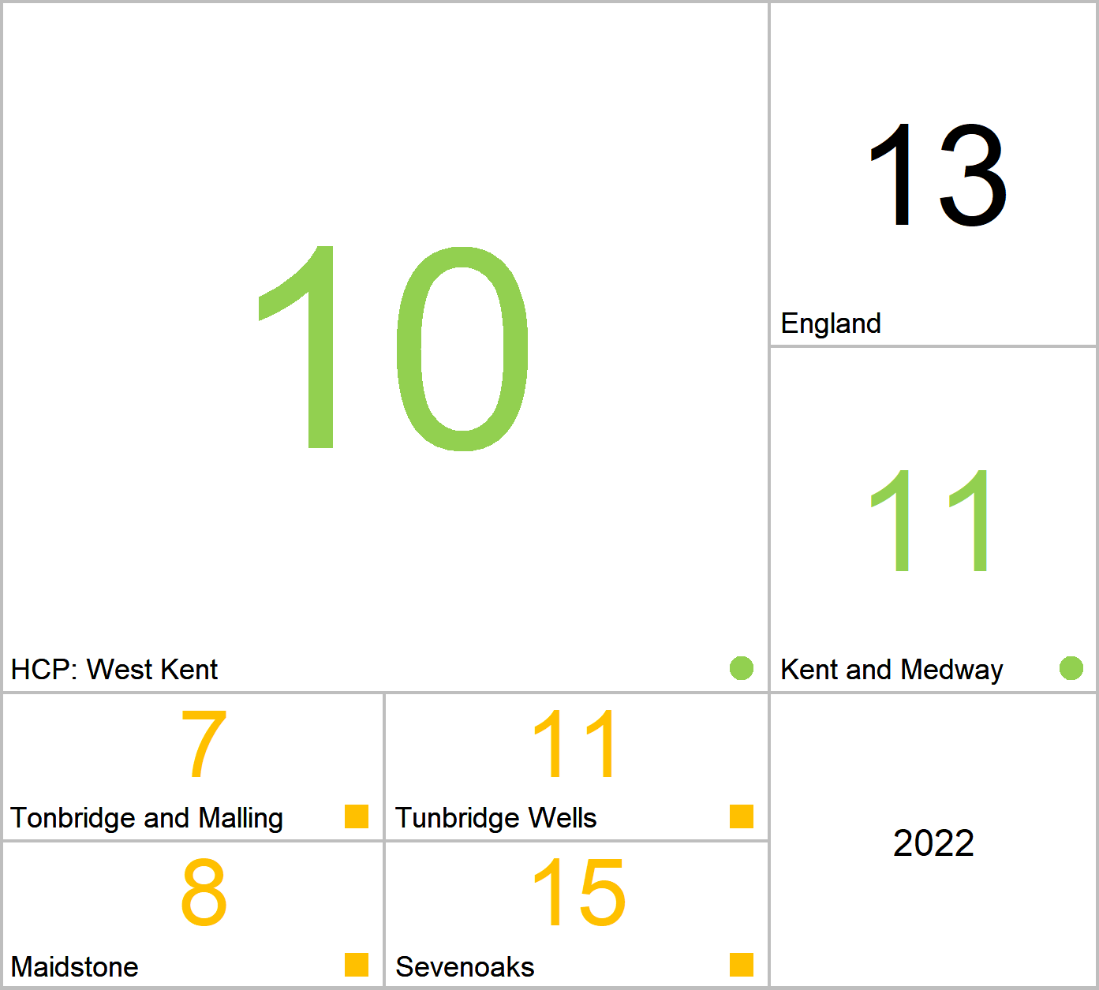
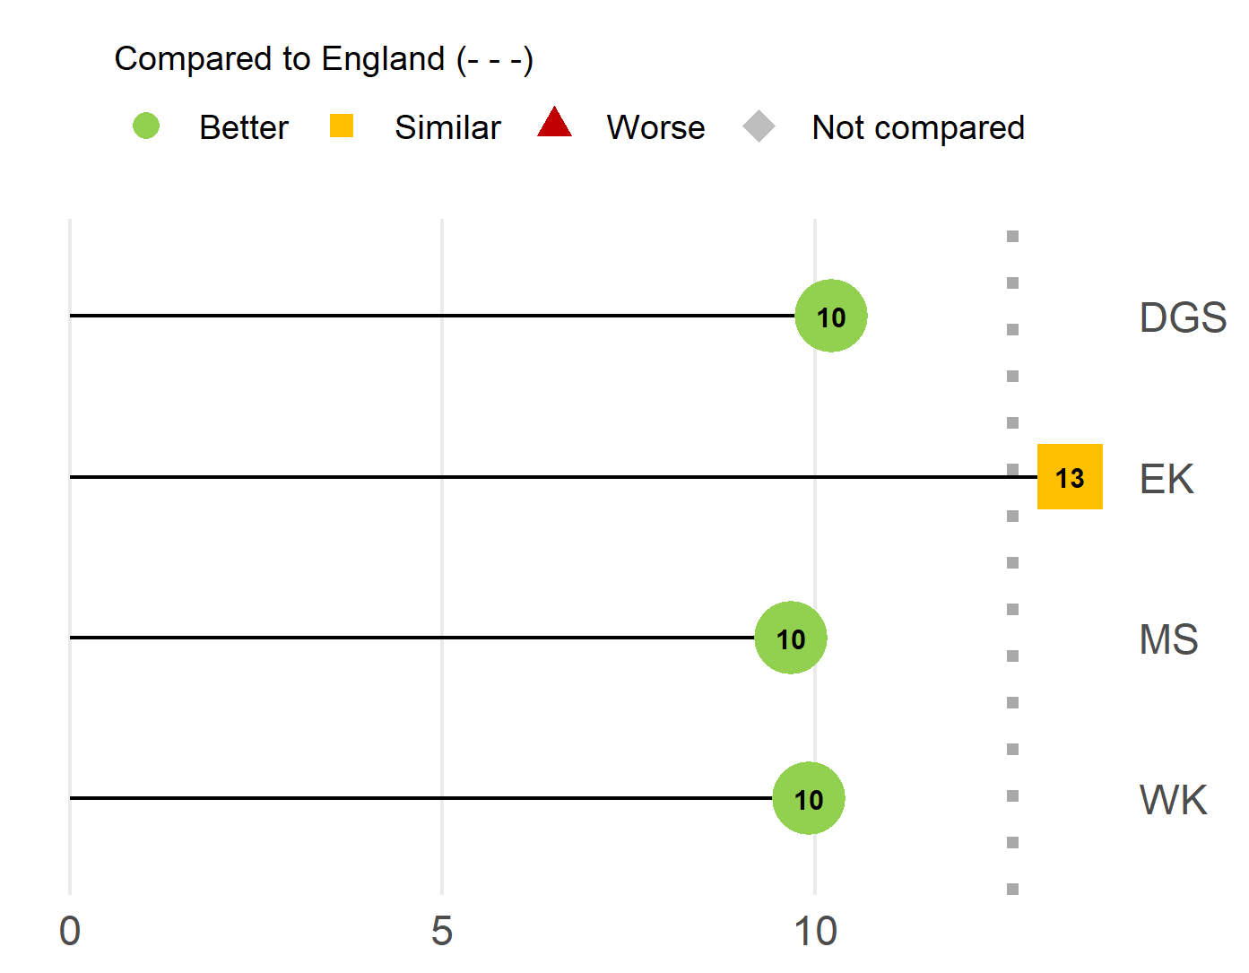
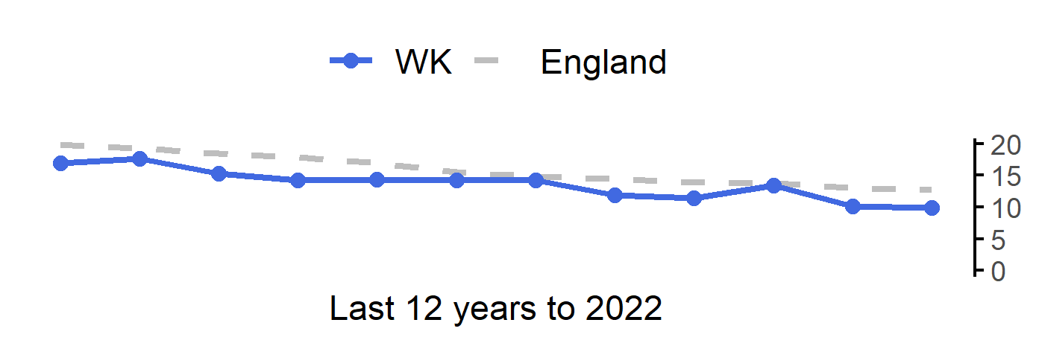
Smoking Prevalence in adults (18+) - current smokers (APS)
29
Version 5.0 © Medway Council, Public Health Intelligence Team, 26/04/2024
The rate in West Kent is better than England.
Value type: Proportion - %.
Latest time period: 2022.
Source: OHID, Fingertips, Indicator ID: 92443.
Value calculation: Population weighted average.
Small area type: Districts & UAs (2021/22-2022/23).
RAG method: England plus/minus 10%.

Slide 30
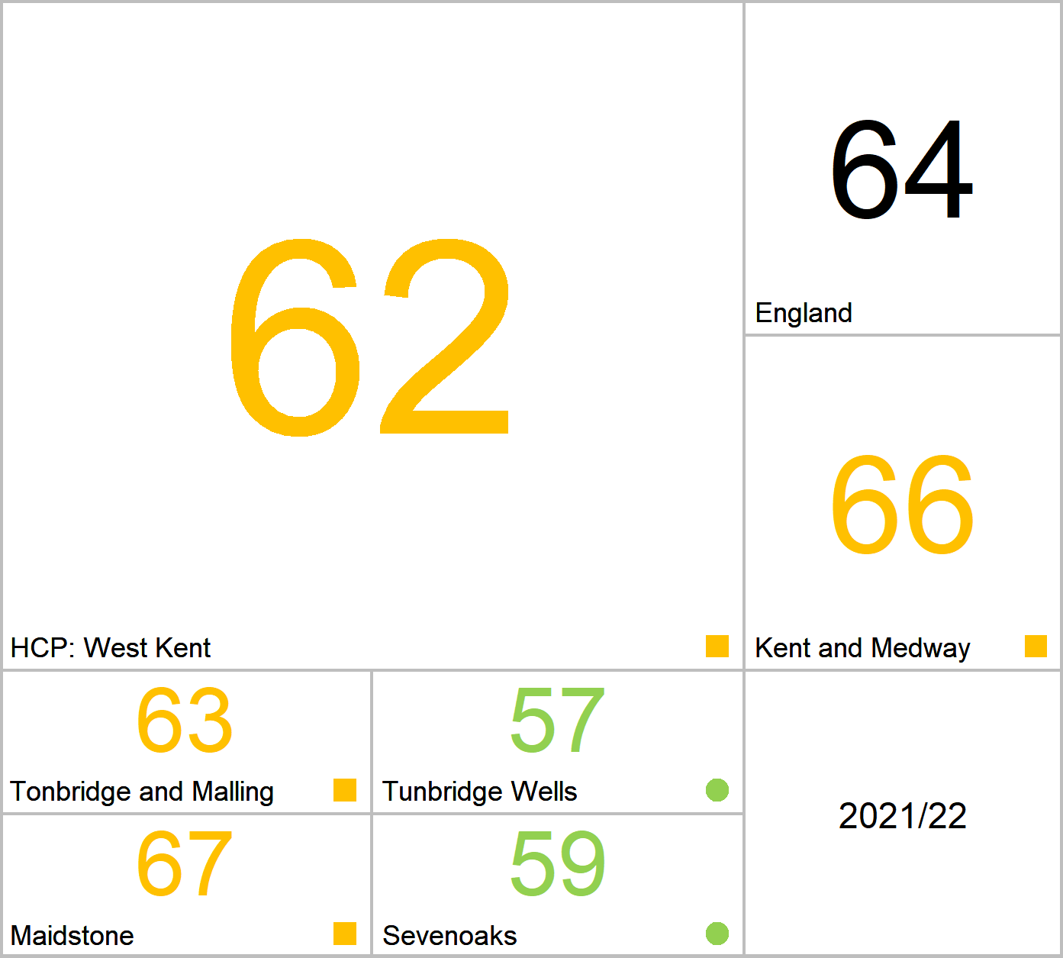
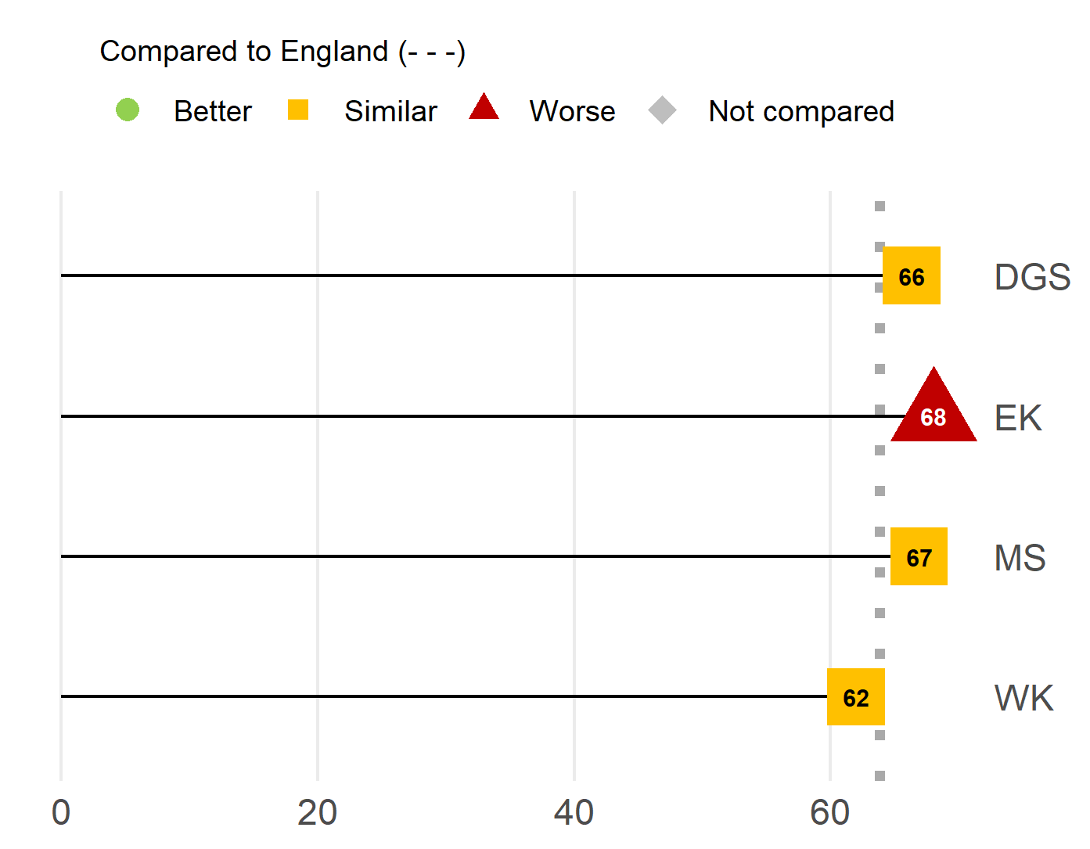
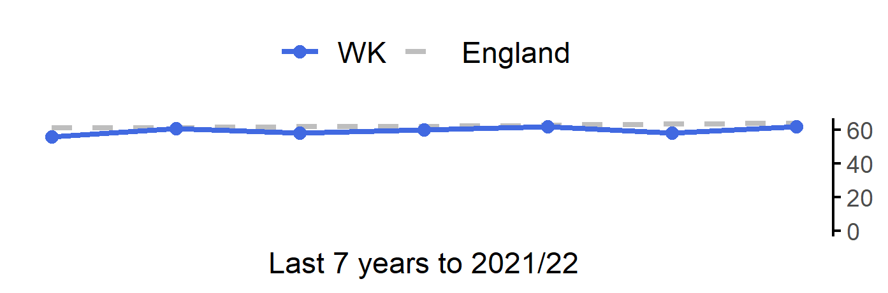
Percentage of adults (aged 18 plus) classified as overweight or obese
30
Version 5.0 © Medway Council, Public Health Intelligence Team, 26/04/2024
The rate in West Kent is similar to England.
Value type: Proportion - %.
Latest time period: 2021/22.
Source: OHID, Fingertips, Indicator ID: 93088.
Value calculation: Population weighted average.
Small area type: Districts & UAs (2021/22-2022/23).
RAG method: England plus/minus 5%.

Slide 31
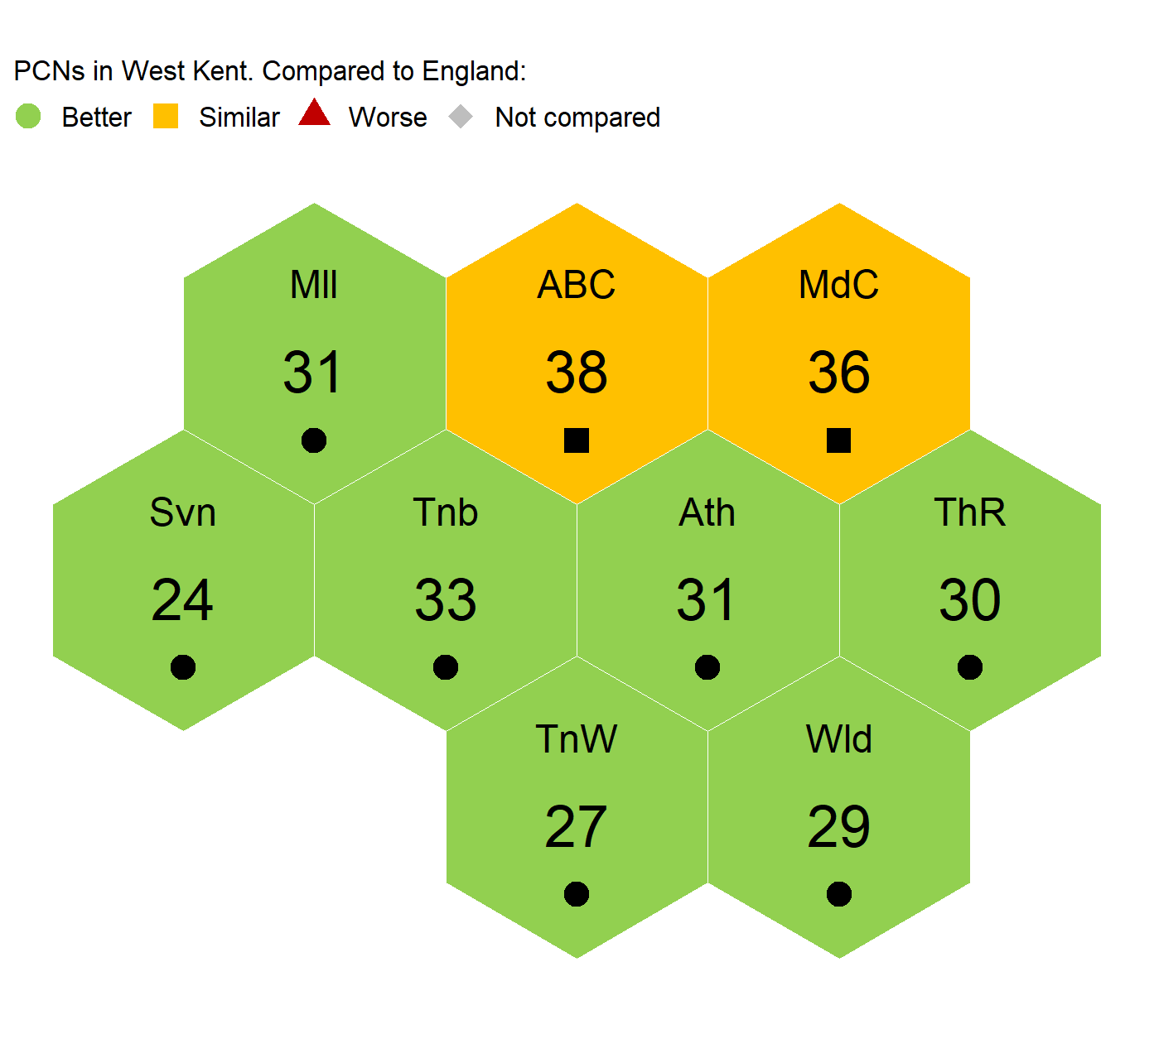
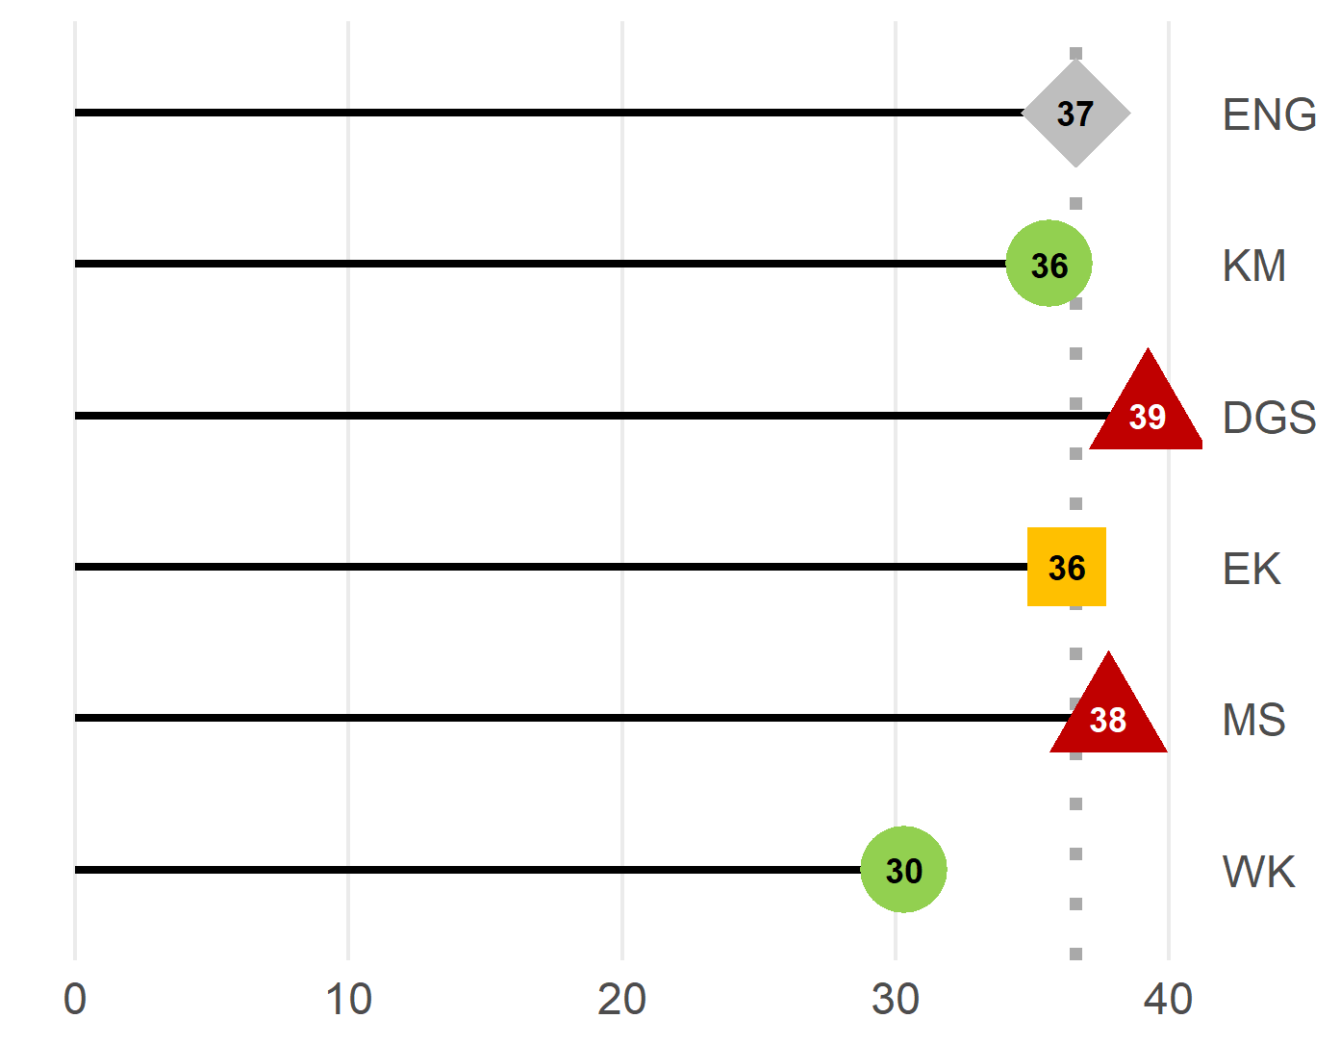
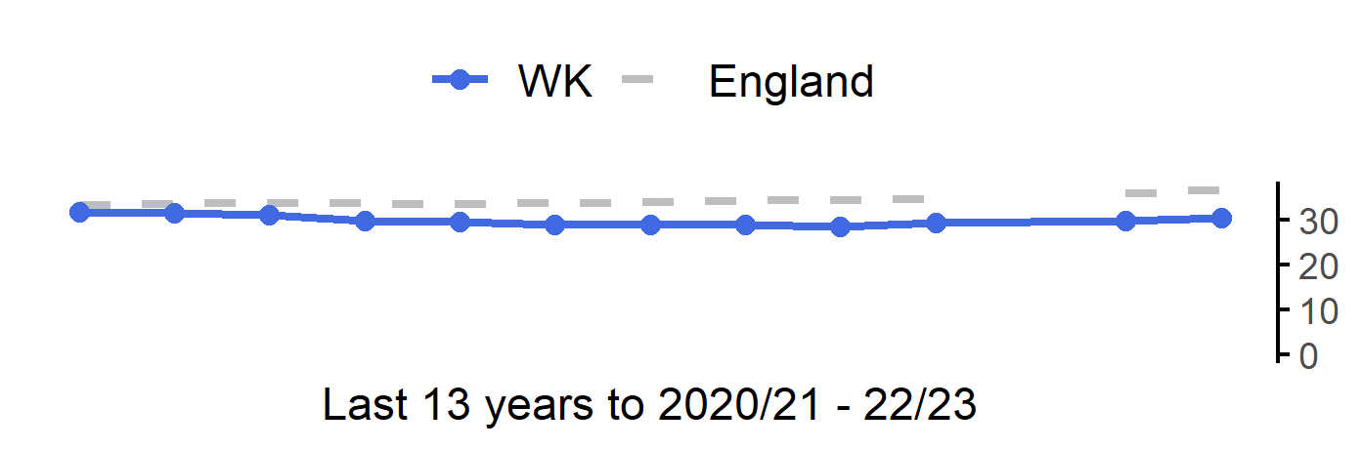
Children with excess weight Year 6, three year average
31
Version 5.0 © Medway Council, Public Health Intelligence Team, 26/04/2024
The rate in West Kent is better than England.
Value type: Proportion - %.
Latest time period: 2020/21 - 22/23.
Source: OHID, Fingertips, Indicator ID: 93108.
Value calculation: Aggregated data.
Small area type: Ward to PCN.
RAG method: Confidence interval (95%) - Wilson Score method.* Due to difficulties with the varied geographies covered by the practices in MPA PCN, it is not possible to estimate values for this PCN using ward level data at this time.

Slide 32
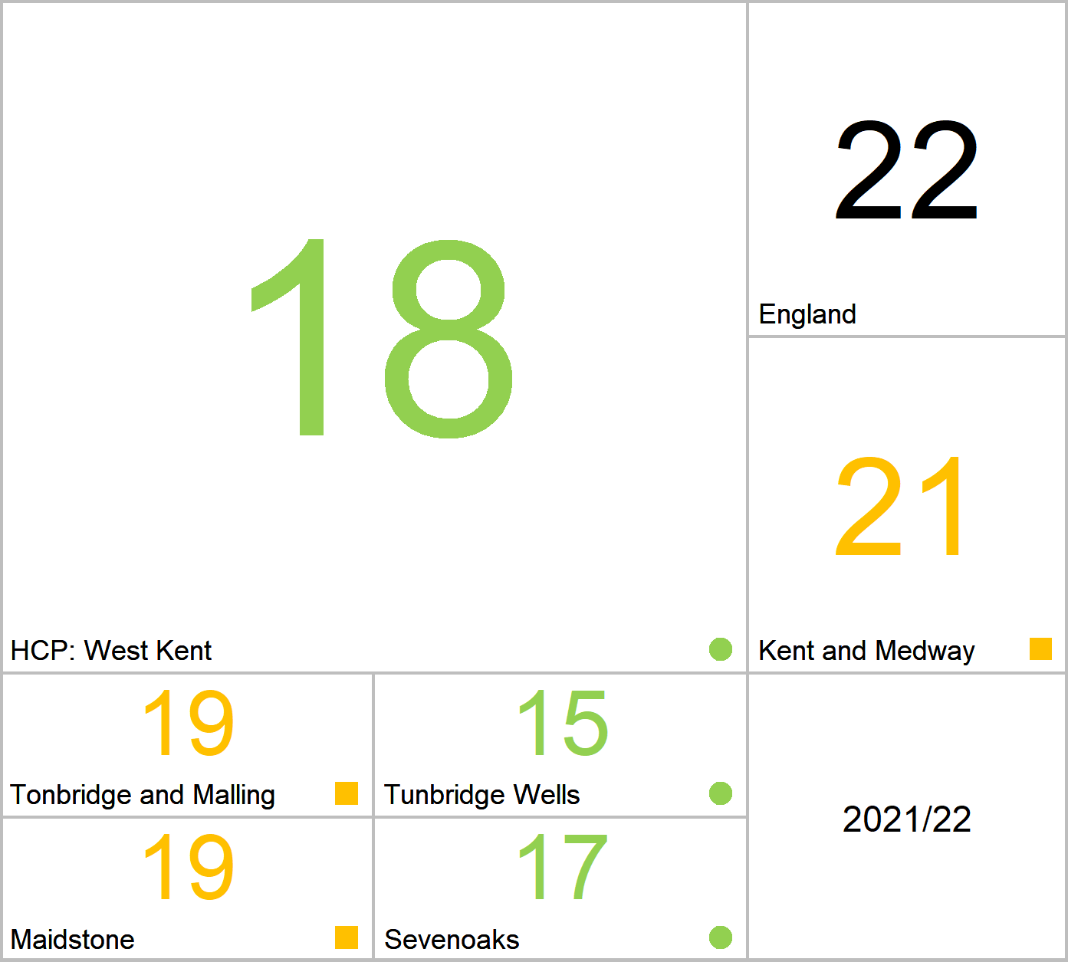
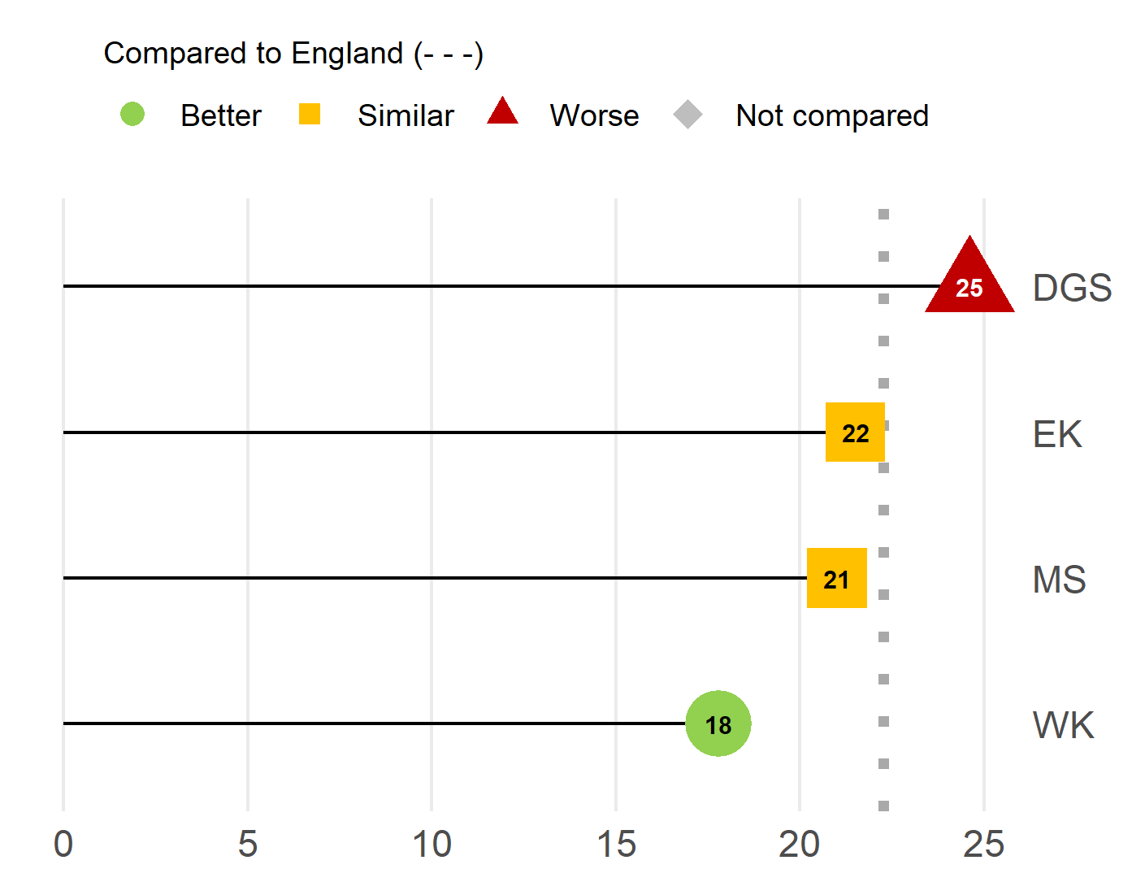
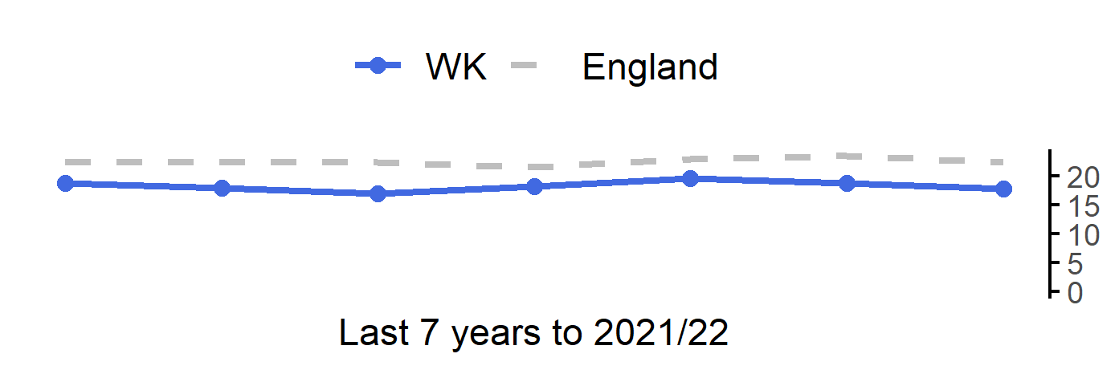
Percentage of physically inactive adults
32
Version 5.0 © Medway Council, Public Health Intelligence Team, 26/04/2024
The rate in West Kent is better than England.
Value type: Proportion - %.
Latest time period: 2021/22.
Source: OHID, Fingertips, Indicator ID: 93015.
Value calculation: Population weighted average.
Small area type: Districts & UAs (2021/22-2022/23).
RAG method: England plus/minus 10%.

Slide 33
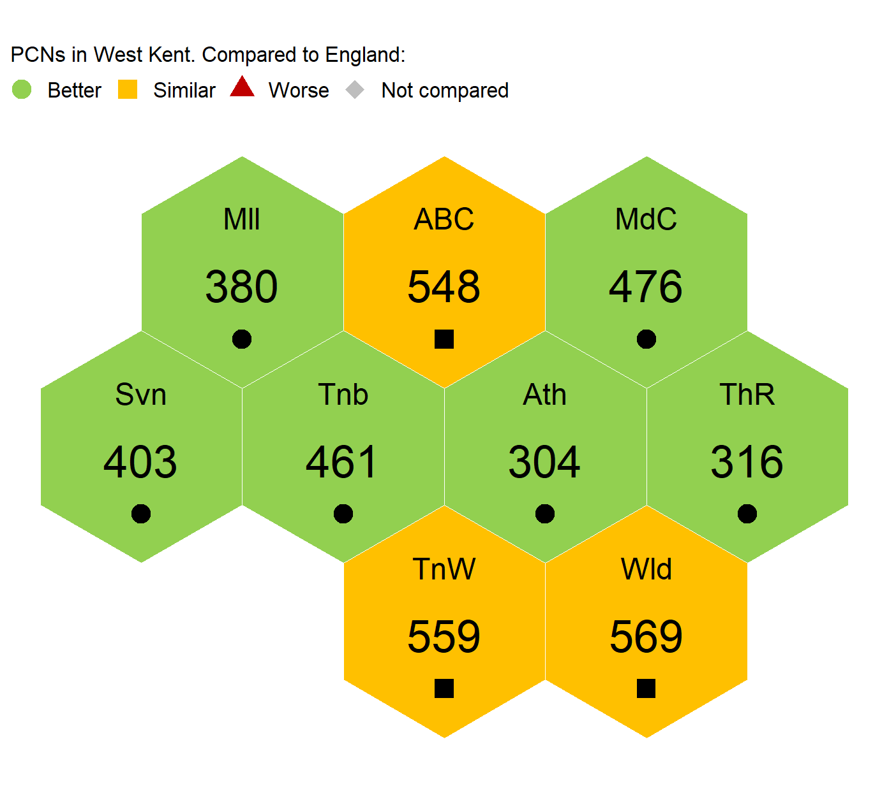
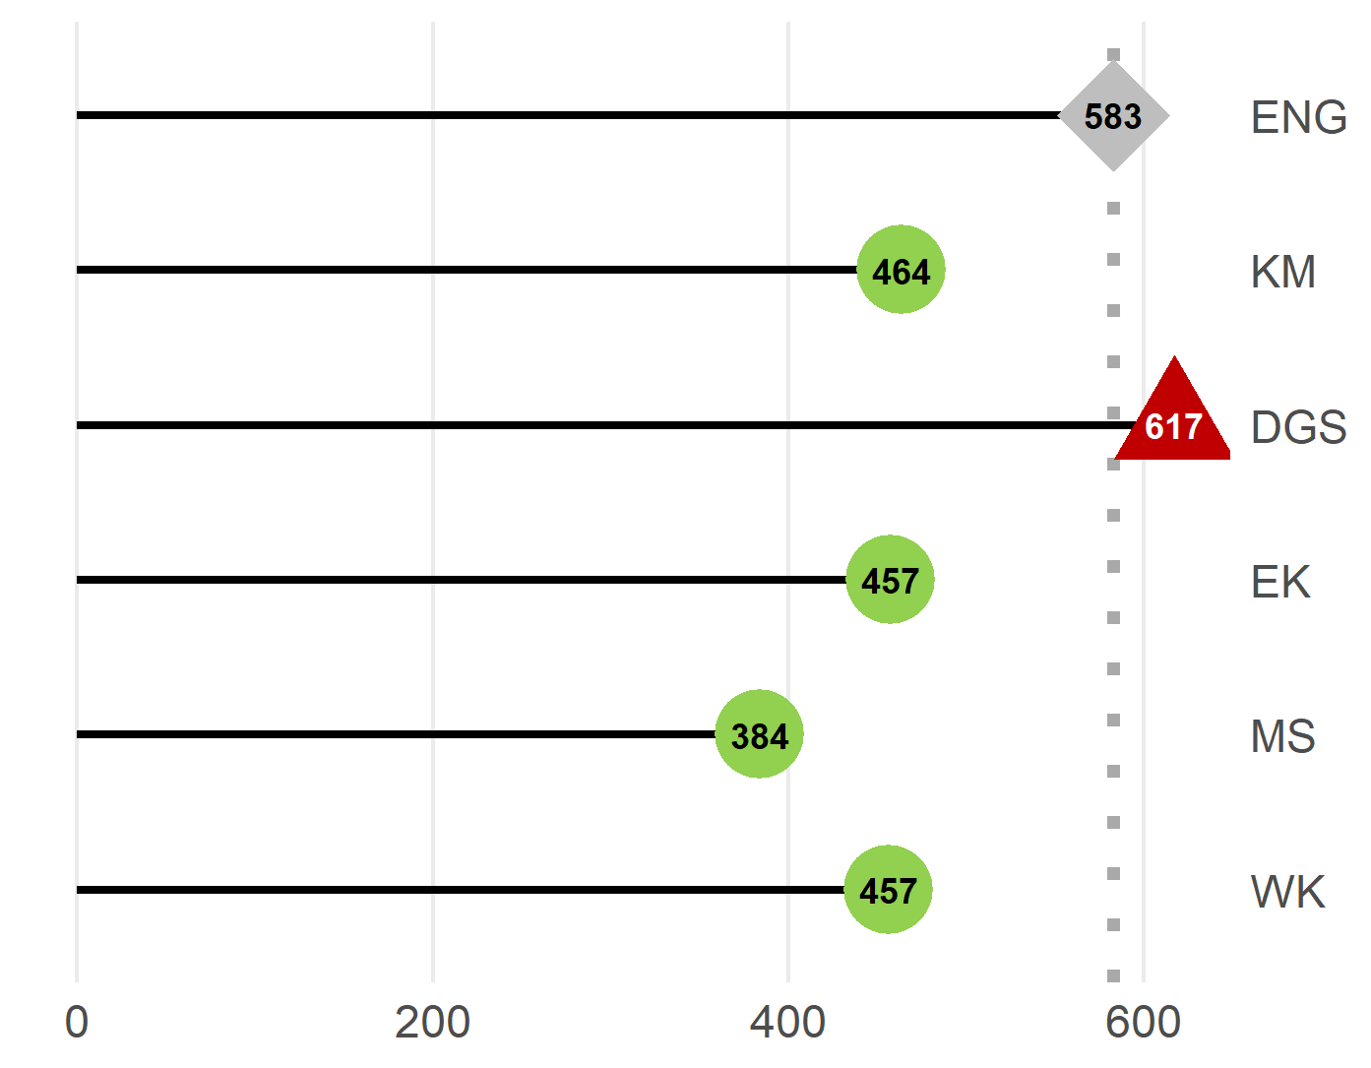
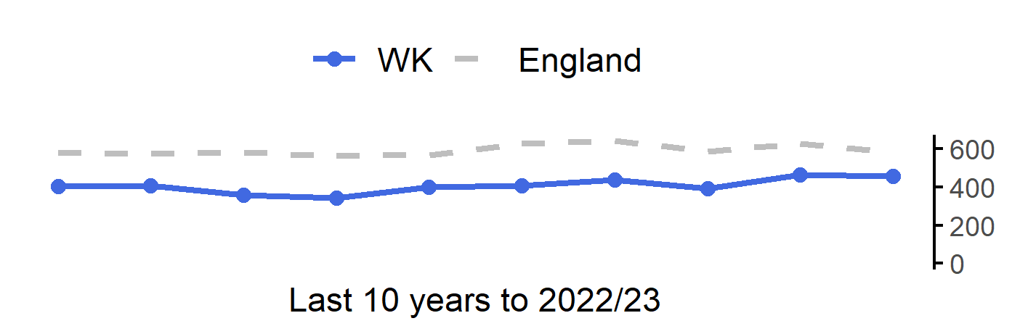
Admission episodes for alcohol-specific conditions
33
Version 5.0 © Medway Council, Public Health Intelligence Team, 26/04/2024
The rate in West Kent is better than England.
Value type: Directly standardised rate per 100,000.
Latest time period: 2022/23.
Source: Hospital Episode Statistics (HES), NHS Digital.
Value calculation: Aggregated data.
Small area type: LSOA to PCN.
RAG method: Confidence interval (95%) - Dobson's method.

Slide 34
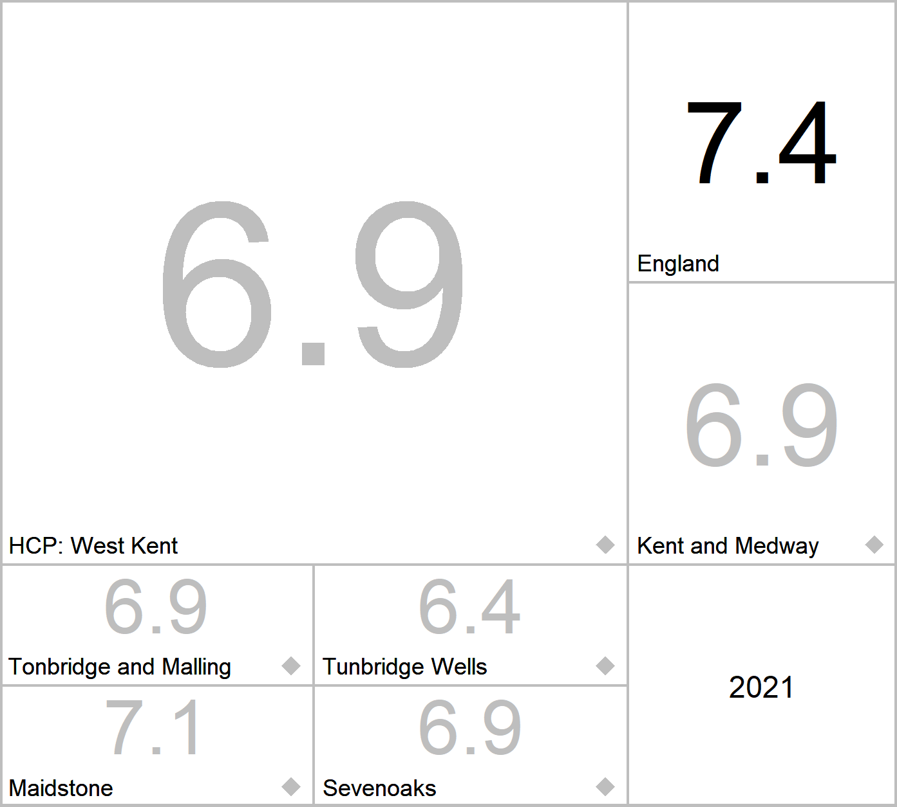


Air pollution: fine particulate matter (new method - concentrations of total PM2.5)
34
Version 5.0 © Medway Council, Public Health Intelligence Team, 26/04/2024
West Kent cannot be compared to England statistically.
Value type: Mean - µg/m3.
Latest time period: 2021.
Source: OHID, Fingertips, Indicator ID: 93867.
Value calculation: Population weighted average.
Small area type: Districts & UAs (2021/22-2022/23).
RAG method: None applied.

Slide 35



Total number of prescribed antibiotic items per STAR-PU
35
Version 5.0 © Medway Council, Public Health Intelligence Team, 26/04/2024
STAR-PU: Specific Therapeutic group Age-sex weightings Related Prescribing Unit
The rate in West Kent is similar to England.
Value type: Indirectly standardised ratio - per STAR-PU.
Latest time period: 2023 Q3.
Source: OHID, Fingertips, Indicator ID: 91900.
Value calculation: Population weighted average.
Small area type: Practice to PCN.
RAG method: England plus/minus 5%.

Slide 36



Breast cancer screening coverage (females aged 50-70)
37
Version 5.0 © Medway Council, Public Health Intelligence Team, 26/04/2024
The rate in West Kent is better than England.
Value type: Proportion - %.
Latest time period: 2023.
Source: OHID, Fingertips, Indicator ID: 22001.
Value calculation: Aggregated data.
Small area type: Districts & UAs (from Apr 2023).
RAG method: Confidence interval (95%) - Wilson Score method.

Slide 37



Cervical cancer screening coverage (females aged 25-49)
38
Version 5.0 © Medway Council, Public Health Intelligence Team, 26/04/2024
The rate in West Kent is better than England.
Value type: Proportion - %.
Latest time period: 2022/23.
Source: OHID, Fingertips, Indicator ID: 93725.
Value calculation: Aggregated data.
Small area type: Practice to PCN.
RAG method: Confidence interval (99.8%) - Wilson Score method.

Slide 38



Bowel cancer screening coverage (persons aged 60-74)
39
Version 5.0 © Medway Council, Public Health Intelligence Team, 26/04/2024
The rate in West Kent is better than England.
Value type: Proportion - %.
Latest time period: 2022/23.
Source: OHID, Fingertips, Indicator ID: 92600.
Value calculation: Aggregated data.
Small area type: Practice to PCN.
RAG method: Confidence interval (99.8%) - Wilson Score method.

Slide 39
Best Start in Life
40
Version 5.0 © Medway Council, Public Health Intelligence Team, 26/04/2024

Slide 40



Infant mortality rate
41
Version 5.0 © Medway Council, Public Health Intelligence Team, 26/04/2024
The rate in West Kent is better than England.
Value type: Crude rate - per 1,000.
Latest time period: 2020 - 22.
Source: OHID, Fingertips, Indicator ID: 92196.
Value calculation: Aggregated data.
Small area type: Districts & UAs (from Apr 2023).
RAG method: Confidence interval (95%) - Byar's method.

Slide 41



Low birth weight of term babies
42
Version 5.0 © Medway Council, Public Health Intelligence Team, 26/04/2024
The rate in West Kent is better than England.
Value type: Proportion - %.
Latest time period: 2021.
Source: OHID, Fingertips, Indicator ID: 20101.
Value calculation: Aggregated data.
Small area type: Districts & UAs (2021/22-2022/23).
RAG method: Confidence interval (95%) - Wilson Score method.

Slide 42



AE attendances (0-4 years)
43
Version 5.0 © Medway Council, Public Health Intelligence Team, 26/04/2024
The rate in West Kent is worse than England.
Value type: Crude rate per 1,000.
Latest time period: 2022/23.
Source: Hospital Episode Statistics (HES), NHS Digital.
Value calculation: Aggregated data.
Small area type: LSOA to PCN.
RAG method: Confidence interval (95%) - Byar's method.

Slide 43



Percentage of 5 year olds with experience of visually obvious dental decay
44
Version 5.0 © Medway Council, Public Health Intelligence Team, 26/04/2024
The rate in West Kent is better than England.
Value type: Proportion - %.
Latest time period: 2018/19.
Source: OHID, Fingertips, Indicator ID: 93563.
Value calculation: Population weighted average.
Small area type: Districts & UAs (from Apr 2023).
RAG method: England plus/minus 10%.

Slide 44


Under 18s conception rate / 1,000
45
Version 5.0 © Medway Council, Public Health Intelligence Team, 26/04/2024
The rate in West Kent is similar to England.
Value type: Crude rate - per 1,000.
Latest time period: 2021.
Source: OHID, Fingertips, Indicator ID: 20401.
Value calculation: Aggregated data.
Small area type: Districts & UAs (2021/22-2022/23).
RAG method: Confidence interval (95%) - Byar's method.
Trend data currently not available

Slide 45



Emergency hospital admissions for asthma (< 19 yrs)
46
Version 5.0 © Medway Council, Public Health Intelligence Team, 26/04/2024
The rate in West Kent is better than England.
Value type: Crude rate - per 100,000.
Latest time period: 2020/21 - 22/23.
Source: Hospital Episode Statistics (HES), NHS Digital.
Value calculation: Aggregated data.
Small area type: LSOA to PCN.
RAG method: Confidence interval (95%) - Byar's method.

Slide 46



Emergency hospital admissions for epilepsy (< 19 yrs)
45
Version 5.0 © Medway Council, Public Health Intelligence Team, 26/04/2024
The rate in West Kent is better than England.
Value type: Crude rate - per 100,000.
Latest time period: 2020/21 - 22/23.
Source: Hospital Episode Statistics (HES), NHS Digital.
Value calculation: Aggregated data.
Small area type: District & UA.
RAG method: Confidence interval (95%) - Byar's method.

Slide 47



Emergency hospital admissions for diabetes (< 19 yrs)
46
Version 5.0 © Medway Council, Public Health Intelligence Team, 26/04/2024
The rate in West Kent is similar to England.
Value type: Crude rate - per 100,000.
Latest time period: 2020/21 - 22/23.
Source: Hospital Episode Statistics (HES), NHS Digital.
Value calculation: Aggregated data.
Small area type: District & UA.
RAG method: Confidence interval (95%) - Byar's method.

Slide 48



Hospital admissions for mental health conditions (0-17 years)
47
Version 5.0 © Medway Council, Public Health Intelligence Team, 26/04/2024
The rate in West Kent is similar to England.
Value type: Crude rate - per 100,000.
Latest time period: 2020/21 - 22/23.
Source: Hospital Episode Statistics (HES), NHS Digital.
Value calculation: Aggregated data.
Small area type: District & UA.
RAG method: Confidence interval (95%) - Byar's method.

Slide 49



Hospital admissions as a result of self-harm (10-24 years)
49
Version 5.0 © Medway Council, Public Health Intelligence Team, 26/04/2024
The rate in West Kent is worse than England.
Value type: Directly standardised rate - per 100,000.
Latest time period: 2022/23.
Source: Hospital Episode Statistics (HES), NHS Digital.
Value calculation: Aggregated data.
Small area type: LSOA to PCN.
RAG method: Confidence interval (95%) - Dobson's method.

Slide 50



Hospital admissions due to substance misuse (15-24 years)
49
Version 5.0 © Medway Council, Public Health Intelligence Team, 26/04/2024
The rate in West Kent is worse than England.
Value type: Crude rate - per 100,000.
Latest time period: 2020/21 - 22/23.
Source: Hospital Episode Statistics (HES), NHS Digital.
Value calculation: Aggregated data.
Small area type: District & UA.
RAG method: Confidence interval (95%) - Byar's method.

Slide 51
Major Health Conditions
51
Version 5.0 © Medway Council, Public Health Intelligence Team, 26/04/2024

Slide 52



Hypertension: QOF prevalence (all ages)
52
Version 5.0 © Medway Council, Public Health Intelligence Team, 26/04/2024
The rate in West Kent is higher than England.
Value type: Proportion - %.
Latest time period: 2022/23.
Source: OHID, Fingertips, Indicator ID: 219.
Value calculation: Aggregated data.
Small area type: Practice to PCN.
RAG method: Confidence interval (99.8%) - Wilson Score method.

Slide 53



Diabetes: QOF prevalence (17+ yrs)
53
Version 5.0 © Medway Council, Public Health Intelligence Team, 26/04/2024
The rate in West Kent is lower than England.
Value type: Proportion - %.
Latest time period: 2022/23.
Source: OHID, Fingertips, Indicator ID: 241.
Value calculation: Aggregated data.
Small area type: Practice to PCN.
RAG method: Confidence interval (99.8%) - Wilson Score method.

Slide 54



CHD: QOF prevalence (all ages)
54
Version 5.0 © Medway Council, Public Health Intelligence Team, 26/04/2024
The rate in West Kent is lower than England.
Value type: Proportion - %.
Latest time period: 2022/23.
Source: OHID, Fingertips, Indicator ID: 273.
Value calculation: Aggregated data.
Small area type: Practice to PCN.
RAG method: Confidence interval (99.8%) - Wilson Score method.

Slide 55



CKD: QOF prevalence (18+ yrs)
55
Version 5.0 © Medway Council, Public Health Intelligence Team, 26/04/2024
The rate in West Kent is higher than England.
Value type: Proportion - %.
Latest time period: 2022/23.
Source: OHID, Fingertips, Indicator ID: 258.
Value calculation: Aggregated data.
Small area type: Practice to PCN.
RAG method: Confidence interval (99.8%) - Wilson Score method.

Slide 56



Stroke: QOF prevalence (all ages)
56
Version 5.0 © Medway Council, Public Health Intelligence Team, 26/04/2024
The rate in West Kent is similar to England.
Value type: Proportion - %.
Latest time period: 2022/23.
Source: OHID, Fingertips, Indicator ID: 212.
Value calculation: Aggregated data.
Small area type: Practice to PCN.
RAG method: Confidence interval (99.8%) - Wilson Score method.

Slide 57



Deaths from circulatory disease, under 75 years
57
Version 5.0 © Medway Council, Public Health Intelligence Team, 26/04/2024
The rate in West Kent is better than England.
Value type: Directly standardised rate per 100,000.
Latest time period: 2020 - 22.
Source: OHID, Fingertips and NHS Digital, PCMD, Indicator ID: 40401.
Value calculation: Aggregated data.
Small area type: Ward to PCN.
RAG method: Confidence interval (95%) - Dobson's method.

Slide 58



Deaths from all cancer, under 75 years
58
Version 5.0 © Medway Council, Public Health Intelligence Team, 26/04/2024
The rate in West Kent is better than England.
Value type: Directly standardised rate per 100,000.
Latest time period: 2020 - 22.
Source: OHID, Fingertips and NHS Digital, PCMD, Indicator ID: 40501.
Value calculation: Aggregated data.
Small area type: Ward to PCN.
RAG method: Confidence interval (95%) - Dobson's method.

Slide 59



Unplanned hospitalisation for chronic ACSC
59
Version 5.0 © Medway Council, Public Health Intelligence Team, 26/04/2024
The rate in West Kent is better than England.
Value type: Directly standardised rate per 100,000.
Latest time period: 2022/23.
Source: Hospital Episode Statistics (HES), NHS Digital.
Value calculation: Aggregated data.
Small area type: LSOA to PCN.
RAG method: Confidence interval (95%) - Dobson's method.

Slide 60



Depression: QOF prevalence (18+ yrs)
60
Version 5.0 © Medway Council, Public Health Intelligence Team, 26/04/2024
The rate in West Kent is higher than England.
Value type: Proportion - %.
Latest time period: 2022/23.
Source: OHID, Fingertips, Indicator ID: 848.
Value calculation: Aggregated data.
Small area type: Practice to PCN.
RAG method: Confidence interval (99.8%) - Byar's method.

Slide 61



Serious Mental Illness: QOF prevalence (all ages)
61
Version 5.0 © Medway Council, Public Health Intelligence Team, 26/04/2024
The rate in West Kent is lower than England.
Value type: Proportion - %.
Latest time period: 2022/23.
Source: OHID, Fingertips, Indicator ID: 90581.
Value calculation: Aggregated data.
Small area type: Practice to PCN.
RAG method: Confidence interval (99.8%) - Wilson Score method.

Slide 62



Suicide rate (Persons)
62
Version 5.0 © Medway Council, Public Health Intelligence Team, 26/04/2024
The rate in West Kent is worse than England.
Value type: Directly standardised rate - per 100,000.
Latest time period: 2020 - 22.
Source: OHID, Fingertips, Indicator ID: 41001.
Value calculation: Population weighted average.
Small area type: Districts & UAs (from Apr 2023).
RAG method: England plus/minus 10%.

Slide 63



Suicide rate (Male)
63
Version 5.0 © Medway Council, Public Health Intelligence Team, 26/04/2024
The rate in West Kent is similar to England.
Value type: Directly standardised rate - per 100,000.
Latest time period: 2020 - 22.
Source: OHID, Fingertips, Indicator ID: 41001.
Value calculation: Population weighted average.
Small area type: Districts & UAs (from Apr 2023).
RAG method: England plus/minus 10%.

Slide 64
Ageing Well
64
Version 5.0 © Medway Council, Public Health Intelligence Team, 26/04/2024

Slide 65



Estimated dementia diagnosis rate (aged 65 and older)
65
Version 5.0 © Medway Council, Public Health Intelligence Team, 26/04/2024
West Kent cannot be compared to England statistically.
Value type: Proportion - %.
Latest time period: 2023.
Source: OHID, Fingertips, Indicator ID: 92949.
Value calculation: Aggregated data.
Small area type: Districts & UAs (from Apr 2023).
RAG method: None applied.

Slide 66


Emergency hospital admissions due to falls (persons aged 65 and over)
66
Version 5.0 © Medway Council, Public Health Intelligence Team, 26/04/2024
The rate in West Kent is worse than England.
Value type: Directly standardised rate - per 100,000.
Latest time period: 2021/22.
Source: OHID, Fingertips, Indicator ID: 22401.
Value calculation: Population weighted average.
Small area type: Districts & UAs (from Apr 2023).
RAG method: England plus/minus 5%.
Trend data not available.

Slide 67



Emergency hospital admissions for hip fracture (persons aged 65 and over)
67
Version 5.0 © Medway Council, Public Health Intelligence Team, 26/04/2024
The rate in West Kent is worse than England.
Value type: Directly standardised rate - per 100,000.
Latest time period: 2022/23.
Source: OHID, Fingertips, Indicator ID: 41401.
Value calculation: Population weighted average.
Small area type: Districts & UAs (from Apr 2023).
RAG method: England plus/minus 5%.

Slide 68



Osteoporosis: QOF prevalence (50+ yrs)
68
Version 5.0 © Medway Council, Public Health Intelligence Team, 26/04/2024
The rate in West Kent is higher than England.
Value type: Crude rate - %.
Latest time period: 2022/23.
Source: OHID, Fingertips, Indicator ID: 90443.
Value calculation: Aggregated data.
Small area type: Practice to PCN.
RAG method: Confidence interval (99.8%) - Wilson Score method.

