Slide 1
Malling PCN
Version 4.1
Public Health PCN profile
Life course indicators
West Kent HCP
Created by Medway Council Public Health Intelligence Team

Slide 2
Summary: Malling
2
Version 4.1 © Medway Council, Public Health Intelligence Team, 13/06/2024
Indicator | Compared to England
Pupil absence primary [%] | Worse
Unemployment | Better
Fuel poverty [% households] | Lower
Life expectancy (Female) [Years] | Better
Life expectancy (Male) [Years] | Better
Smoking prev 15+ [%] | Lower
Year 6 excess weight | Better
Obesity prev 18+ [%] | Similar
Alcohol admissions | Better
Prescribed antibiotics [ISR] | Lower
Breast screening [%] | Better
Cervical screening [%] | Better
Bowel screening [%] | Better
Low birth weight | Better
A&E attendances (0-4 years) | Worse
Asthma admissions (<19 yrs) | Better
Self-harm admissions (10-24 yrs) | Worse
CHD prevalence | Lower
Indicator | Compared to England
Stroke prevalence | Lower
PAD prevalence | Lower
Heart failure prevalence | Lower
AF prevalence | Similar
Hypertension prevalence | Lower
CKD prevalence | Higher
Cancer prevalence | Higher
Diabetes prevalence | Similar
COPD prevalence | Similar
Serious mental illness prevalence | Lower
Depression prevalence | Higher
Dementia prevalence | Lower
ACSC adm [DSR/100,000] | Similar
All cause deaths <75 [DSR] | Better
Cancer deaths <75 [DSR] | Similar
Circulatory deaths <75 [DSR] | Similar
Osteoporosis prevalence (>50 yrs) | Lower
Hip fracture admissions (>65 yrs) | Worse

Slide 3
Contact details
3
Version 4.1 © Medway Council, Public Health Intelligence Team, 13/06/2024
If you have any questions or would like further information about these profiles, please contact:
Dr Eluned Broom
Senior Public Health Intelligence Manager
Public Health
Medway Council
eluned.broom@medway.gov.uk
01634 334111

Slide 4
Introduction
4
Version 4.1 © Medway Council, Public Health Intelligence Team, 13/06/2024

Slide 5
Purpose and rationale
5
Version 4.1 © Medway Council, Public Health Intelligence Team, 13/06/2024
Profiles have been created for each of the Primary Care Networks (PCNs) in the Kent and Medway Integrated Care System (ICS).
There are 42 PCNs in Kent and Medway.
The aim of the PCN profiles is to identify the health and social care needs of an area.
In addition to identifying priority areas to explore further, contextual information about the population characteristics is presented to help PCNs understand the underlying causes for these differences.
Key stakeholders were consulted to identify the indicators that should be included.

Slide 6
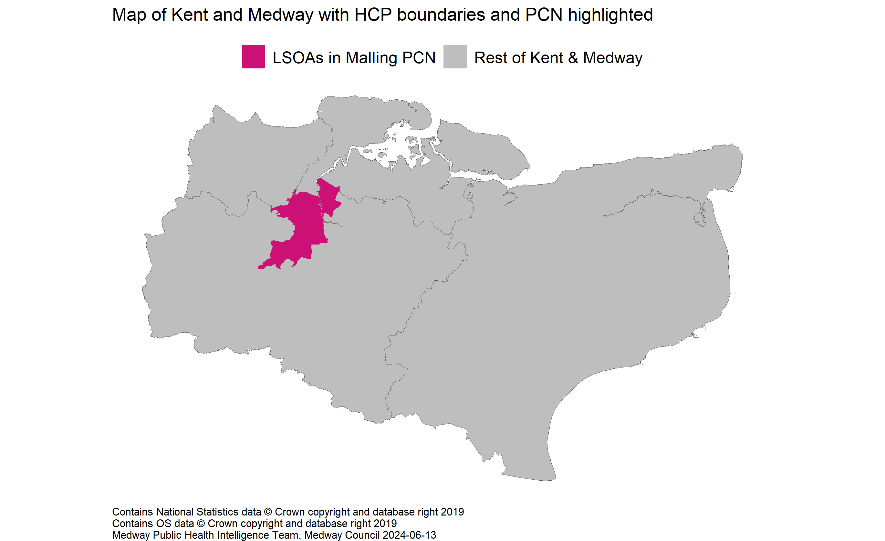
Location of the PCN
6
Version 4.1 © Medway Council, Public Health Intelligence Team, 13/06/2024

Slide 7
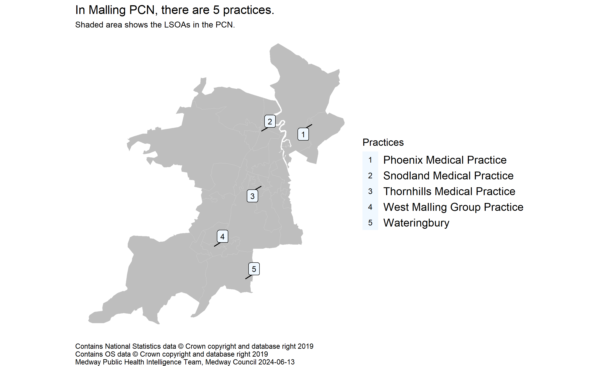
Practices in the PCN
7
Version 4.1 © Medway Council, Public Health Intelligence Team, 13/06/2024
Source: NHS Digital. GP and GP practice related data. GP Practices (epraccur).

Slide 8
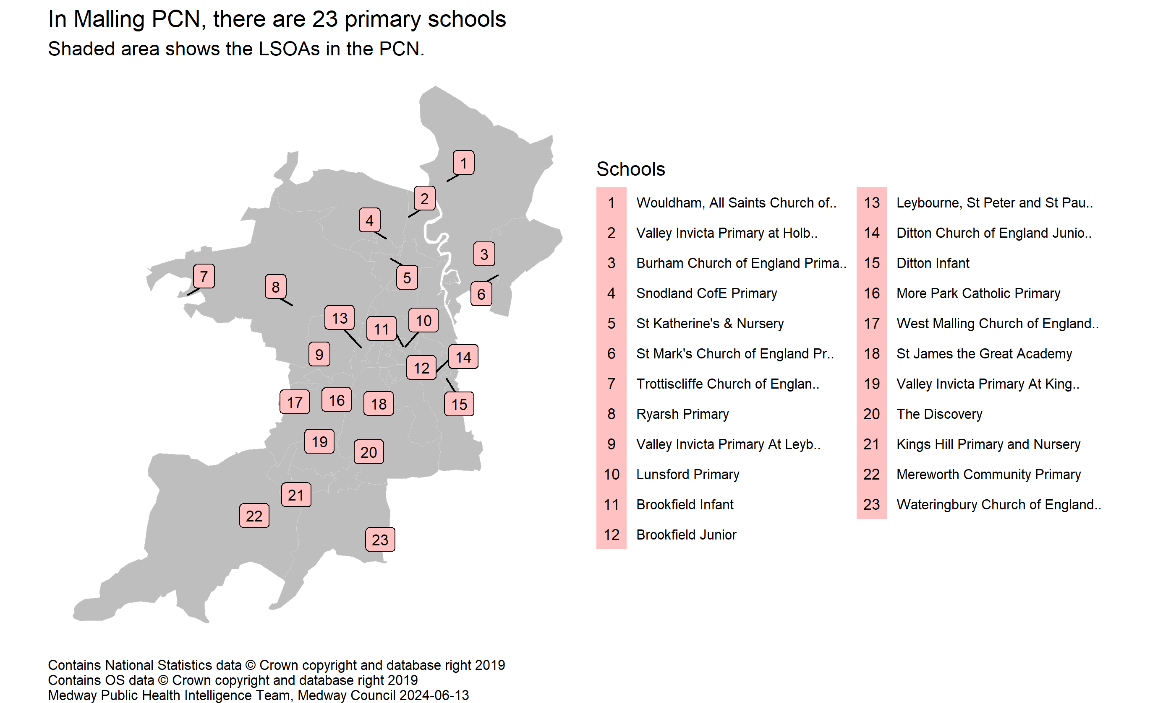
Primary schools in the PCN
8
Version 4.1 © Medway Council, Public Health Intelligence Team, 13/06/2024
Source: GOV.UK. Get information about schools.

Slide 9
Small areas
9
Version 4.1 © Medway Council, Public Health Intelligence Team, 13/06/2024
Data at several small area levels has been used as building blocks to calculate the PCN values: 2011 Lower layer Super Output Area (LSOA), ward, general practice and school.
2011 LSOAs have a defined geographical boundary. On average the population is about 1,700 people so they can be thought of as representing a neighbourhood. There are 1,065 2011 LSOAs within Kent and Medway.
LSOAs and wards were assigned to PCNs on a first passed the post basis, e.g. LSOAs or wards were mapped to PCNs based on which PCN has the highest count of registered patients living in that LSOA/ward.
School level data was assigned to PCNs based on the ward the school was located in. Only primary and nursery school data was used as this more likely reflects the child profile of the local area due to the larger catchment areas of secondary schools.

Slide 10
PCN value and RAG rating
10
Version 4.1 © Medway Council, Public Health Intelligence Team, 13/06/2024
The PCN values have been calculated from LSOA, ward, practice or school level data using one of two methods:
1) Aggregated data: PCN values are created from aggregated counts and denominators, where data is available.
2) Population weighted average: PCN values are created by averaging values from smaller areas, considering each group's population size.
A RAG rating (red, amber, green) has been applied to the majority of indicators to show how well an area is performing compared to a benchmark (England). The RAG rating is assigned by comparing an area's value to a reference range, which was created using either confidence intervals (CIs) or a 5% range around the England average. Green corresponds to a value that is better than England, red to a value that is worse, and amber indicates that there is no difference.
Where it is inappropriate to label high or low values as 'better' or 'worse', for example osteoporosis prevalence, the terms 'higher' and 'lower' have been used with neutral colouring: magenta and aqua. Such labelling does not imply that high values of these indicators, for example, are 'worse'.
An indicator is shaded grey where it is inappropriate to apply a RAG rating due to the methods used in the calculation or the count is less than 10.

Slide 11
Peer groups
11
Version 4.1 © Medway Council, Public Health Intelligence Team, 13/06/2024
Peer groups were created to enable the comparison of PCNs with similar characteristics.
Cluster analysis was used to determine the PCN peer groups. Clustering divides the population into a number of groups with similar traits.
Two clustering algorithms were used to explore the data: K-means and hierarchical clustering.
The characteristics input into the cluster analysis were:
1) Total PCN population
2) Percentage aged 0 to 4 years
3) Percentage aged 5 to 18 years
4) Percentage aged 65 to 84 years
5) Percentage aged 85 years and over
6) Index of Multiple Deprivation (IMD) score
7) Total QOF points
The cluster analysis indicates that the optimum number of distinct groups is two, based on these inputs.
This methodology is being developed and additional characteristics may be added in the future, which may alter the peer groups.

Slide 12
Indicator slides explained
12
Version 4.1 © Medway Council, Public Health Intelligence Team, 13/06/2024

Slide 13
Accessibility
13
Version 4.1 © Medway Council, Public Health Intelligence Team, 13/06/2024
All plots contain alternative text (alt text), which describes the plot and, where possible, includes values. To access the alt text: Right-click an image, and then select View Alt Text. This will open the Alt Text pane.
Shapes have been used to communicate meaning in the plots when the colour palette may not be accessible. For instance, a RAG rating (red, amber, green) is used for most indicators to show how well an area is performing compared to a benchmark. Green represents better performance, amber represents similarity, and red signifies worse performance. Additionally, shapes are also used to communicate this information, where a circle signifies better performance, a square represents similarity, a triangle indicates worse, and a diamond signifies there has been no comparison.
The maps use patterns to communicate significance when the colour palette may not be accessible. Dots represent better performance compared to a benchmark, cross hatching indicates similar performance, and lines represent worse performance.

Slide 14
Demographics
14
Version 4.1 © Medway Council, Public Health Intelligence Team, 13/06/2024

Slide 15
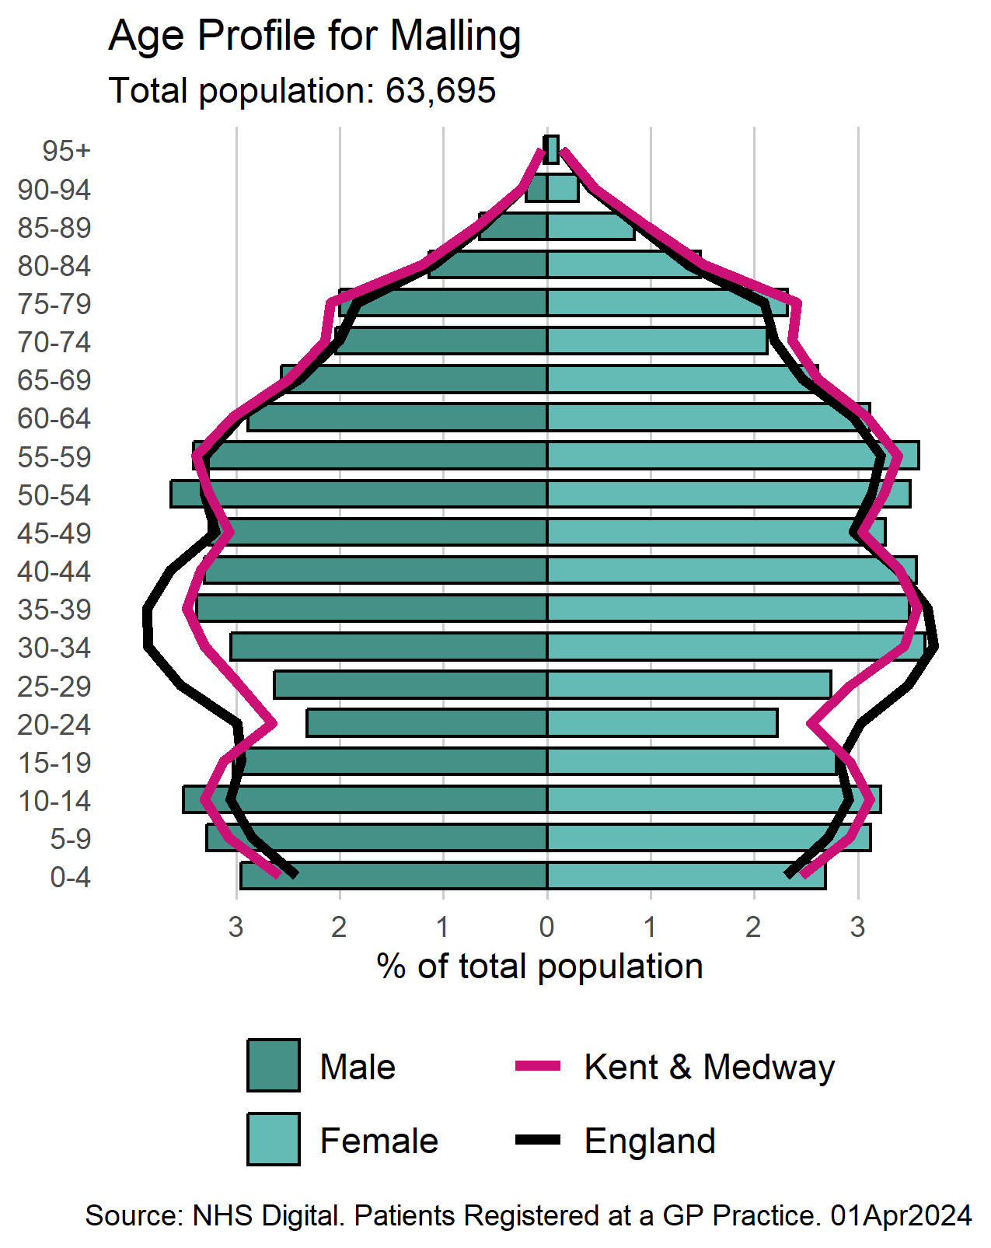
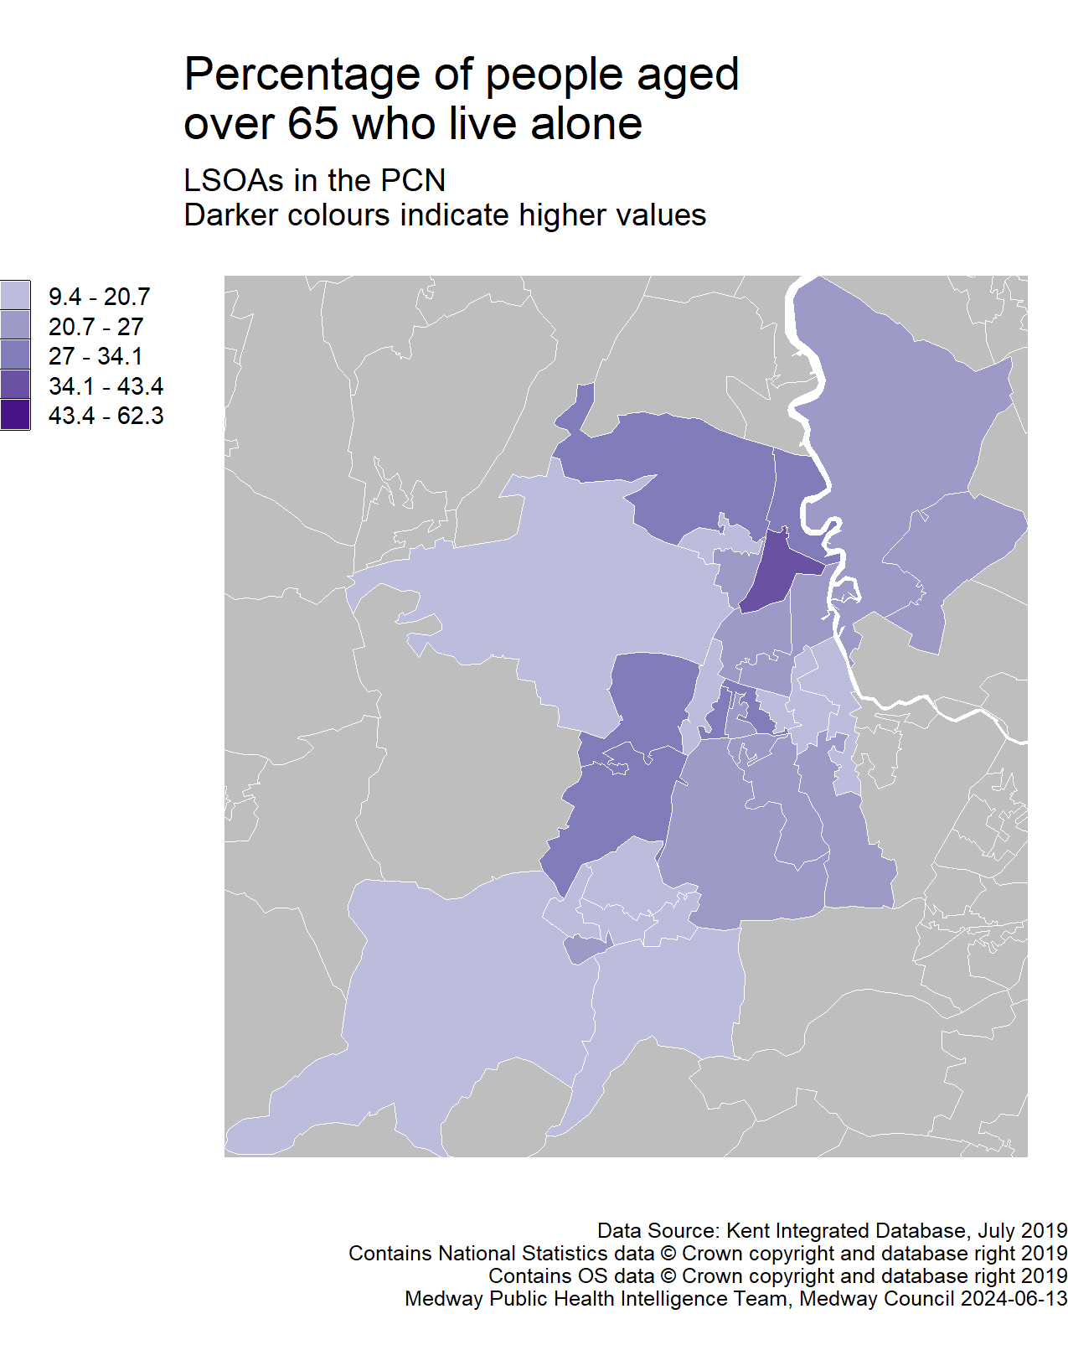
Population
15
Version 4.1 © Medway Council, Public Health Intelligence Team, 13/06/2024
Data for people living alone aged 65 and over due to be updated to Census 2021. Awaiting 2021 LSOAs to be used in the NHS Digital Patients registered at a GP practice data.

Slide 16
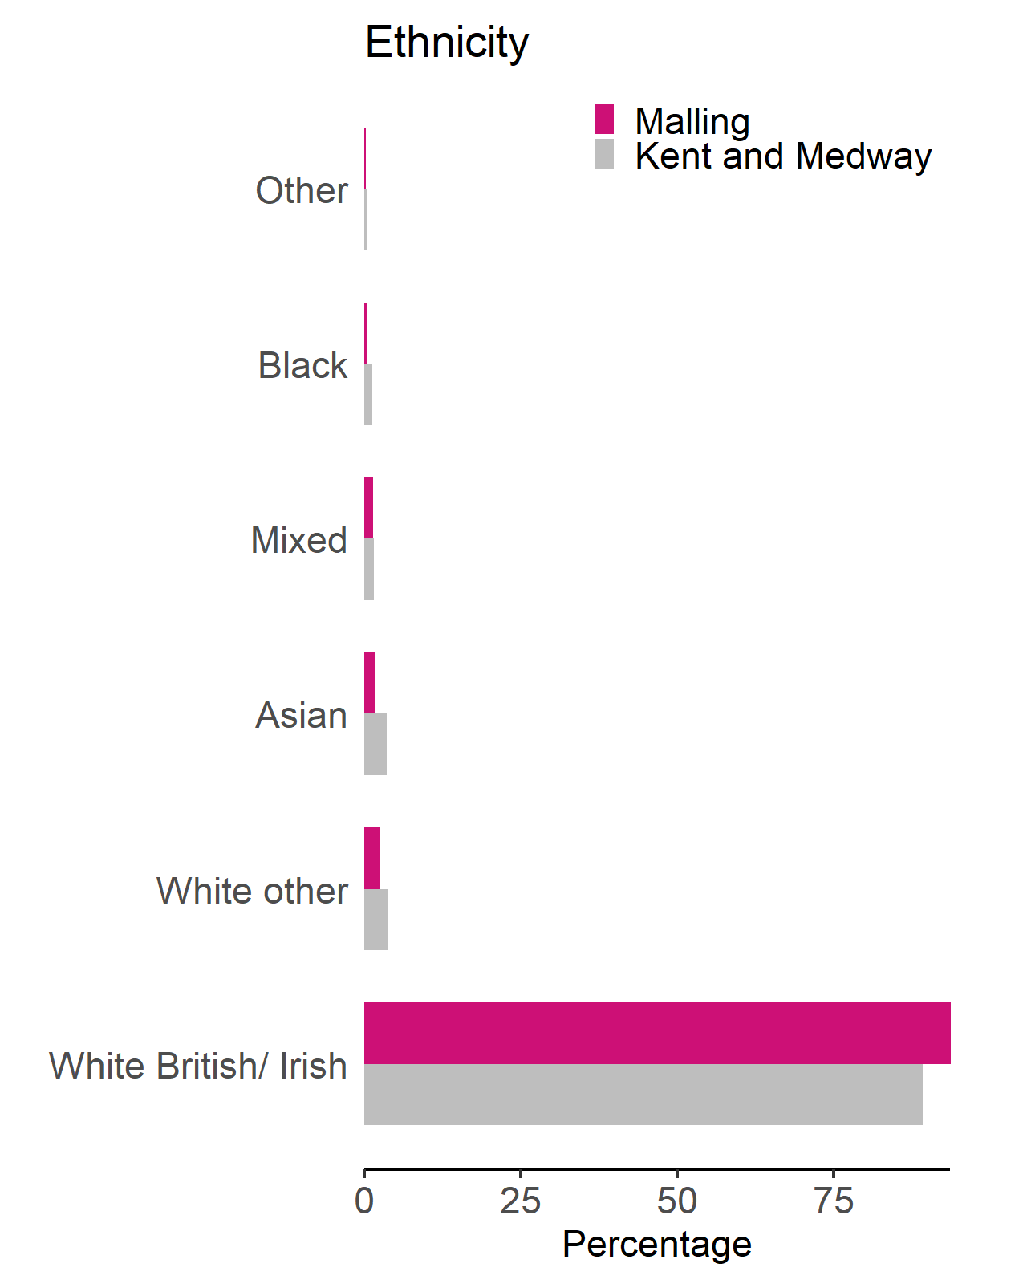
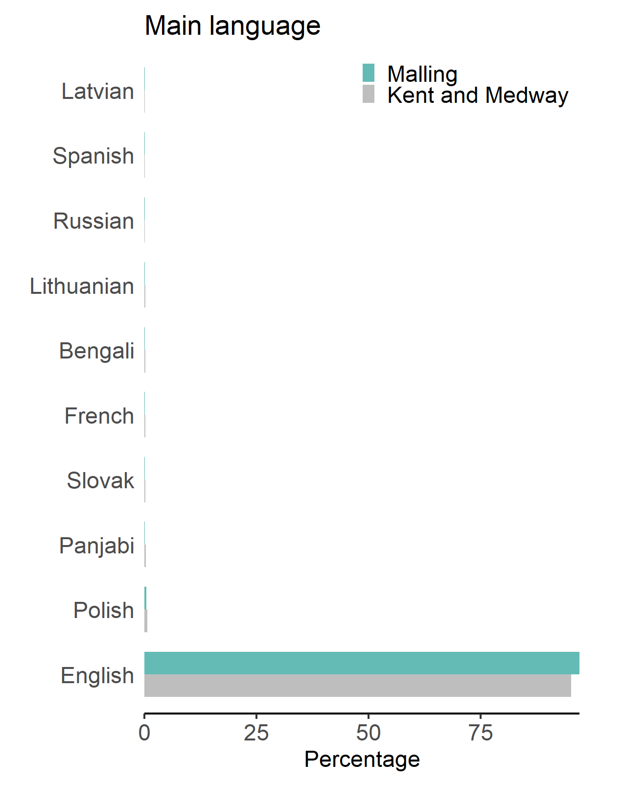
Ethnicity and main language
16
Version 4.1 © Medway Council, Public Health Intelligence Team, 13/06/2024
Census 2011 (Office for National Statistics), 2011 ethnicity and main language.
Data due to be updated to Census 2021. Awaiting 2021 LSOAs to be used in the NHS Digital Patients registered at a GP practice data.

Slide 17
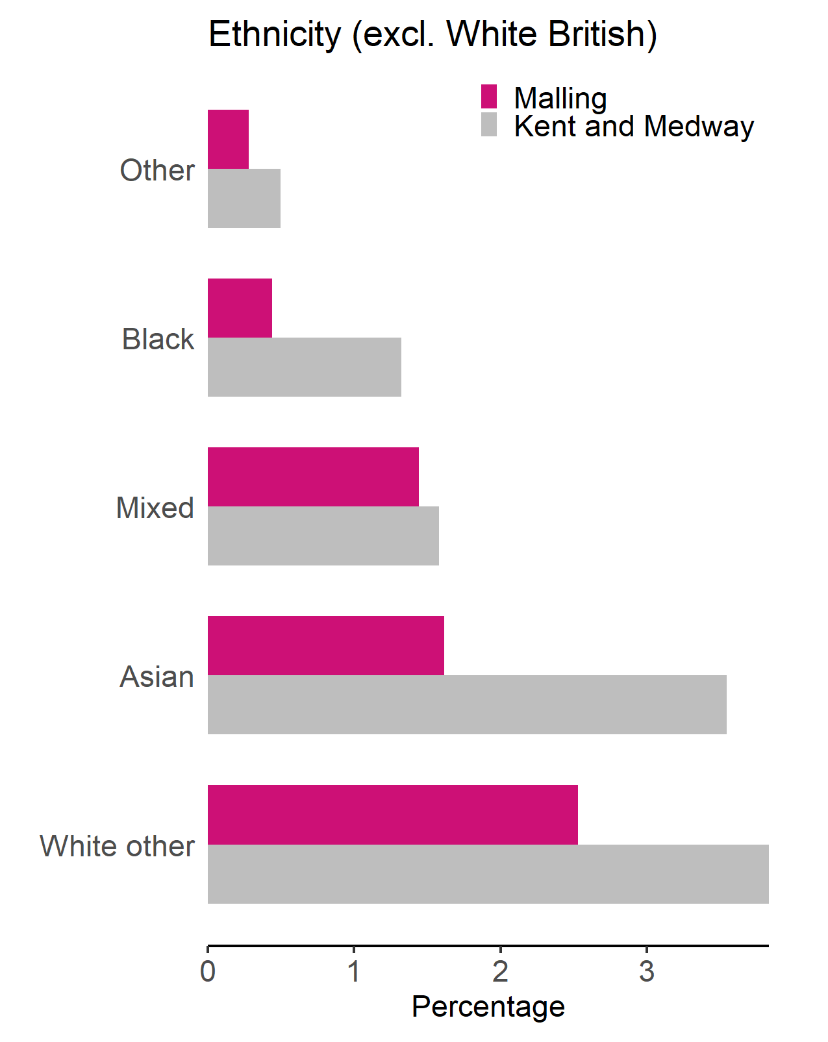
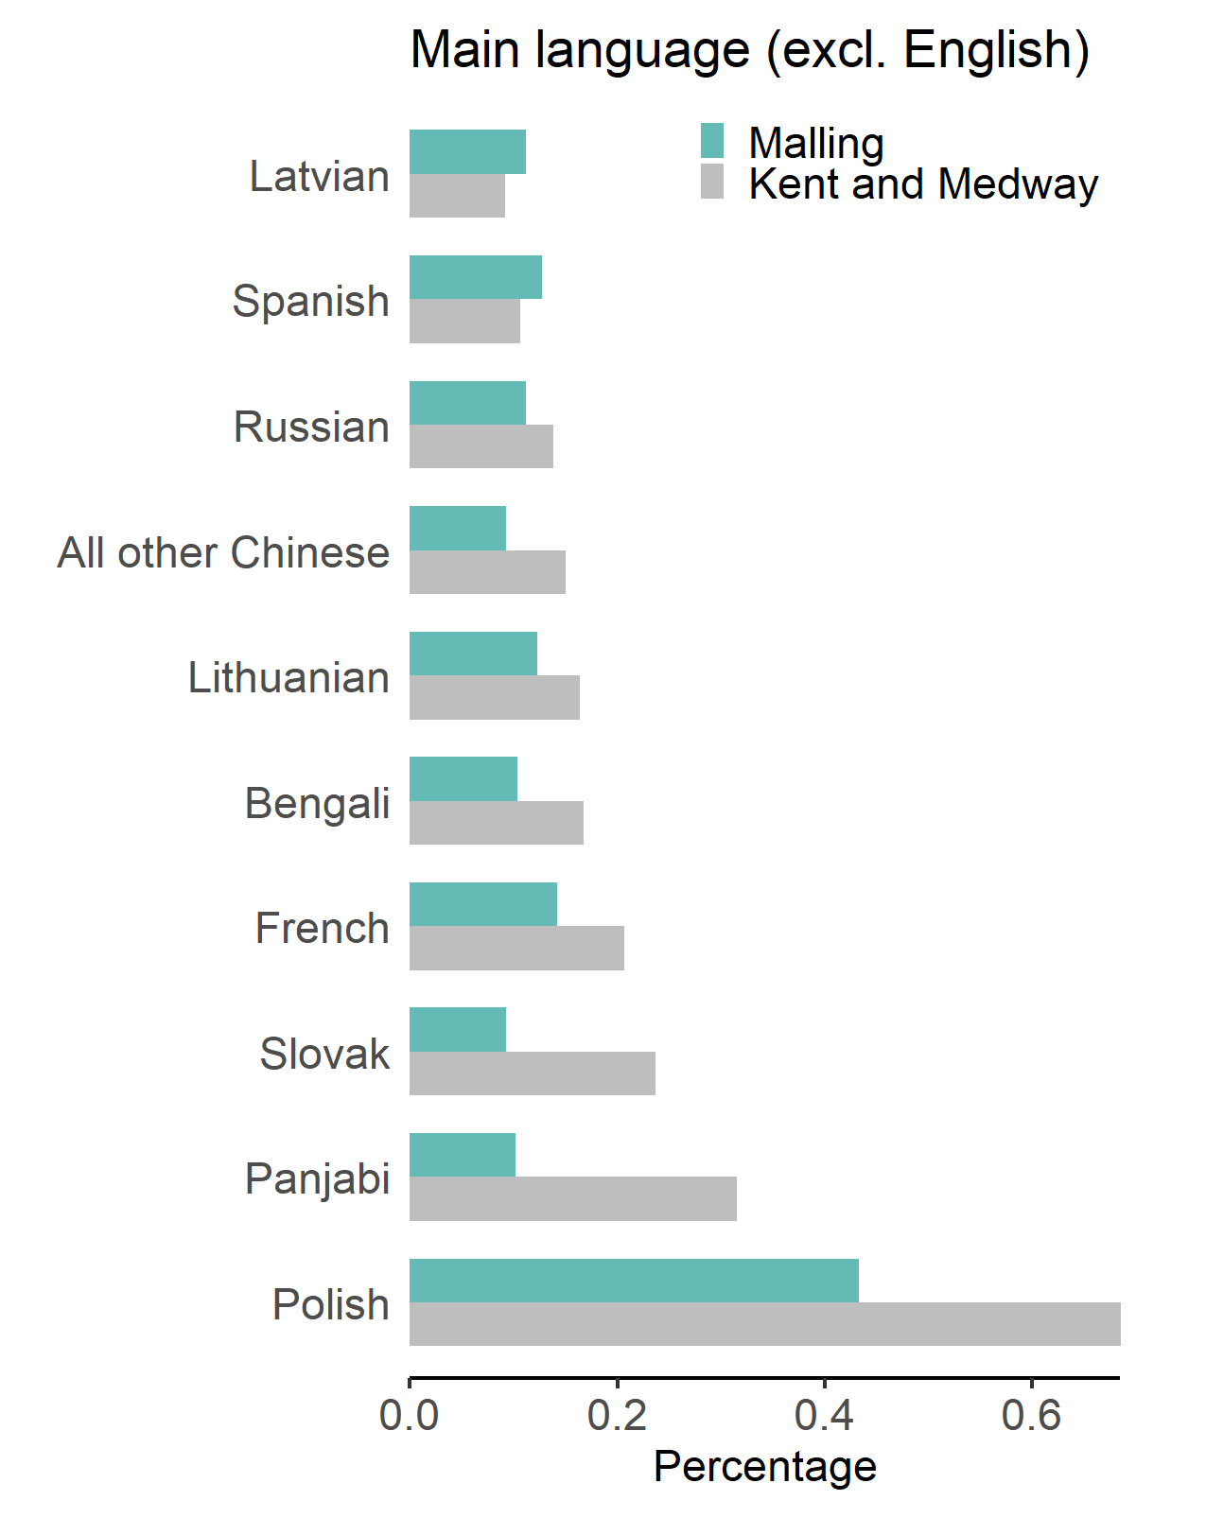
Ethnicity and main language (excluding White British and English)
17
Version 4.1 © Medway Council, Public Health Intelligence Team, 13/06/2024
Census 2011 (Office for National Statistics), 2011 ethnicity and main language.
Data due to be updated to Census 2021. Awaiting 2021 LSOAs to be used in the NHS Digital Patients registered at a GP practice data.

Slide 18
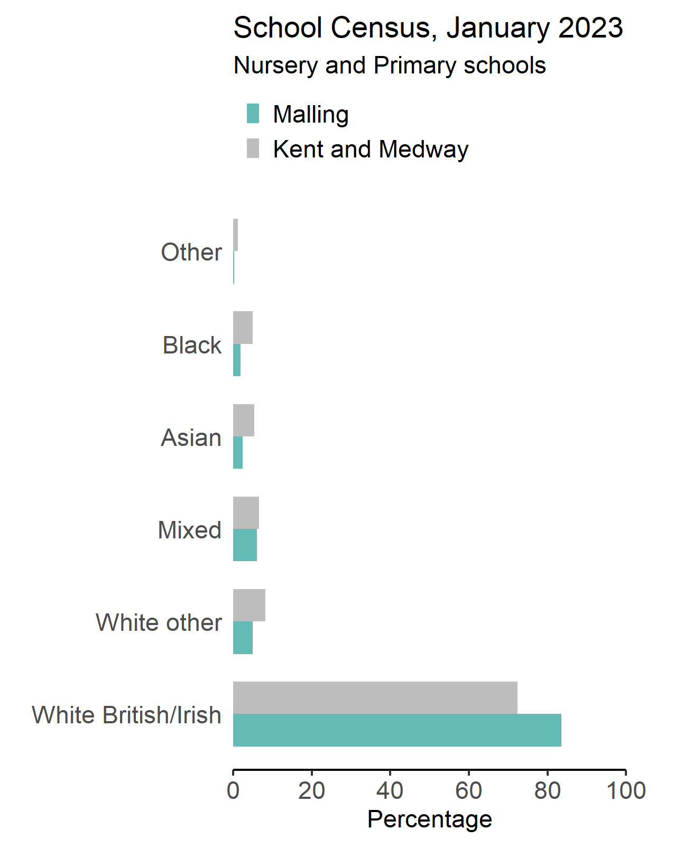
School ethnicity
18
Version 4.1 © Medway Council, Public Health Intelligence Team, 13/06/2024
English as first language:
- 94.6% of pupils in Malling.
- 86% of pupils in Kent and Medway.
Other than English as first language:
- 5.4% of pupils in Malling.
- 13.8% of pupils in Kent and Medway.
School Census source: GOV.UK. Department for Education. (2023). Schools, pupils and their characteristics: January 2023.

Slide 19
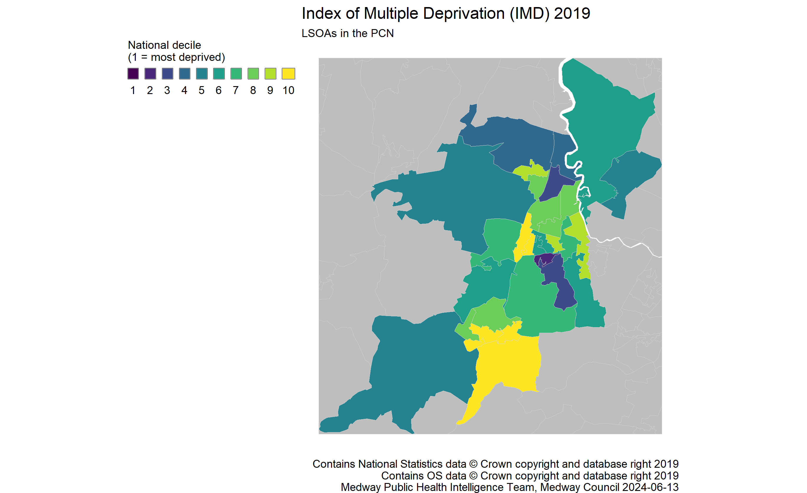
Deprivation
19
Version 4.1 © Medway Council, Public Health Intelligence Team, 13/06/2024
Source: GOV.UK. Ministry of Housing, Communities & Local Government. English Indices of Deprivation 2019.

Slide 20
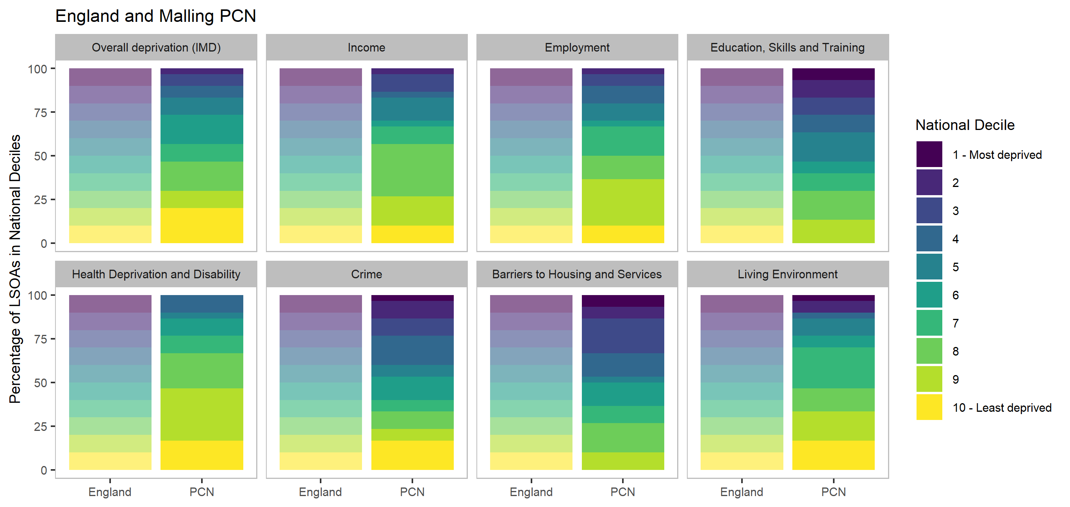
Domains of deprivation
20
Version 4.1 © Medway Council, Public Health Intelligence Team, 13/06/2024
Source: GOV.UK. Ministry of Housing, Communities & Local Government. English Indices of Deprivation 2019.
There are seven domains of deprivation, which combine to create the Index of Multiple Deprivation (IMD2019). Each of these domains describe different aspects of deprivation. The graphic shows the proportion of the PCN population ranked in one of 10 groups across all lower super output areas in England for each of these domains. The darker colours indicate the most deprived groups or 'deciles'.

Slide 21
Wider determinants
21
Version 4.1 © Medway Council, Public Health Intelligence Team, 13/06/2024

Slide 22
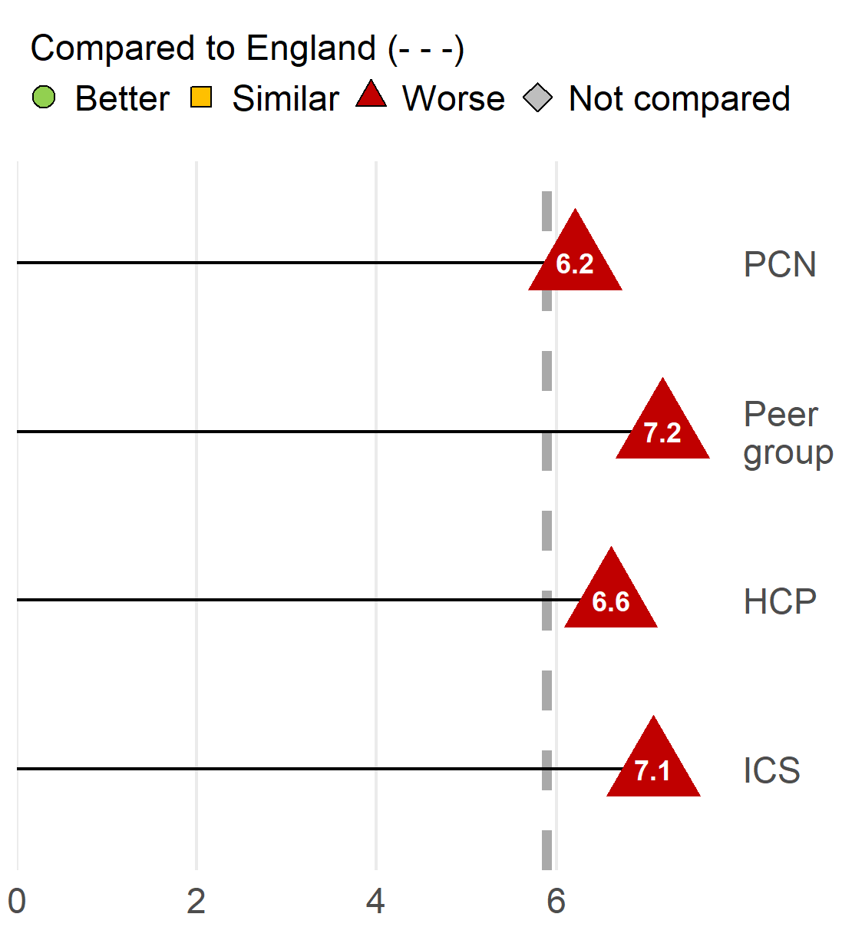
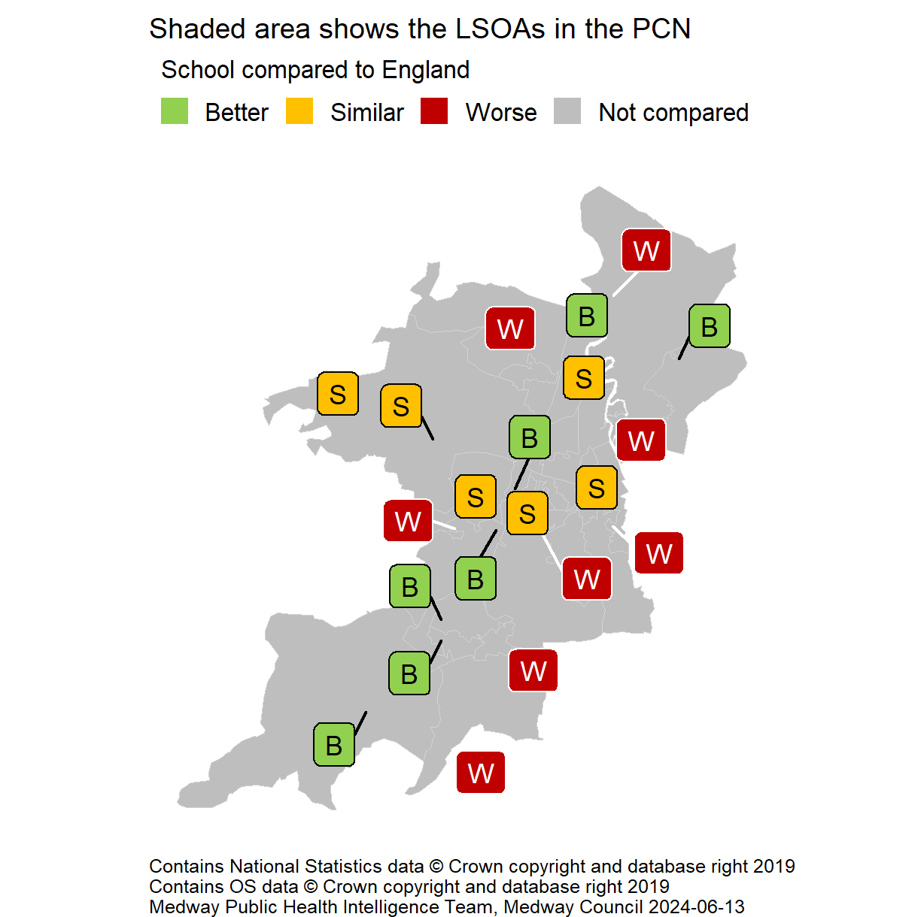
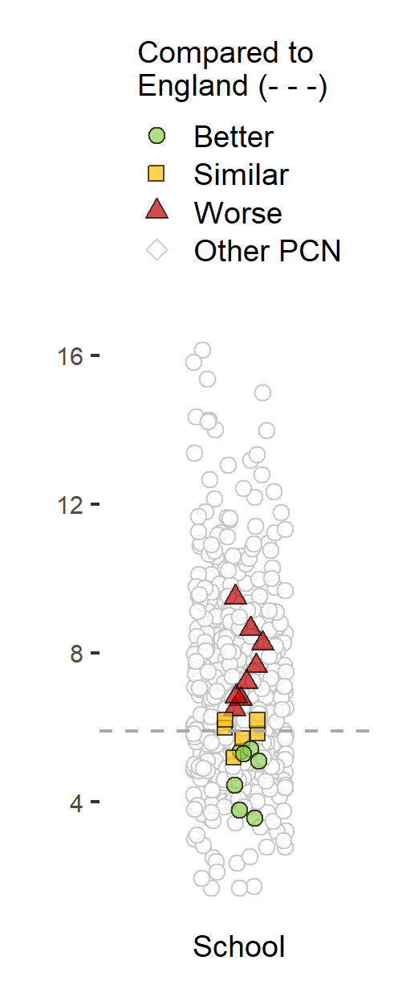
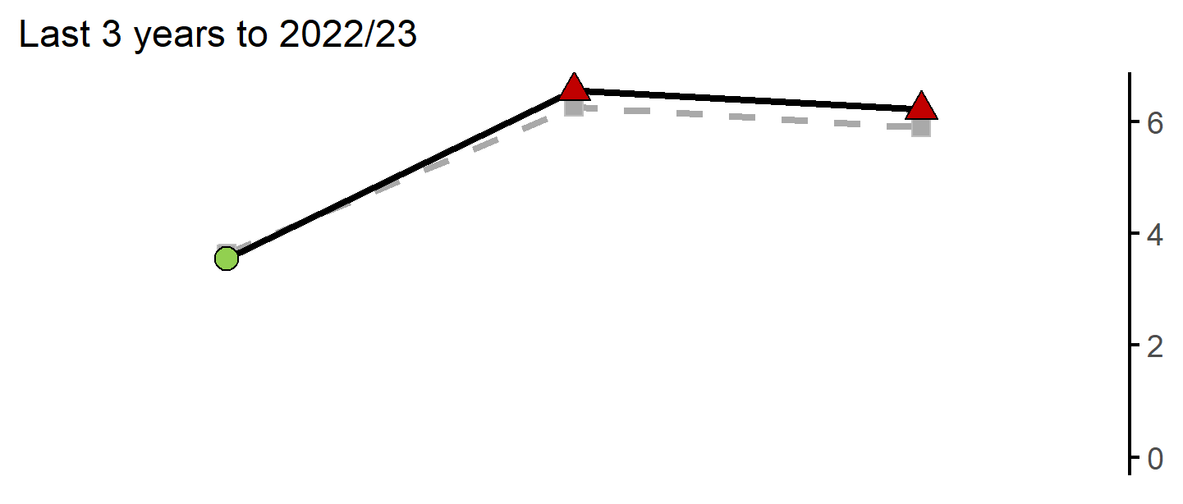
Pupil absence: State-funded primary school
22
Version 4.1 © Medway Council, Public Health Intelligence Team, 13/06/2024
The rate in Malling PCN is worse than England.
Value type: Proportion - %.
Latest time period: 2022/23.
Source: Department for Education, Pupil abscence.
Value calculation: Aggregated data.
PCN RAG method: Confidence interval (95%) - Wilson Score method.
Small area type: State-funded primary school.

Slide 23
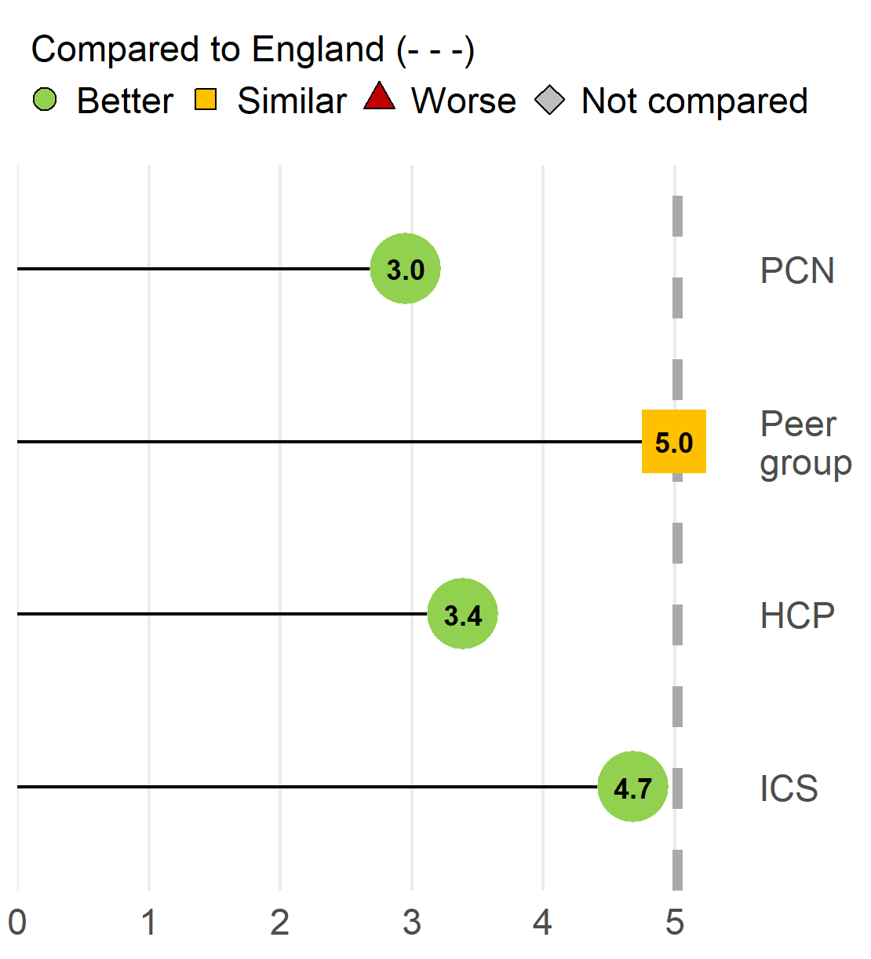
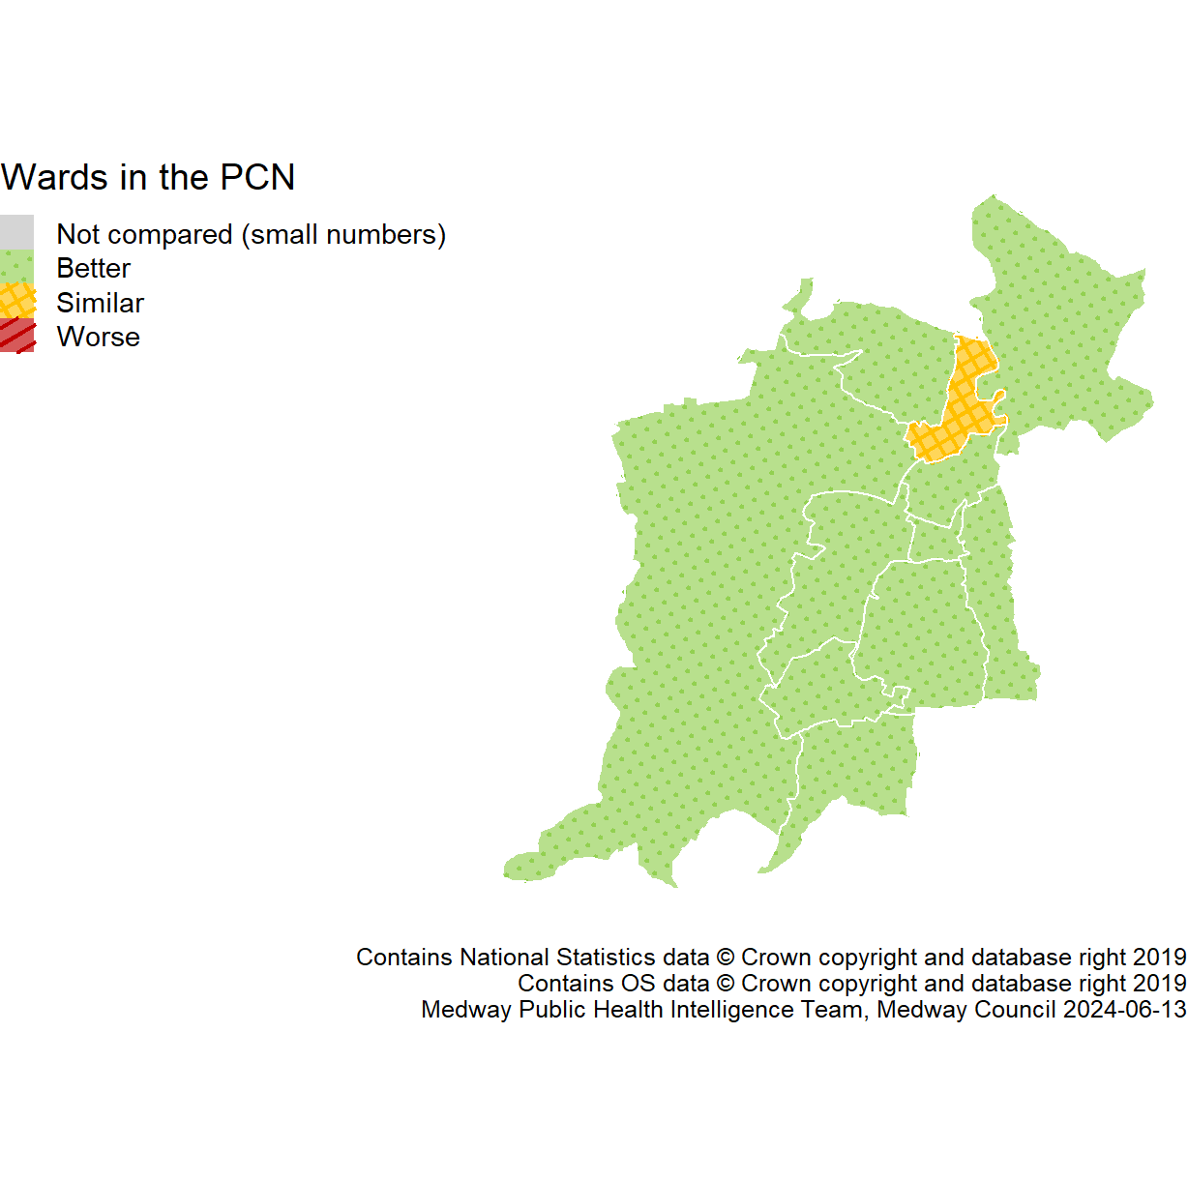
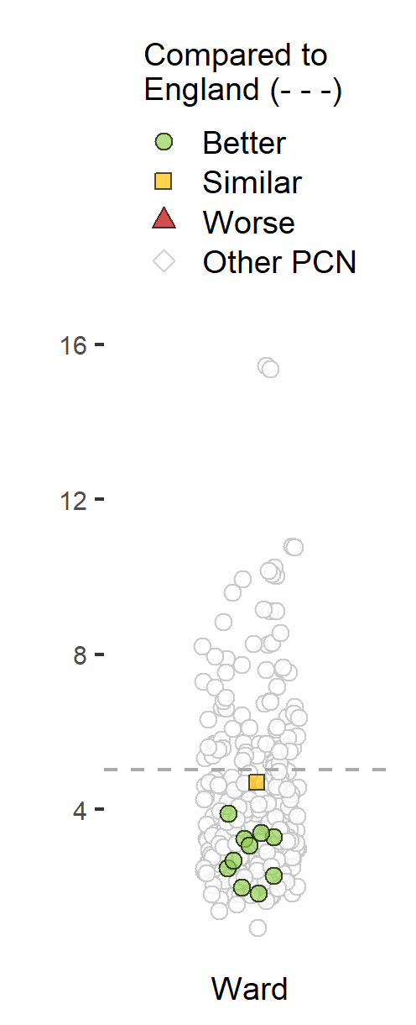
Unemployment
23
Version 4.1 © Medway Council, Public Health Intelligence Team, 13/06/2024
Trend data not available.
Unemployment: Percentage of the working age population claiming out of work benefit.
The rate in Malling PCN is better than England.
Value type: Proportion - %.
Latest time period: 2021/22.
Source: OHID, Fingertips, Indicator ID: 93097.
Value calculation: Aggregated data.
PCN RAG method: Confidence interval (95%) - Wilson Score method.
Small area type: Ward.

Slide 24
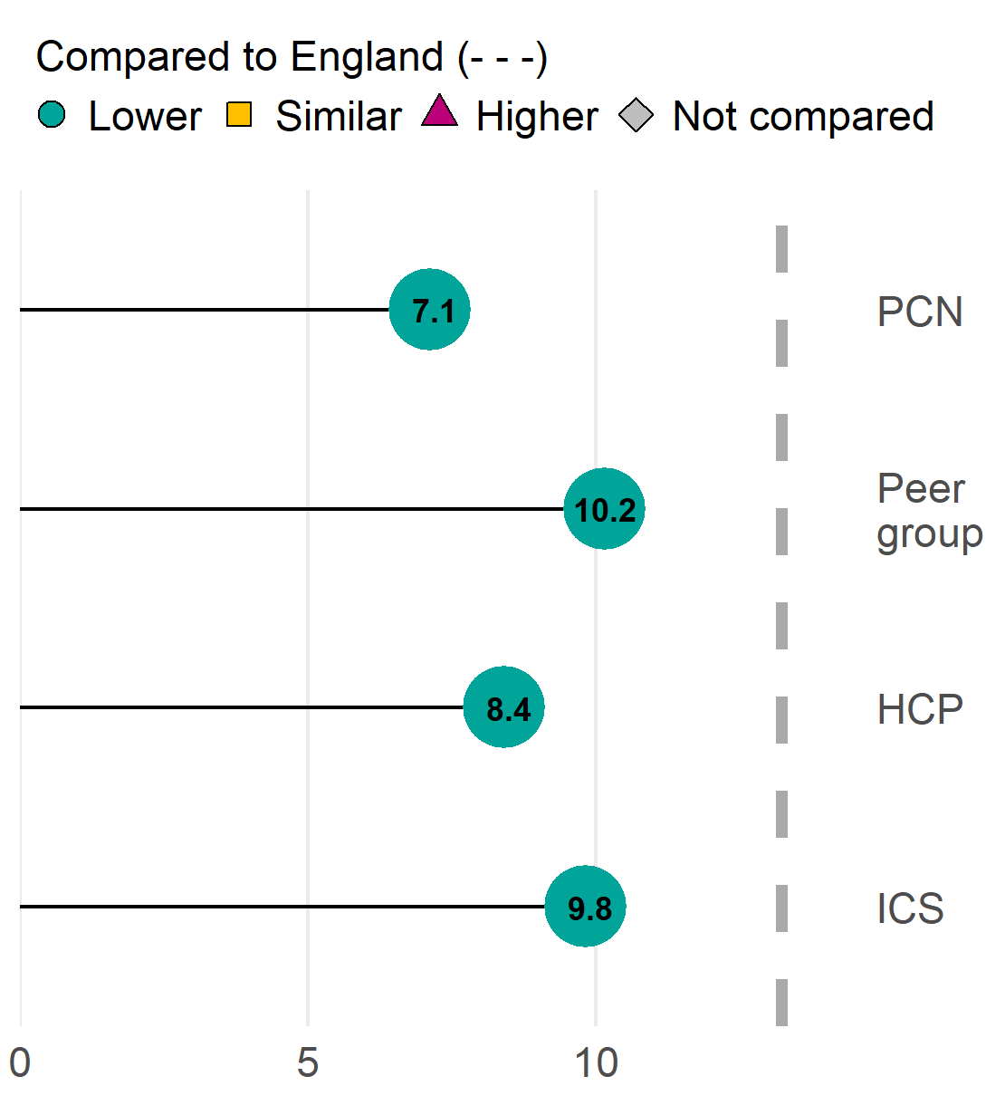
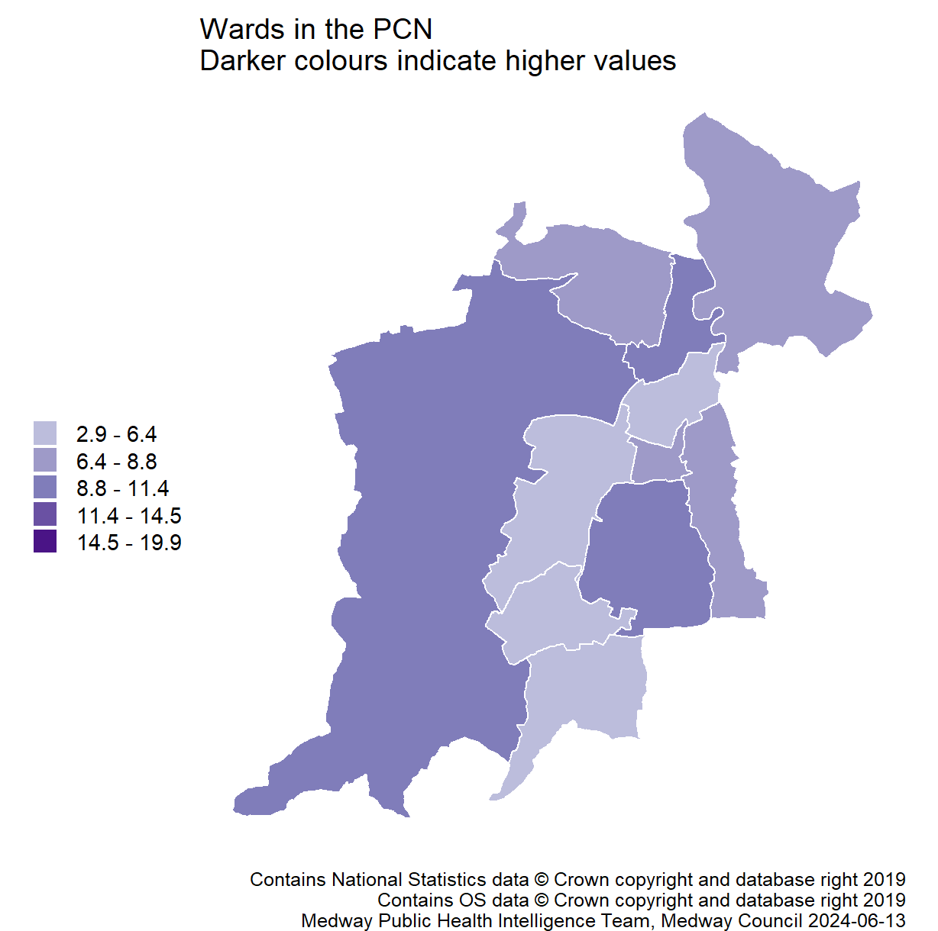
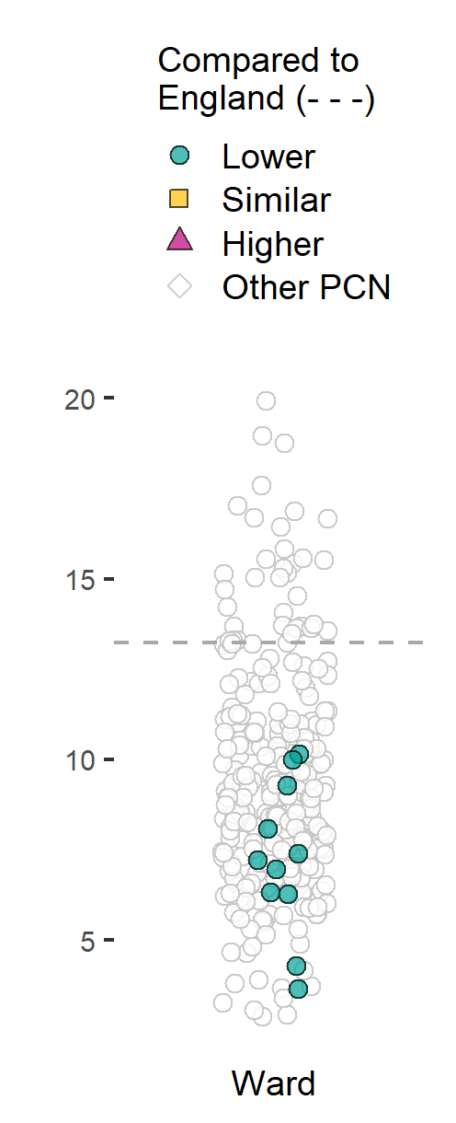
Fuel poverty
24
Version 4.1 © Medway Council, Public Health Intelligence Team, 13/06/2024
Trend data not available. A household is considered to be fuel poor if they have required fuel costs that are above average (the national median level) and, were they to spend that amount, they would be left with a residual income below the official poverty line.
This is used as a proxy indicator of need especially for those people who do not meet the usual criteria of living in a deprived area but have homes which are expensive to heat adequately.
This is a modelled estimate so cannot be compared.
The rate in Malling PCN is lower than England.
Value type: Percentage households.
Latest time period: 2020.
Source: Office for Health Improvement and Disparities. Fingertips. Indicator ID: 93280. Office for National Statistics, © Crown Copyright.
Value calculation: Aggregated data.
PCN RAG method: England plus/minus 5%.
Small area type: Ward.

Slide 25
Prevention and Health Inequalities
25
Version 4.1 © Medway Council, Public Health Intelligence Team, 13/06/2024

Slide 26
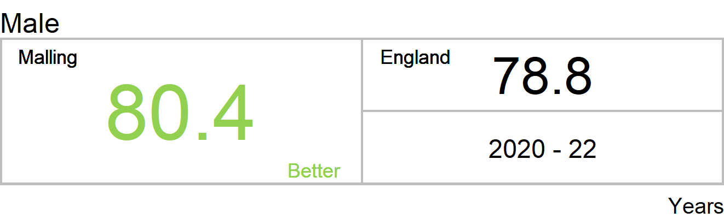
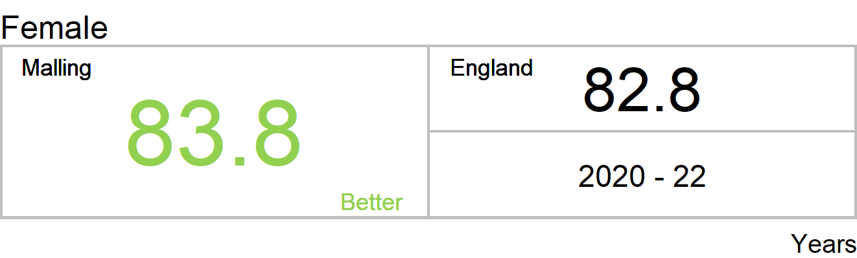
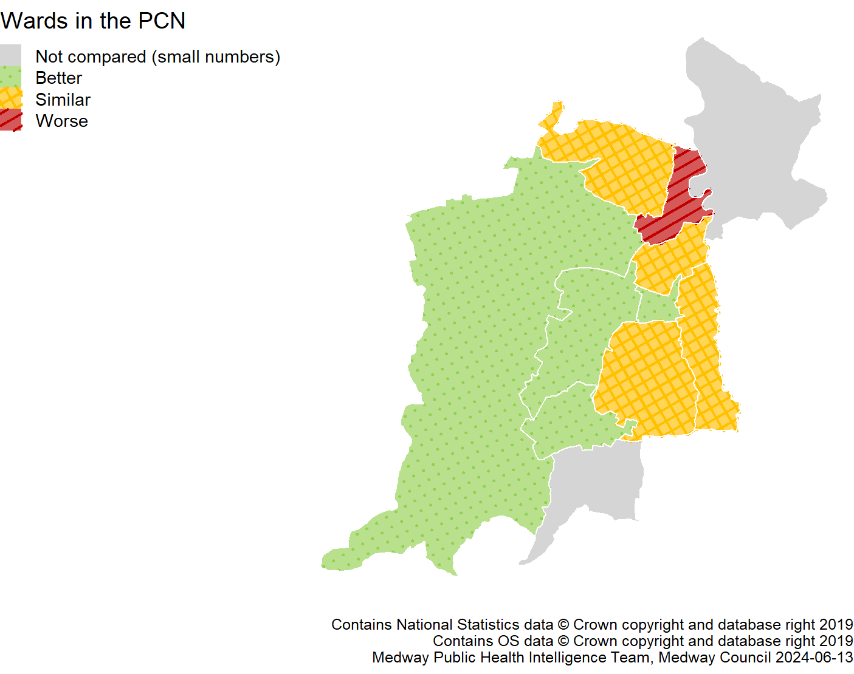
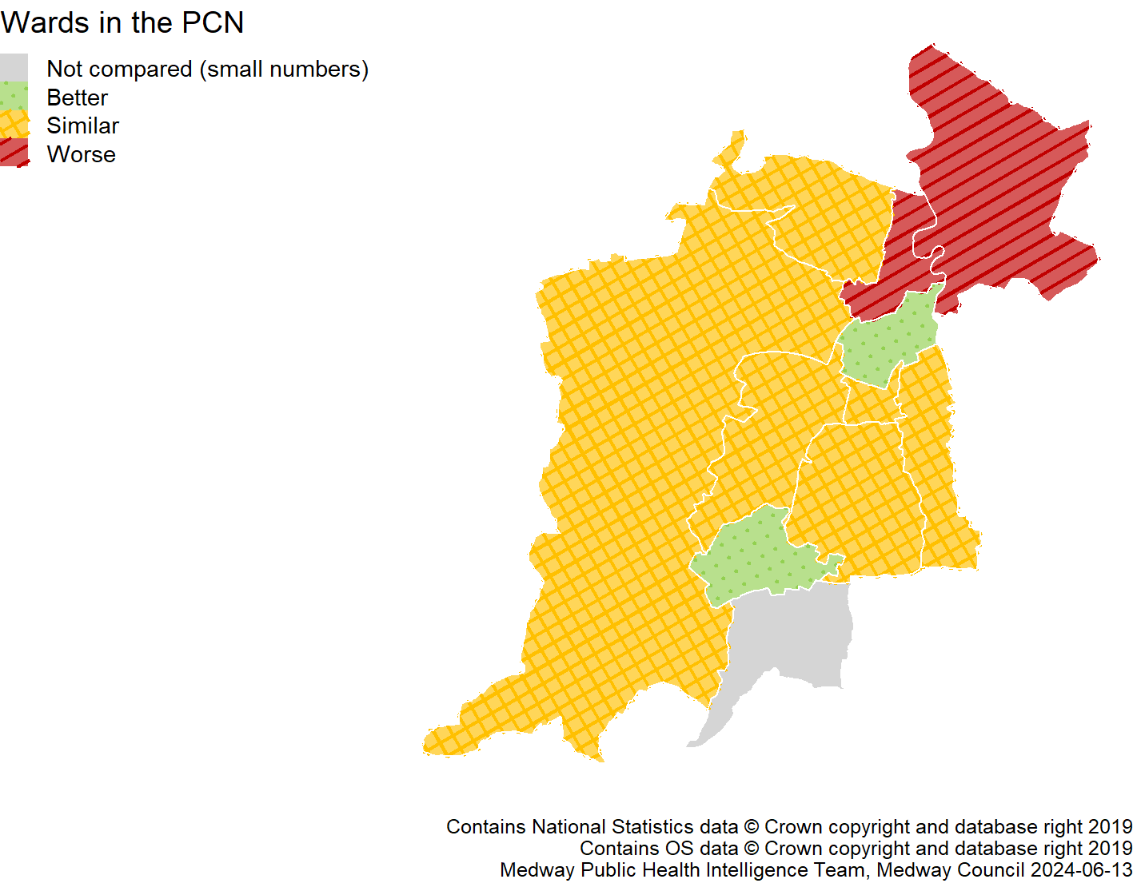
Life expectancy
26
Version 4.1 © Medway Council, Public Health Intelligence Team, 13/06/2024
The rate in Malling PCN is better than England.
Value type: Years.
Latest time period: 2020 - 22.
Source: Office for Health Improvement and Disparities. Fingertips. Indicator ID: 90366. Office for National Statistics, © Crown Copyright.
Value calculation: Aggregated data.
PCN RAG method: Confidence interval (95%) - Chiang method.
Small area type: Ward.
The rate in Malling PCN is better than England.
Value type: Years.
Latest time period: 2020 - 22.
Source: Office for Health Improvement and Disparities. Fingertips. Indicator ID: 90366. Office for National Statistics, © Crown Copyright.
Value calculation: Aggregated data.
PCN RAG method: Confidence interval (95%) - Chiang method.
Small area type: Ward.

Slide 27
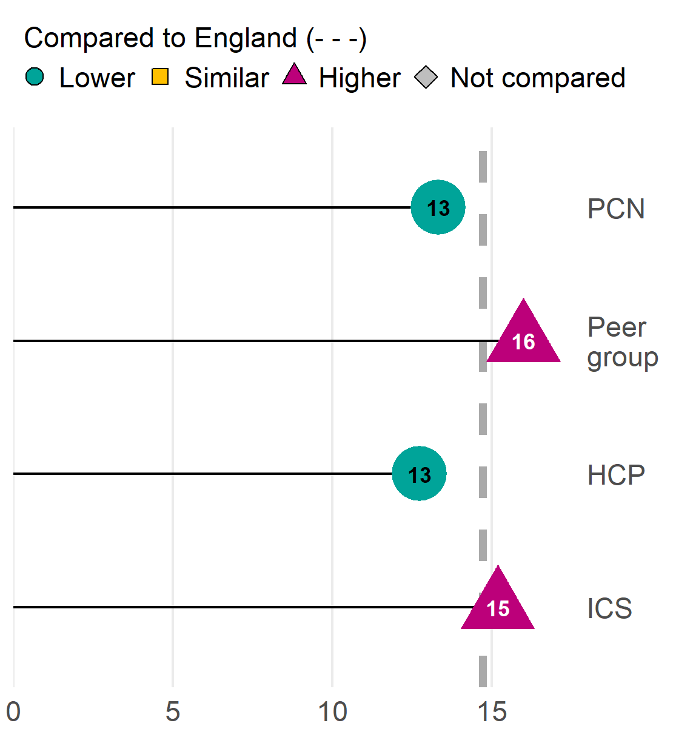
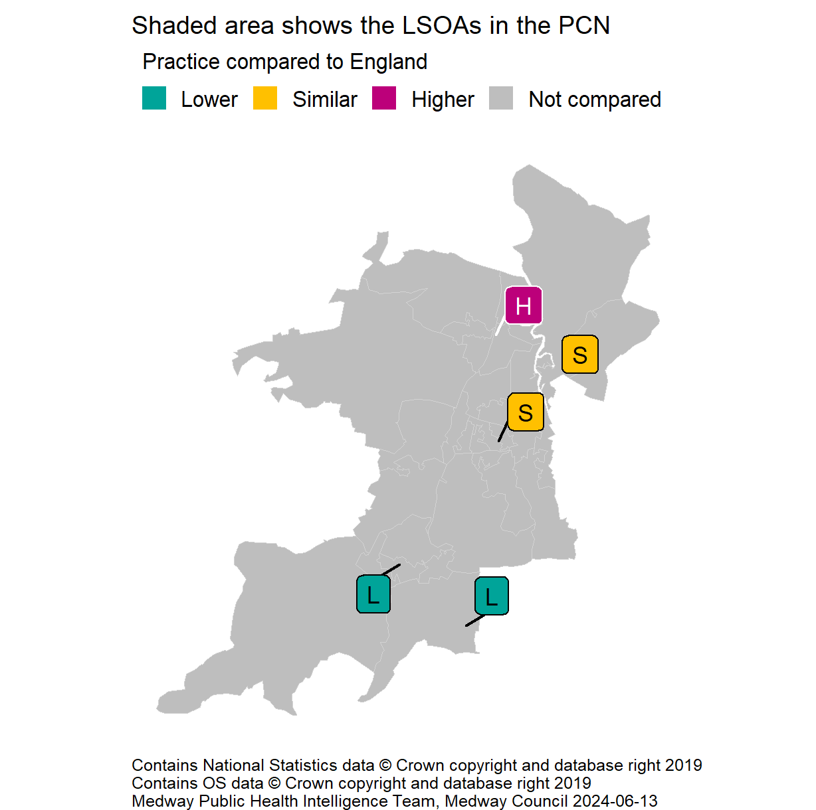
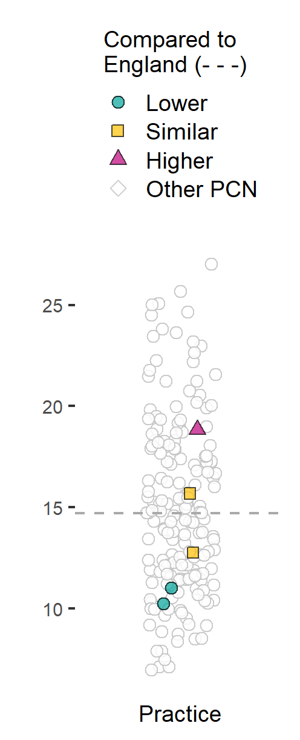
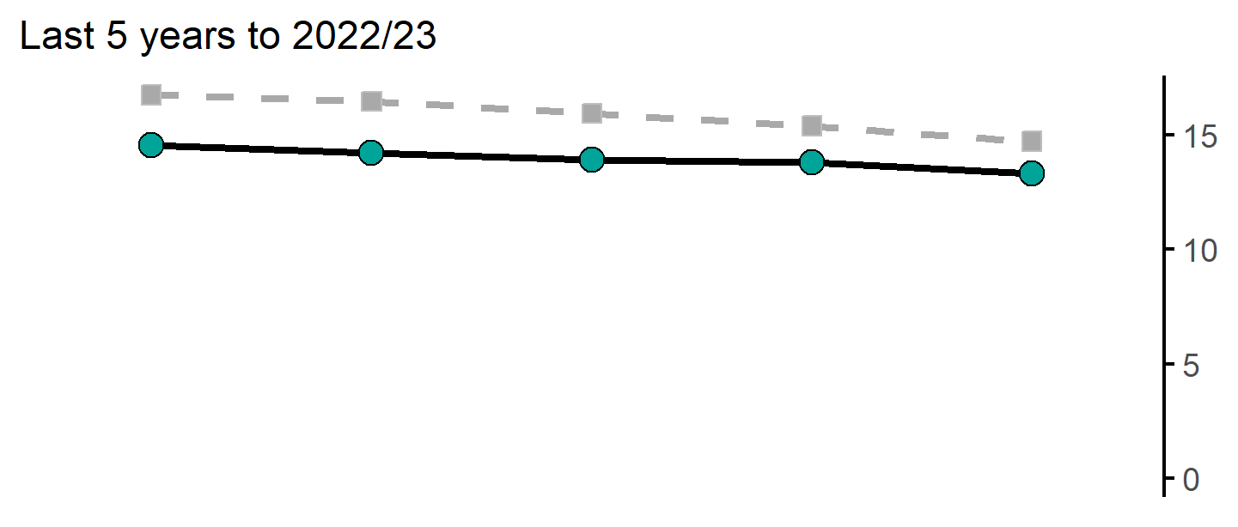
Estimated smoking prevalence (QOF)
27
Version 4.1 © Medway Council, Public Health Intelligence Team, 13/06/2024
The rate in Malling PCN is lower than England.
Value type: Proportion - %.
Latest time period: 2022/23.
Source: Office for Health Improvement and Disparities, Fingertips, Indicator ID: 91280.
Value calculation: Aggregated data.
PCN RAG method: Confidence interval (99.8%) - Byar's method.
Small area type: Practice.
QOF recorded smoking prevalence is thought to underestimate actual smoking prevalence.

Slide 28
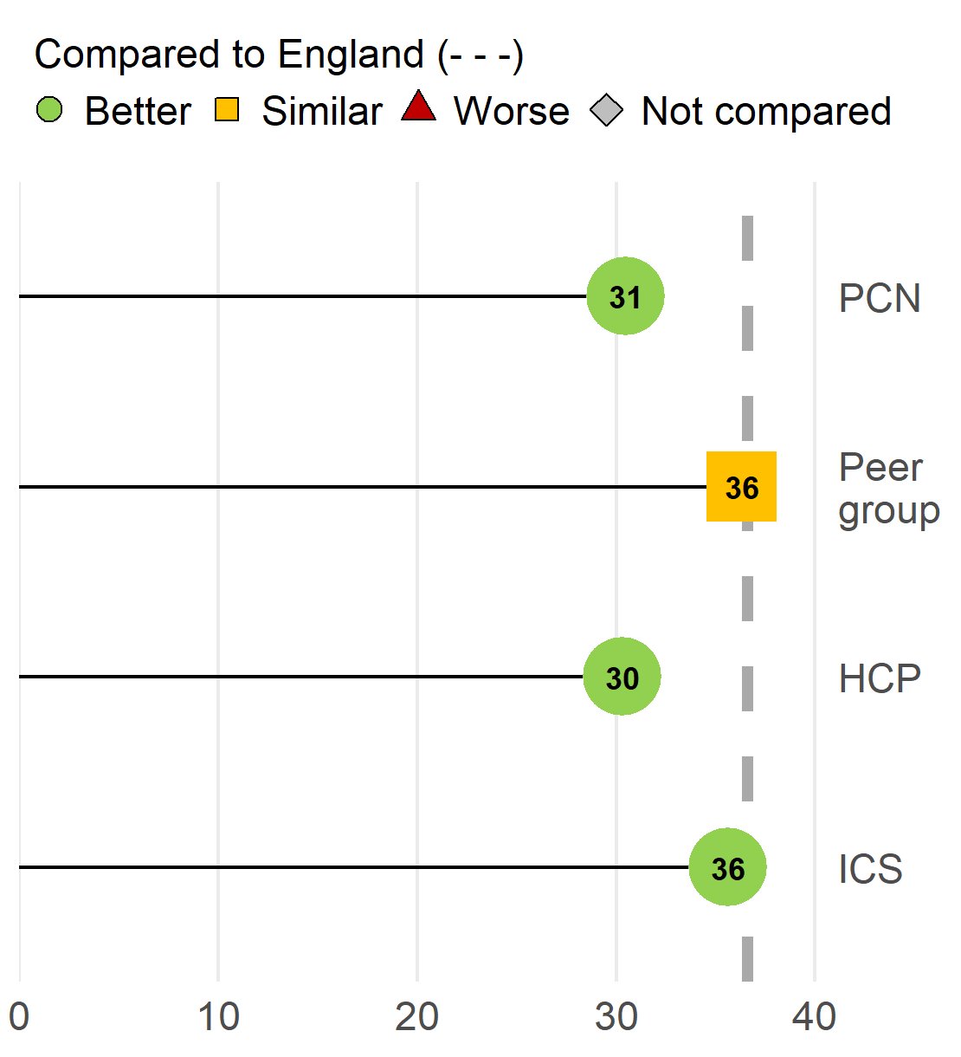
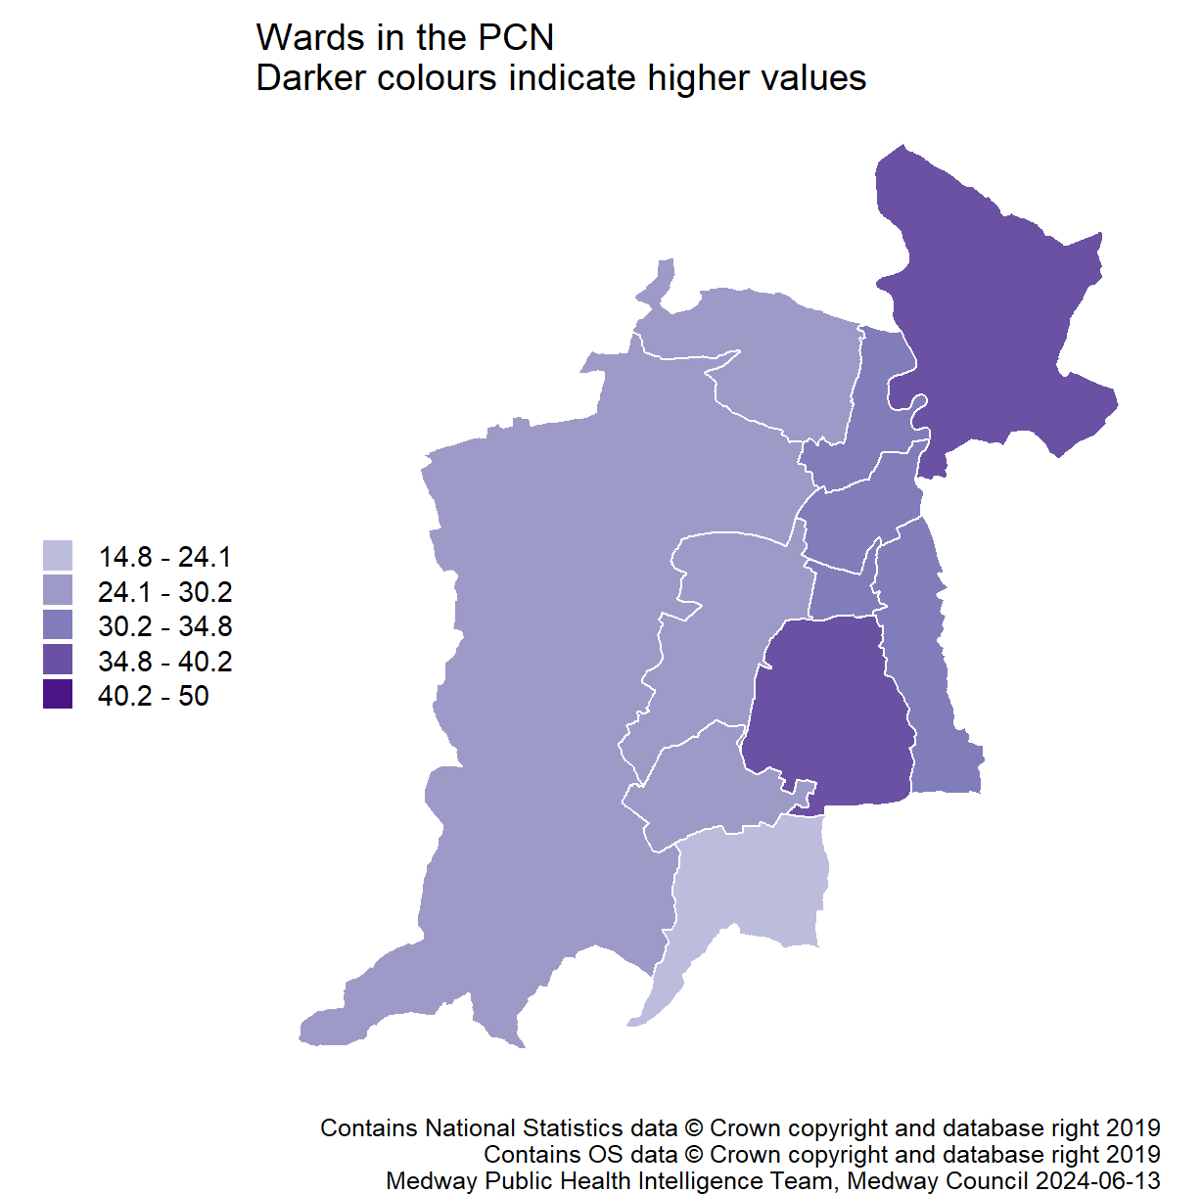
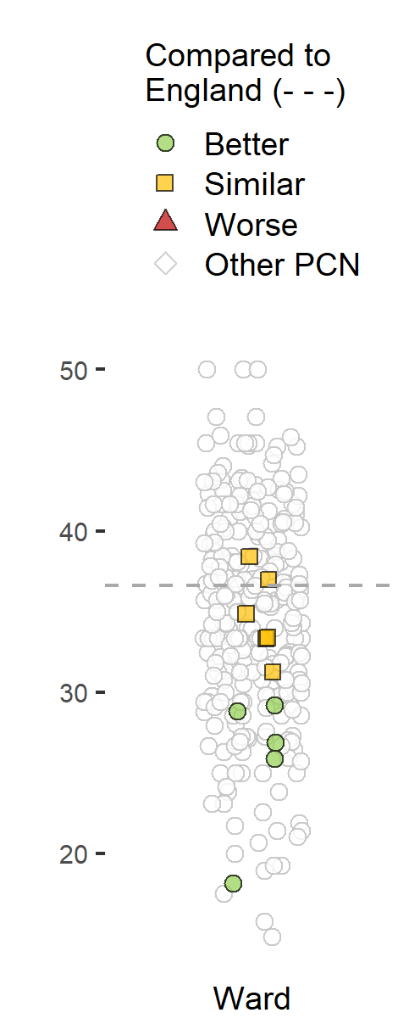
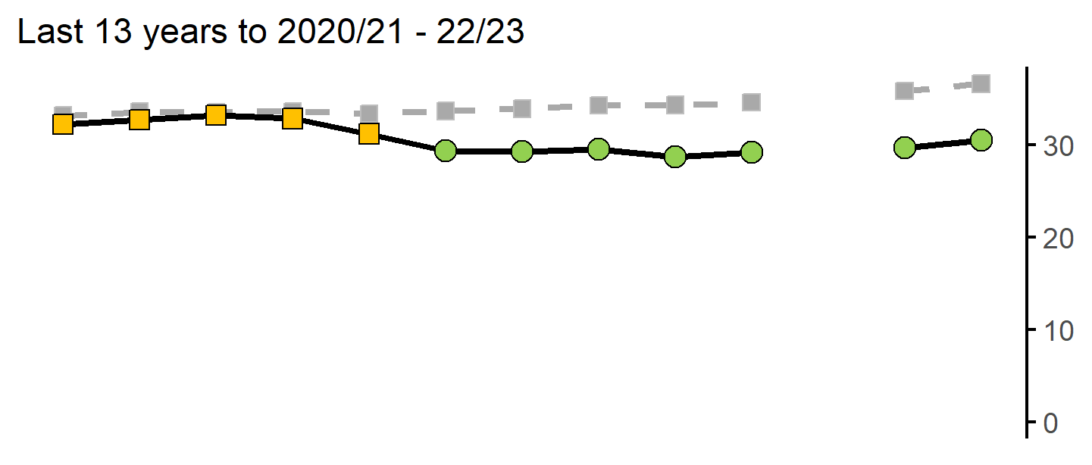
Year 6: Prevalence of overweight (including obesity)
28
Version 4.1 © Medway Council, Public Health Intelligence Team, 13/06/2024
The rate in Malling PCN is better than England.
Value type: Proportion - %.
Latest time period: 2020/21 - 22/23.
Source: Office for Health Improvement and Disparities. Fingertips. Indicator ID: 93108. NHS Digital.
Value calculation: Aggregated data.
PCN RAG method: Confidence interval (95%) - Wilson Score method.
Small area type: Ward.

Slide 29
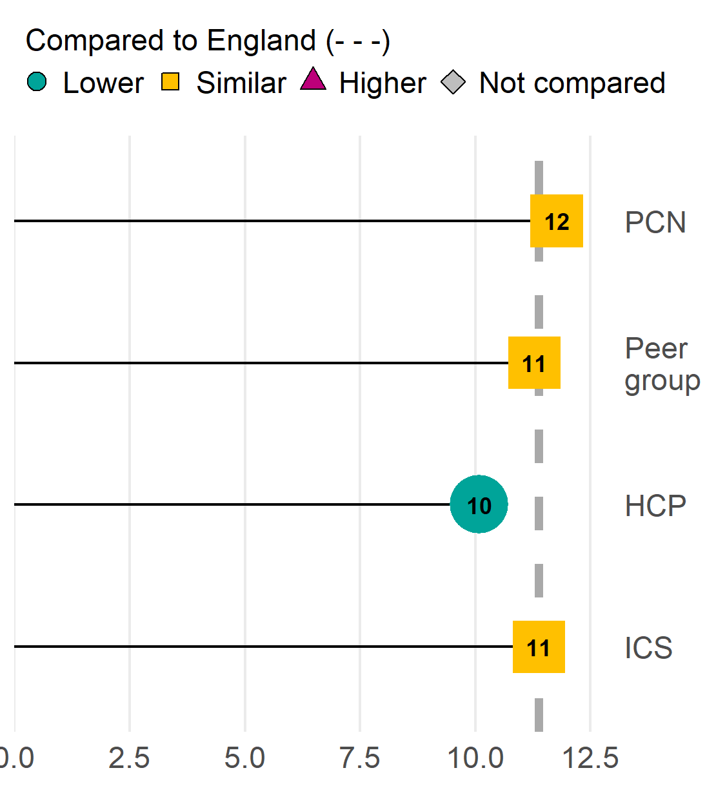
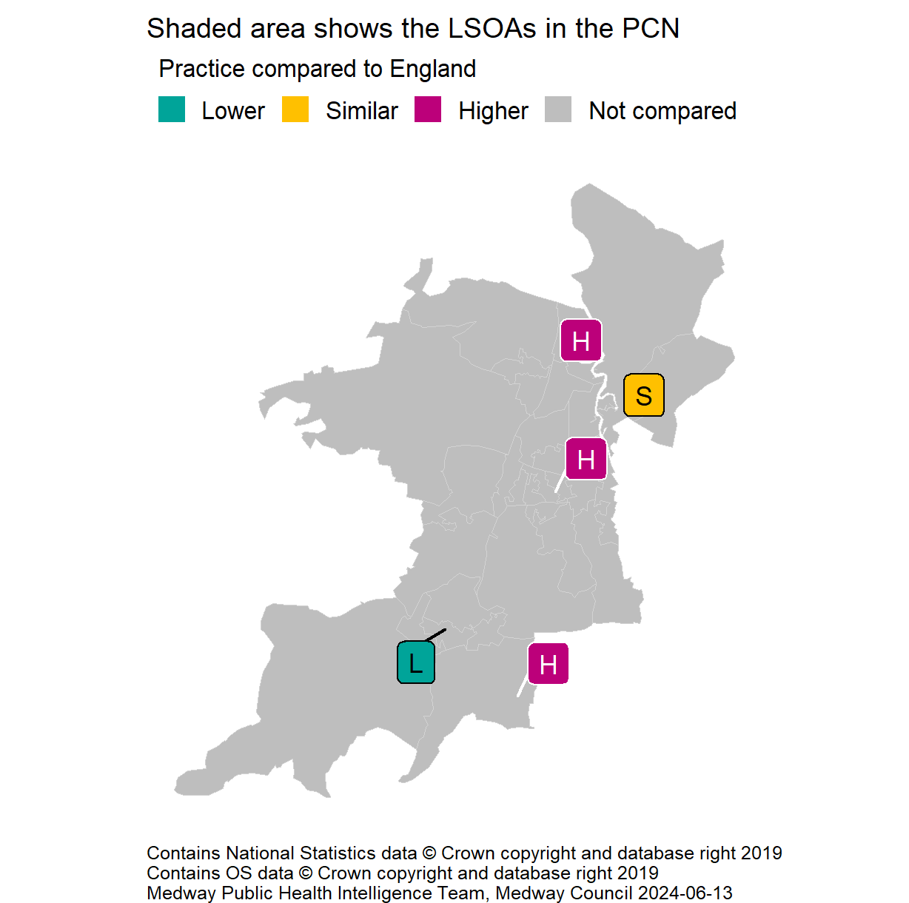
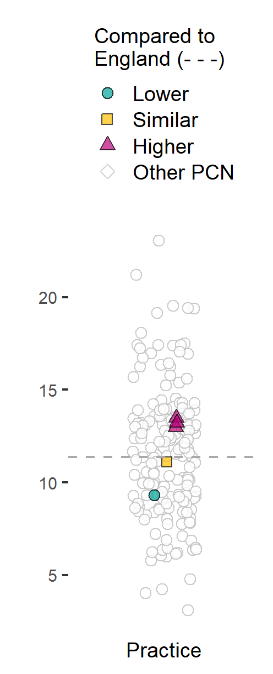
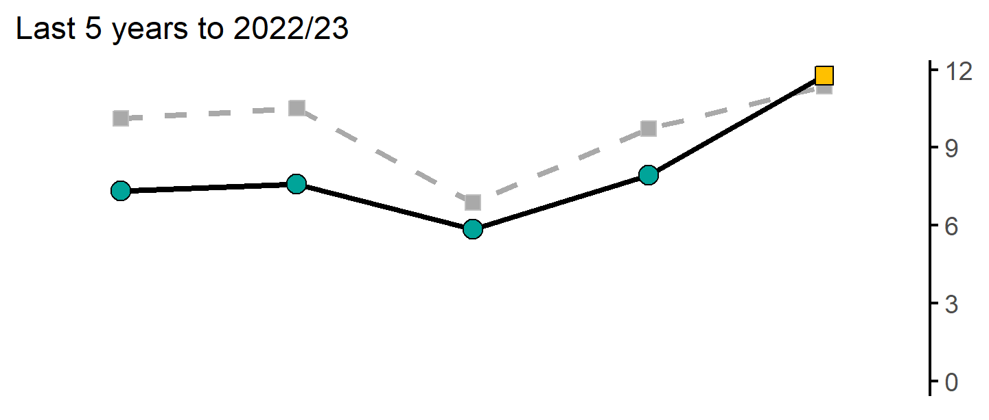
Estimated obesity prevalence (QOF)
29
Version 4.1 © Medway Council, Public Health Intelligence Team, 13/06/2024
The rate in Malling PCN is similar to England.
Value type: Proportion - %.
Latest time period: 2022/23.
Source: Office for Health Improvement and Disparities, Fingertips, Indicator ID: 92588.
Value calculation: Aggregated data.
PCN RAG method: Confidence interval (99.8%) - Wilson Score method.
Small area type: Practice.
QOF recorded obesity prevalence is thought to underestimate actual obesity prevalence.

Slide 30
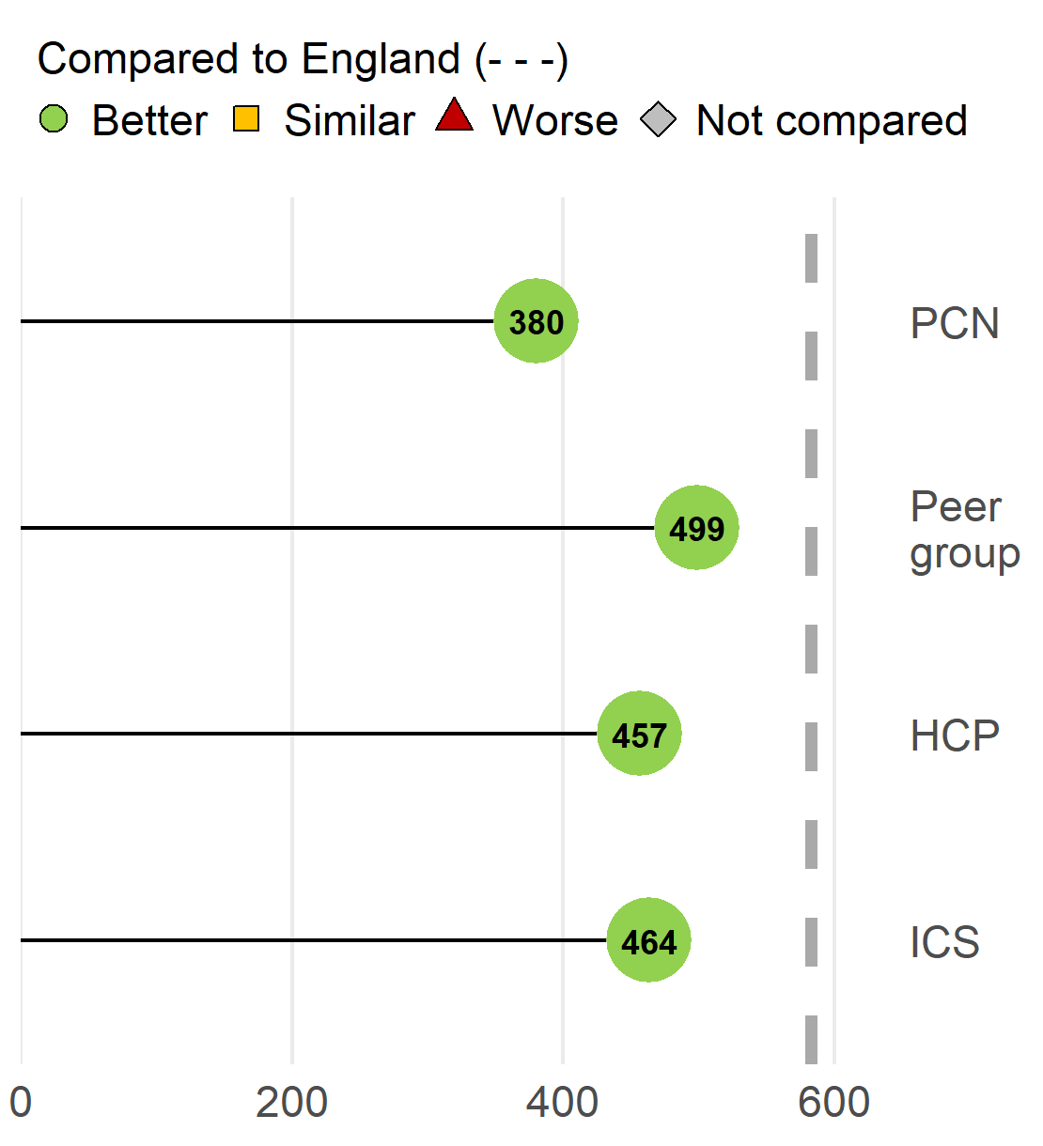
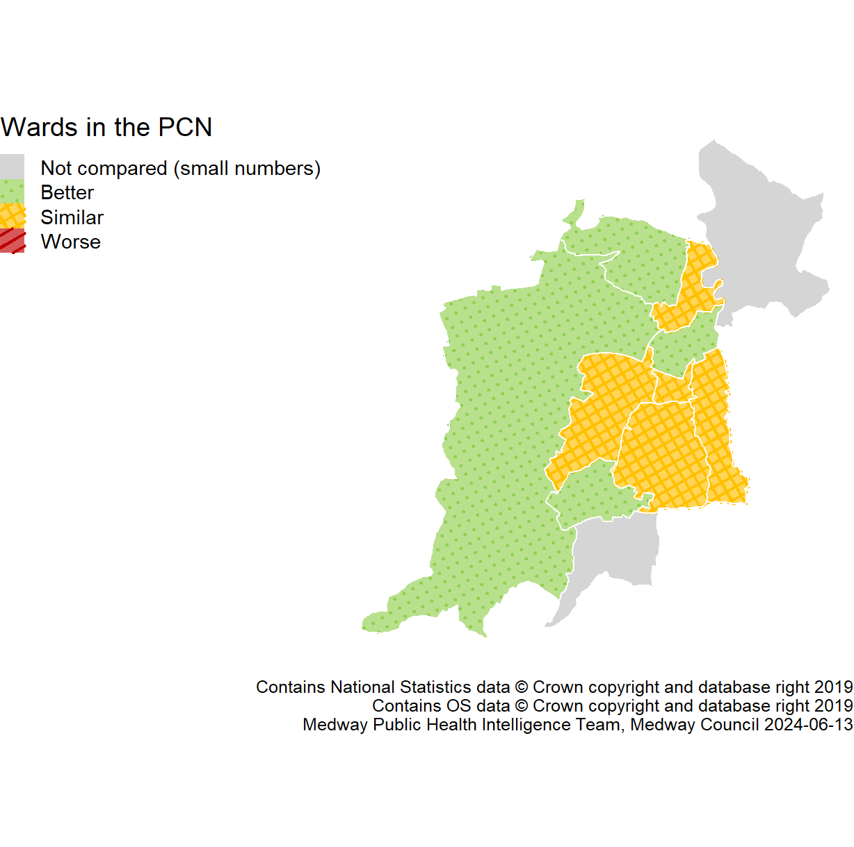
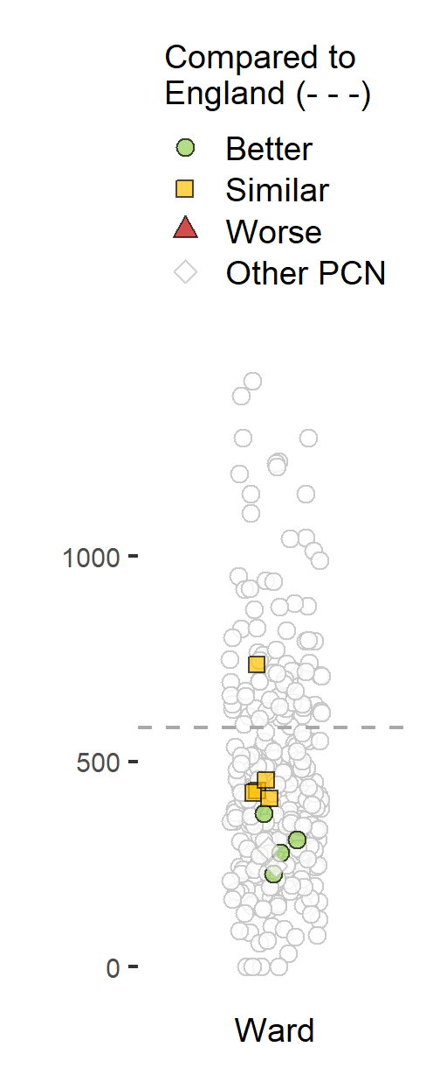
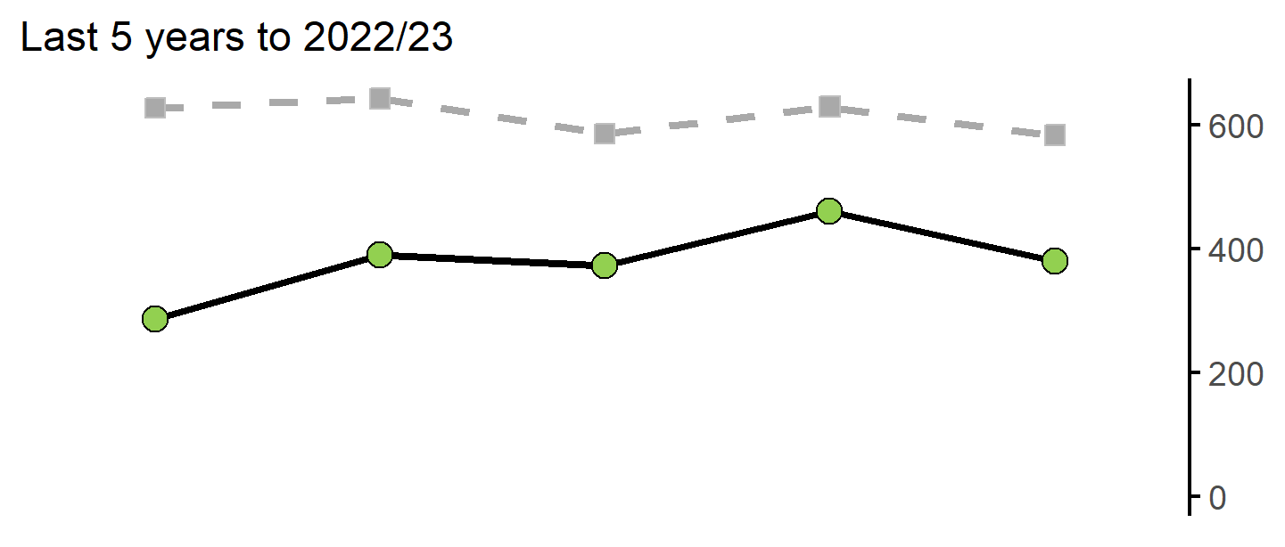
Admission episodes for alcohol-specific conditions
30
Version 4.1 © Medway Council, Public Health Intelligence Team, 13/06/2024
The rate in Malling PCN is better than England.
Value type: Directly standardised rate per 100,000.
Latest time period: 2022/23.
Source: Hospital Episode Statistics (HES), NHS Digital.
Value calculation: Aggregated data.
PCN RAG method: Confidence interval (95%) - Dobson's method.
Small area type: LSOA.

Slide 31
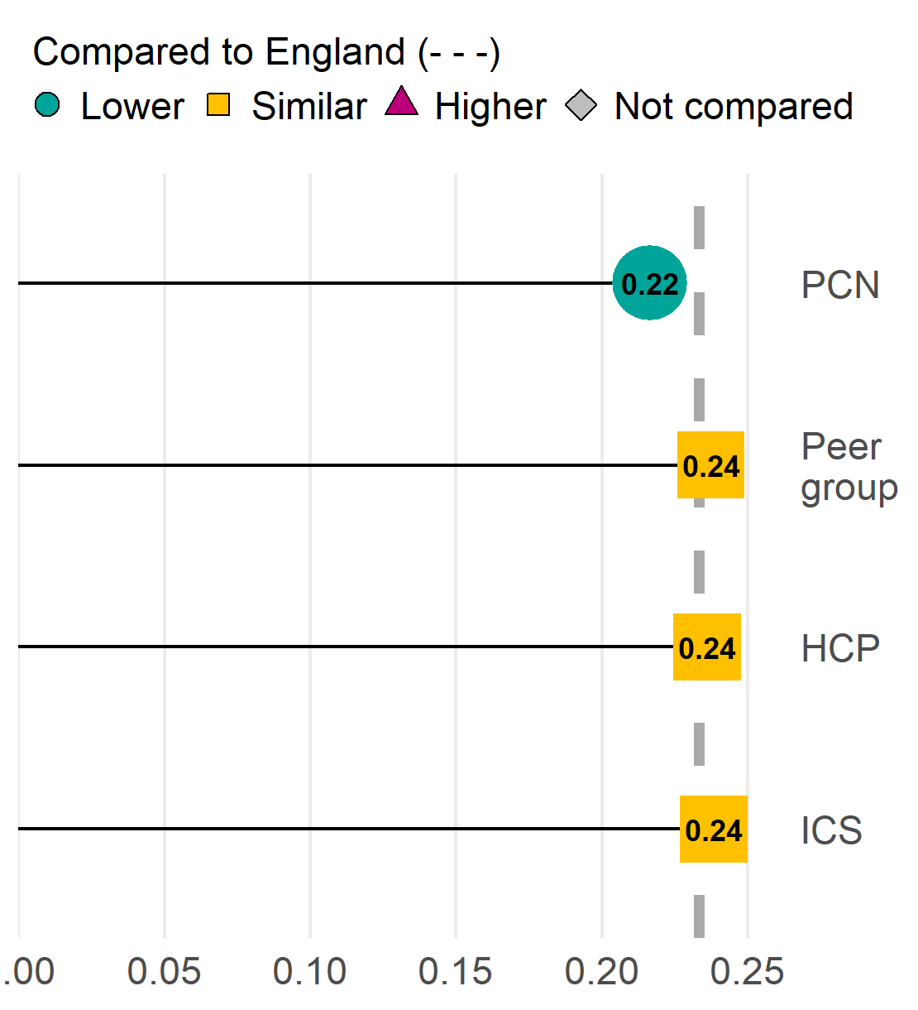
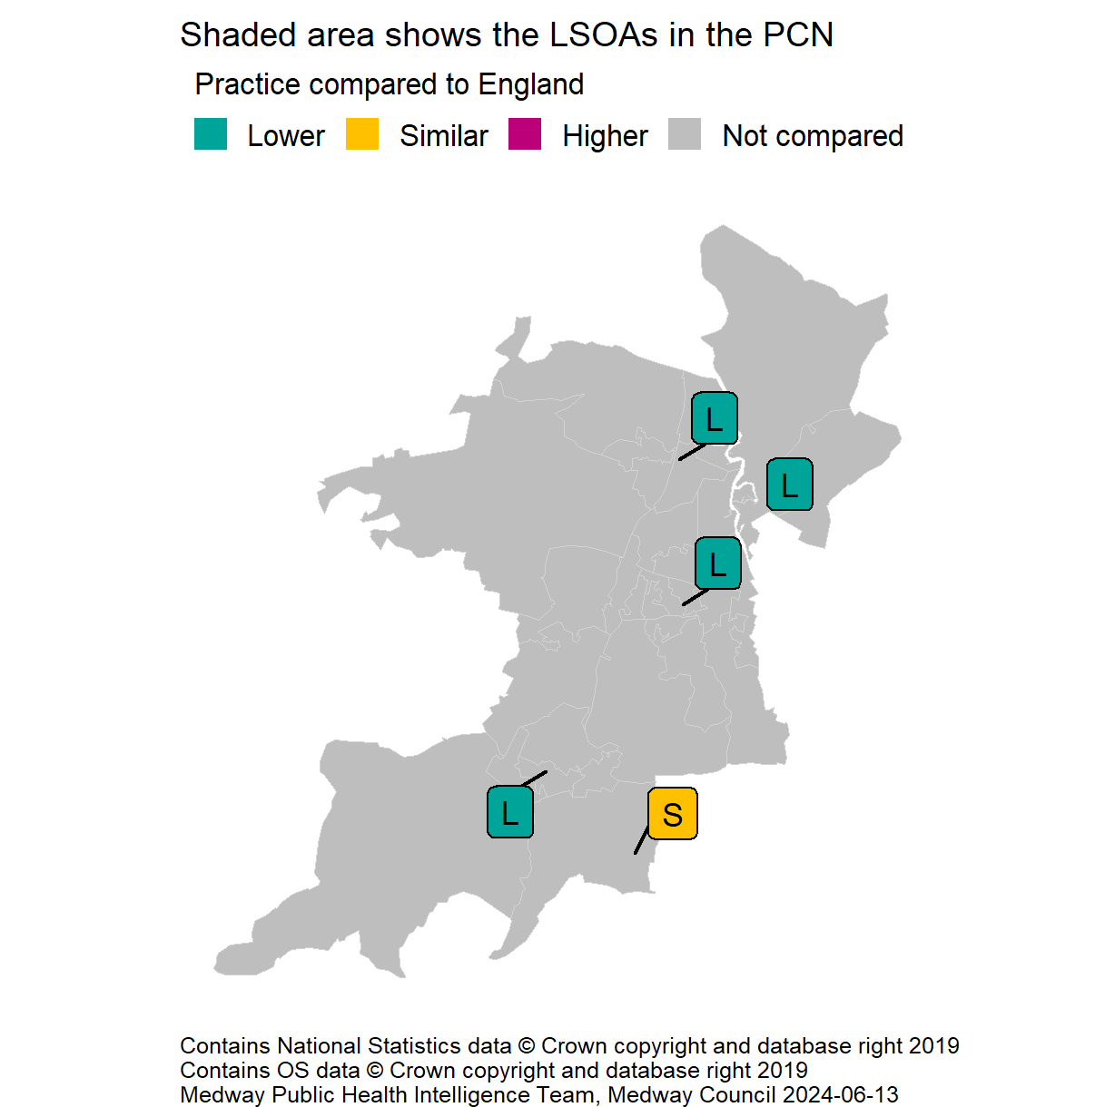
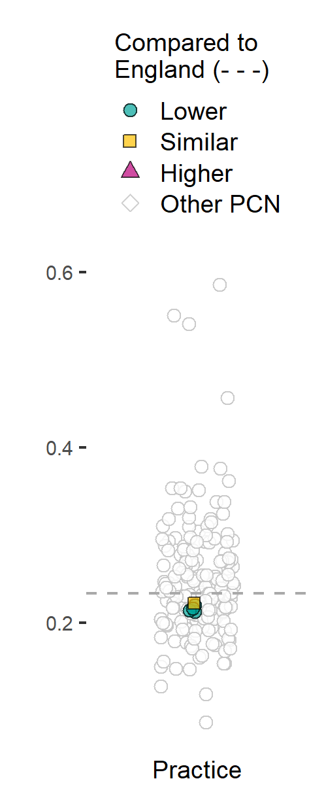
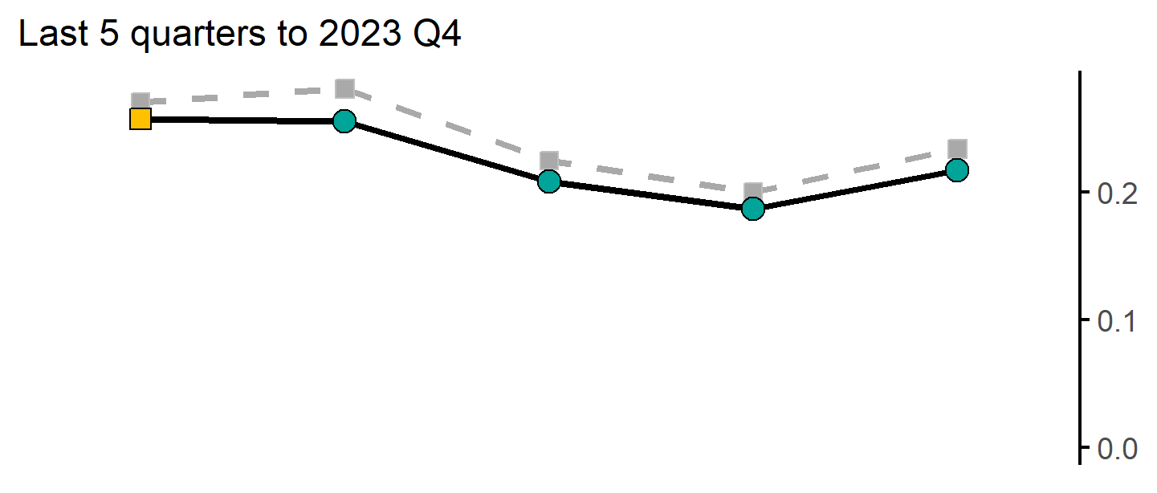
Total number of prescribed antibiotic items per STAR-PU
31
Version 4.1 © Medway Council, Public Health Intelligence Team, 13/06/2024
The rate in Malling PCN is lower than England.
Value type: Indirectly standardised ratio.
Latest time period: 2023 Q4.
Source: Office for Health Improvement and Disparities, Fingertips, Indicator ID: 91900. © Crown Copyright.
Value calculation: Population weighted average.
PCN RAG method: England plus/minus 5%.
Small area type: Practice.

Slide 32
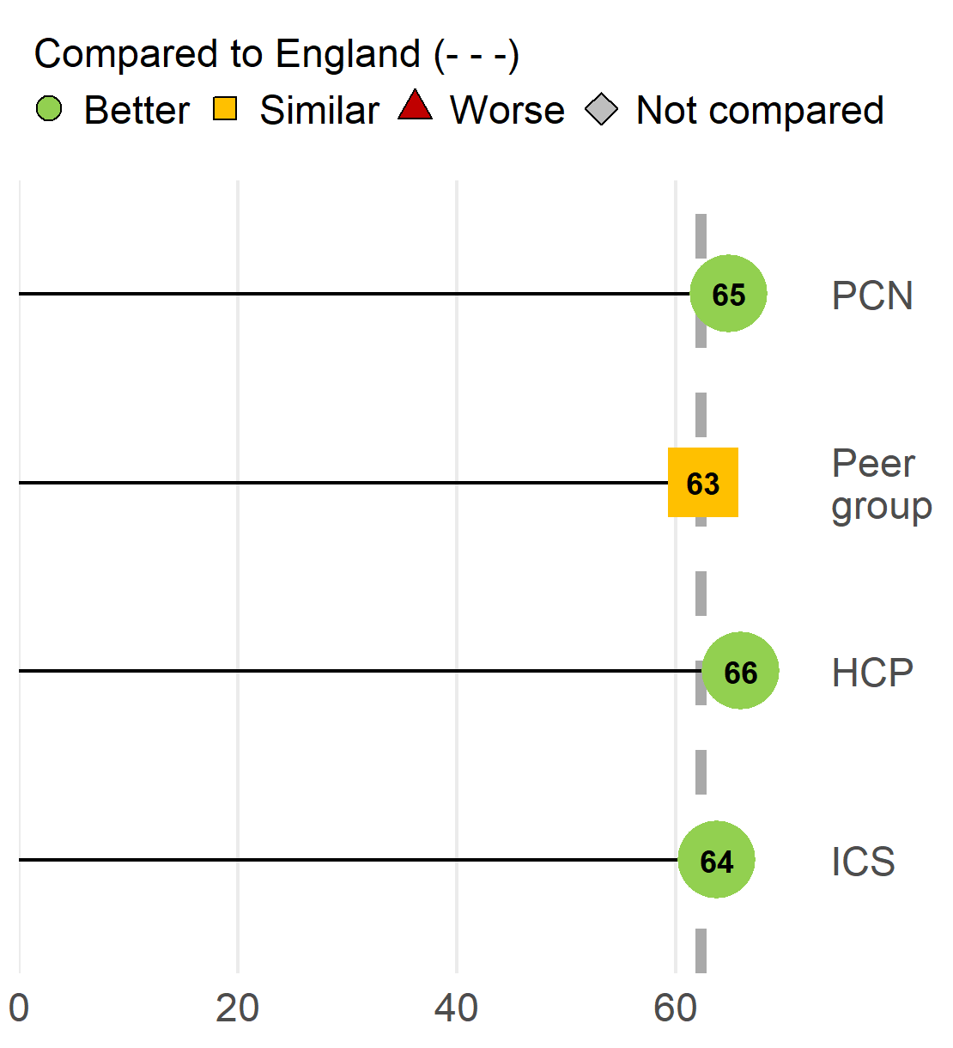
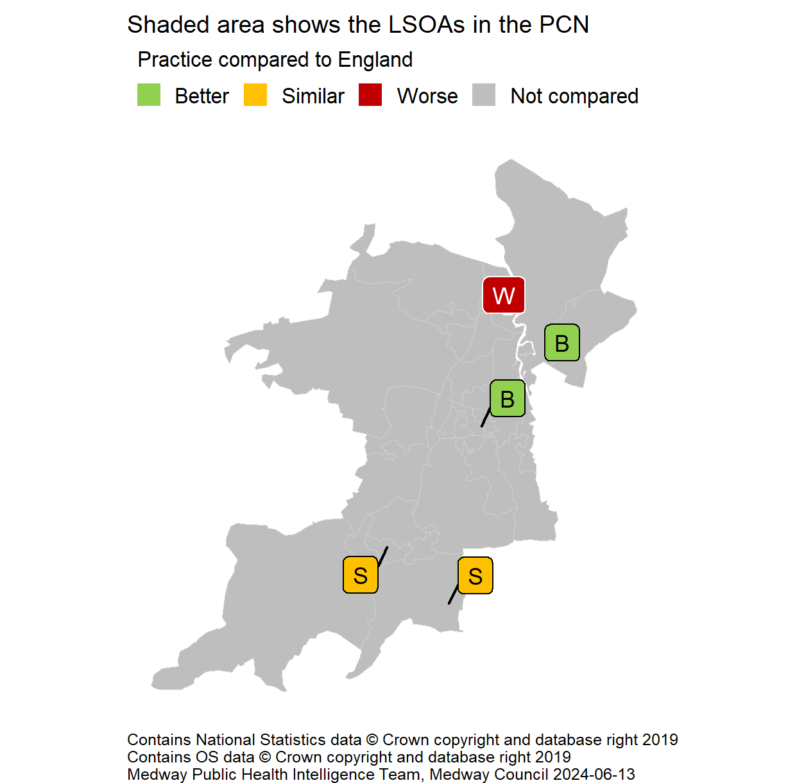
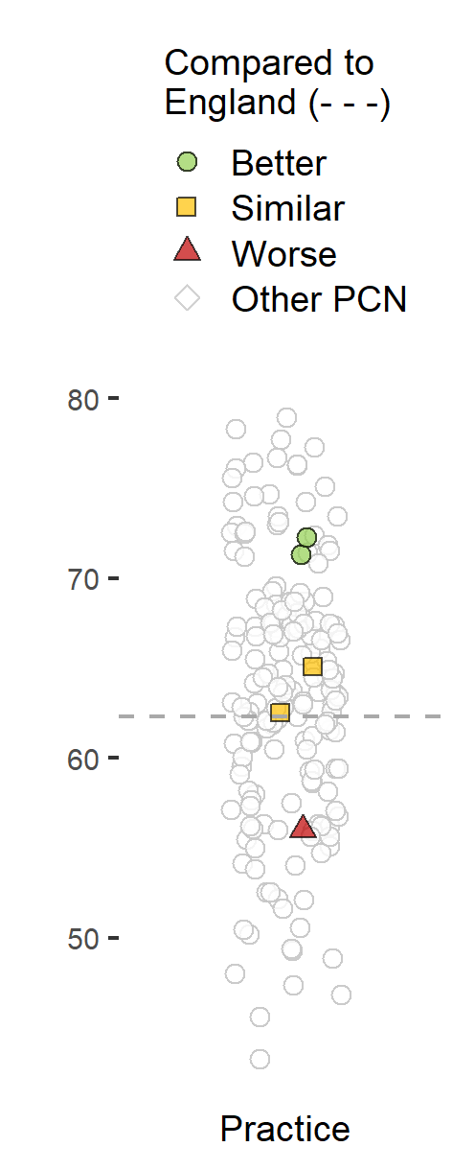
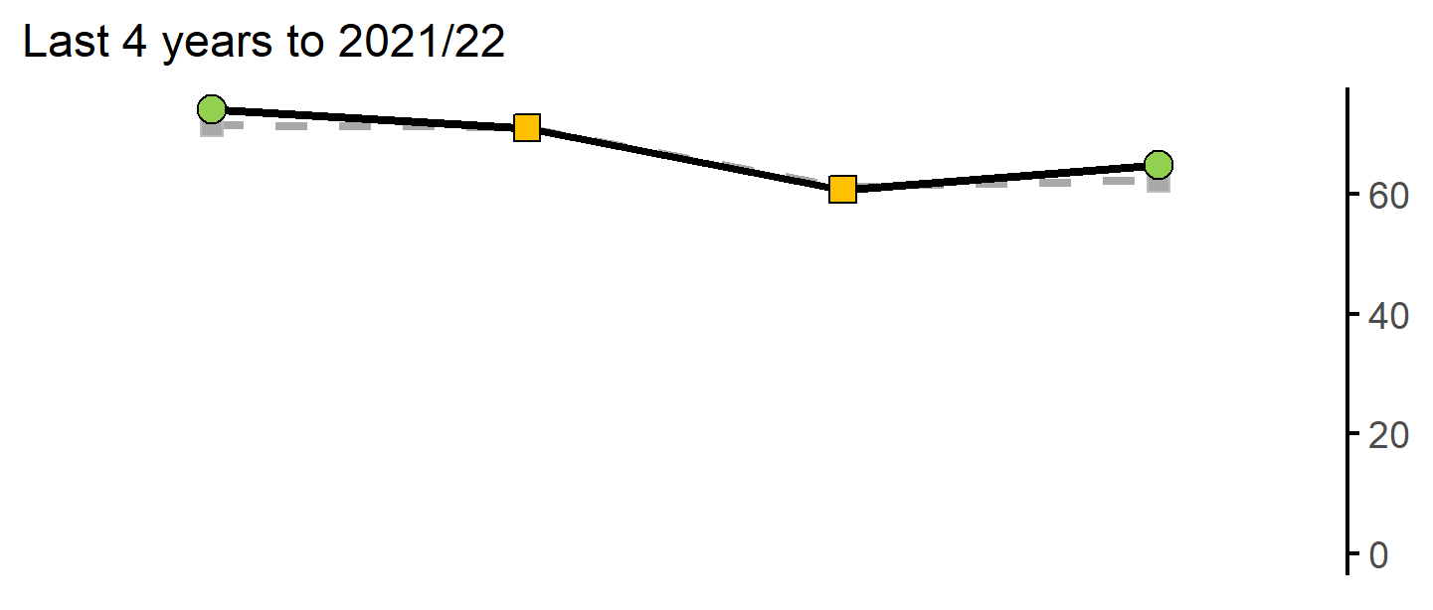
Breast cancer screening coverage (females aged 50-70)
32
Version 4.1 © Medway Council, Public Health Intelligence Team, 13/06/2024
The rate in Malling PCN is better than England.
Value type: Proportion - %.
Latest time period: 2021/22.
Source: Office for Health Improvement and Disparities. Fingertips. Indicator ID: 91339.
Value calculation: Aggregated data.
PCN RAG method: Confidence interval (99.8%) - Wilson Score method.
Small area type: Practice.

Slide 33




Cervical cancer screening coverage (females aged 25-49)
33
Version 4.1 © Medway Council, Public Health Intelligence Team, 13/06/2024
The rate in Malling PCN is better than England.
Value type: Proportion - %.
Latest time period: 2022/23.
Source: Office for Health Improvement and Disparities. Fingertips. Indicator ID: 93725.
Value calculation: Aggregated data.
PCN RAG method: Confidence interval (99.8%) - Wilson Score method.
Small area type: Practice.

Slide 34




Bowel cancer screening coverage (persons aged 60-74)
34
Version 4.1 © Medway Council, Public Health Intelligence Team, 13/06/2024
The rate in Malling PCN is better than England.
Value type: Proportion - %.
Latest time period: 2022/23.
Source: Office for Health Improvement and Disparities. Fingertips. Indicator ID: 92600.
Value calculation: Aggregated data.
PCN RAG method: Confidence interval (99.8%) - Wilson Score method.
Small area type: Practice.

Slide 35
Best start in life
35
Version 4.1 © Medway Council, Public Health Intelligence Team, 13/06/2024

Slide 36



Low birth weight of live babies, five year pooled
36
Version 4.1 © Medway Council, Public Health Intelligence Team, 13/06/2024
Trend data not available.
Definition: All live births with a recorded birth weight under 2500g as a percentage of all live births with stated birth weight.
Low birth weight increases the risk of childhood mortality and of developmental problems for the child and is associated with poorer health in later life.
The rate in Malling PCN is better than England.
Value type: Proportion - %.
Latest time period: 2016 - 20.
Source: Office for Health Improvement and Disparities. Fingertips. Indicator ID: 93092. ONS Crown Copyright.
Value calculation: Aggregated data.
PCN RAG method: Confidence interval (95%) - Wilson Score method.
Small area type: Ward.

Slide 37




A&E attendances (0-4 years)
37
Version 4.1 © Medway Council, Public Health Intelligence Team, 13/06/2024
The rate in Malling PCN is worse than England.
Value type: Crude rate per 1,000.
Latest time period: 2022/23.
Source: Hospital Episode Statistics (HES).
Value calculation: Aggregated data.
PCN RAG method: Confidence interval (95%) - Byar's method.
Small area type: LSOA.

Slide 38




Emergency hospital admissions for asthma (< 19 yrs)
38
Version 4.1 © Medway Council, Public Health Intelligence Team, 13/06/2024
The rate in Malling PCN is better than England.
Value type: Crude rate per 100,000.
Latest time period: 2020/21 - 22/23.
Source: Hospital Episode Statistics (HES), NHS Digital.
Value calculation: Aggregated data.
PCN RAG method: Confidence interval (95%) - Byar's method.
Small area type: LSOA to PCN.

Slide 39



Hospital admissions as a result of self-harm (10-24 years)
39
Version 4.1 © Medway Council, Public Health Intelligence Team, 13/06/2024
The rate in Malling PCN is worse than England.
Value type: Age standardised rate - per 100,000.
Latest time period: 2022/23.
Source: Hospital Episode Statistics (HES), NHS Digital.
Value calculation: Aggregated data.
PCN RAG method: Confidence interval (95%) - Dobson's method.
Small area type: LSOA to PCN.

Slide 40
Major health conditions
40
Version 4.1 © Medway Council, Public Health Intelligence Team, 13/06/2024

Slide 41

QOF prevalence: Cardiovascular disease
41
Version 4.1 © Medway Council, Public Health Intelligence Team, 13/06/2024
Office for Health Improvement and Disparities. Fingertips. Indicator IDs: 273; 212; 92590; 262; 280; 219; 91280; 258

Slide 42

QOF prevalence: Cancer, diabetes and COPD
42
Version 4.1 © Medway Council, Public Health Intelligence Team, 13/06/2024
Office for Health Improvement and Disparities. Fingertips. Indicator IDs: 276; 241; 253

Slide 43

QOF prevalence: Mental health
43
Version 4.1 © Medway Council, Public Health Intelligence Team, 13/06/2024
Office for Health Improvement and Disparities. Fingertips. Indicator IDs: 90581; 848; 247

Slide 44




Unplanned hospitalisation for chronic ACSC
44
Version 4.1 © Medway Council, Public Health Intelligence Team, 13/06/2024
The rate in Malling PCN is similar to England.
Value type: Directly standardised rate per 100,000.
Latest time period: 2022/23.
Source: Hospital Episode Statistics (HES), NHS Digital.
Value calculation: Aggregated data.
PCN RAG method: Confidence interval (95%) - Dobson's method.
Small area type: LSOA to PCN.

Slide 45




Premature mortality from all causes
45
Version 4.1 © Medway Council, Public Health Intelligence Team, 13/06/2024
The rate in Malling PCN is better than England.
Value type: Directly standardised rate per 100,000.
Latest time period: 2020 - 22.
Source: Office for Health Improvement and Disparities. Fingertips. Indicator ID: 108. Office for National Statistics, © Crown Copyright. Primary Care Mortality Dataset (PCMD), NHS Digital.
Value calculation: Aggregated data.
PCN RAG method: Confidence interval (95%) - Dobson's method.
Small area type: Ward.

Slide 46




Premature mortality from all cancers and cardiovascular disease
46
Version 4.1 © Medway Council, Public Health Intelligence Team, 13/06/2024
The rate in Malling PCN is similar to England.
Value type: Directly standardised rate per 100,000.
Latest time period: 2020 - 22.
Source: Office for Health Improvement and Disparities. Fingertips. Indicator ID: 40501. Office for National Statistics, © Crown Copyright. Primary Care Mortality Dataset, NHS Digital.
Value calculation: Aggregated data.
PCN RAG method: Confidence interval (95%) - Dobson's method.
Small area type: Ward.
The rate in Malling PCN is similar to England.
Value type: Directly standardised rate per 100,000.
Latest time period: 2020 - 22.
Source: Office for Health Improvement and Disparities. Fingertips. Indicator ID: 40401. Office for National Statistics, © Crown Copyright. Primary Care Mortality Dataset (PCMD), NHS Digital.
Value calculation: Aggregated data.
PCN RAG method: Confidence interval (95%) - Dobson's method.
Small area type: Ward.

Slide 47
Ageing Well
47
Version 4.1 © Medway Council, Public Health Intelligence Team, 13/06/2024

Slide 48




Osteoporosis prevalence and hip fracture hospital admissions
48
Version 4.1 © Medway Council, Public Health Intelligence Team, 13/06/2024
The rate in Malling PCN is lower than England.
Value type: Prevalence (%).
Latest time period: 2022/23.
Source: Office for Health Improvement and Disparities. Fingertips. Indicator ID: 90443.
Value calculation: Aggregated data.
PCN RAG method: Confidence interval (99.8%) - Wilson Score method.
Small area type: Practice.
The rate in Malling PCN is worse than England.
Value type: Age-standardised admission ratio.
Latest time period: 2016/17 - 20/21.
Source: Office for Health Improvement and Disparities. Fingertips. Indicator ID: 93241.
Value calculation: Population weighted average.
PCN RAG method: England plus/minus 5%.
Small area type: Ward.

