Slide 1
Medway Health and Wellbeing Survey
All Analysis
Medway Council
Public Health Intelligence Team
07/08/2023

Slide 2
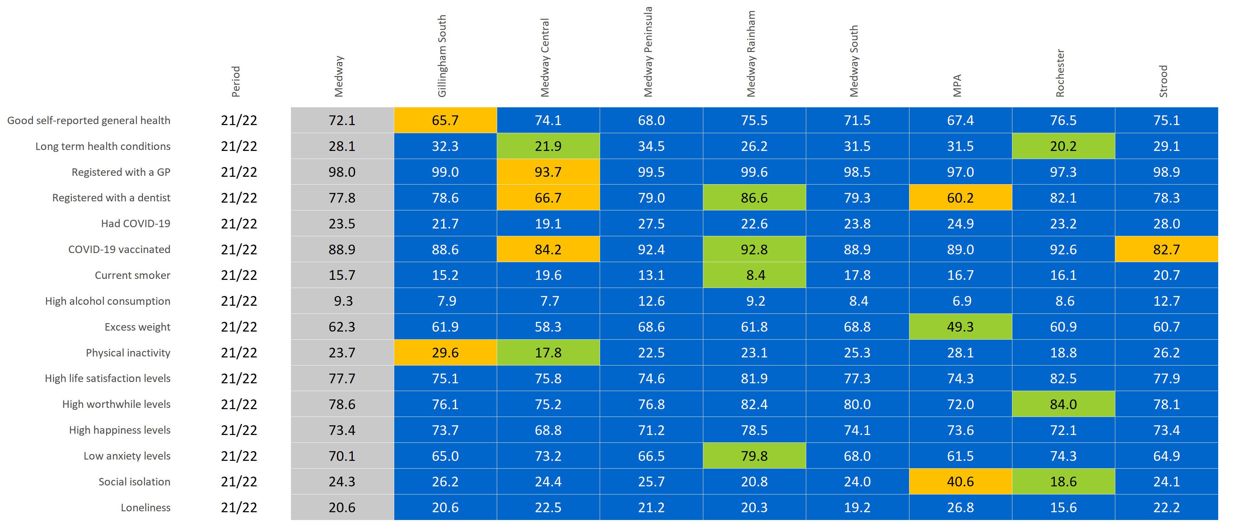
PCN summary
© Medway Council, Public Health Intelligence Team, Version 3.0, 07/08/2023
Estimated proportions for PCNs compared to Medway.

Slide 3
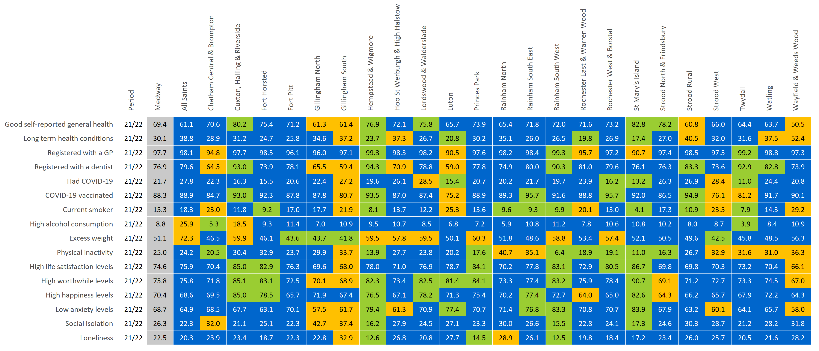
Ward summary
© Medway Council, Public Health Intelligence Team, Version 3.0, 07/08/2023
Estimated proportions for wards compared to Medway.

Slide 4
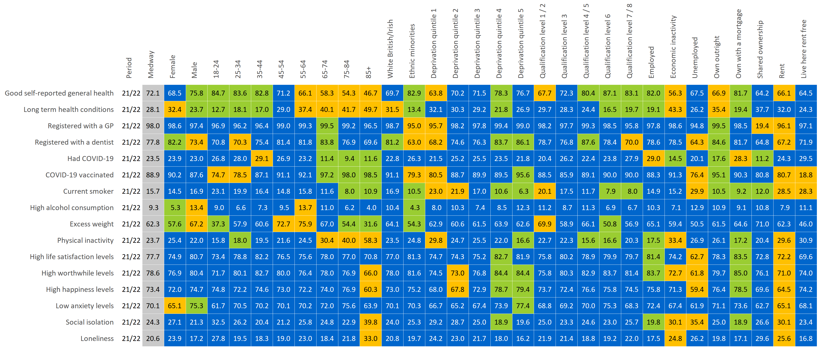
Inequalities and wider determinants summary
© Medway Council, Public Health Intelligence Team, Version 3.0, 07/08/2023
Estimated proportions for inequalities and wider determinants.

Slide 5
Contact details
© Medway Council, Public Health Intelligence Team, Version 3.0, 07/08/2023
If you have any questions or would like further information about the Medway Health and Wellbeing Survey, please contact:
Dr Natalie Goldring
Senior Public Health Intelligence Manager
Public Health
Medway Council
natalie.goldring@medway.gov.uk
01634 337271

Slide 6
Introduction
© Medway Council, Public Health Intelligence Team, Version 3.0, 07/08/2023
The aim of the Medway Health and Wellbeing Survey was to provide within Medway estimates (ward and Primary Care Network (PCN) level) of key health states and risk factors.
The survey was carried out in 2021/22.
Participants were asked a number of questions about their health and wellbeing, which were grouped into 6 key topic areas:

Slide 7
Sample
© Medway Council, Public Health Intelligence Team, Version 3.0, 07/08/2023
The Medway Health and Wellbeing Survey selected a random sample of the Medway population.
From this sample, characteristics of the entire Medway population were estimated.
The random sample was created from a list of all 119,369 residential properties in Medway.
Medway is split into smaller areas called Lower Layer Super Output Areas (LSOAs) and there are 163 LSOAs in Medway.
Using the residential property list, a survey was sent out to 6.77% of the residential properties within each LSOA (a range of 6.58% to 6.78% across the 163 LSOAs).
In total, 7,998 residential properties were sent a survey.
One adult was asked to complete the survey for each residential property.
We asked the person whose birthday was next to complete the survey.
In total, there were around 3,600 responses.

Slide 8
Weighting
© Medway Council, Public Health Intelligence Team, Version 3.0, 07/08/2023
Weights were calculated to make the survey data more representative of the population it is designed to represent, i.e. Medway as a whole.
Weighting assigns a value to each survey response to indicate how much it should be represented in the analysis.
The weights for the Medway Health and Wellbeing Survey are currently based on the number of adults within each household and the known population distributions by Middle Layer Super Output Areas (MSOA), broad age band (18-64 and 65+) and sex.
This methodology is being developed and may be updated in the future.

Slide 9
Estimating proportions
© Medway Council, Public Health Intelligence Team, Version 3.0, 07/08/2023
The survey results are presented as proportions.
  Frequentist approach
The majority of the survey analysis used a frequentist approach to estimate proportions.
For each survey question, the number of responses per category were divided by the total number of survey responses. This method is based solely on the answers given in the survey.
  Bayesian approach
In some cases, however, the sample size was too small to use the frequentist approach. For example, for ward level estimates. In this instance, a Bayesian approach was used to calculate the proportion.
This involves using prior knowledge to estimate a proportion and then update this value based on the answers given in the survey.
Current Bayesian model: Simple logistic regression model
Bayesian model in development: Hierarchical logistic regression including multiple levels and predictor variables. Will also incorporate survey weights and age-standardisation.

Slide 10
Confidence intervals
© Medway Council, Public Health Intelligence Team, Version 3.0, 07/08/2023
When samples are used, the values are usually accompanied by a measure of uncertainty.
Uncertainty relates to how an estimate might differ from the 'true value'.
Confidence intervals are used to show uncertainty in the Medway Health and Wellbeing Survey proportion estimates.
Confidence intervals provide a range in which we think the true proportion is likely to lie.
The confidence intervals are shown as lines in the middle of the bar graphs.
The wider the confidence interval, the greater the level of uncertainty in the estimate. This could be due to a small sample size or high variability.
A narrow confidence interval suggests that the estimate is more precise.
The 'logit' method has been used to calculate confidence intervals for the majority of the analysis.
However, when a Bayesian approach has been used to estimate the proportion, credible intervals are presented instead.

Slide 11
Validation
© Medway Council, Public Health Intelligence Team, Version 3.0, 07/08/2023
The objective of validation is to check the quality of the data collected from the Medway Health and Wellbeing survey.
Where possible, the survey estimates have been compared to values from national surveys, such as the Census and the Annual Population Survey, covering similar time periods.
Survey estimates have been considered acceptable if the value falls within the range (confidence interval) of the national survey.

Slide 12
Inequalities and wider determinants
© Medway Council, Public Health Intelligence Team, Version 3.0, 07/08/2023
Survey estimates have also been calculated for inequalities and the wider determinants of health to explore the characteristics that may influence health states or risk factors.
  Inequalities
    Gender
    Age group
    Ethnic group
    Deprivation
  Wider determinants
    Highest level of qualification
    Economic activity
    Housing tenure

Slide 13
Demographics

Slide 14
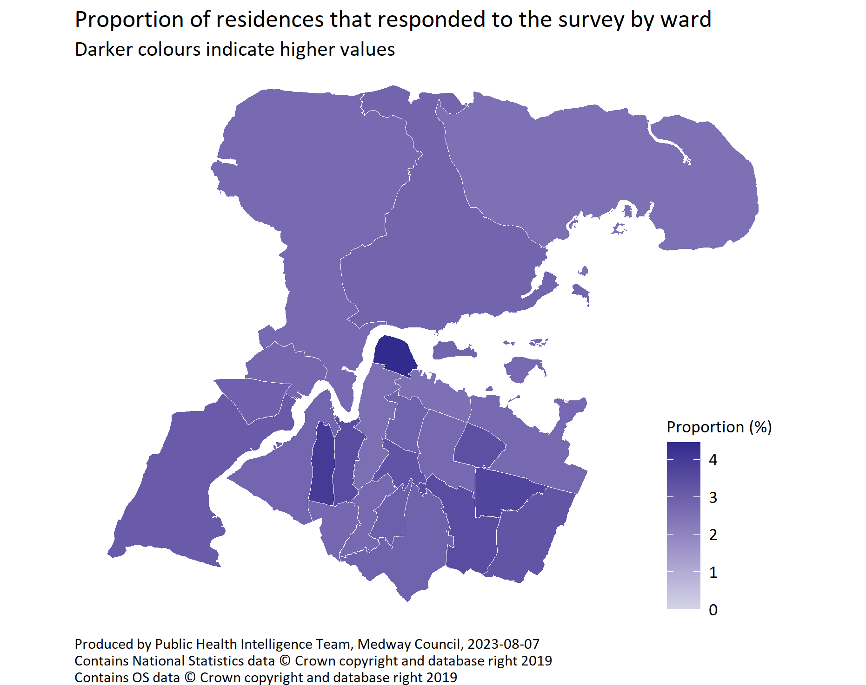
Ward
© Medway Council, Public Health Intelligence Team, Version 3.0, 07/08/2023
Ward | Number of responses | Number of residences | % residences responded
All Saints | 52 | 2,067 | 2.52%
Chatham Central & Brompton | 211 | 8,249 | 2.56%
Cuxton, Halling & Riverside | 85 | 2,752 | 3.09%
Fort Horsted | 63 | 2,300 | 2.74%
Fort Pitt | 205 | 5,894 | 3.48%
Gillingham North | 172 | 6,823 | 2.52%
Gillingham South | 204 | 7,095 | 2.88%
Hempstead & Wigmore | 139 | 3,979 | 3.49%
Hoo St Werburgh & High Halstow | 171 | 6,047 | 2.83%
Lordswood & Walderslade | 163 | 5,669 | 2.88%
Luton | 148 | 4,483 | 3.30%
Princes Park | 124 | 4,151 | 2.99%
Rainham North | 166 | 6,110 | 2.72%
Rainham South East | 183 | 5,641 | 3.24%
Rainham South West | 141 | 3,820 | 3.69%
Rochester East & Warren Wood | 234 | 5,865 | 3.99%
Rochester West & Borstal | 141 | 5,027 | 2.80%
St Mary's Island | 73 | 1,639 | 4.45%
Strood North & Frindsbury | 160 | 5,867 | 2.73%
Strood Rural | 137 | 5,130 | 2.67%
Strood West | 196 | 6,726 | 2.91%
Twydall | 129 | 3,799 | 3.40%
Watling | 167 | 6,161 | 2.71%
Wayfield & Weeds Wood | 110 | 4,075 | 2.70%
Total | 3,594 | 119,369 | 3.01%
  Target coverage: 3%
  Ward coverage range: 2.52% to 4.45%

Slide 15
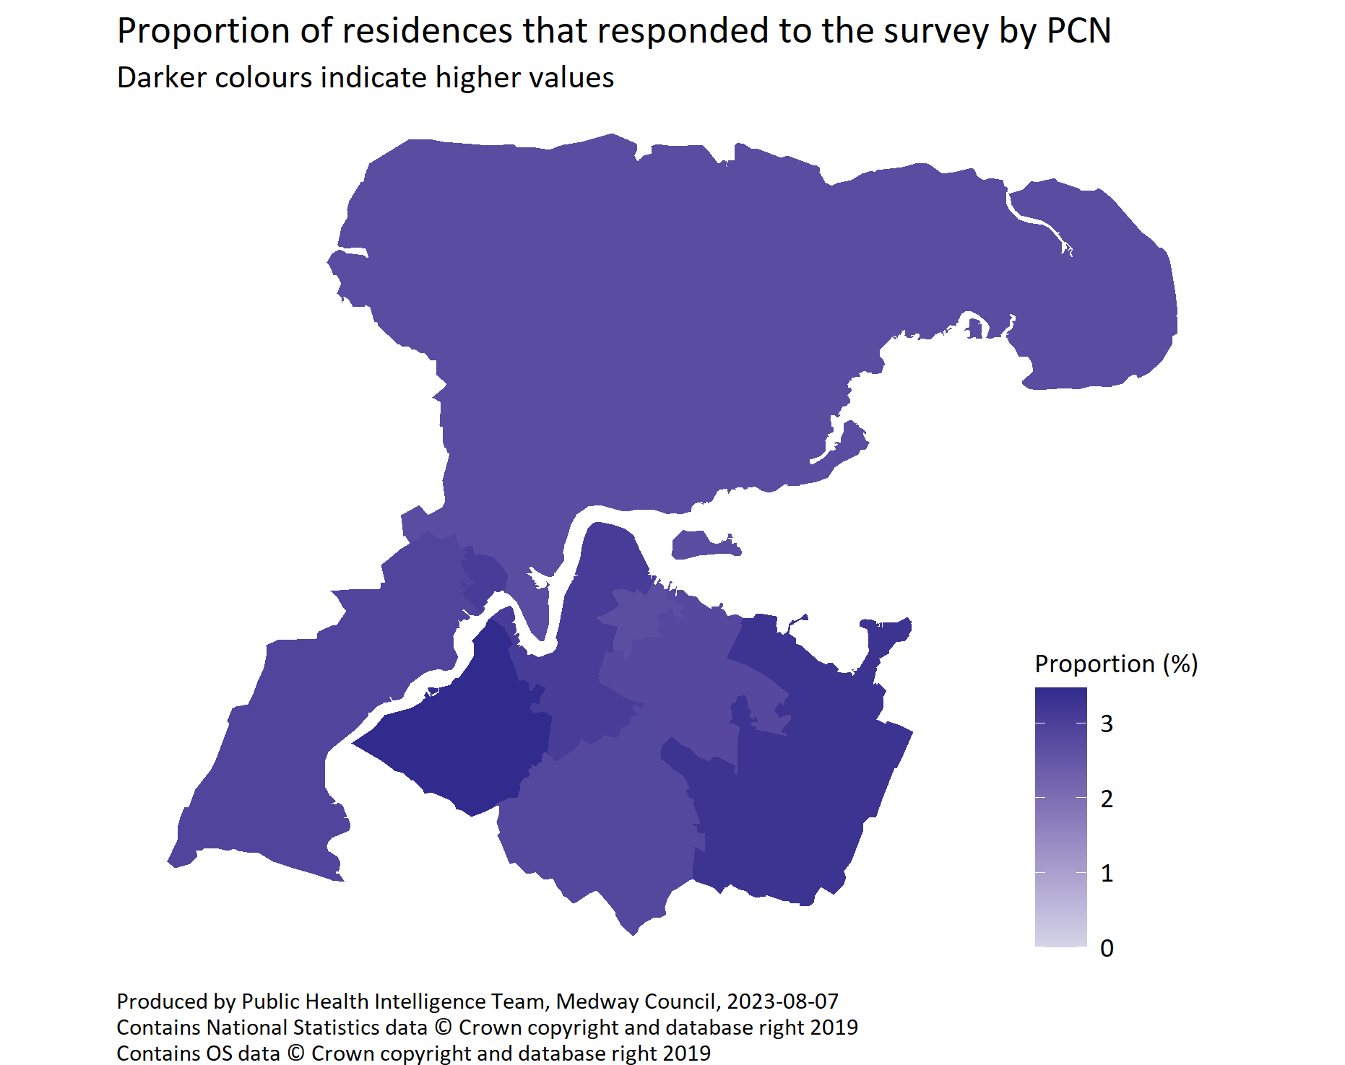
PCN
© Medway Council, Public Health Intelligence Team, Version 3.0, 07/08/2023
PCN | Number of responses | Number of residences | % residences responded
Gillingham South | 488 | 17,341 | 2.81%
Medway Central | 562 | 18,254 | 3.08%
Medway Peninsula | 360 | 13,244 | 2.72%
Medway Rainham | 635 | 19,482 | 3.26%
Medway South | 499 | 17,678 | 2.82%
MPA | 178 | 6,605 | 2.69%
Rochester | 467 | 13,468 | 3.47%
Strood | 385 | 13,297 | 2.90%
Total | 3,574 | 119,369 | 2.99%
  Target coverage: 3%
  PCN coverage range: 2.69% to 3.47%

Slide 16
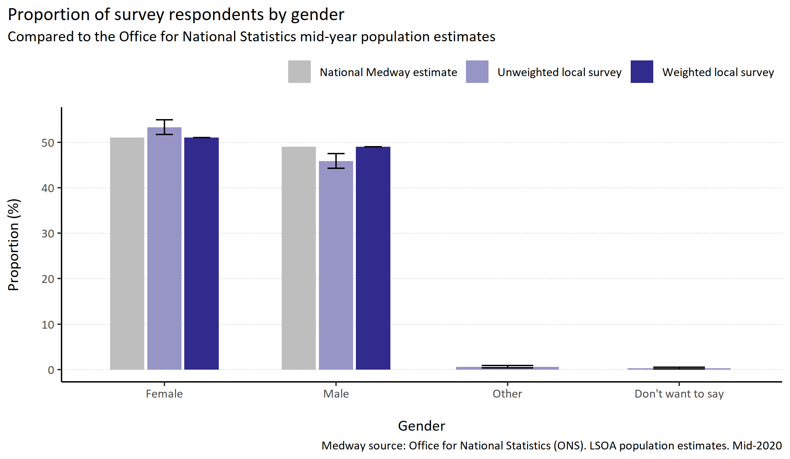
Gender
© Medway Council, Public Health Intelligence Team, Version 3.0, 07/08/2023
Plot description
  Males were slightly under-represented in the survey, and females were slightly over-represented.
  The proportion of males that completed the survey (45.9%) was lower compared to the Medway population as a whole (49.0%).
  The proportion of females that completed the survey (53.3%) was higher (51.0%).
  0.56% reported their gender as 'other'.
  0.3% did not state their gender.
Survey question: What is your gender?
Possible answers: Male, Female, Other, Don't want to say

Slide 17
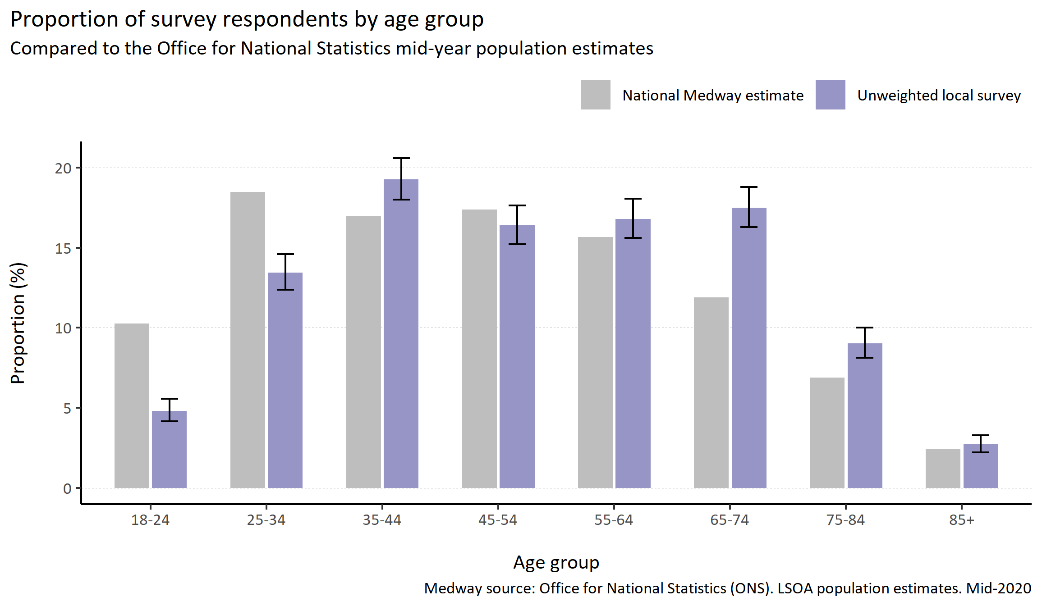
Age group
© Medway Council, Public Health Intelligence Team, Version 3.0, 07/08/2023
Plot description
  Younger age groups were under-represented in the survey (18-34 years).
  Some older age groups were over-represented (65-74 years).
  19 out of 3,594 respondents did not state their age or age group.
Survey question: What is your age? - Ageband
Possible answers: 18-24, 25-34, 35-44, 45-54, 55-64, 65-74, 75-84, 85+

Slide 18
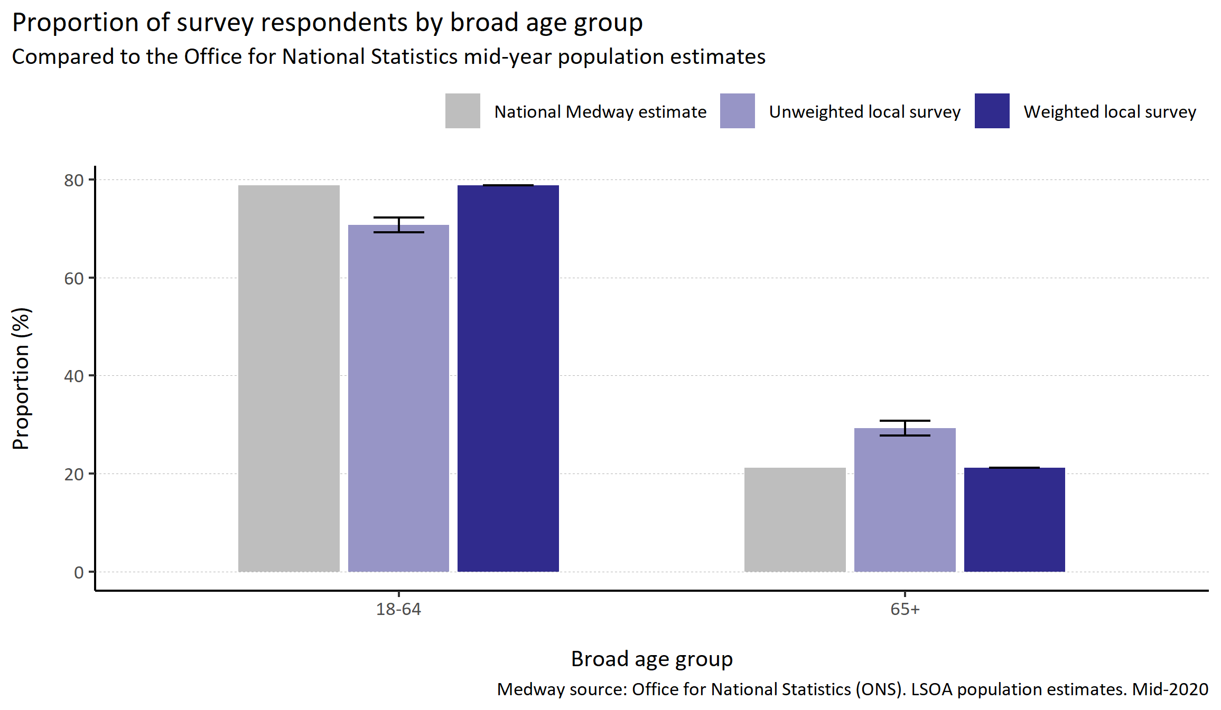
Broad age group
© Medway Council, Public Health Intelligence Team, Version 3.0, 07/08/2023
Plot description
  The majority of weights for the survey responses were created using broad age group to ensure there was good representation when using Middle Super Output Areas (MSOAs). MSOAs are the lowest level of geography used when creating survey weights.
Survey question: What is your age? - Ageband
Categories: 18-64, 65+

Slide 19
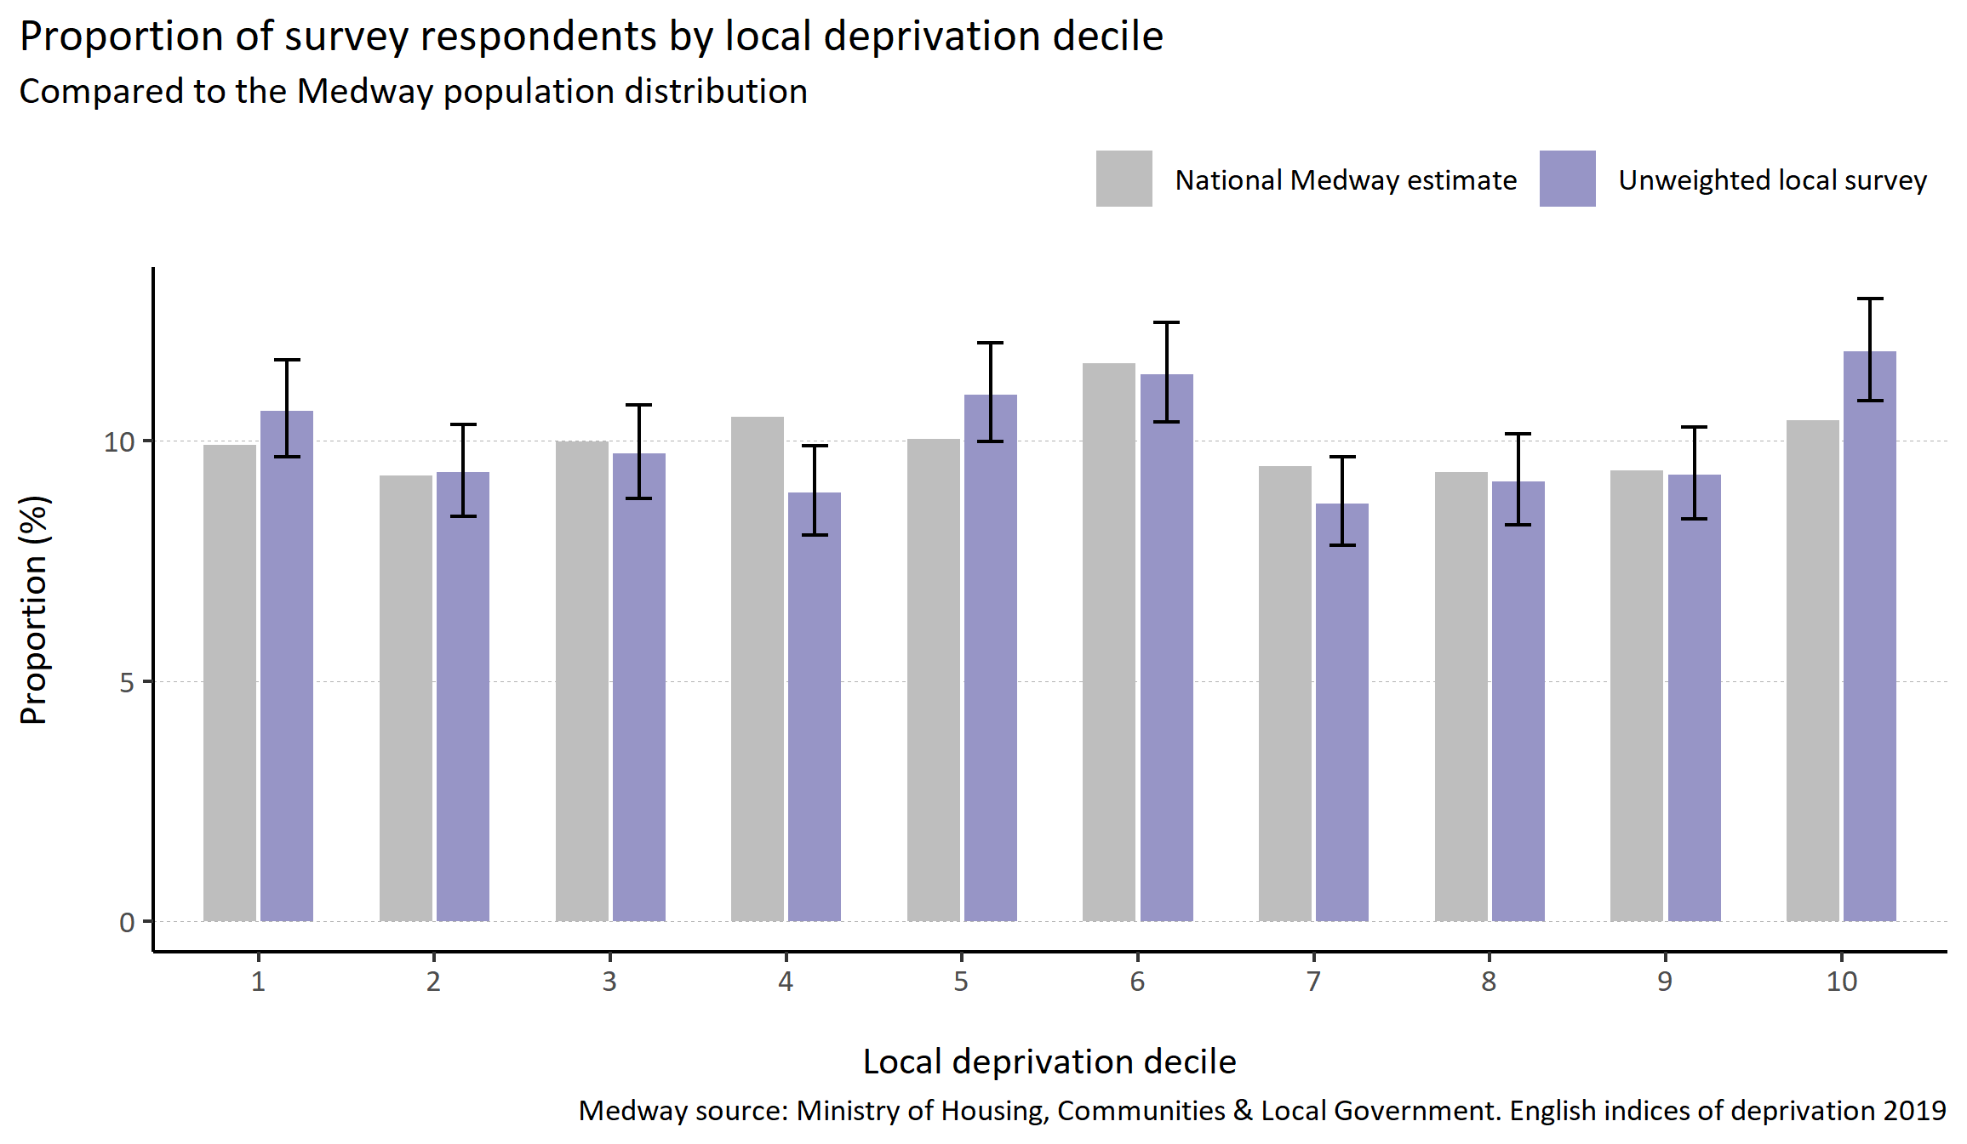
Deprivation
© Medway Council, Public Health Intelligence Team, Version 3.0, 07/08/2023
Plot description
  Decile 1 represents areas that are most deprived and decile 10 least deprived.
  Decile 4 is under represented in the survey and decile 10 is over represented.
  For 20 out of 3,594 survey responses, the postcode, and therefore decile, was unknown.
Survey question: What is your postcode?
Postcode to LSOA: Office for National Statistics. National Statistics Postcode Lookup (NSPL).

Slide 20
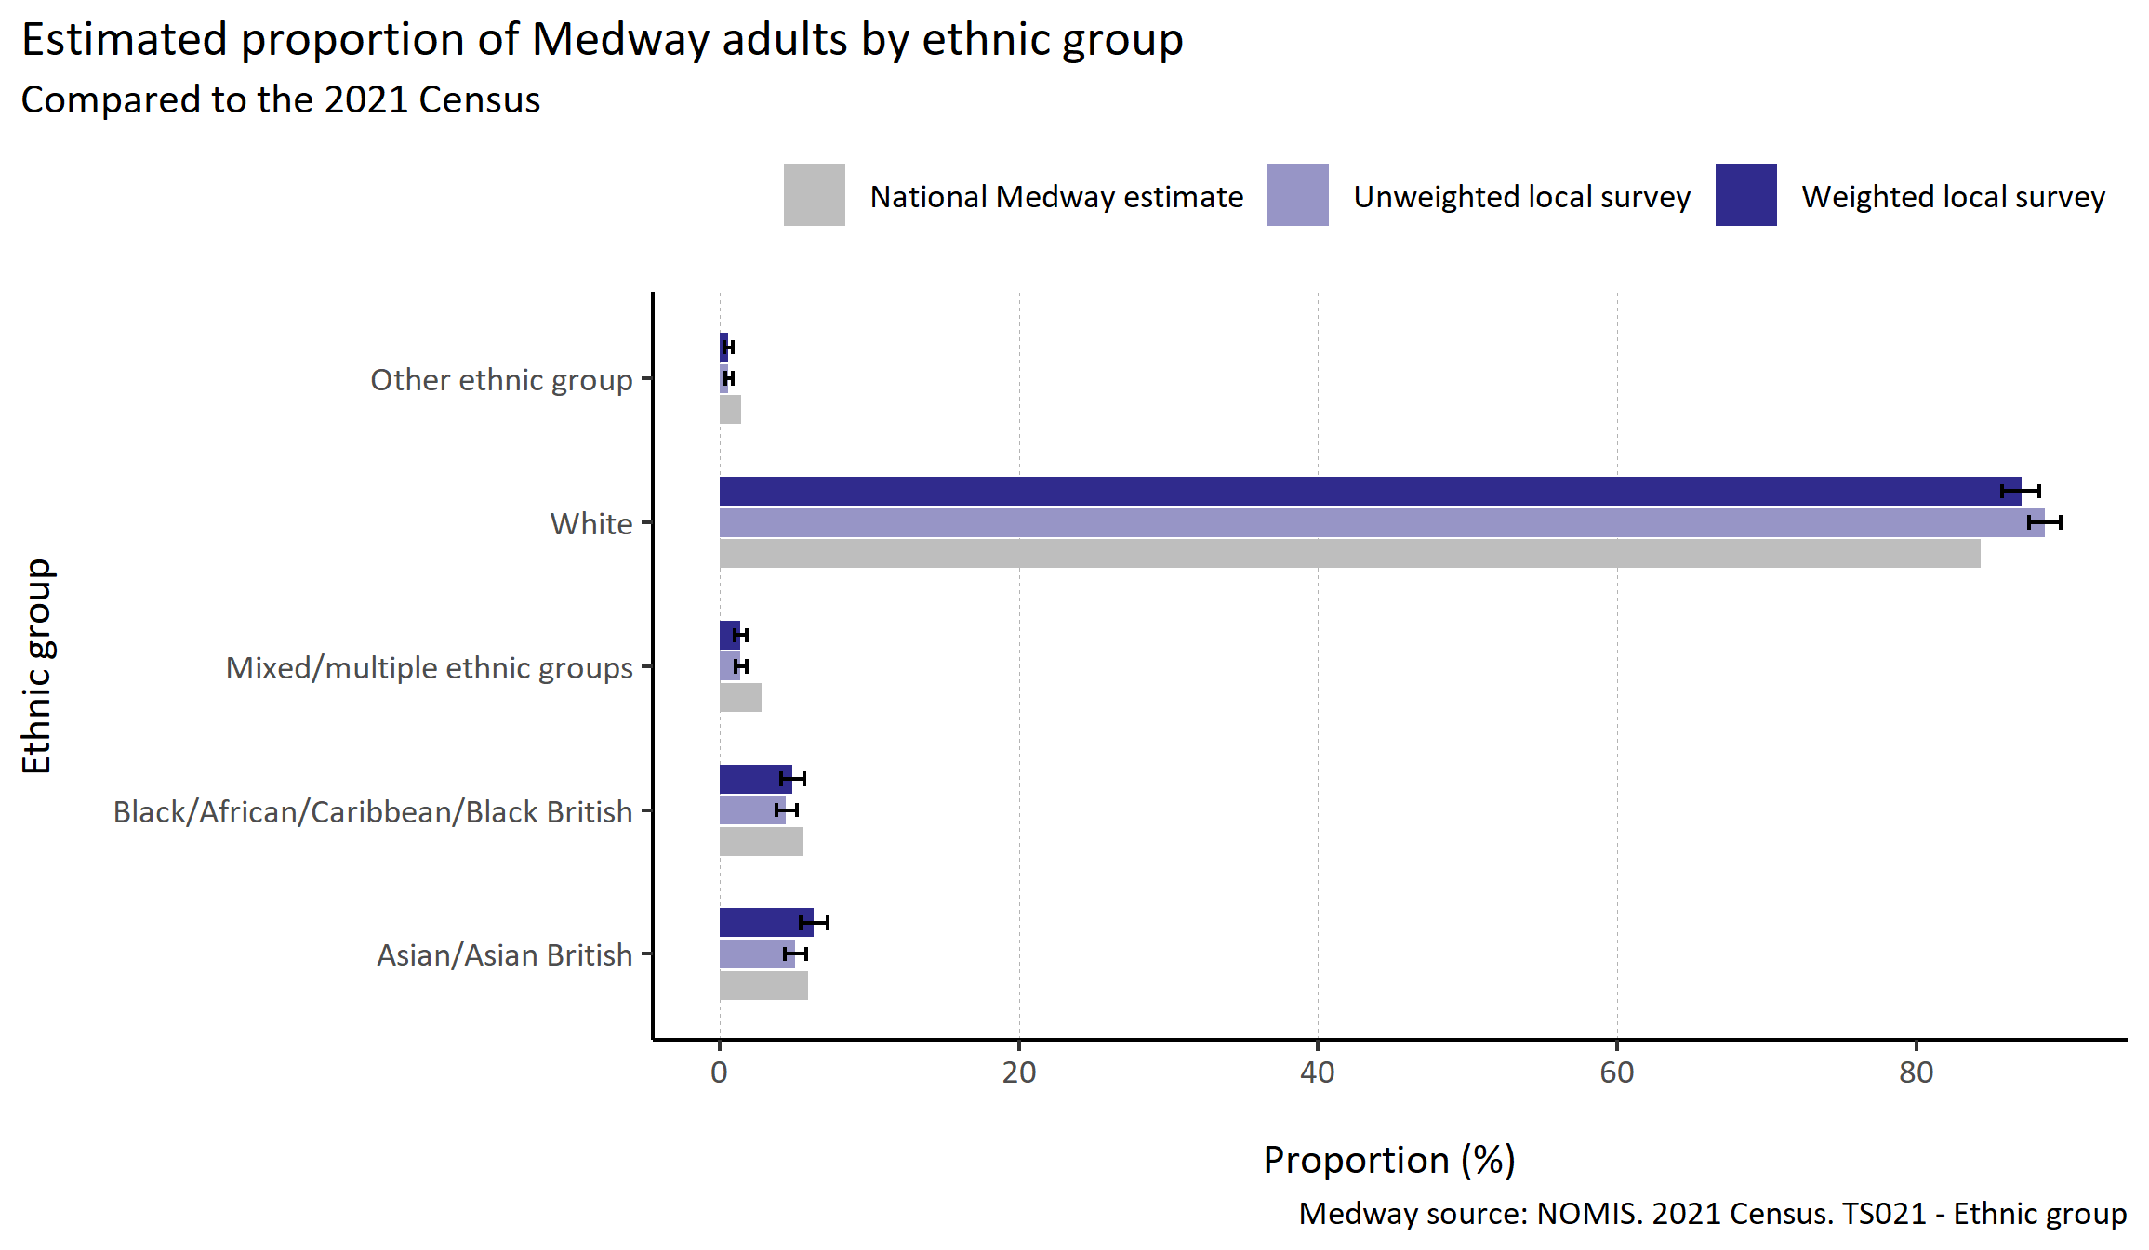
Ethnic group
© Medway Council, Public Health Intelligence Team, Version 3.0, 07/08/2023
Plot description
  The distribution of survey responses by ethnic group was similar to the 2021 Census.
  However, the White ethnic group was slightly over-represented, and the Mixed/Multiple and Other ethnic groups were slightly under-represented.
  33 out of 3,594 respondents did not state their ethnic group.
Survey question: What is your ethnicity?
Categories: White: English/Welsh/Scottish/Northern Irish/British; Irish; Gypsy or Irish Traveller; Any other White background. Black/African/Caribbean/Black British: African background; Caribbean; Any other Black, Black British or Caribbean background. Asian/Asian British: Indian; Pakistani; Bangladeshi; Chinese; Any other Asian background. Mixed/multiple ethnic groups: White and Black Caribbean; White and Black African; White and Asian; Any other Multiple/Multiple ethnic background. Other ethnic group: Arab; Any other ethnic group; Other.

Slide 21
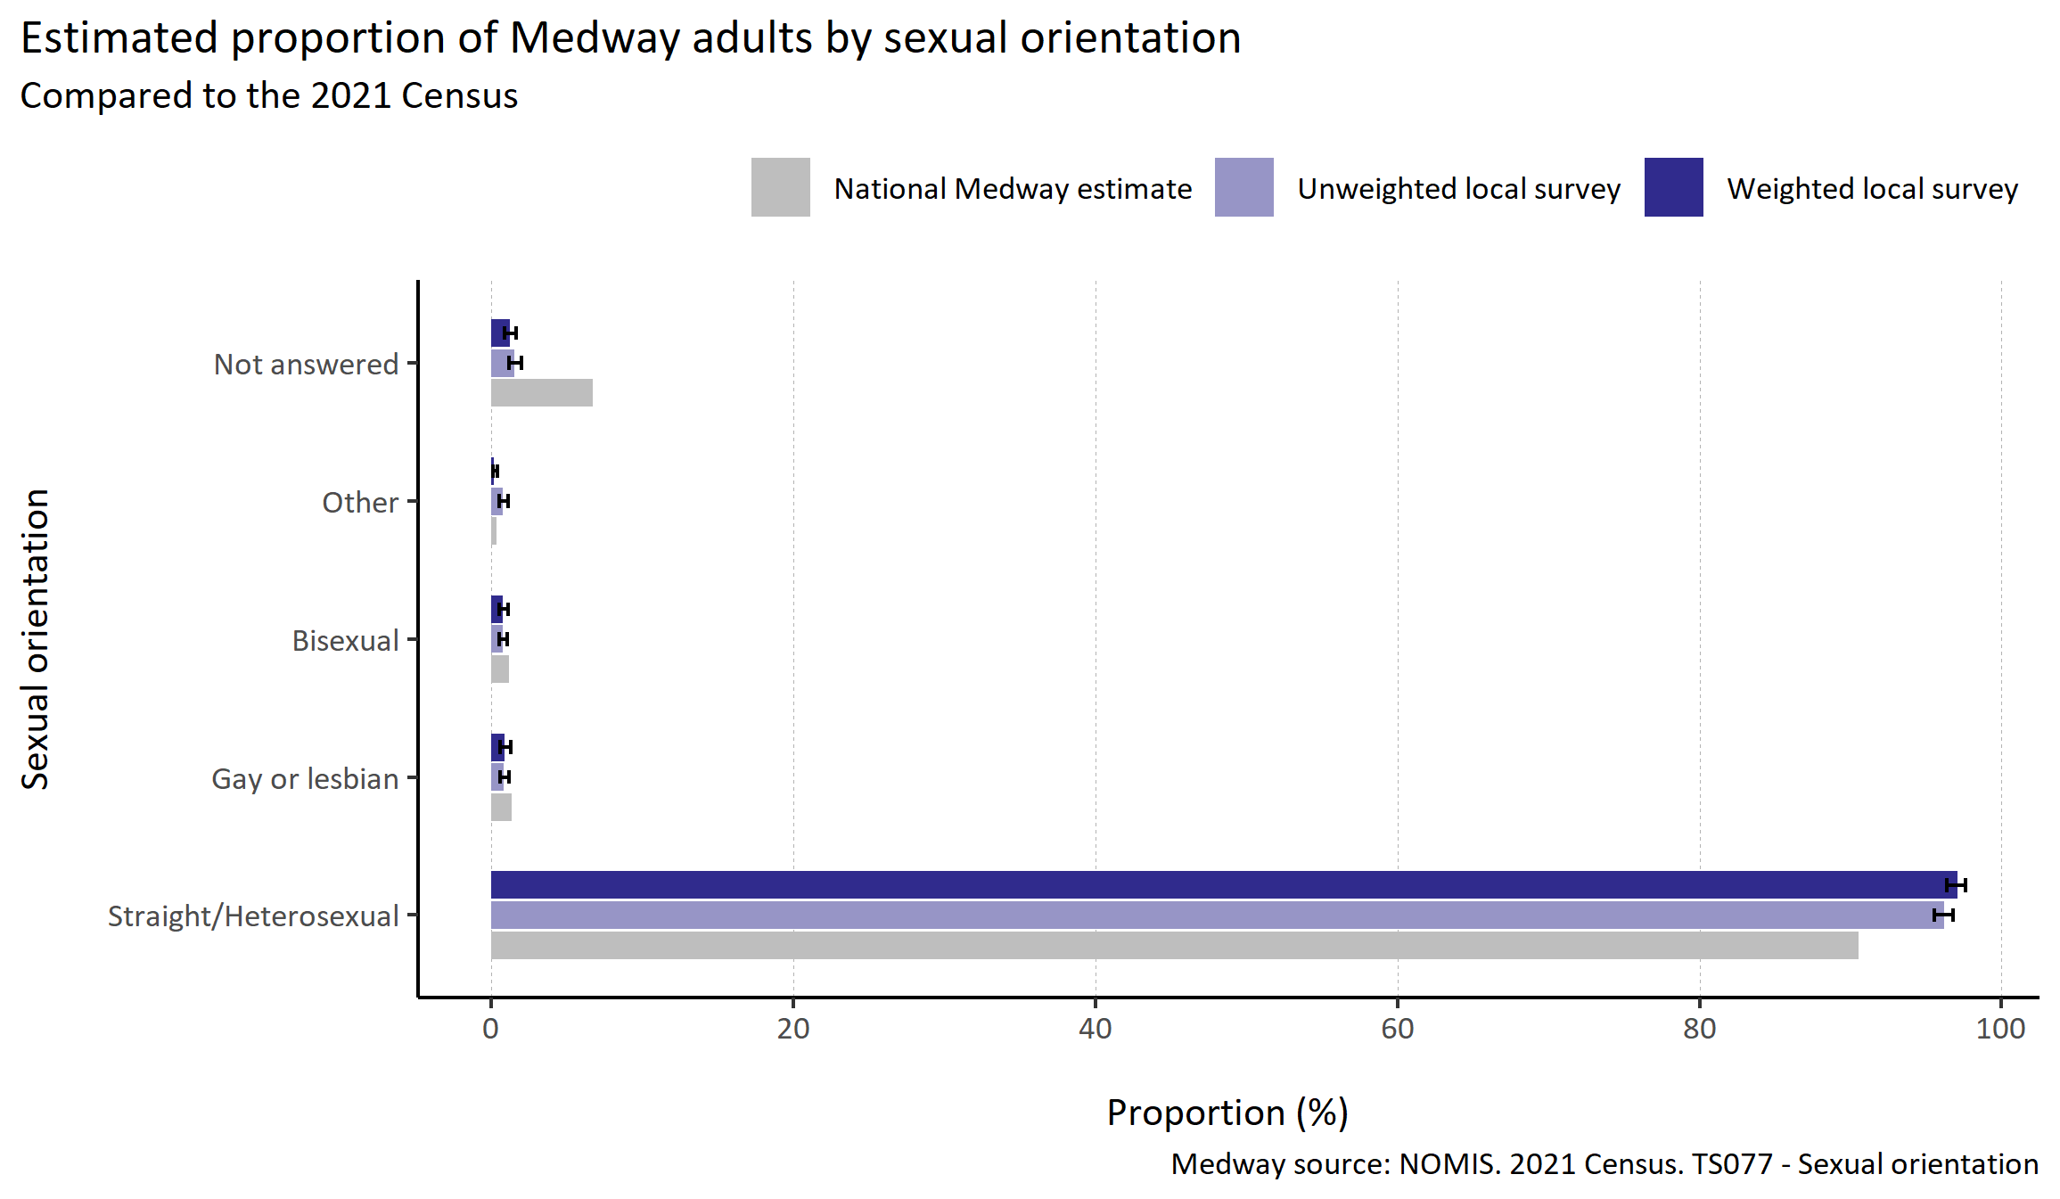
Sexual orientation
© Medway Council, Public Health Intelligence Team, Version 3.0, 07/08/2023
Plot description
  The distribution of survey responses by sexual orientation was similar to the 2021 Census.
  The weighted survey results estimate that 97.1% of Medway adults identify as straight or heterosexual and 1.6% identify as gay, lesbian or bisexual.
  55 out of 3,594 respondents did not answer this question.
Survey question: Which of the following best describes your sexual orientation?
Possible answers: Straight/Heterosexual; Gay or lesbian; Bisexual; Other; Don't know/don't want to say.

Slide 22
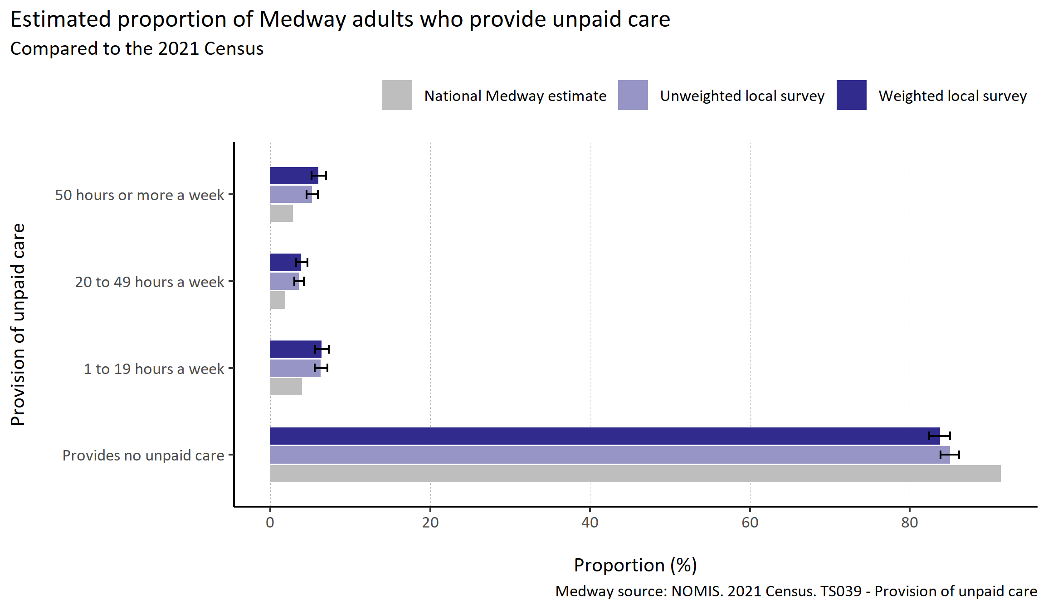
Provision of unpaid care
© Medway Council, Public Health Intelligence Team, Version 3.0, 07/08/2023
Plot description
  The distribution of survey responses by provision of unpaid care was similar to the 2021 Census.
  However, those that that provide no unpaid care were slightly under-represented in comparison to those that provide care.
  The weighted survey results estimate that 83.8% of Medway adults provide no unpaid care a week, 6.4% provide 1 to 19 hours a week, 3.9% provide 20 to 49 hours a week, and 6.0% provide 50 hours or more a week.
  37 out of 3,594 respondents did not answer this question.
Survey question: Do you look after, or give any help or support to anyone because they have a long-term physical or mental health condition or illness, or problem related to old age? Do not include paid employment.
Categories: Provides no unpaid care: No. Provides 1 to 19 hours unpaid care a week: Yes, 9 hours a week or less; Yes, 10 to 19 hours a week. Provides 20 to 49 hours unpaid care a week: Yes, 20 to 34 hours a week; Yes, 35 to 49 hours a week. Provides 50 or more hours unpaid care a week: Yes, 50 hours or more a week.

Slide 23
Wider determinants

Slide 24
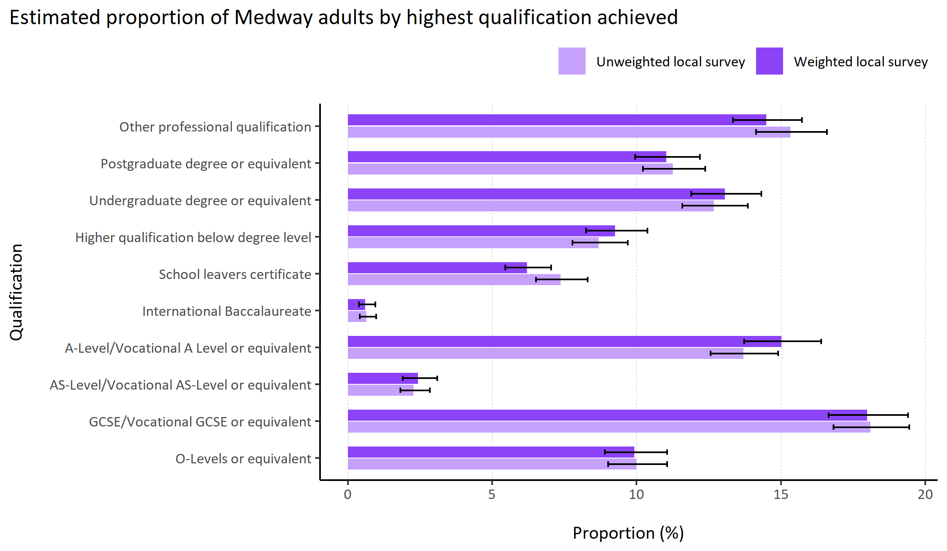
Highest qualification
© Medway Council, Public Health Intelligence Team, Version 3.0, 07/08/2023
Plot description
  National Medway estimate not available for comparison for this indicator.
  280 out of 3,594 survey respondents did not answer this question.
Survey question: Can you tell me the highest educational or school qualification you have obtained?
Possible answers: O-Levels or equivalent, GCSE/Vocational GCSE or equivalent, AS-Level/Vocational AS-Level or equivalent, A-Level/Vocational A Level or equivalent, International Baccalaureate, School leavers certificate, Higher qualification below degree level, Undergraduate degree or equivalent, Postgraduate degree or equivalent, Other professional qualification, Don't know/don't want to say.

Slide 25
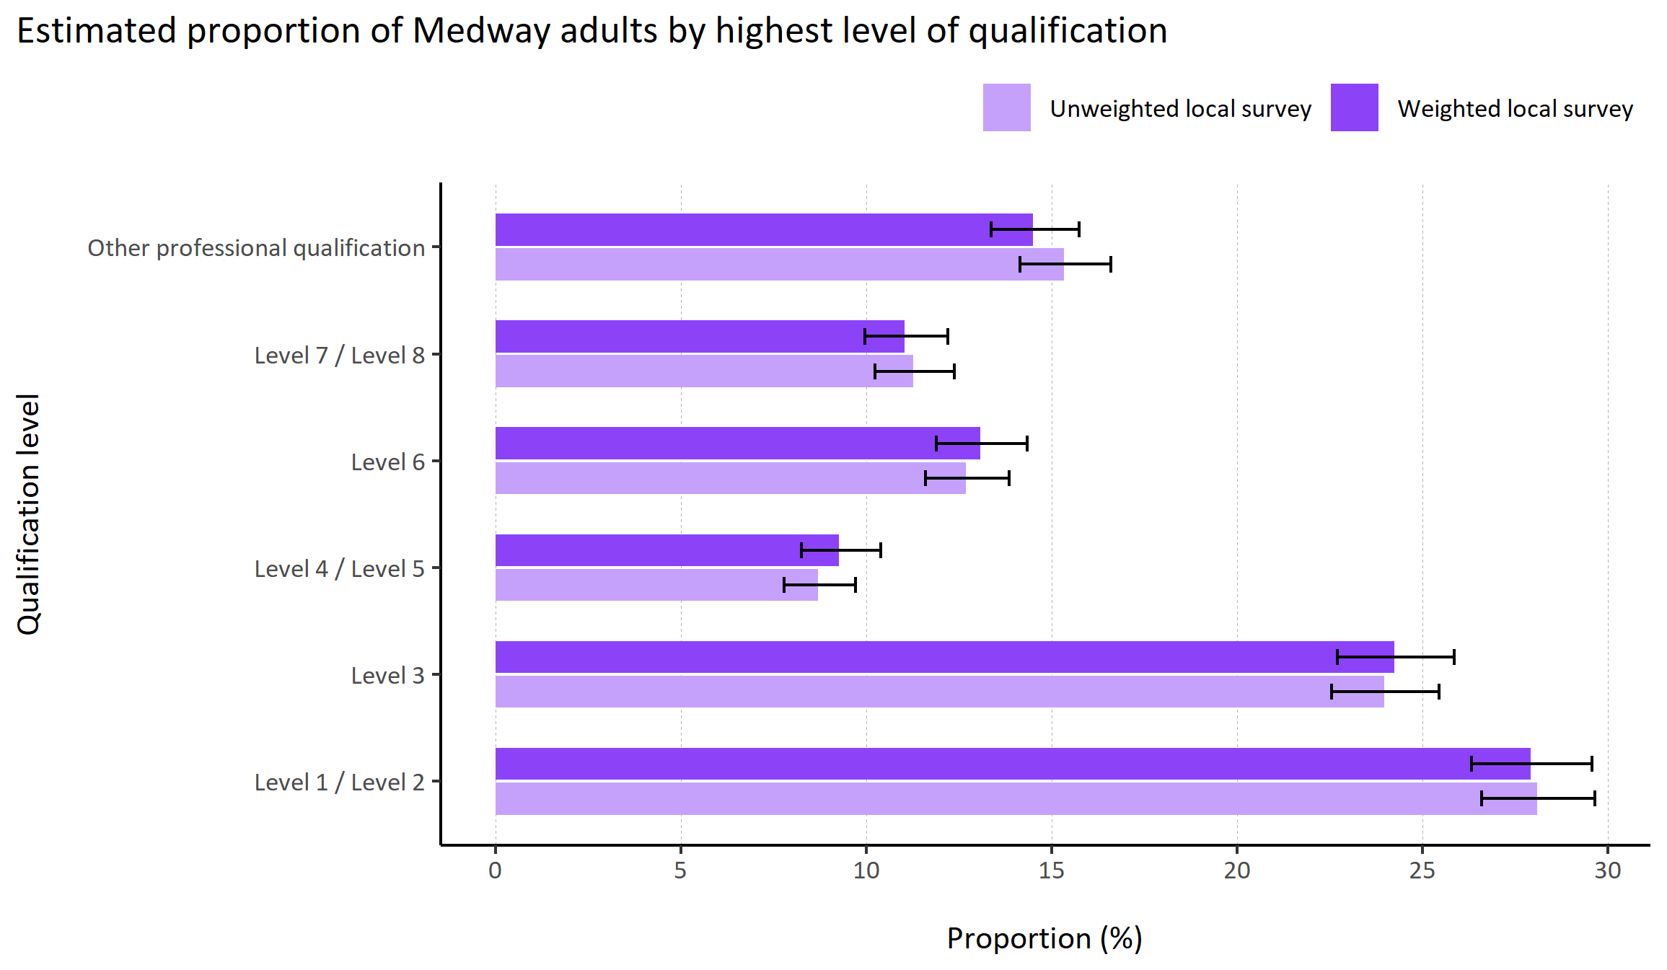
Highest level of qualification
© Medway Council, Public Health Intelligence Team, Version 3.0, 07/08/2023
Plot description
  National Medway estimate not available for comparison for this indicator.
  The weighted survey results estimate that 27.9% of Medway adults have a highest qualification of level 1 or 2, 24.2% level 3, 9.3% level 4 or 5, 13.1% level 6, and 11.0% level 7 or 8.
  280 out of 3,594 survey respondents did not answer this question.
Survey question: Can you tell me the highest educational or school qualification you have obtained?
Categories: Level 1 / Level 2: O-Levels or equivalent; GCSE/Vocational GCSE or equivalent. Level 3: AS-Level/Vocational AS-Level or equivalent; A-Level/Vocational A Level or equivalent; International Baccalaureate; School leavers certificate. Level 4 / Level 5: Higher qualification below degree level. Level 6: Undergraduate degree or equivalent. Level 7 / Level 8: Postgraduate degree or equivalent. Other professional qualification.

Slide 26
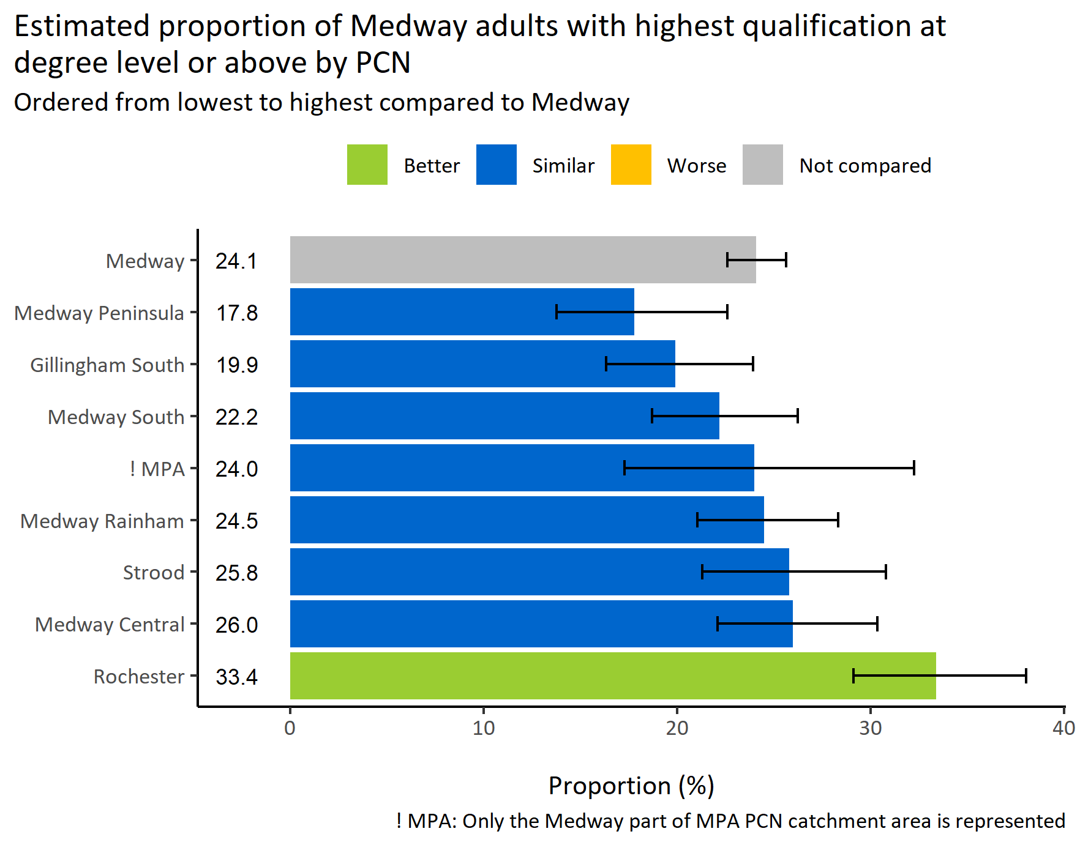
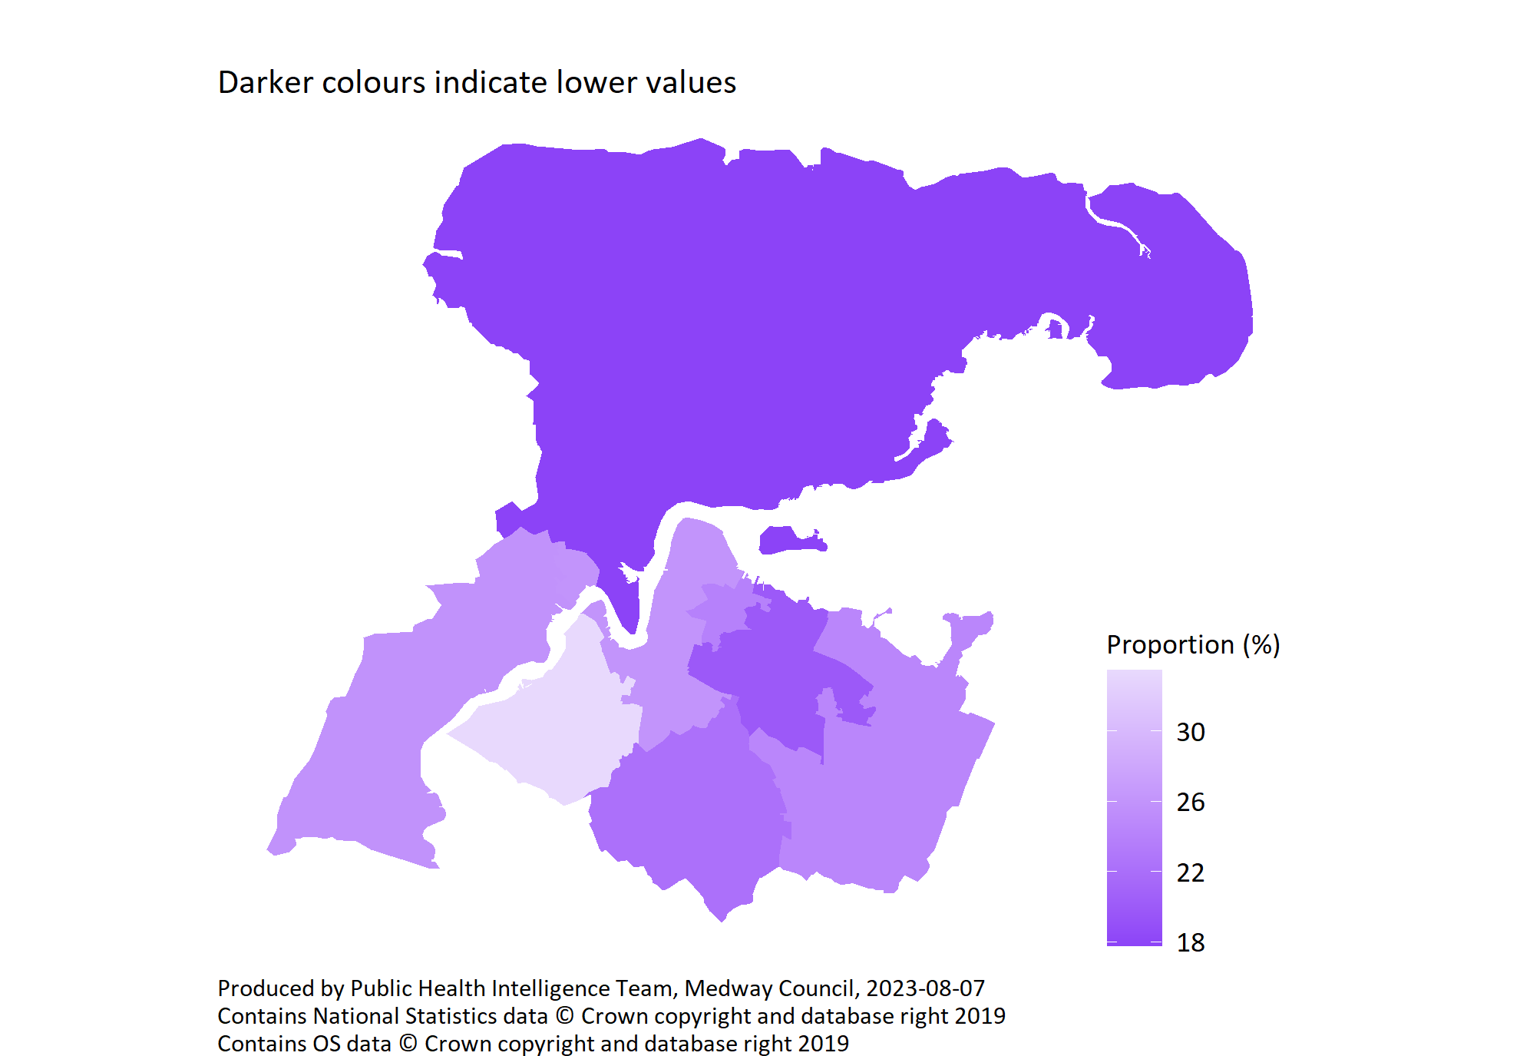
Highest qualification at degree level or above by PCN
© Medway Council, Public Health Intelligence Team, Version 3.0, 07/08/2023
Survey question: Can you tell me the highest educational or school qualification you have obtained?
Possible answers: O-Levels or equivalent, GCSE/Vocational GCSE or equivalent, AS-Level/Vocational AS-Level or equivalent, A-Level/Vocational A Level or equivalent, International Baccalaureate, School leavers certificate, Higher qualification below degree level, Undergraduate degree or equivalent, Postgraduate degree or equivalent, Other professional qualification, Don't know/don't want to say.
Category selected: Degree level or above: Undergraduate degree or equivalent, Postgraduate degree or equivalent.

Slide 27
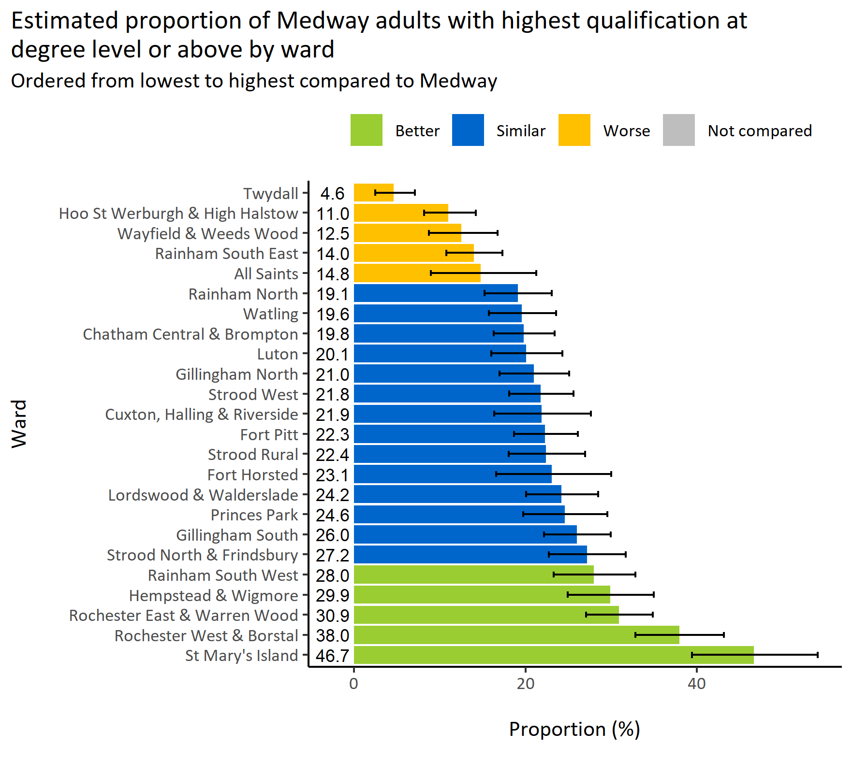
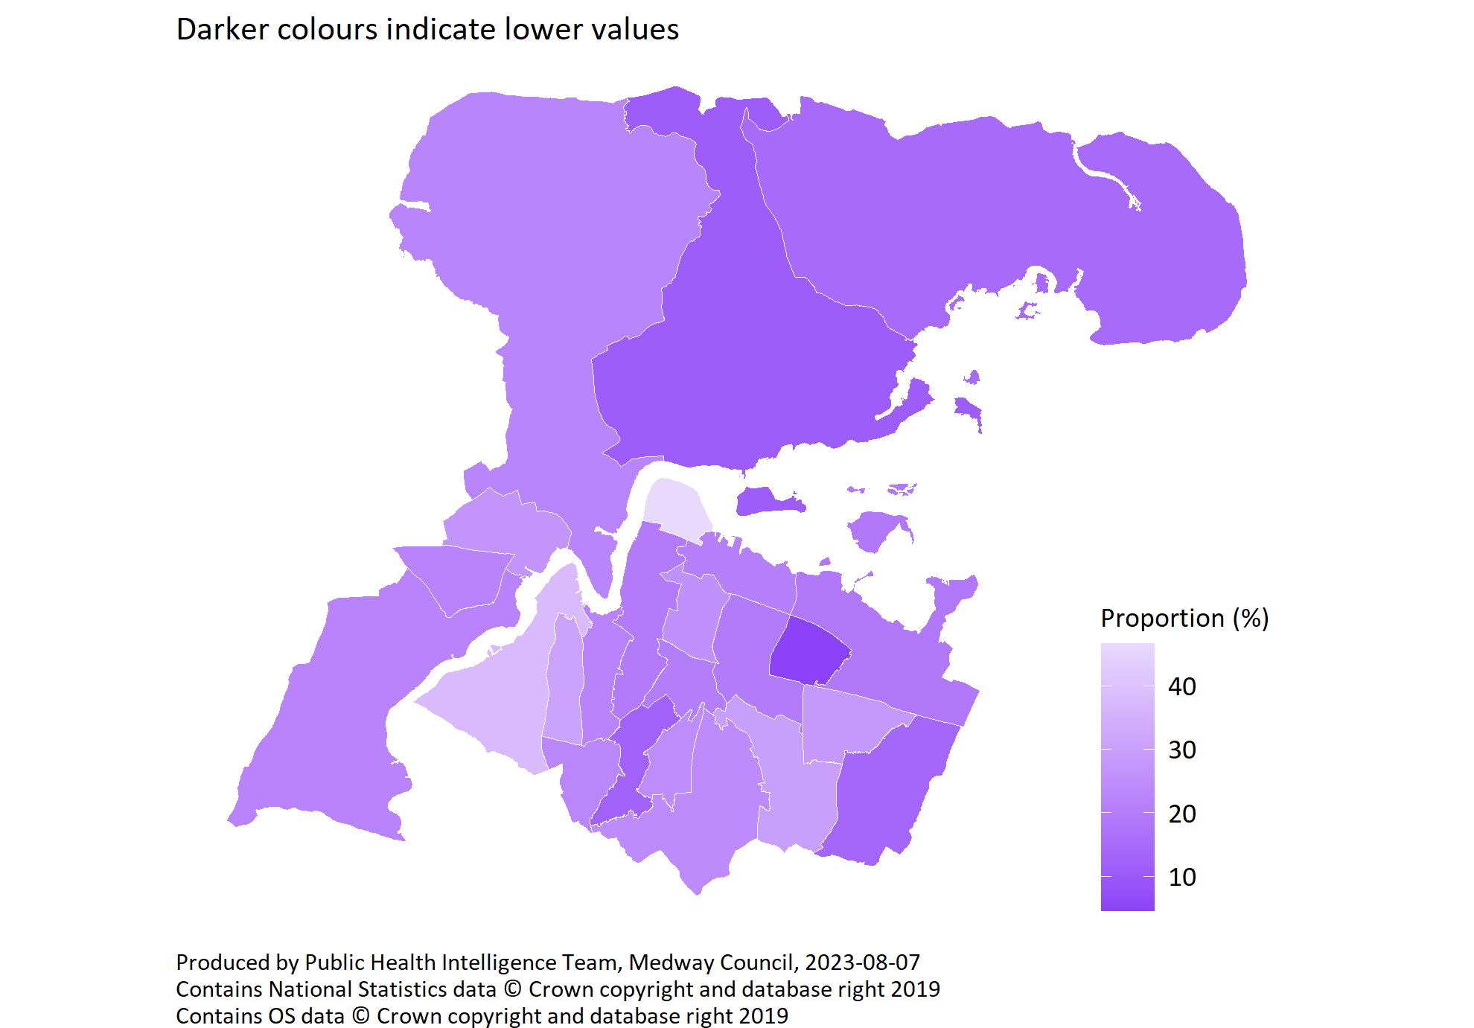
Highest qualification at degree level or above by ward
© Medway Council, Public Health Intelligence Team, Version 3.0, 07/08/2023
Survey question: Can you tell me the highest educational or school qualification you have obtained?
Degree level or above: Answers include Undergraduate degree or equivalent, Postgraduate degree or equivalent.
Estimates are calculated using Bayesian methods. These do not take into
account survey weighting but will be updated in the future to do so.

Slide 28
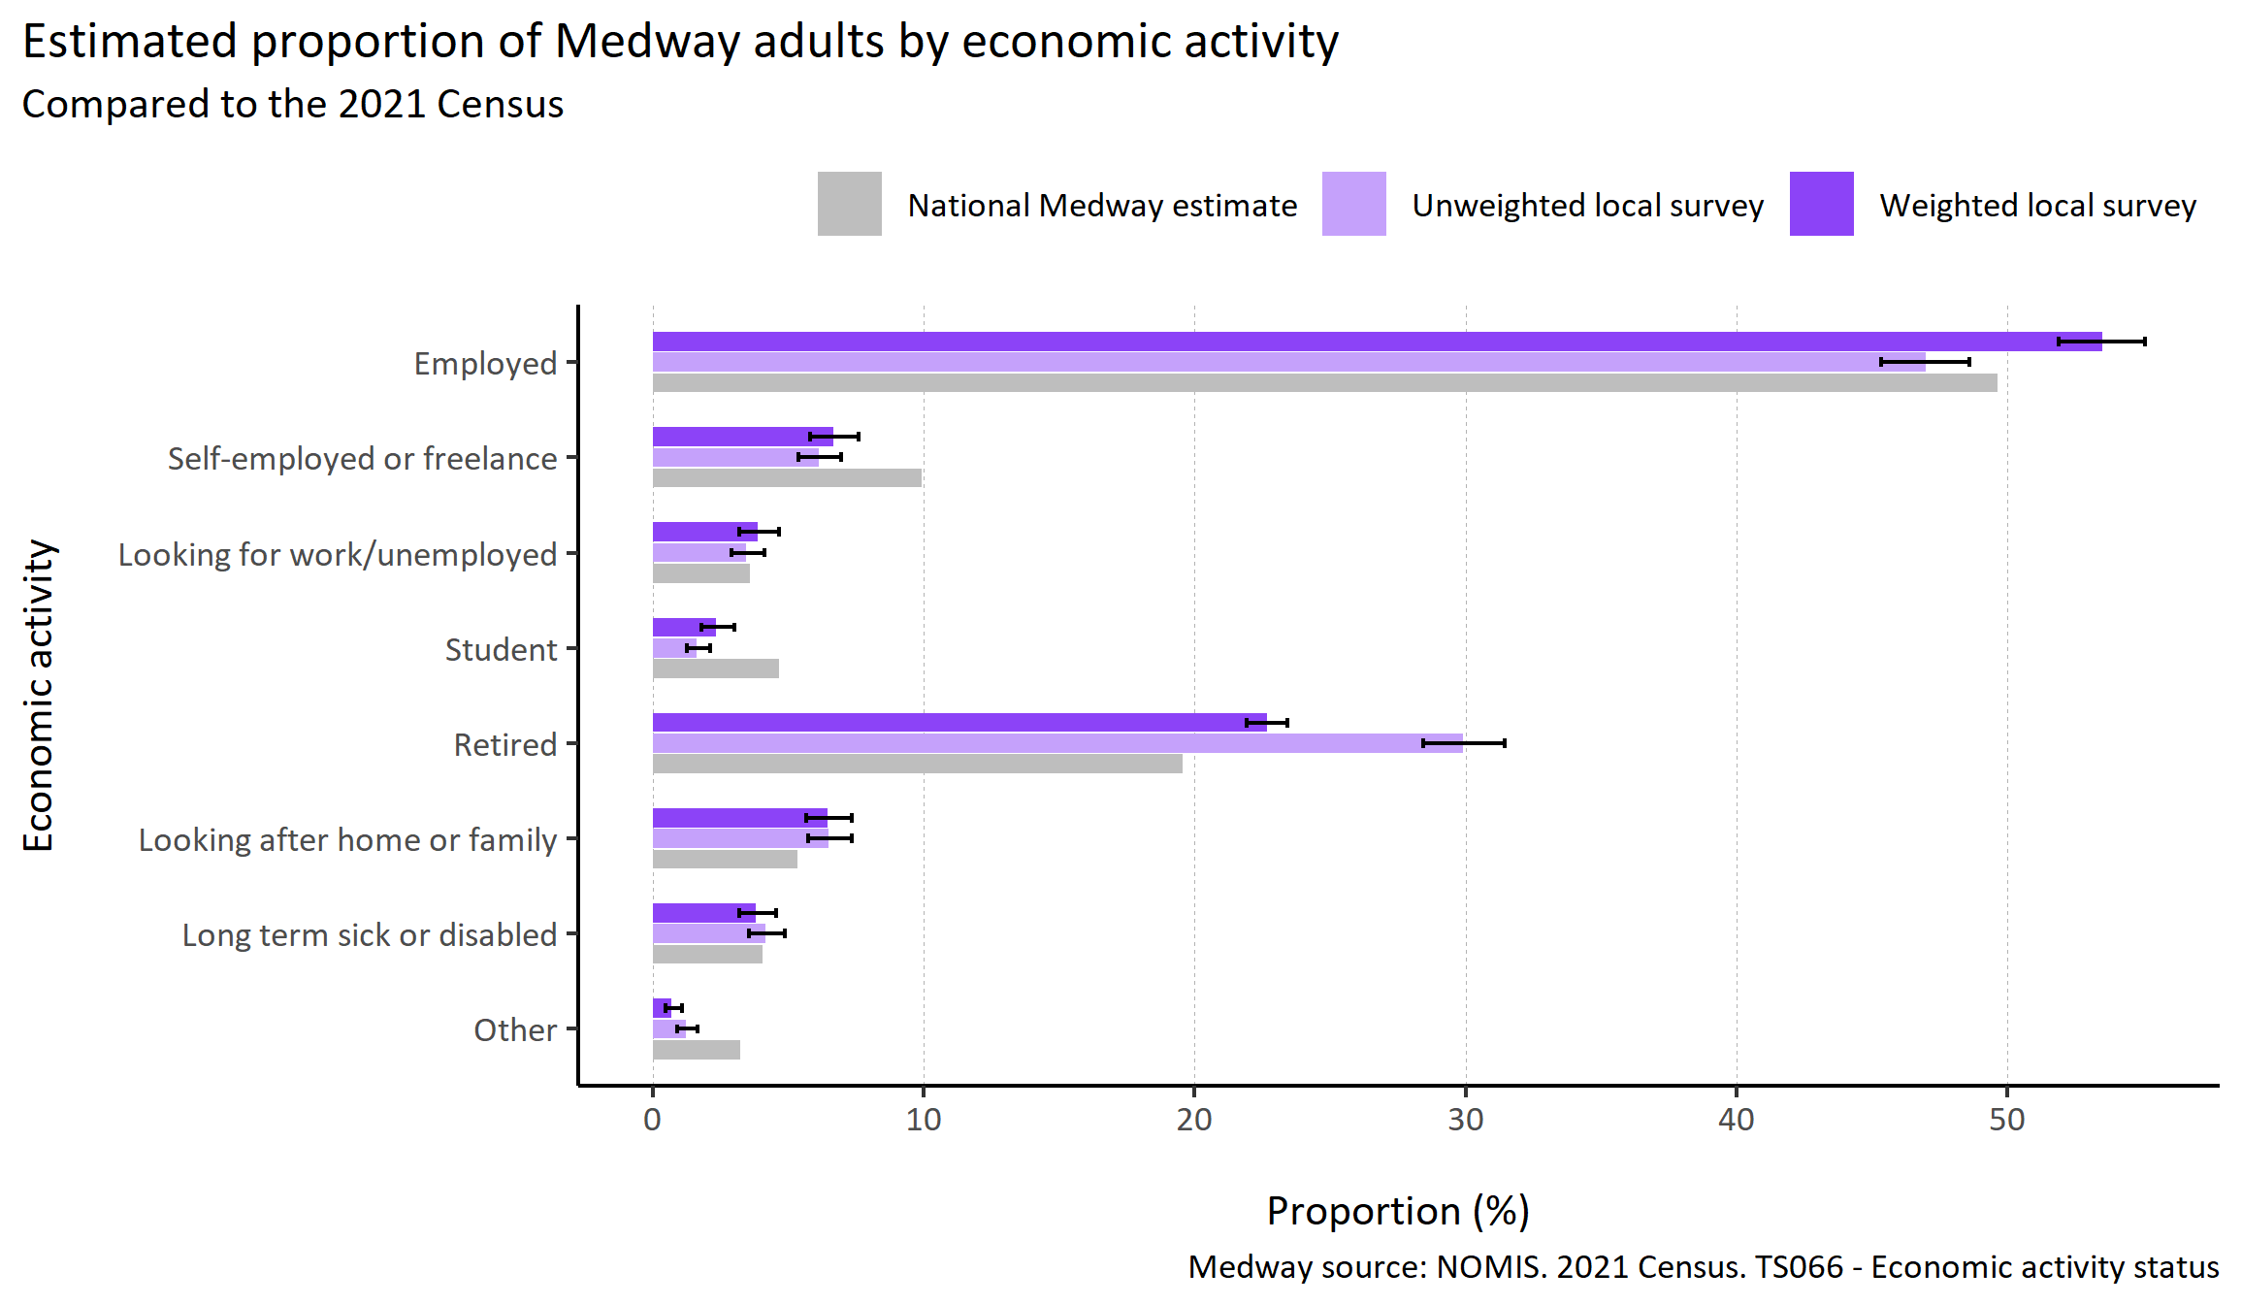
Economic activity
© Medway Council, Public Health Intelligence Team, Version 3.0, 07/08/2023
Plot description
  The distribution of survey responses by economic activity was similar to the 2021 Census.
  However, employed and retired were slightly over-represented and self-employed and student were slightly under-represented.
  The weighted survey results estimate that 53.5% of Medway adults are employed and 6.7% are self-employed or freelance.
  3.9% of Medway adults are unemployed.
  22.7 % are retired.
  40 out of 3,594 survey respondents did not answer this question.
Survey question: Are you...?
Possible answers: Employed, Self-employed or freelance, Looking for work/unemployed, Student, Retired, Looking after home or family, Long term sick or disabled, Other, Don't know/don't want to say.

Slide 29
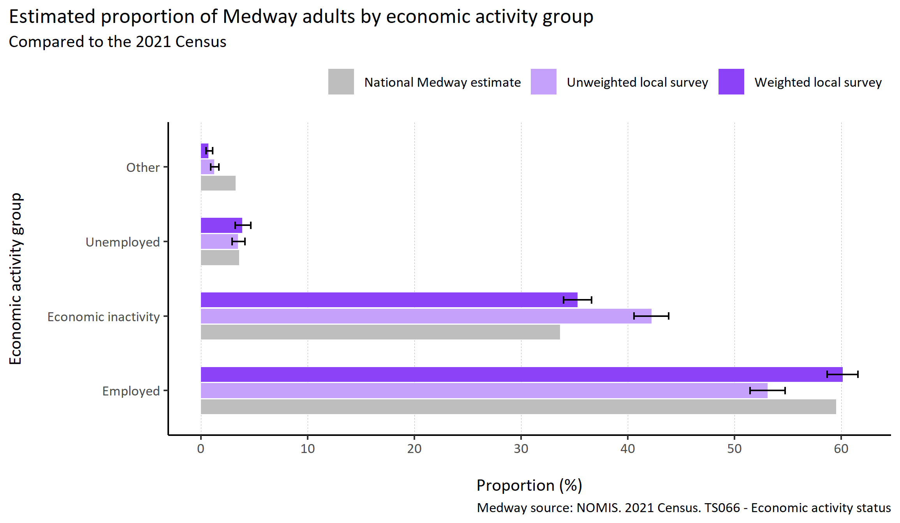
Economic activity grouped
© Medway Council, Public Health Intelligence Team, Version 3.0, 07/08/2023
Plot description
  The distribution of survey responses by economic activity group was similar to the 2021 Census.
  The weighted survey results estimate that 60.1% of Medway adults are employed (including self-employed), 35.3% are economically inactive, and 3.9% are unemployed.
  40 out of 3,594 survey respondents did not answer this question.
Survey question: Are you...?
Possible answers: Employed, Self-employed or freelance, Looking for work/unemployed, Student, Retired, Looking after home or family, Long term sick or disabled, Other, Don't know/don't want to say.
Categories: Employed: Employed; Self-employed or freelance. Economic inactivity: Student; Retired; Looking after home or family; Long term sick or disabled. Unemployed: Looking for work/unemployed. Other.

Slide 30
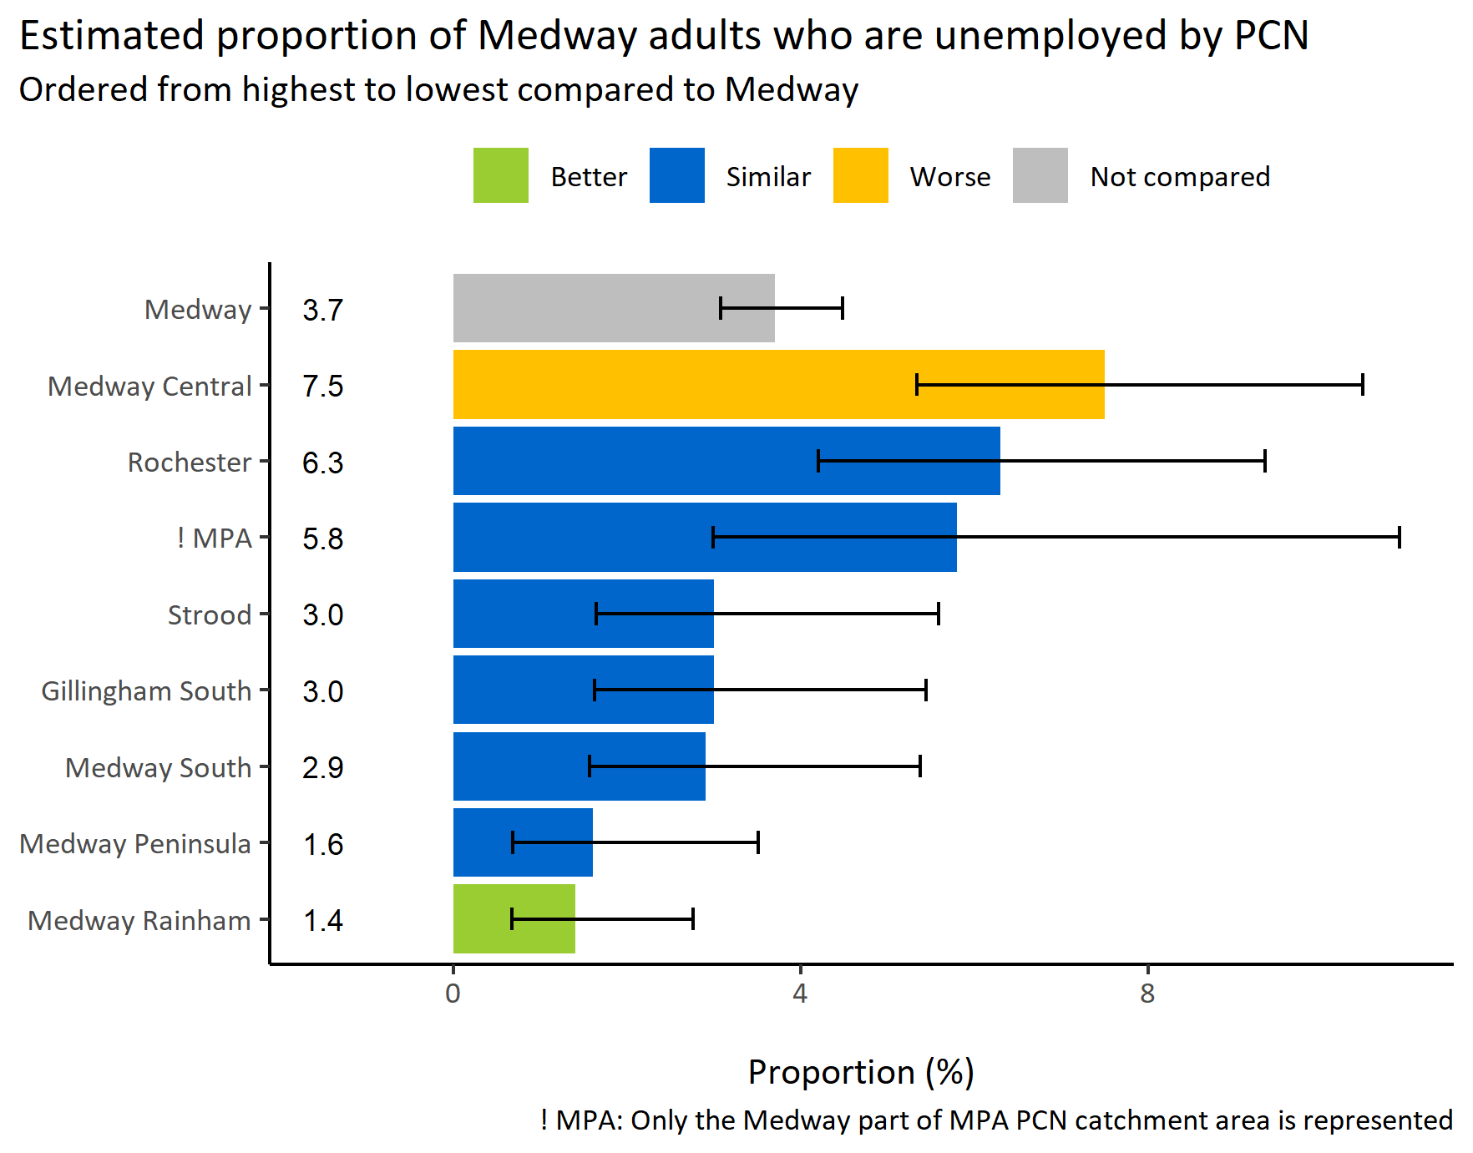
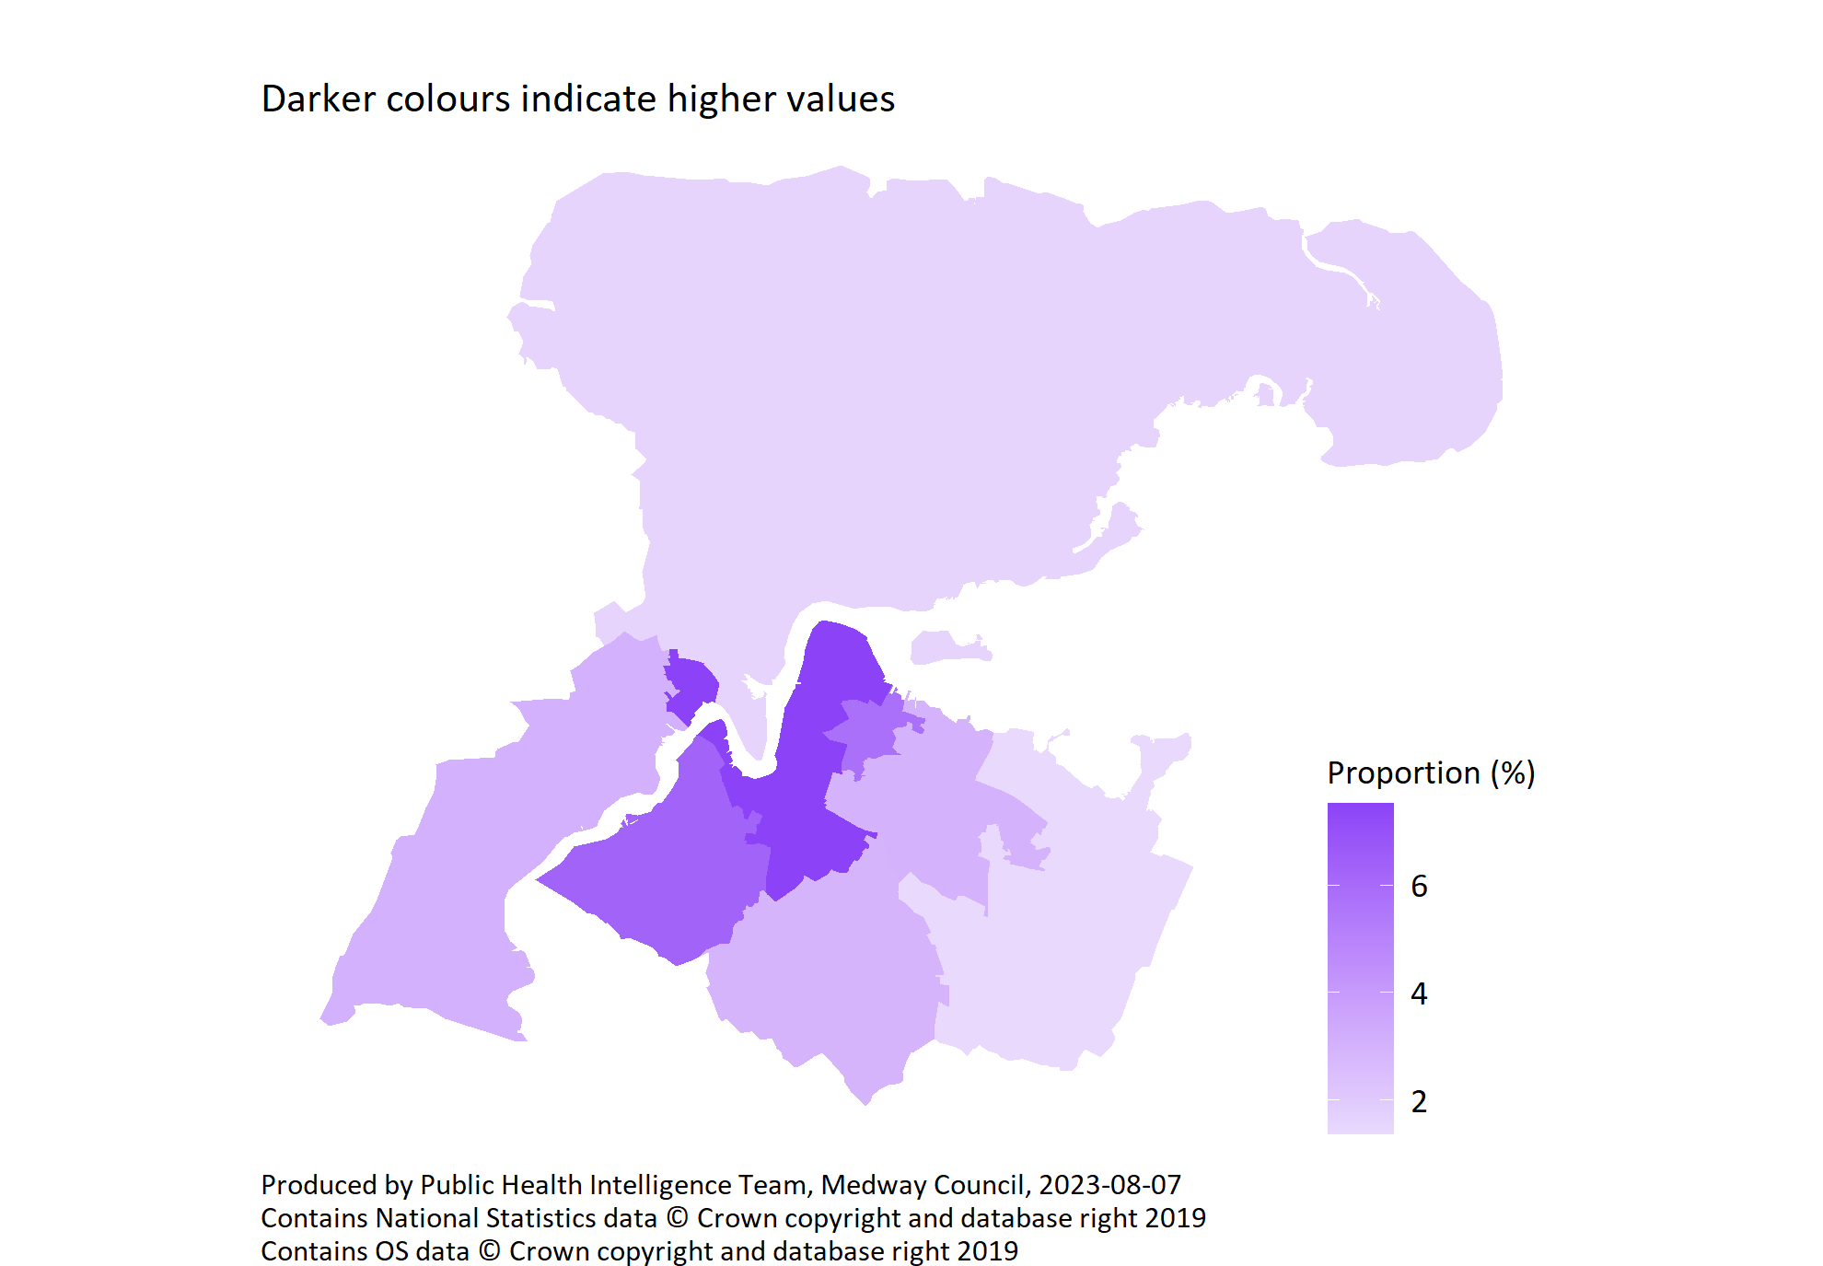
Unemployed by PCN
© Medway Council, Public Health Intelligence Team, Version 3.0, 07/08/2023
Survey question: Are you...?
Possible answers: Employed, Self-employed or freelance, Looking for work/unemployed, Student, Retired, Looking after home or family, Long term sick or disabled, Other, Don't know/don't want to say.
Category selected: Unemployed: Looking for work/unemployed.

Slide 31
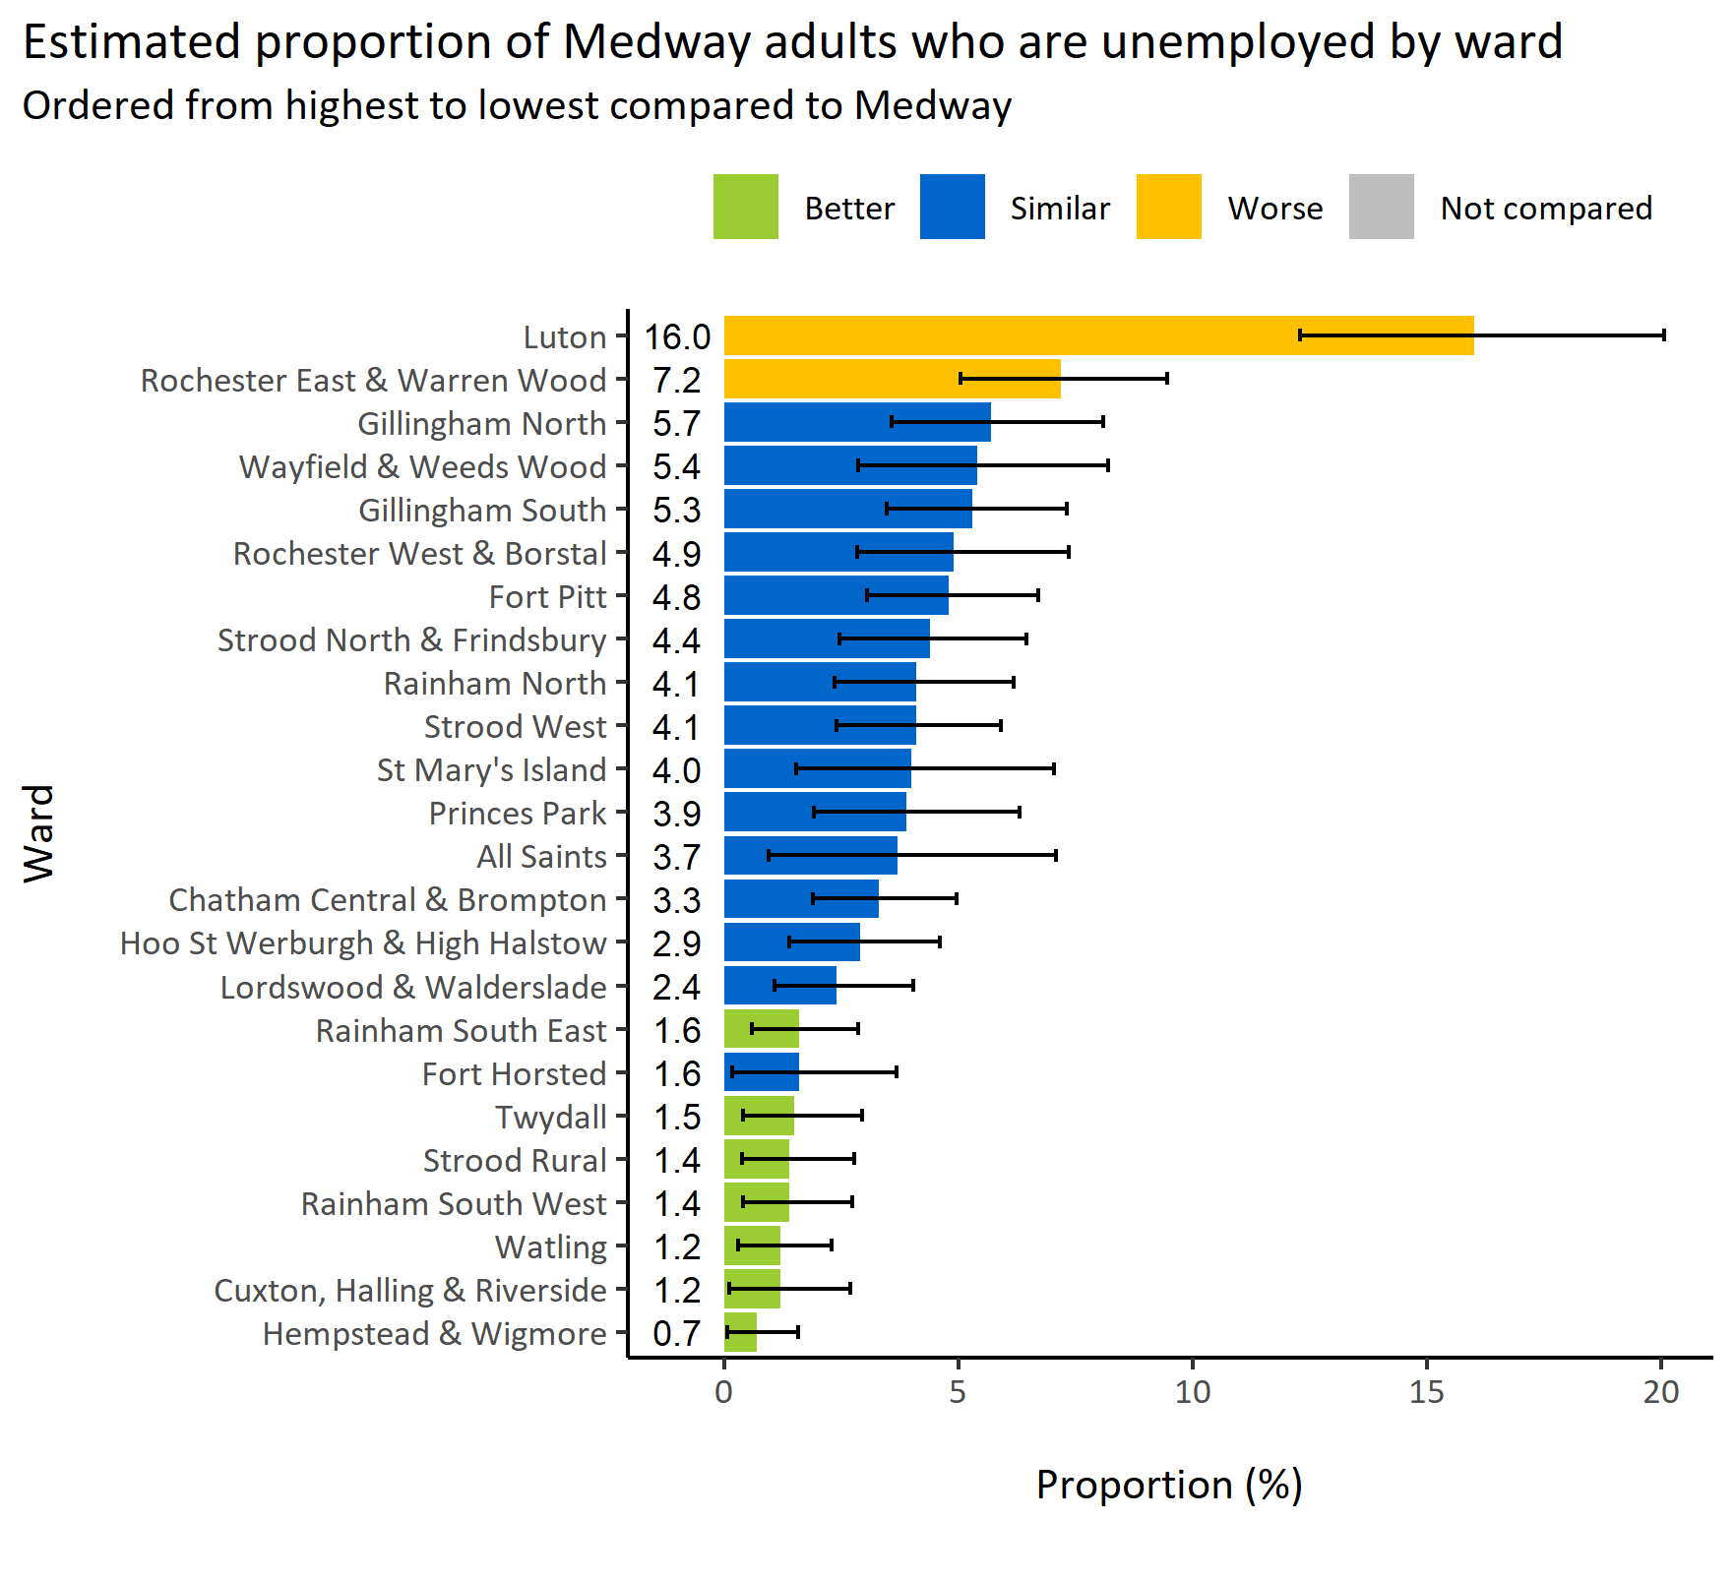
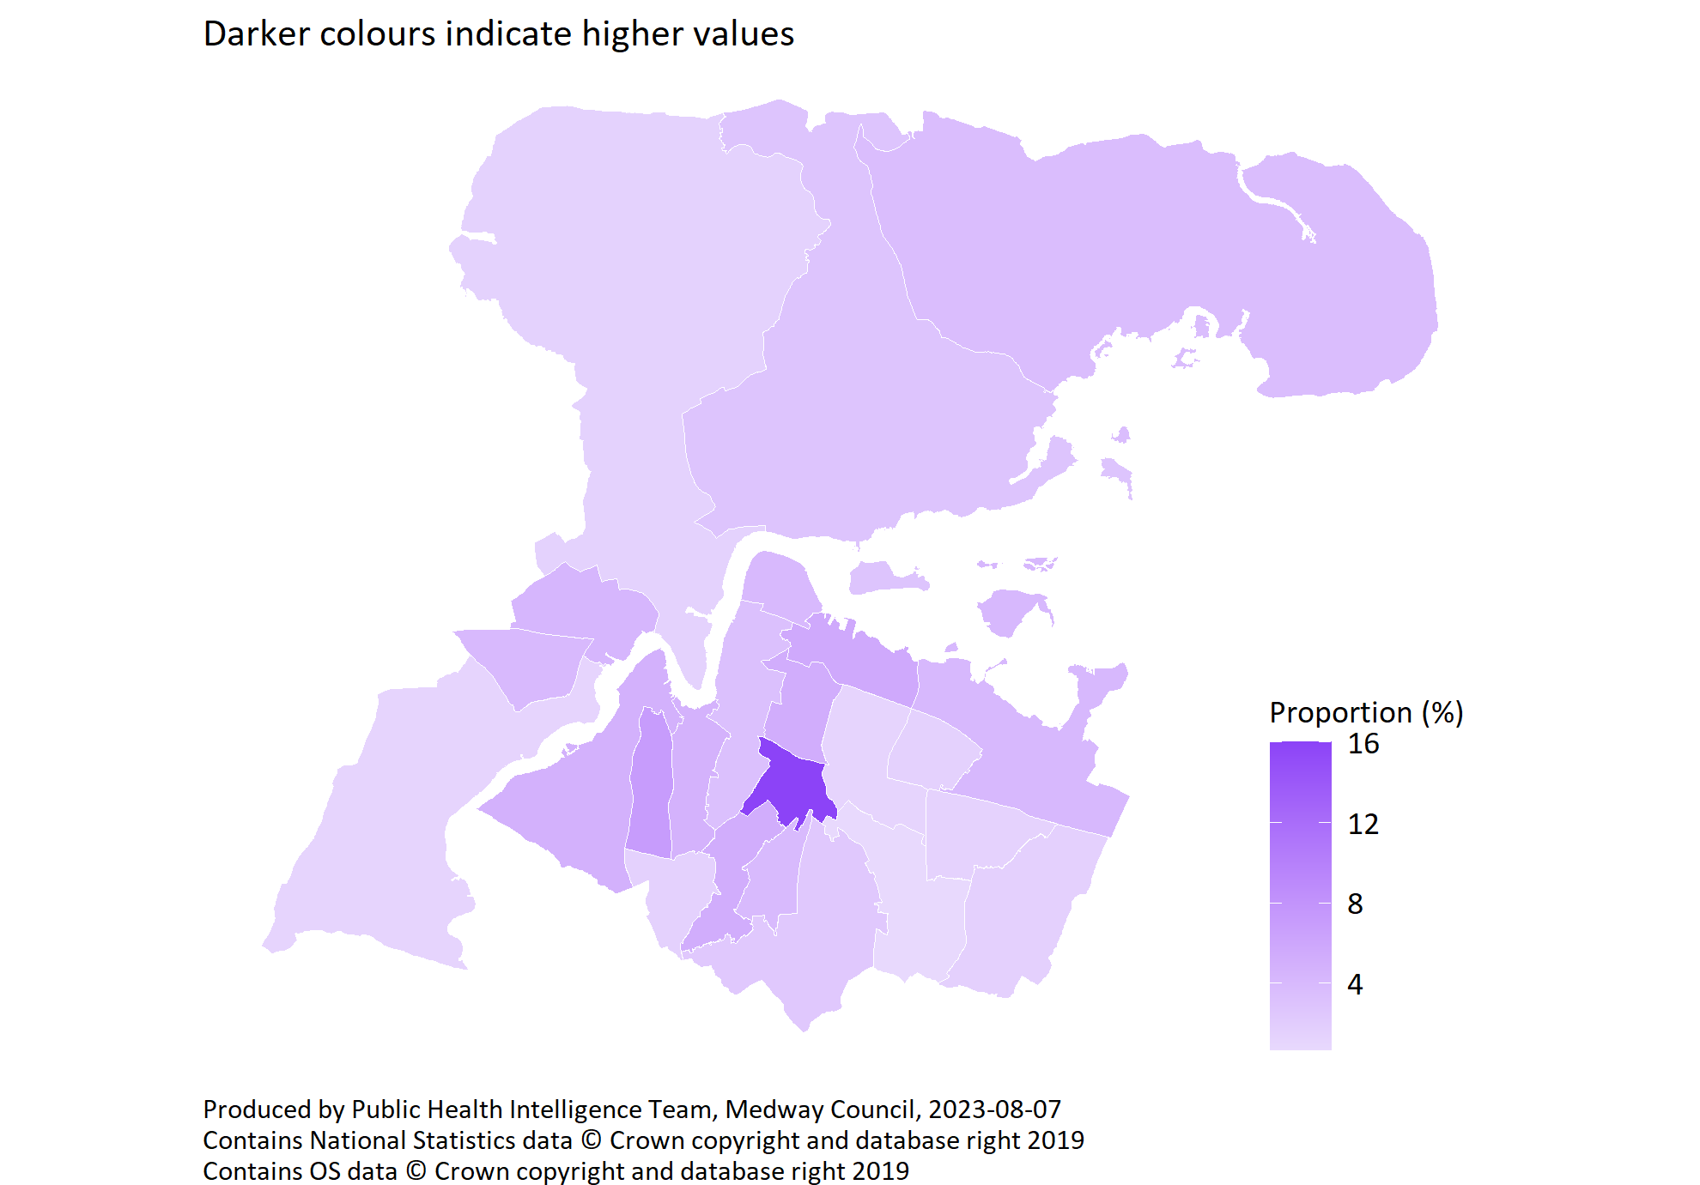
Unemployed by ward
© Medway Council, Public Health Intelligence Team, Version 3.0, 07/08/2023
Survey question: Can you tell me the highest educational or school qualification you have obtained?
Unemployed: Answers include people who are looking for work or are unemployed.
Estimates are calculated using Bayesian methods. These do not take into
account survey weighting but will be updated in the future to do so.

Slide 32
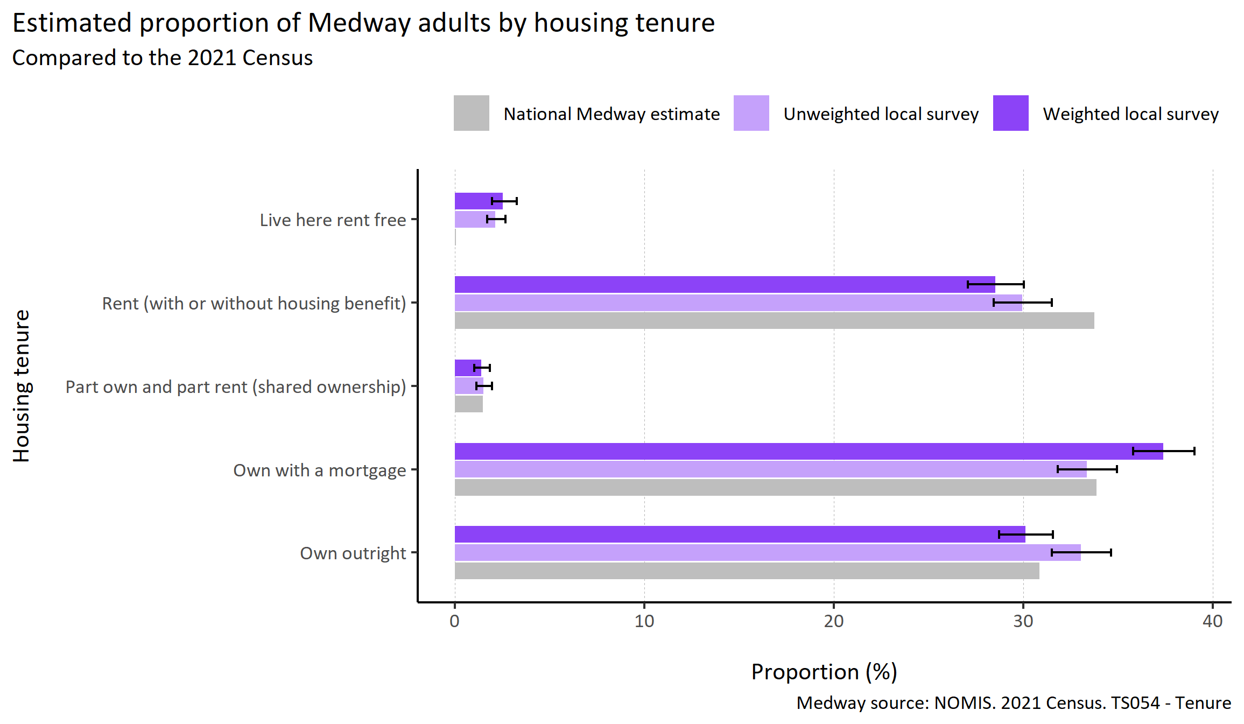
Housing tenure
© Medway Council, Public Health Intelligence Team, Version 3.0, 07/08/2023
Plot description
  The distribution of survey responses by housing tenure was similar to the 2021 Census.
  However, those that 'own with a mortgage' or 'live here rent free' were slightly over-represented and those that 'rent (with or without housing benefit)' were slightly under-represented.
  The weighted survey results estimate that 30.1% of Medway adults own their home outright, 37.4% own with a mortgage, 28.5% rent, 1.4% have shared ownership over their home, and 2.6% live rent free.
  144 out of 3,594 survey respondents did not answer this question.
Survey question: Thinking about your home, do you...?
Possible answers: Own outright, Own with a mortgage, Part own and part rent (shared ownership), Rent (with or without housing benefit), Live here rent free, Don't know/don't want to say.

Slide 33
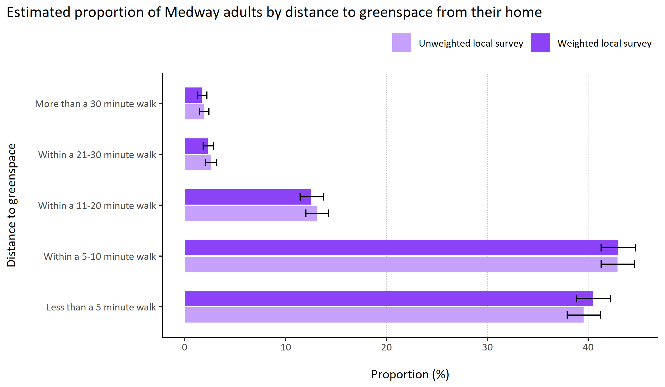
Distance to greenspace
© Medway Council, Public Health Intelligence Team, Version 3.0, 07/08/2023
Plot description
  National Medway estimate not available for comparison for this indicator.
  The weighted survey results estimate that 40.5% of Medway adults live within a 5 minute walk of greenspace, 43.0% live within 5 to 10 minutes, 12.6% live within 10 to 20 minutes, 2.3% live within 20 to 30 minutes, and 1.7% live 30 minutes or more away from greenspace.
  155 out of 3,594 survey respondents did not answer this question.
Survey question: How far away from your home is your nearest greenspace area?
Possible answers: Less than a 5 minute walk, Within a 5-10 minute walk, Within a 11-20 minute walk, Within a 21-30 minute walk, More than a 30 minute walk, Don't know/don't want to say.

Slide 34
General health

Slide 35
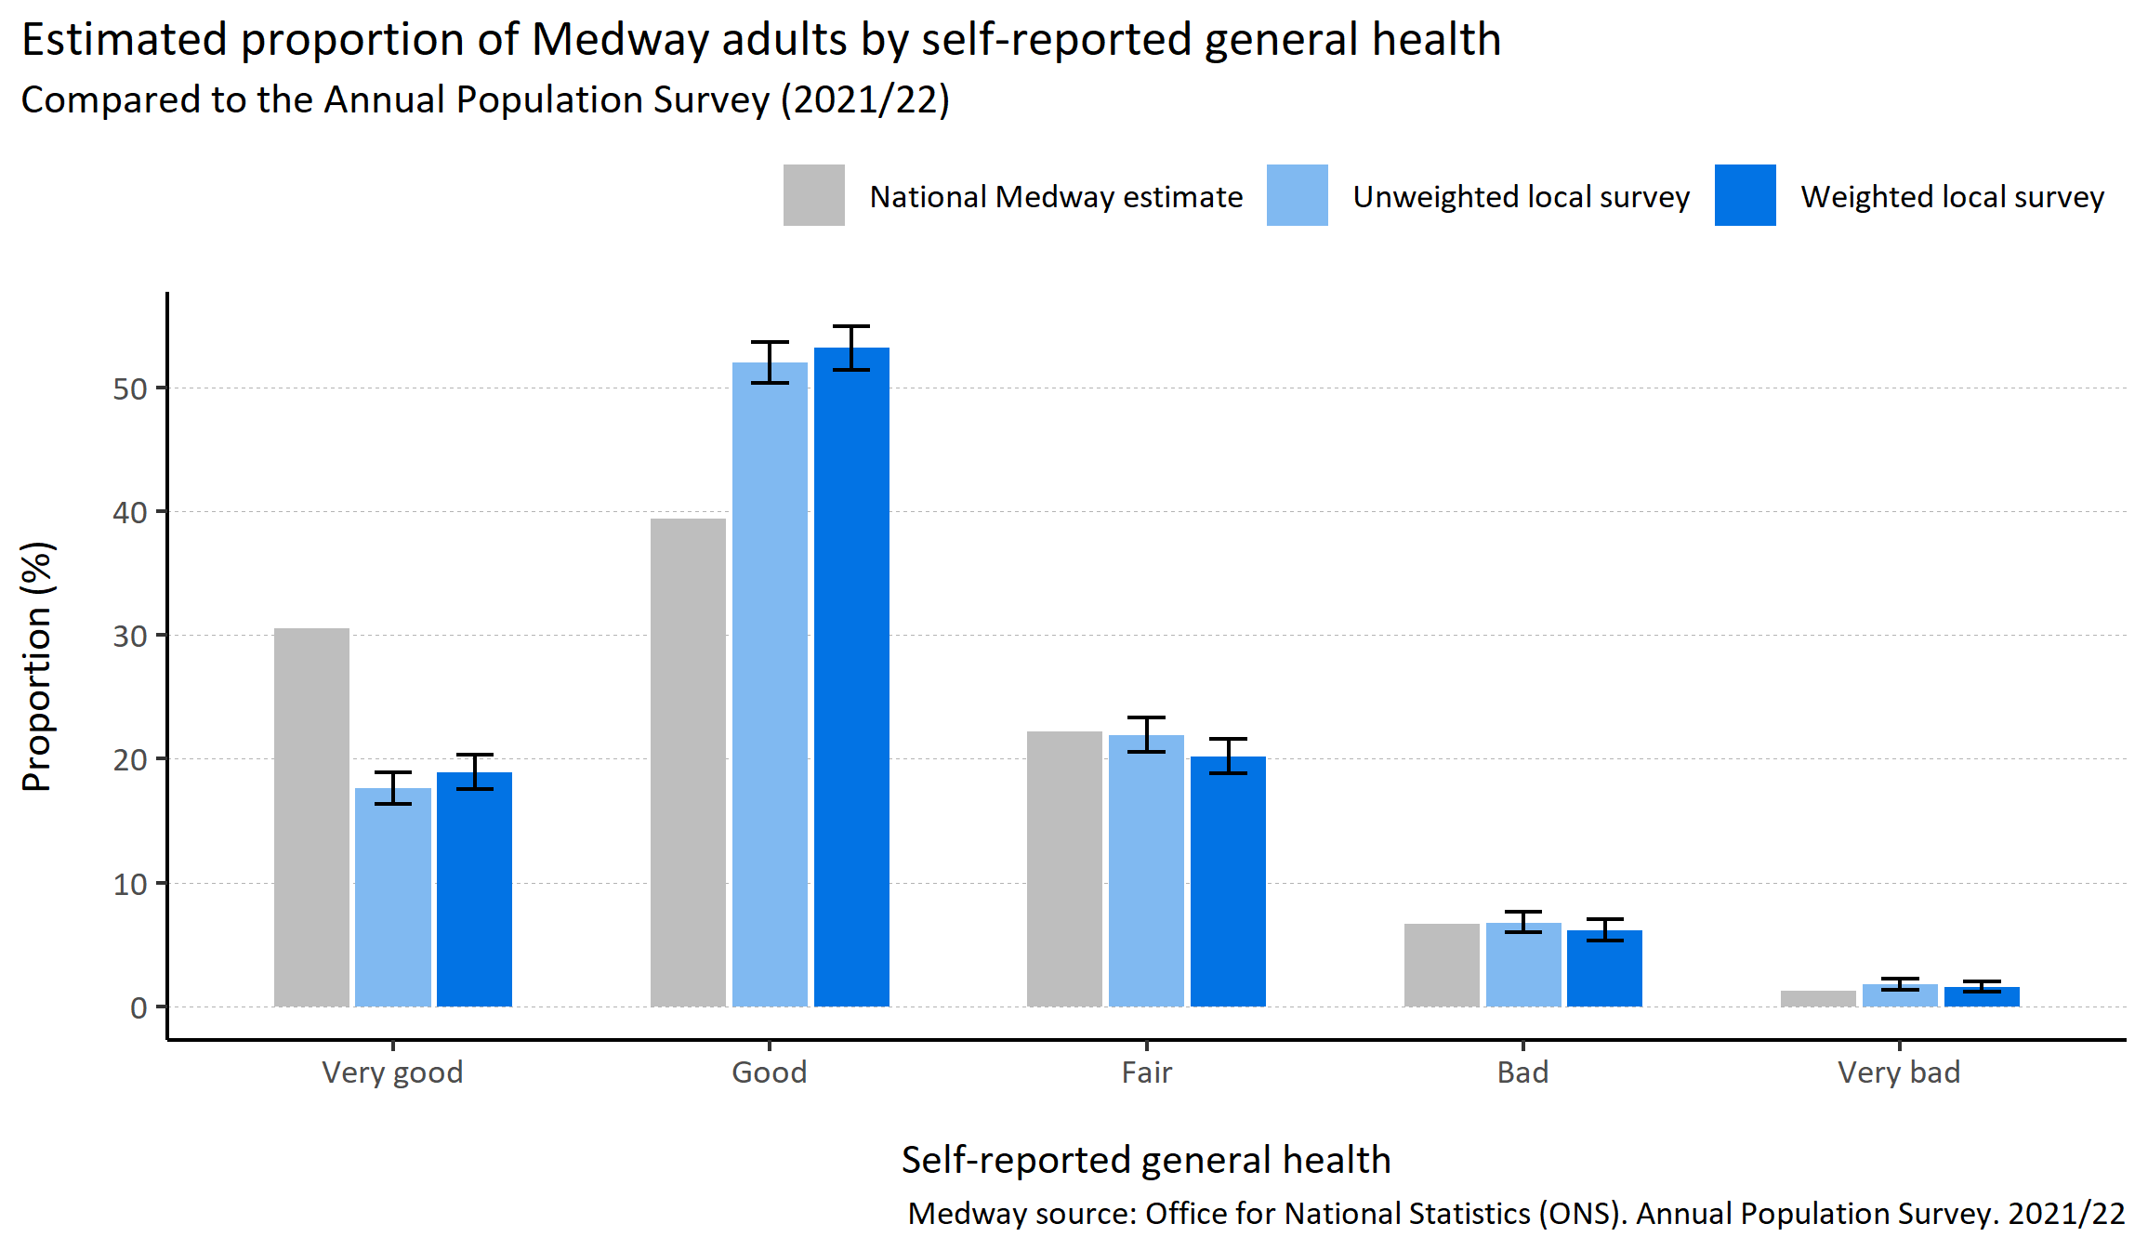
Self-reported general health
© Medway Council, Public Health Intelligence Team, Version 3.0, 07/08/2023
Plot description
  The weighted survey results for self-reported fair, bad and very bad general health are comparable to national estimates.
  However, the weighted survey results showed a lower proportion of self-reported very good health and a higher proportion self-reported good health compared to national estimates.
  The weighted survey results estimate that 18.9% of Medway adults would describe their general health as very good, 53.2% as good, 20.2% as fair, 6.1% as bad and 1.6% as very bad.
  49 out of 3,594 survey respondents did not answer this question.
Survey question: How is your health in general?
Possible answers: Very good, Good, Fair, Bad, Very bad, Don't know/don't want to say.

Slide 36
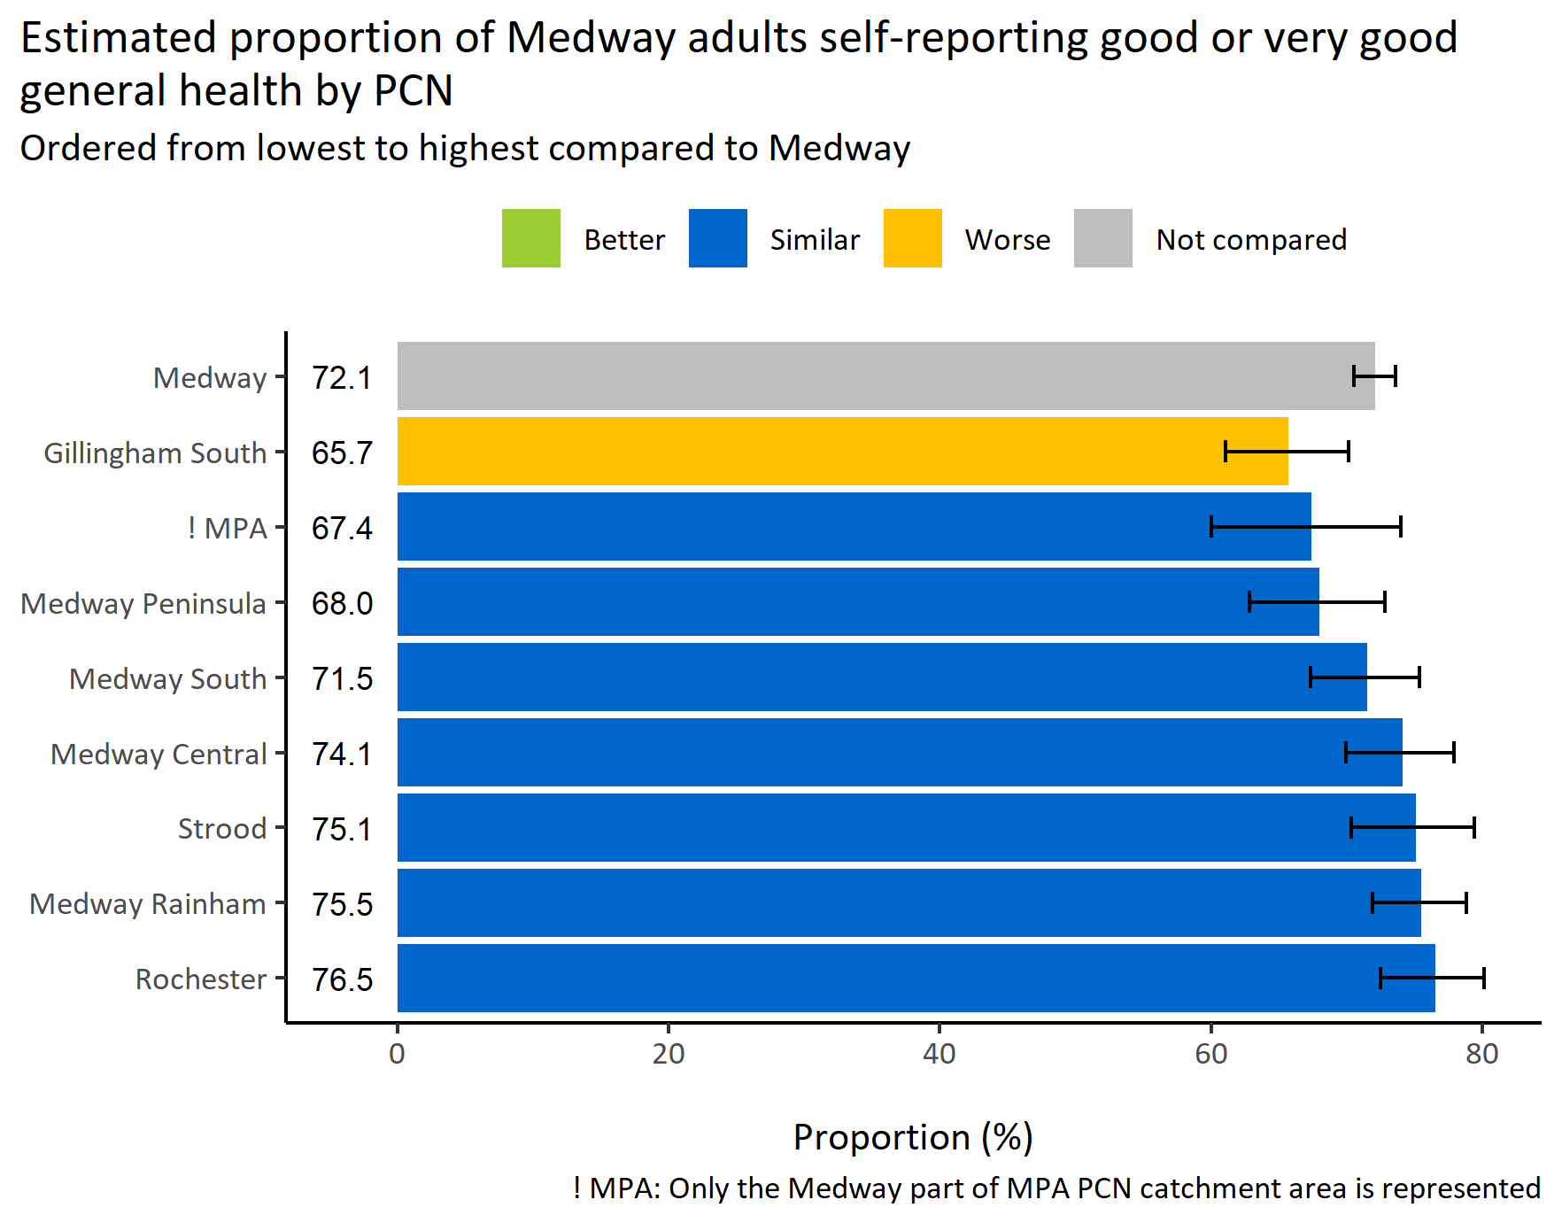
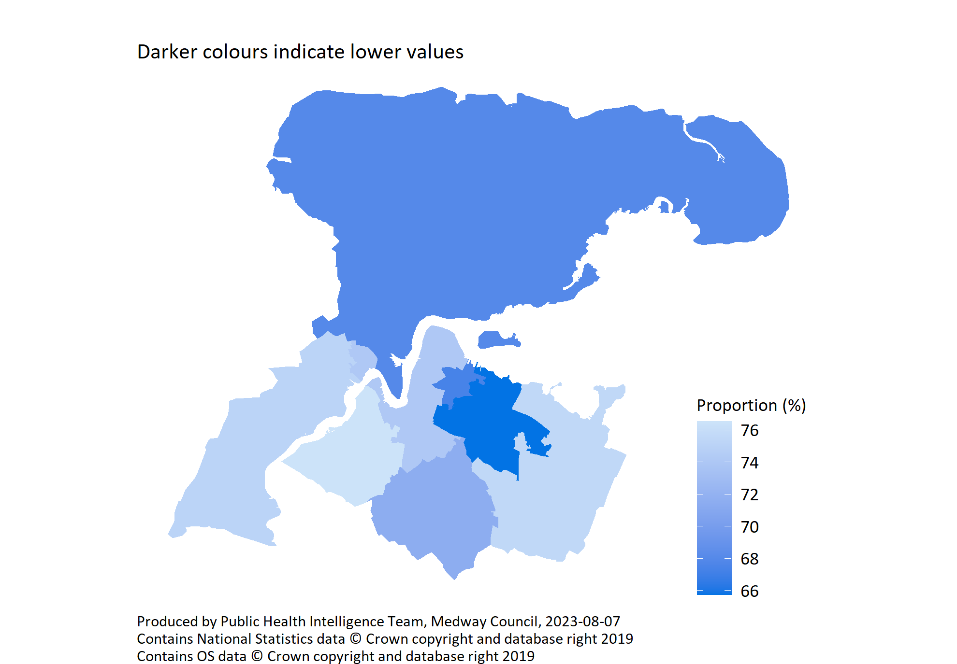
Self-reported general health by PCN
© Medway Council, Public Health Intelligence Team, Version 3.0, 07/08/2023
Survey question: How is your health in general?
Possible answers: Very good, Good, Fair, Bad, Very bad, Don't know/don't want to say.
Categories selected: Good or very good.

Slide 37
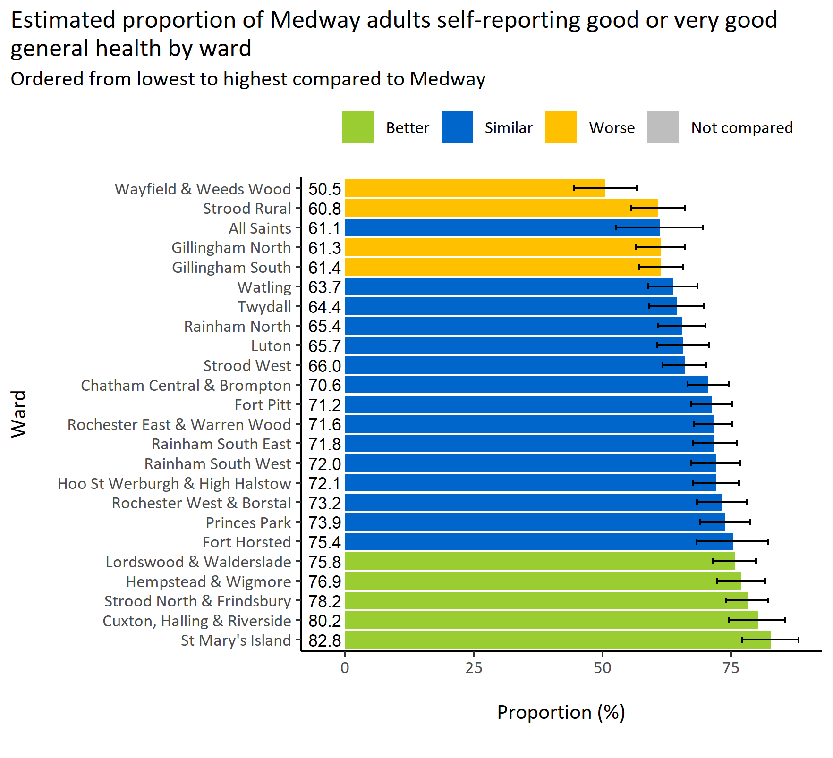
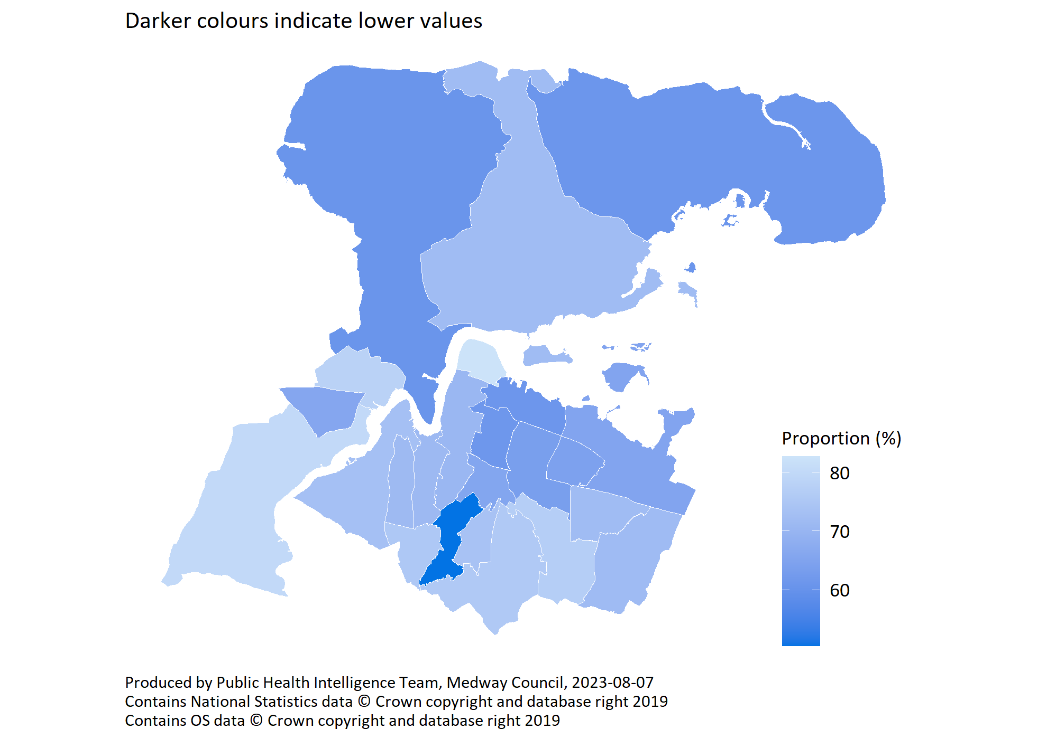
Self-reported general health by ward
© Medway Council, Public Health Intelligence Team, Version 3.0, 07/08/2023
Survey question: How is your health in general?
Categories selected: Answers include people who report good or very good health.
Estimates are calculated using Bayesian methods. These do not take into
account survey weighting but will be updated in the future to do so.

Slide 38
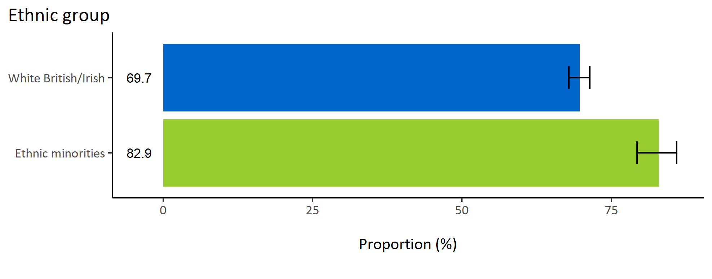
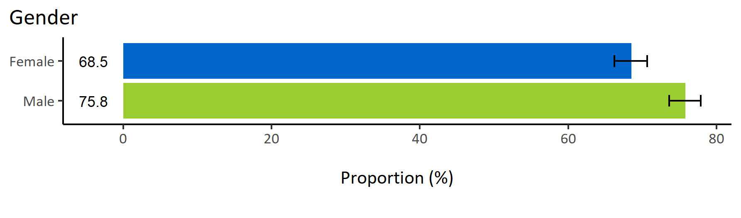
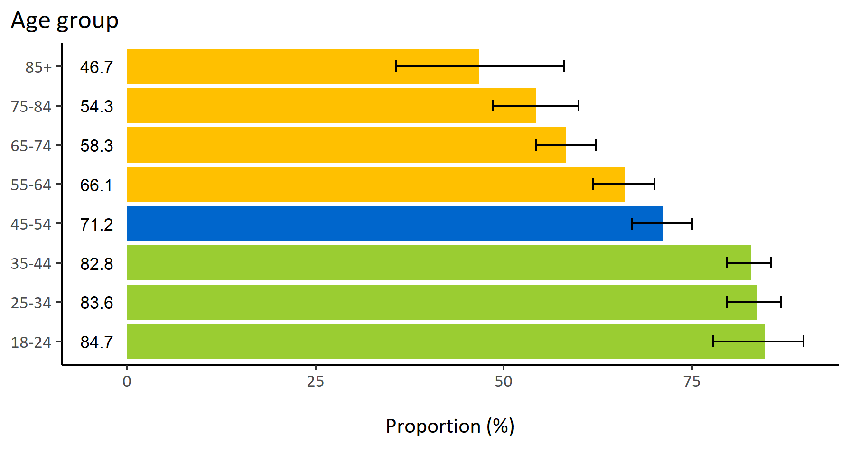
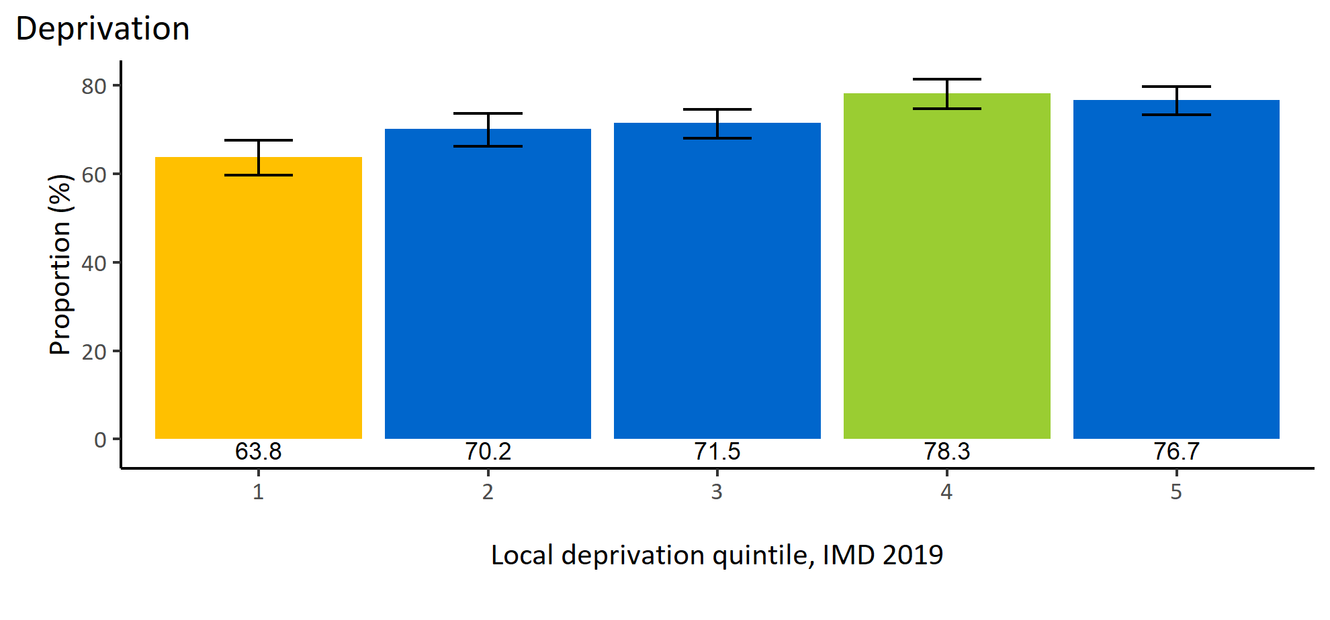
Self-reported general health by inequalities
© Medway Council, Public Health Intelligence Team, Version 3.0, 07/08/2023
Estimated proportion of Medway adults self-reporting good or very good general health by inequalities

Slide 39
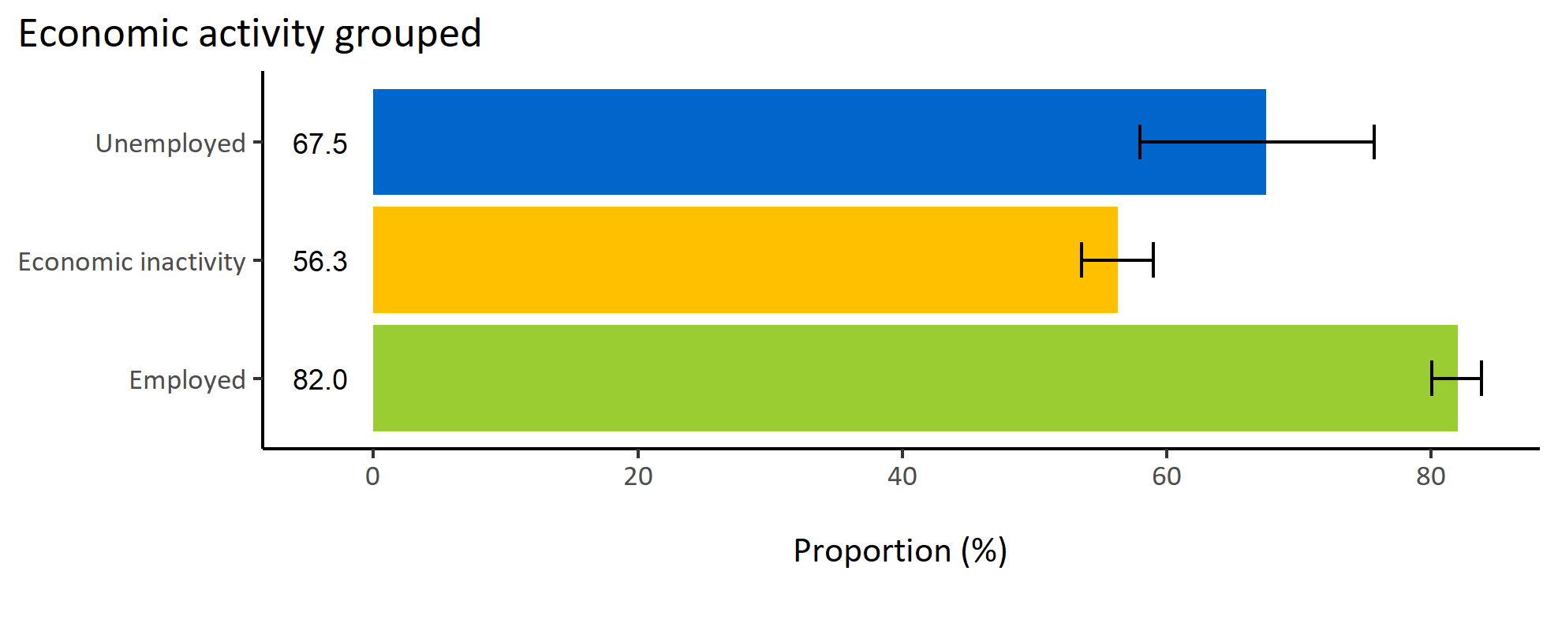
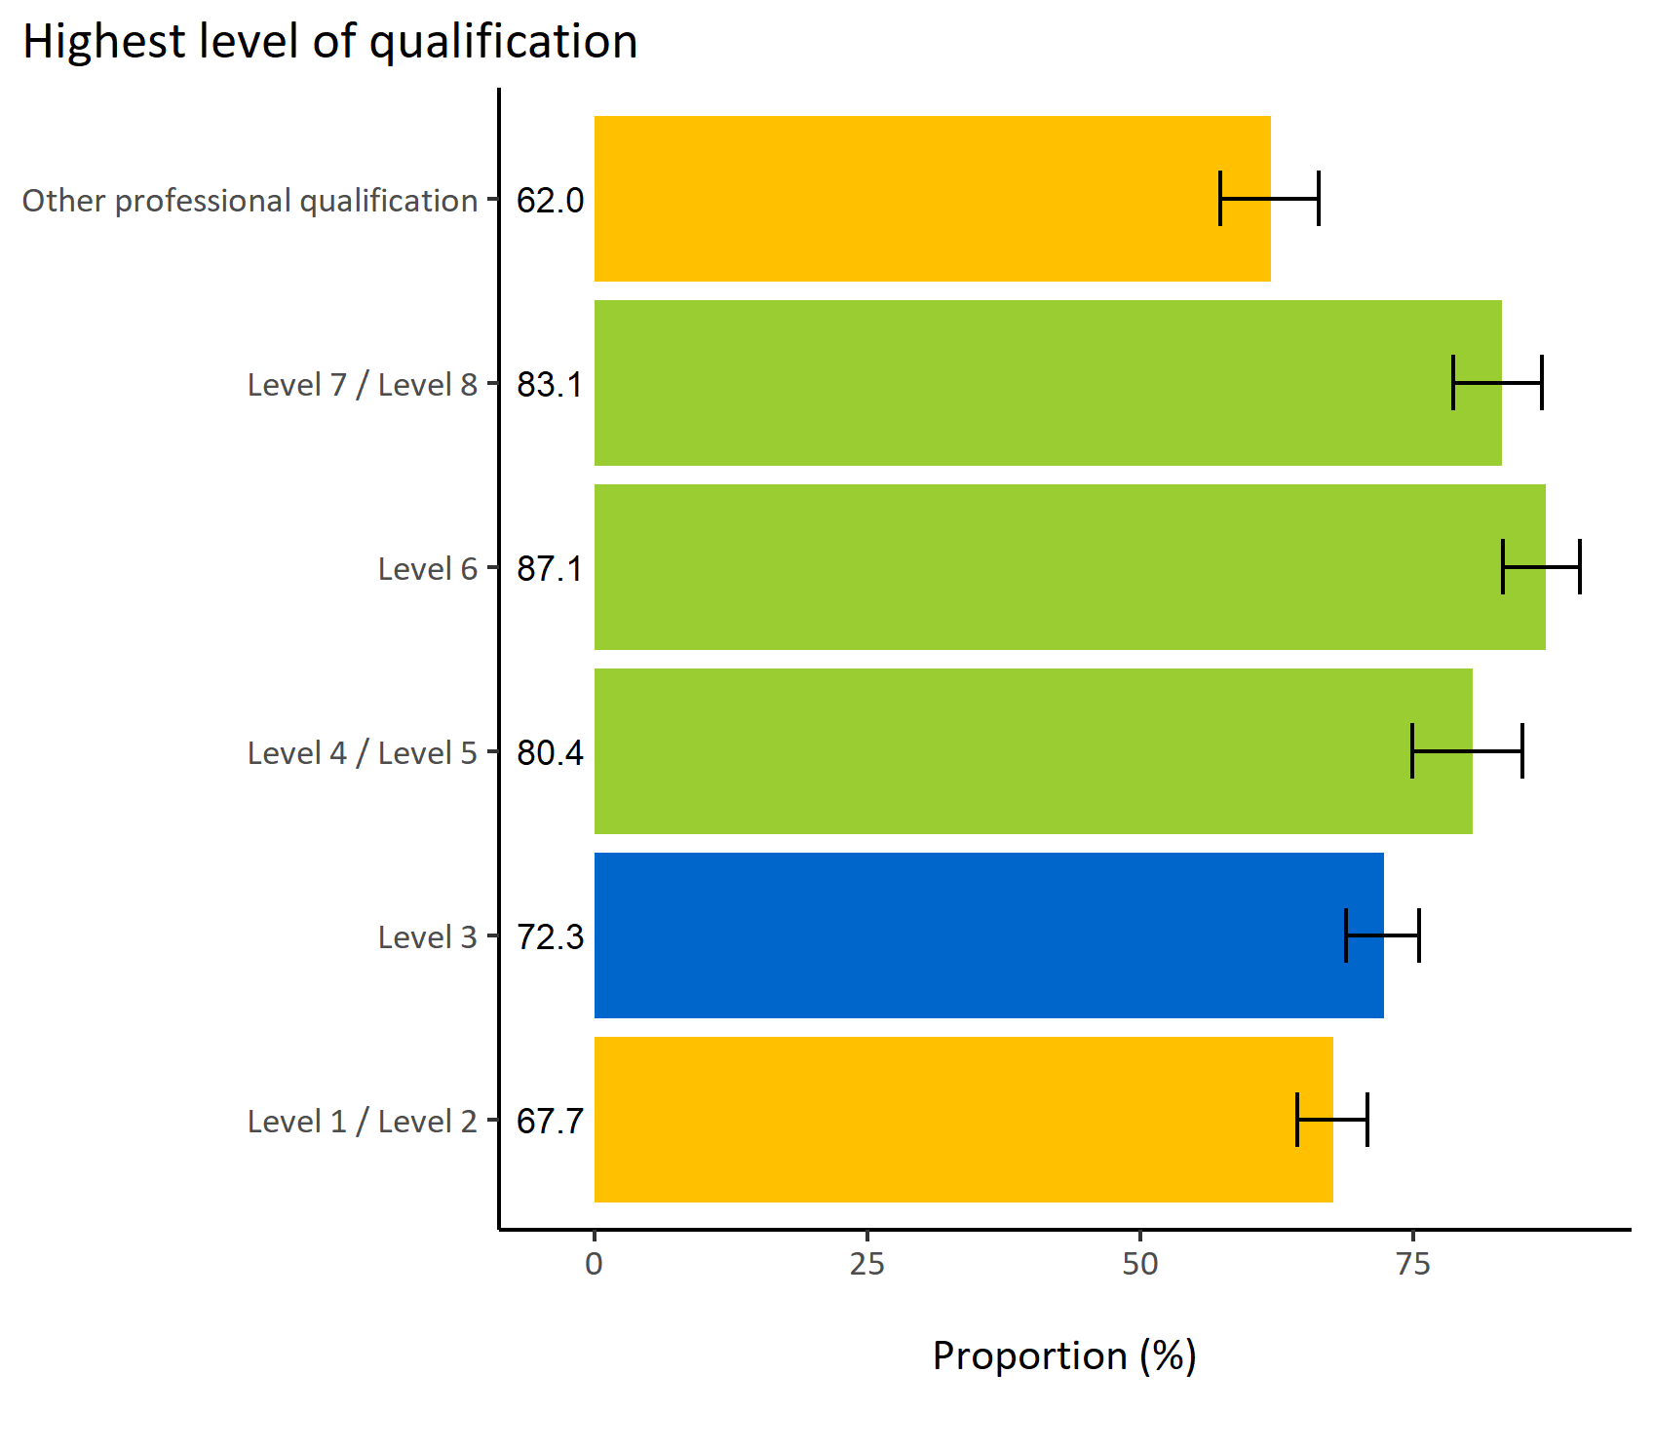
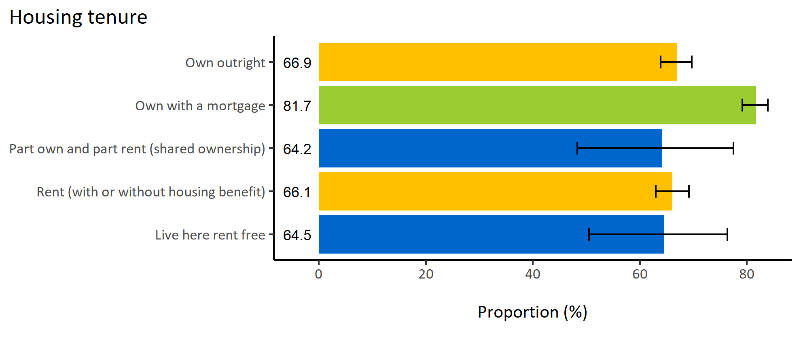
Self-reported general health by wider determinants
© Medway Council, Public Health Intelligence Team, Version 3.0, 07/08/2023
Estimated proportion of Medway adults self-reporting good or very good general health by wider determinants

Slide 40
Summary: Self-reported general health
© Medway Council, Public Health Intelligence Team, Version 3.0, 07/08/2023
The weighted survey results estimate that 72.1% of Medway adults would describe their general health as good or very good.
Certain groups in Medway are less likely to describe their general health as good or very good. These groups include:
  Adults in Gillingham South PCN
  Adults in wards Strood Rural, Wayfield & Weeds Wood, Gillingham North, and Gillingham South
  Adults aged 55 and over
  Adults living in areas of high deprivation (quintile 1)
  Adults whose highest qualification achieved is level 1 or 2, or another professional qualification
  Economically inactive adults
  Adults who own their home outright or rent (with or without housing benefit).

Slide 41
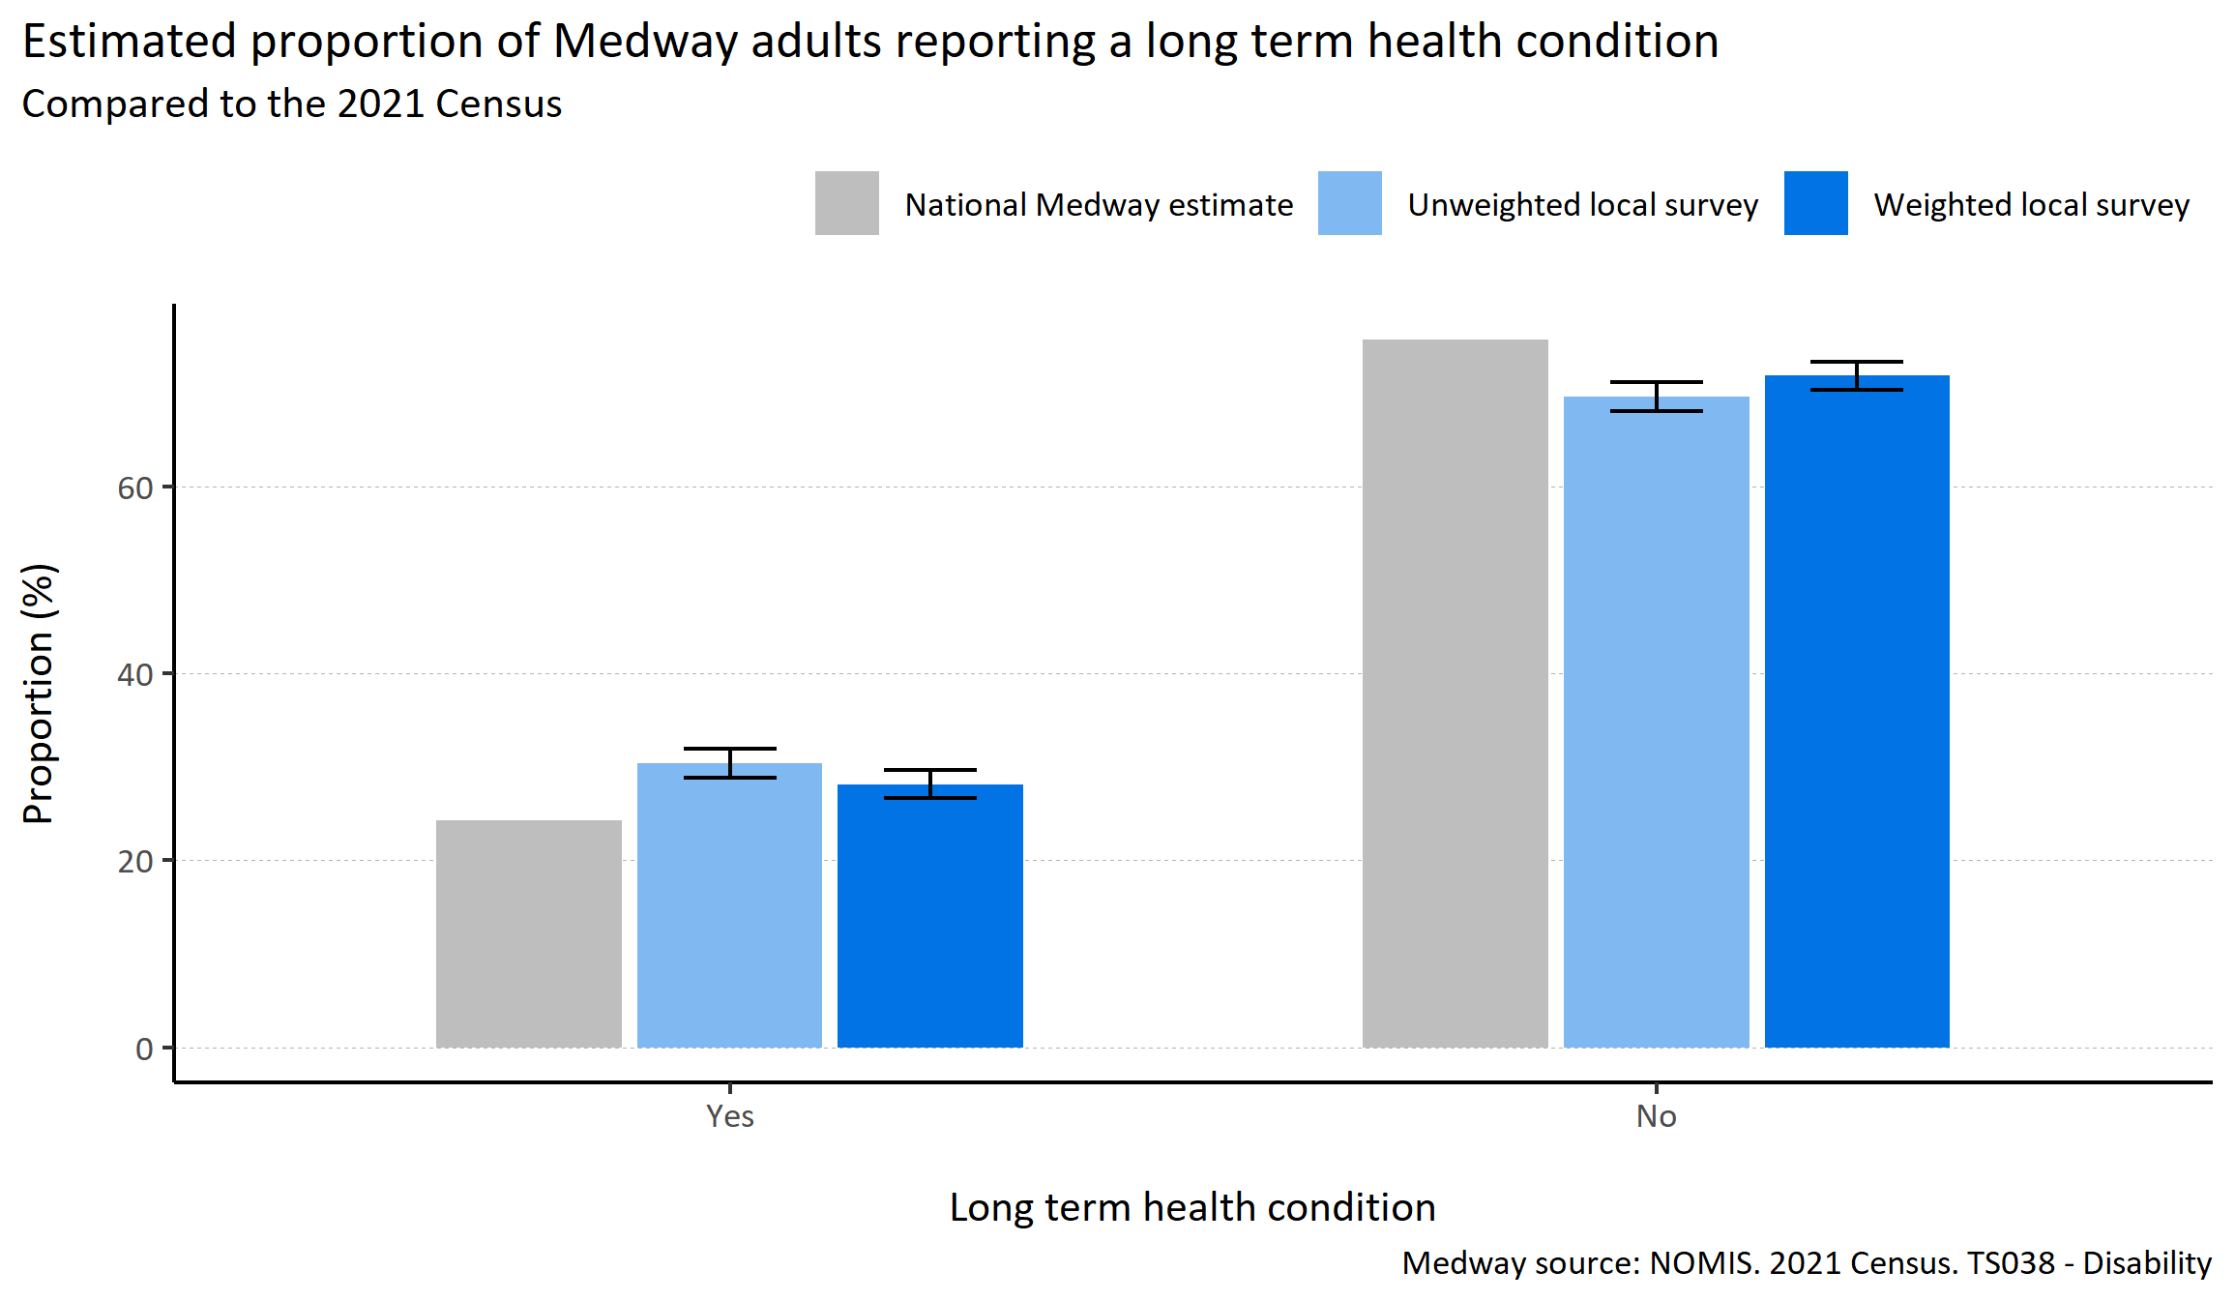
Long term health conditions
© Medway Council, Public Health Intelligence Team, Version 3.0, 07/08/2023
Plot description
  The distribution of survey responses by long term health condition was similar to the 2021 Census.
  The weighted survey results estimate that 28.1% of Medway adults report having a physical or mental long term health condition.
  76 out of 3,594 survey respondents did not answer this question.
Survey question: Do you have any physical or mental health conditions or illnesses lasting or expecting to last 12 months or more?
Possible answers: Yes, No, Don't know/don't want to say.

Slide 42
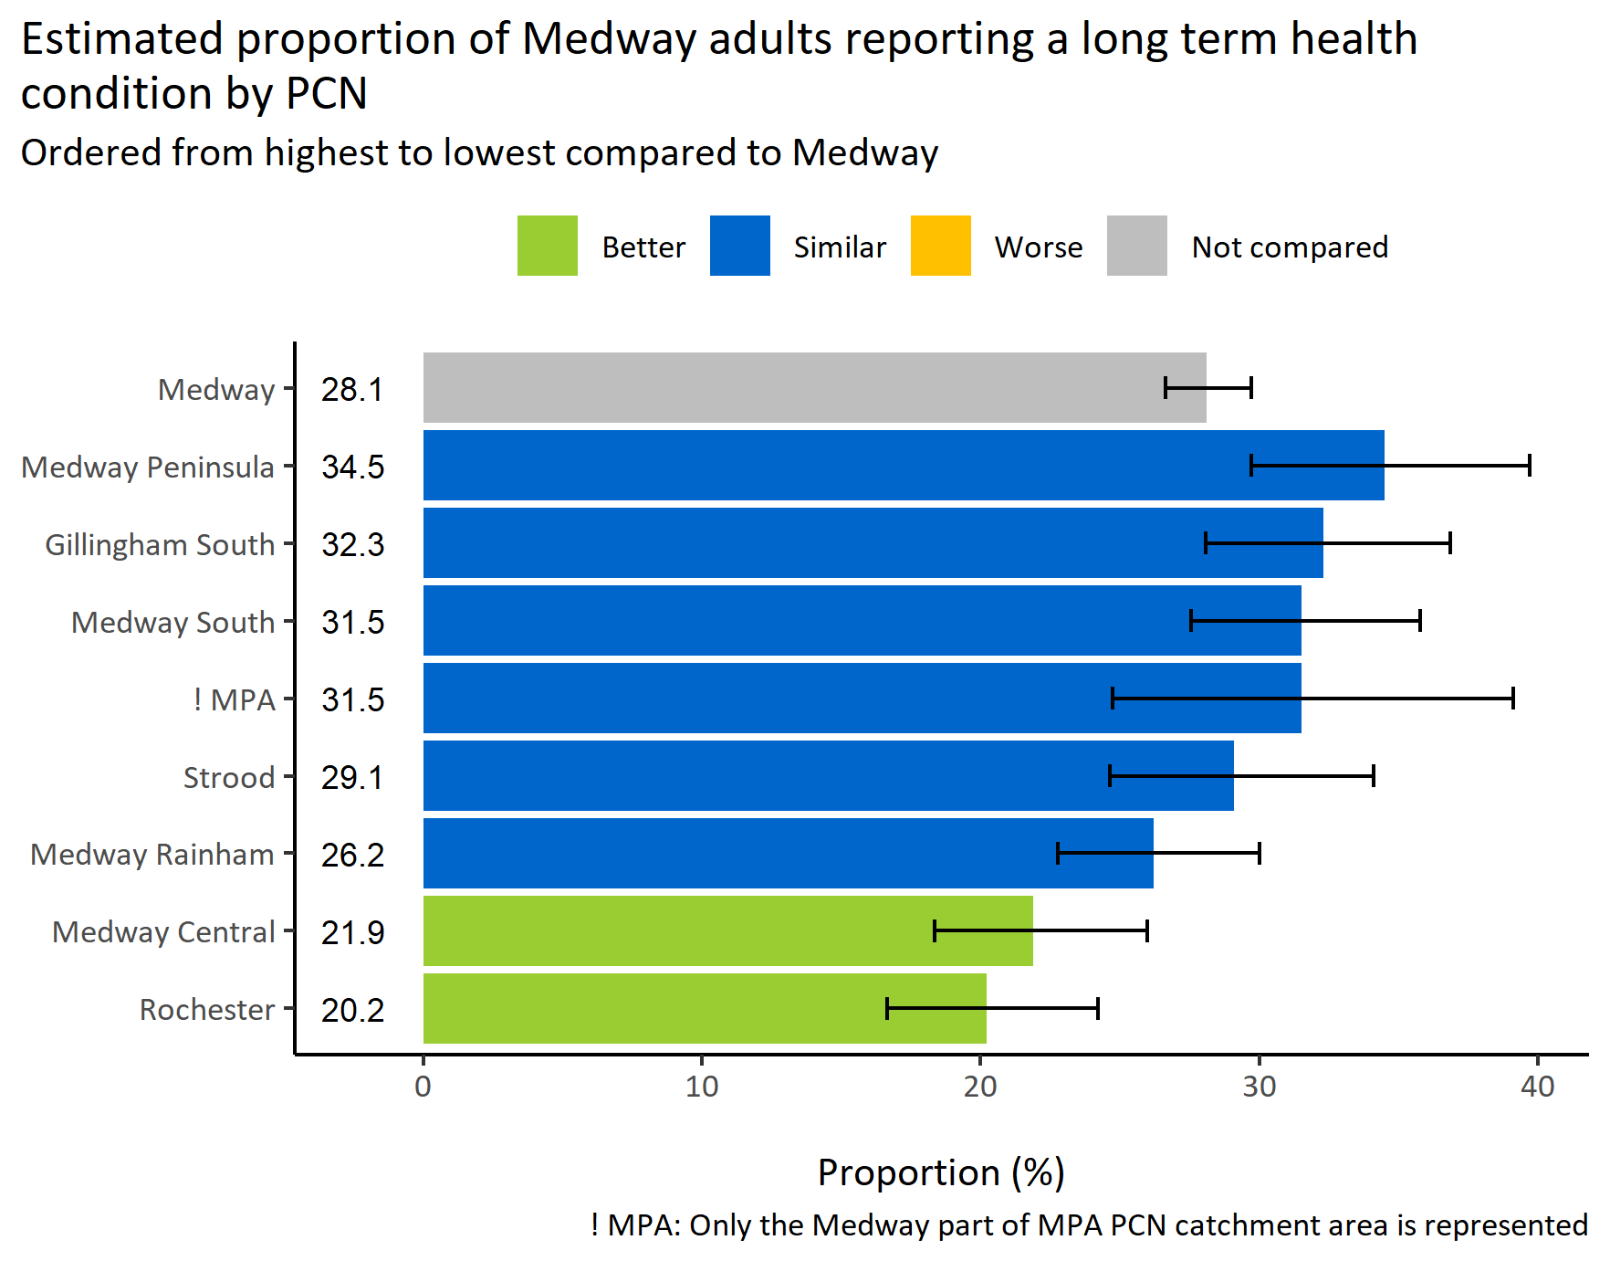
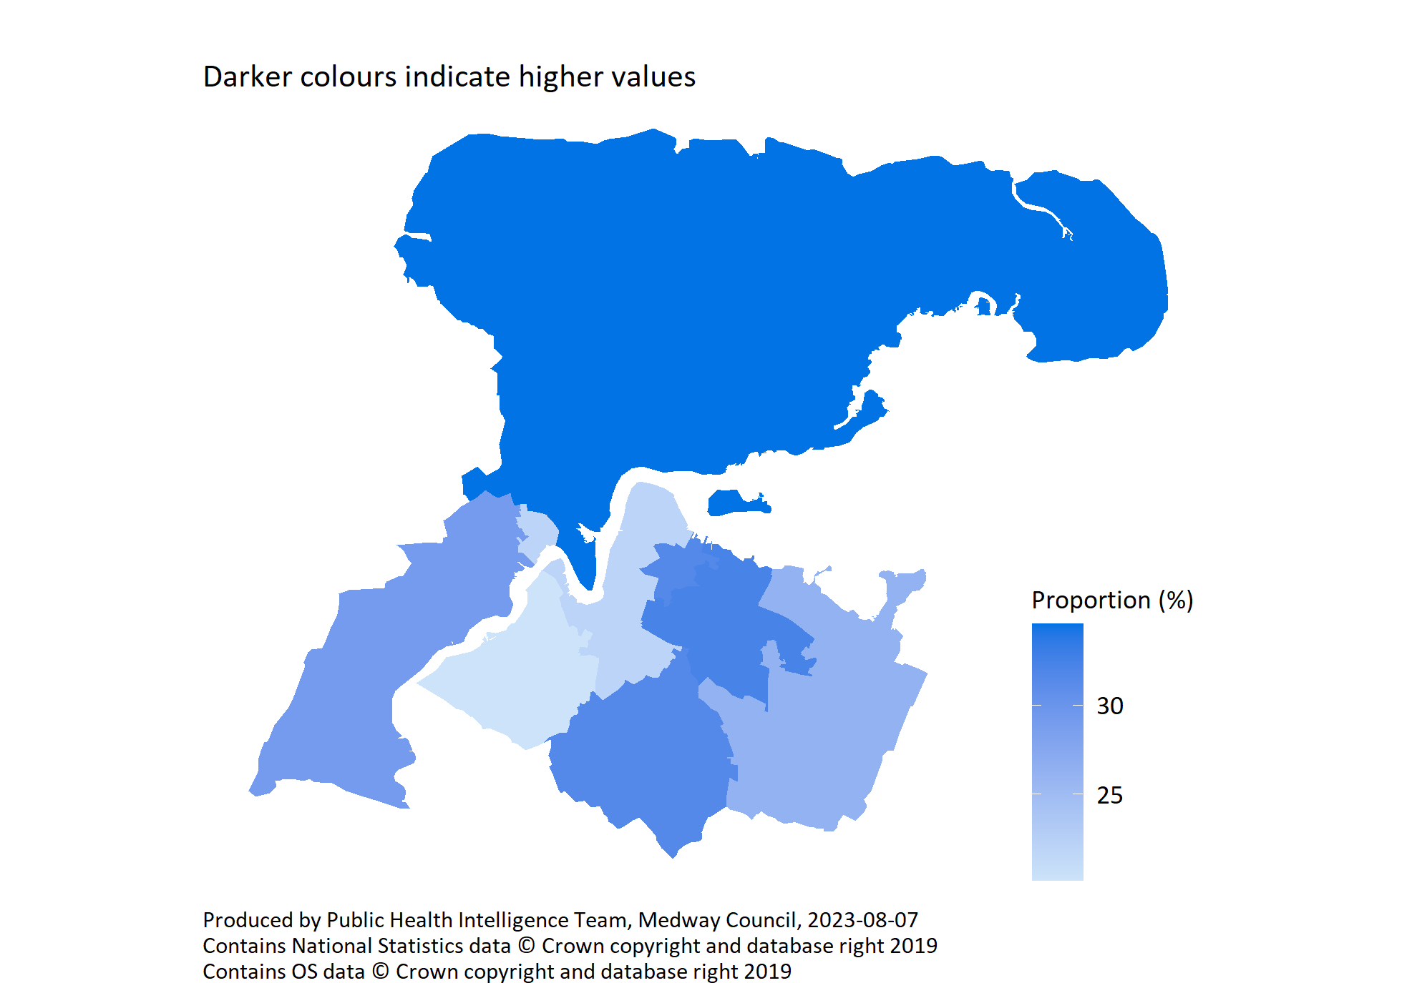
Long term health conditions by PCN
© Medway Council, Public Health Intelligence Team, Version 3.0, 07/08/2023
Survey question: Do you have any physical or mental health conditions or illnesses lasting or expecting to last 12 months or more?
Possible answers: Yes, No, Don't know/don't want to say.
Category selected: Yes.

Slide 43
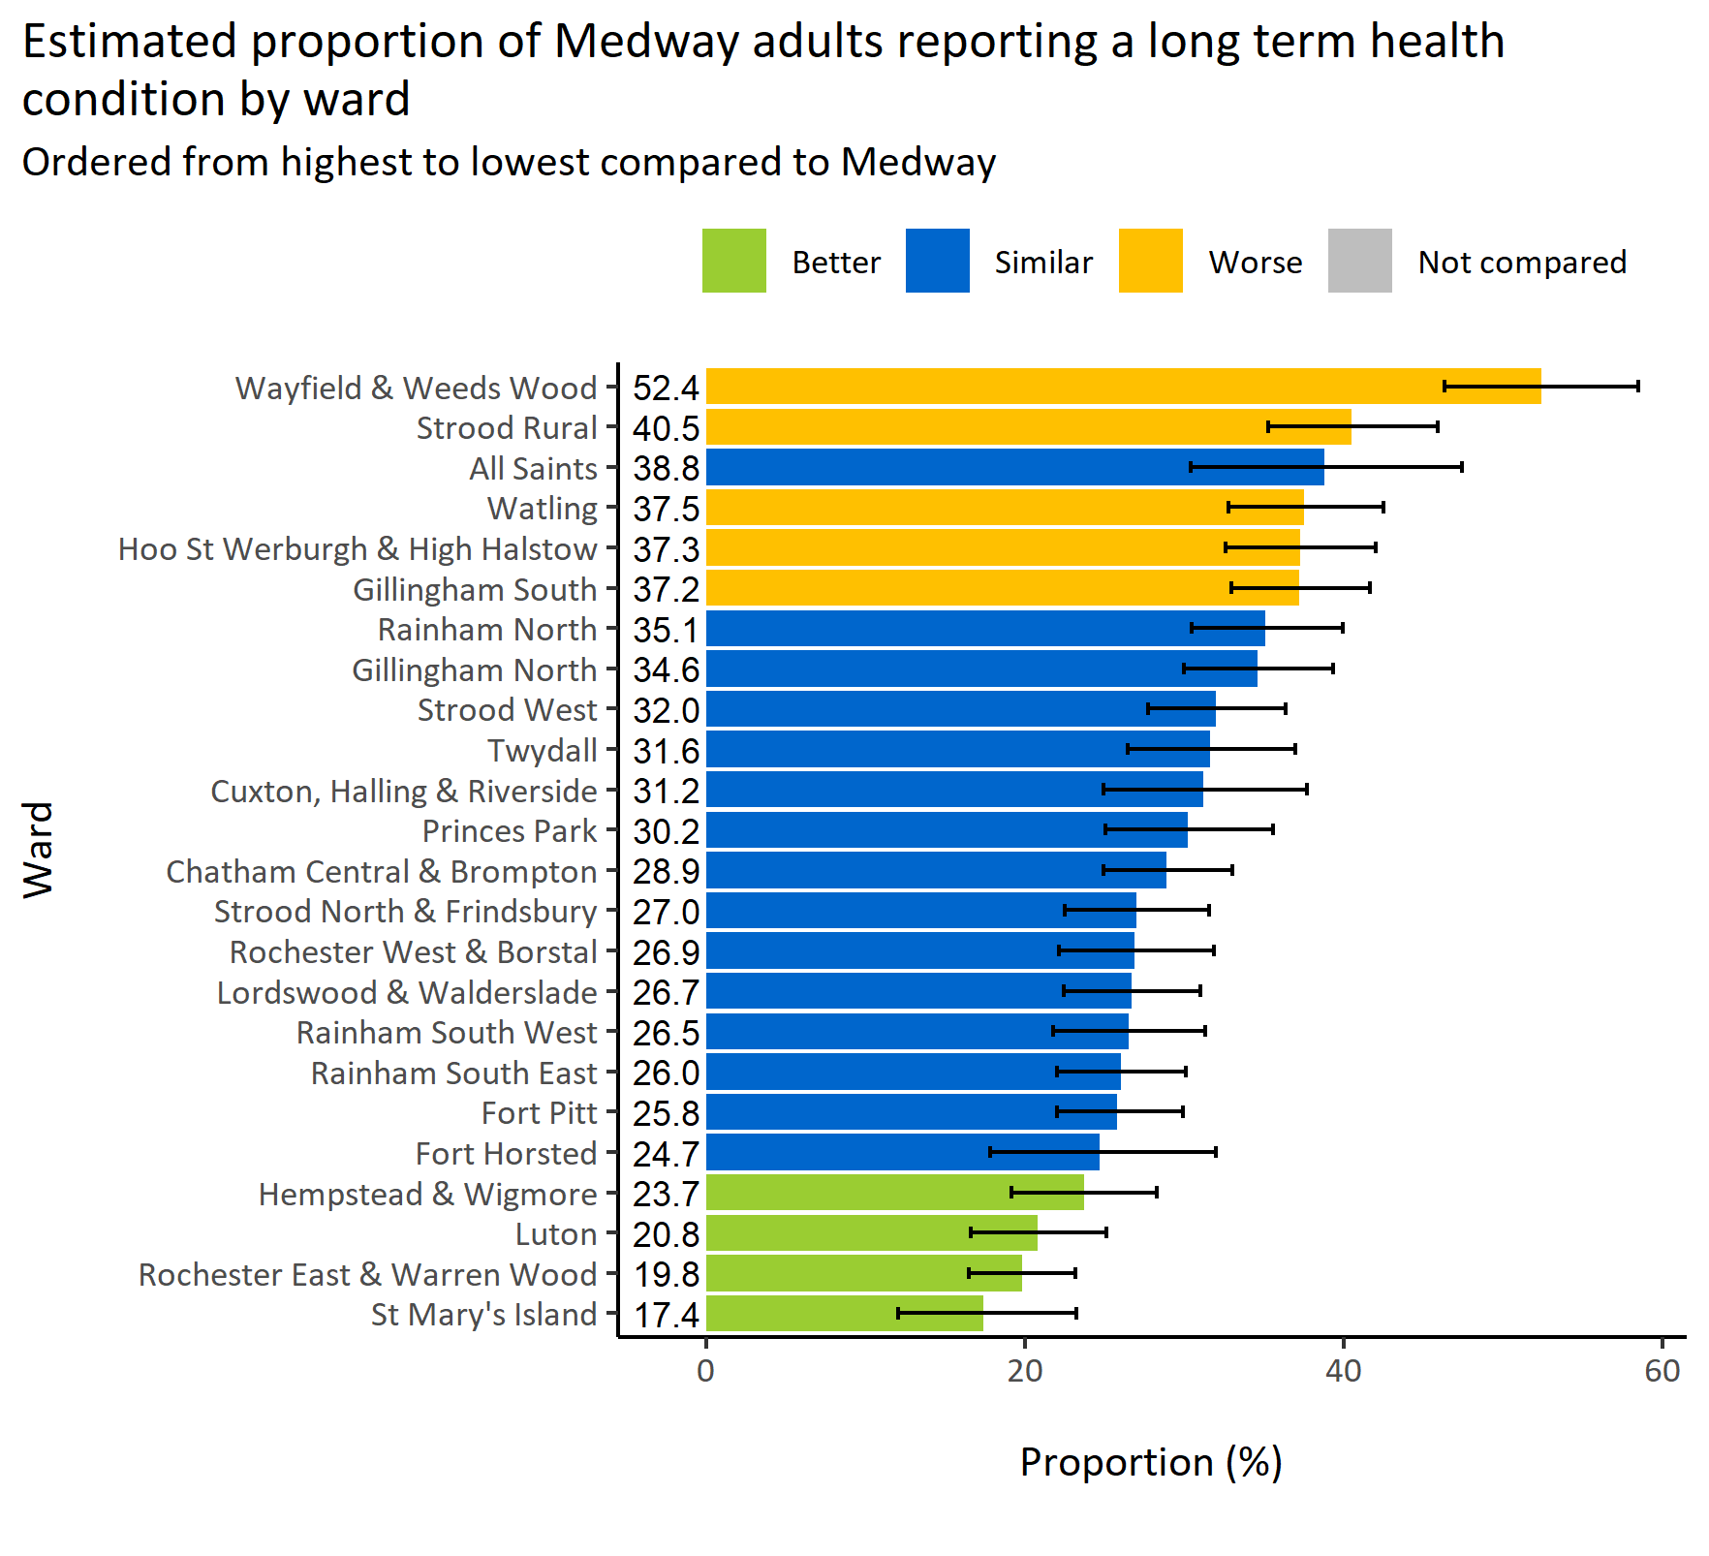
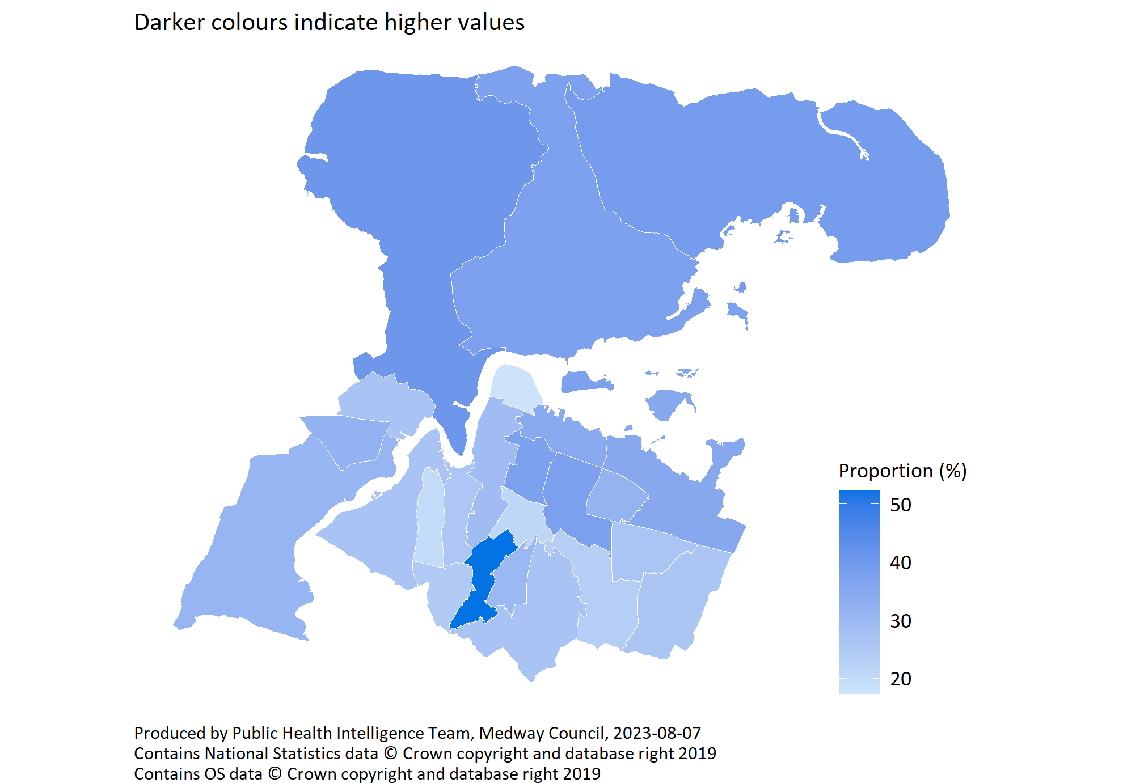
Long term health conditions by ward
© Medway Council, Public Health Intelligence Team, Version 3.0, 07/08/2023
Survey question: Do you have any physical or mental health conditions or illnesses lasting or expecting to last 12 months or more?
Category selected: Answers include people who report a long term health condition.
Estimates are calculated using Bayesian methods. These do not take into
account survey weighting but will be updated in the future to do so.

Slide 44
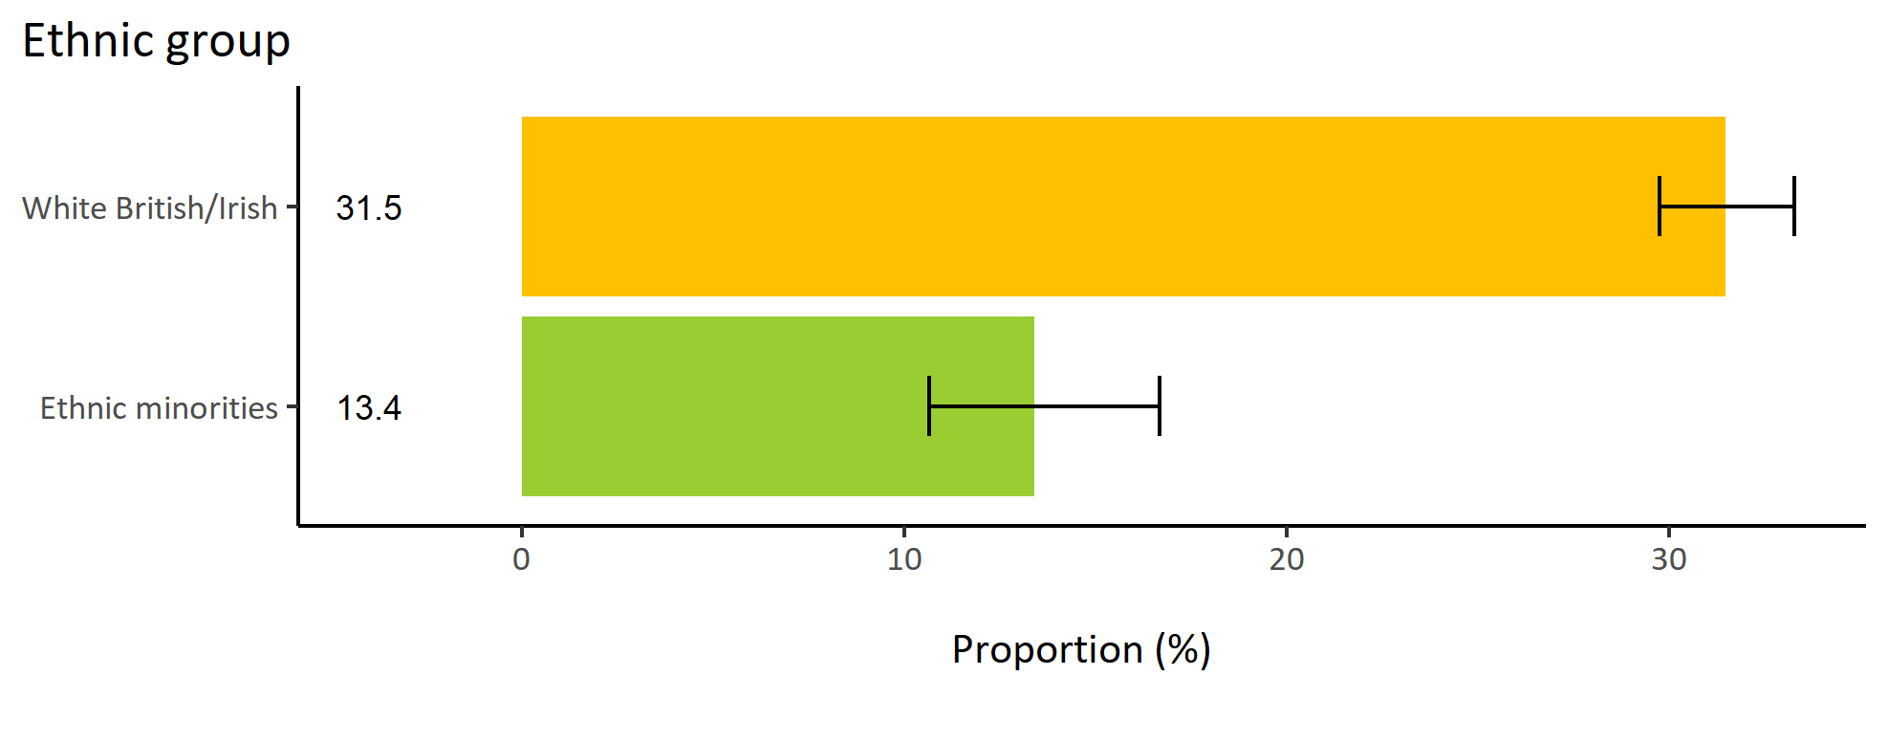
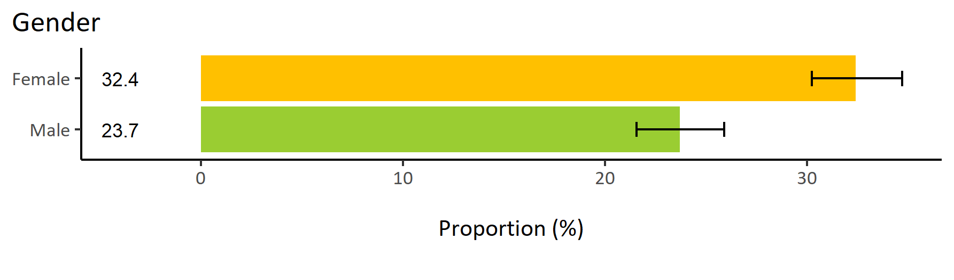
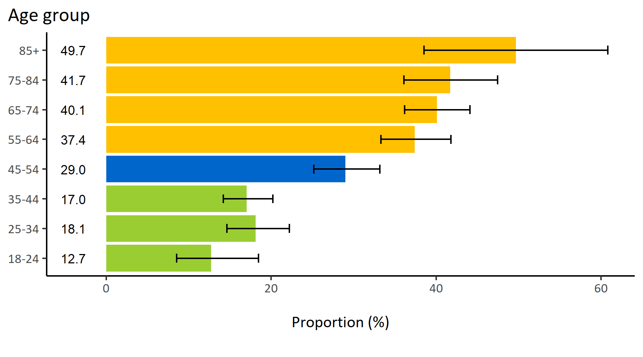
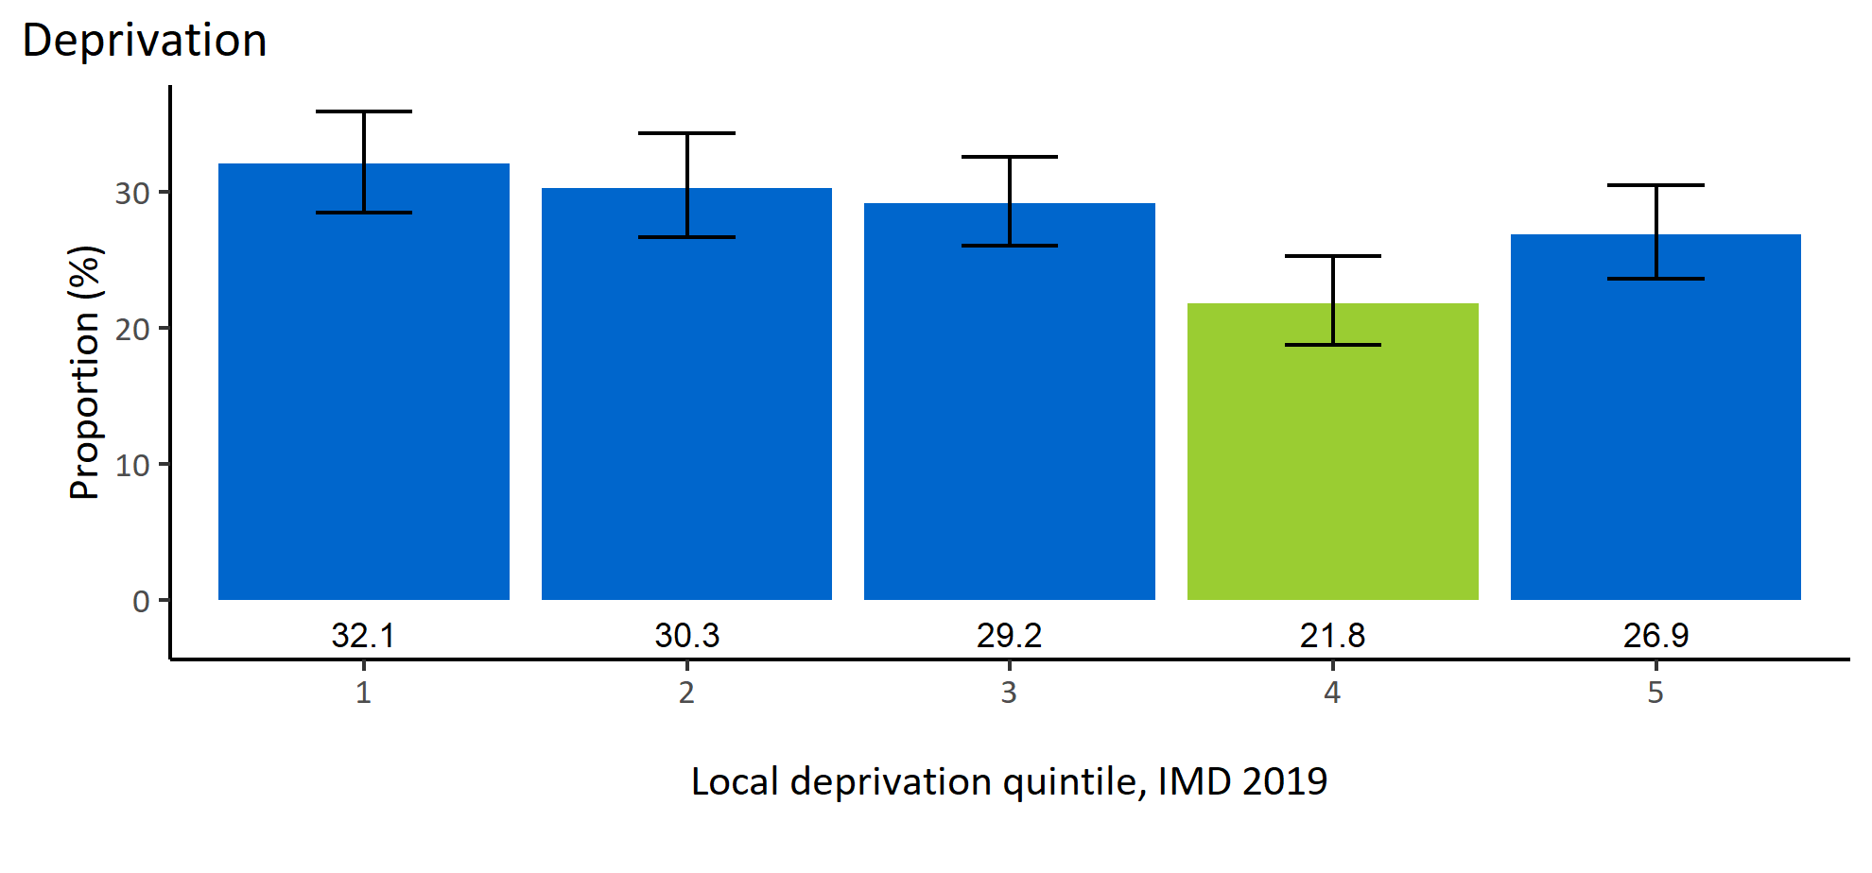
Long term health conditions by inequalities
© Medway Council, Public Health Intelligence Team, Version 3.0, 07/08/2023
Estimated proportion of Medway adults reporting a long term health condition by inequalities

Slide 45
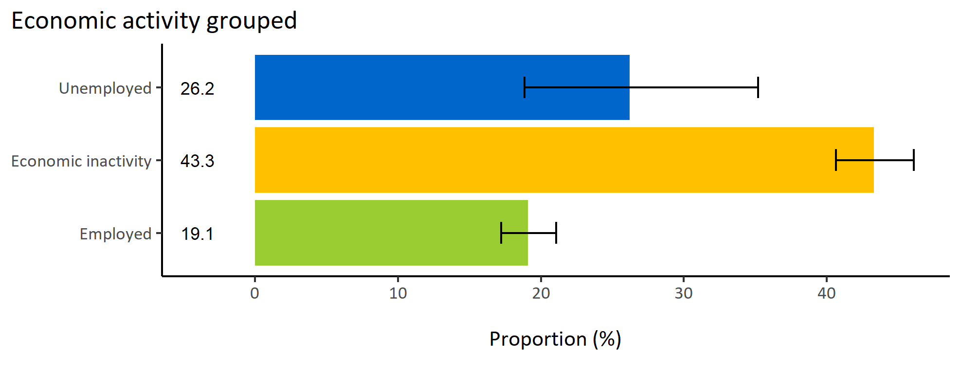
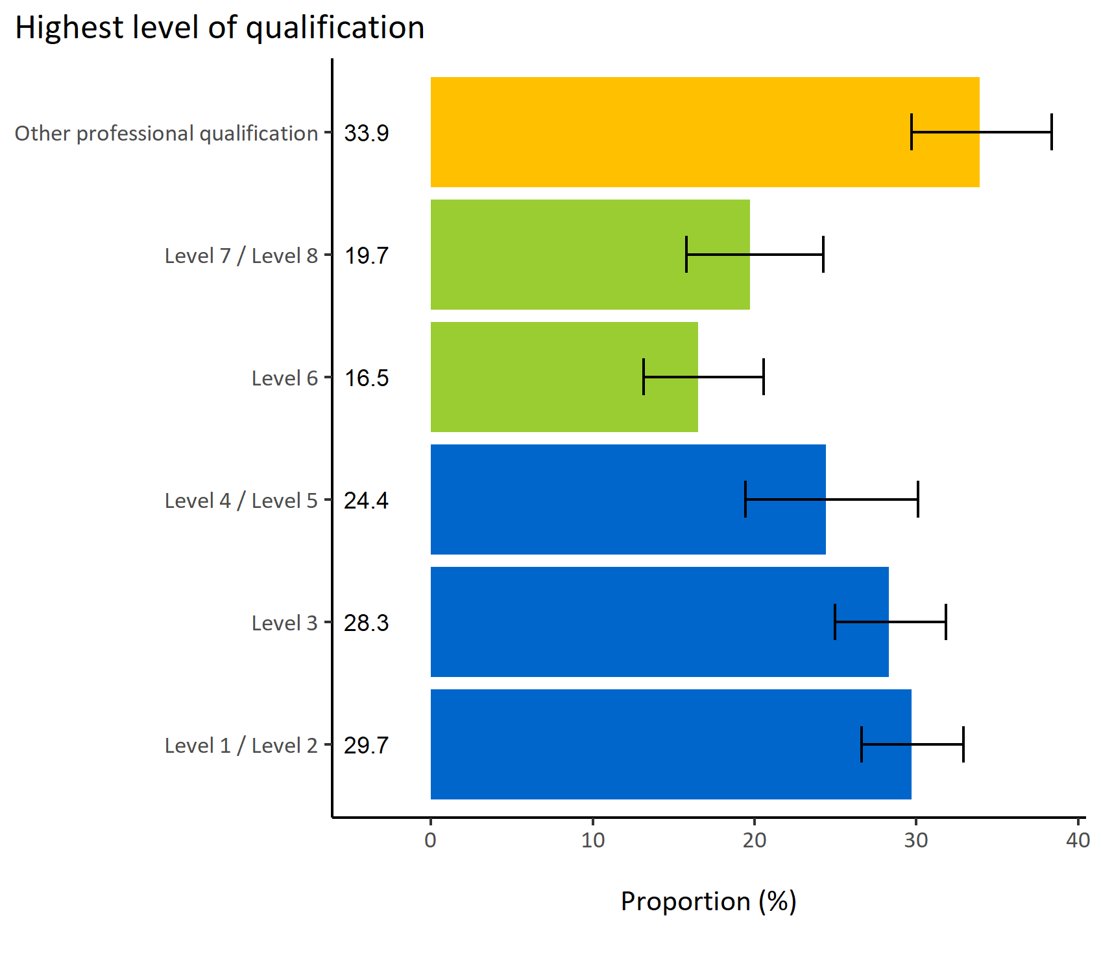
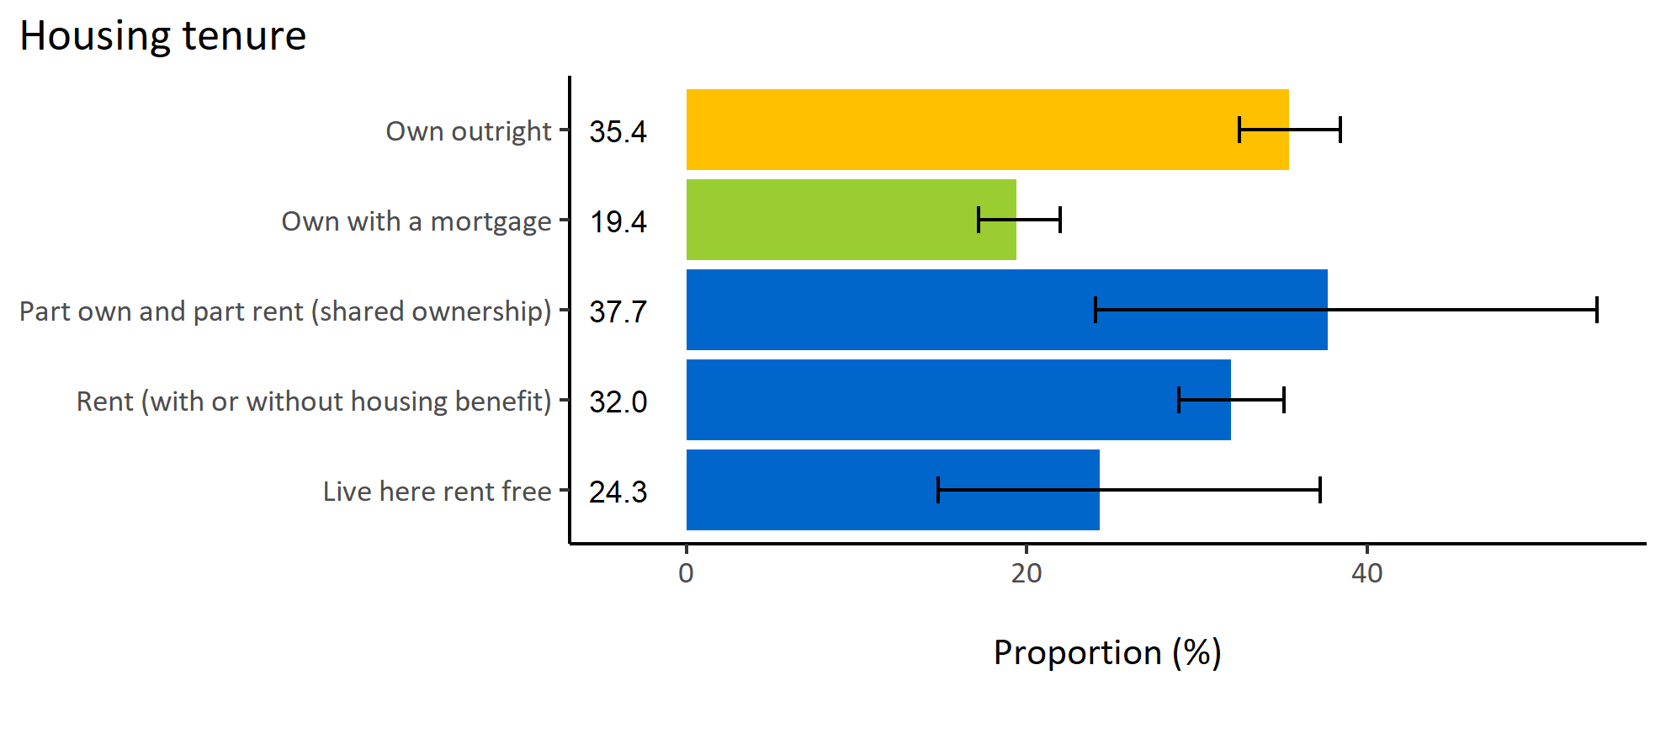
Long term health conditions by wider determinants
© Medway Council, Public Health Intelligence Team, Version 3.0, 07/08/2023
Estimated proportion of Medway adults reporting a long term health condition by wider determinants

Slide 46
Summary: Long term health conditions
© Medway Council, Public Health Intelligence Team, Version 3.0, 07/08/2023
The weighted survey results estimate that 28.1% of Medway adults report having a physical or mental long term health condition.
Certain groups in Medway are more likely to have long-term health conditions. These groups include:
  Adults in wards Strood Rural, Watling, Wayfield & Weeds Wood, Gillingham South, and Hoo St Werburgh & High Halstow
  Females
  Adults aged 55 and over
  Adults in the White British/Irish ethnic group
  Economically inactive adults
  Adults who own their home outright.

Slide 47

Registered with a GP
© Medway Council, Public Health Intelligence Team, Version 3.0, 07/08/2023
Plot description
  National Medway estimate not available for comparison for this indicator.
  The weighted survey results estimate that 98.0% of Medway adults report being registered with a GP.
  49 out of 3,594 survey respondents did not answer this question.
Survey question: Are you registered with a GP or a family doctor?
Possible answers: Yes, No, Don't know/don't want to say.

Slide 48


Registered with a GP by PCN
© Medway Council, Public Health Intelligence Team, Version 3.0, 07/08/2023
Survey question: Are you registered with a GP or a family doctor?
Possible answers: Yes, No, Don't know/don't want to say.
Category selected: Yes.

Slide 49


Registered with a GP by ward
© Medway Council, Public Health Intelligence Team, Version 3.0, 07/08/2023
Survey question: Are you registered with a GP or a family doctor?
Category selected: Answers include people who are registered with a GP.
Estimates are calculated using Bayesian methods. These do not take into
account survey weighting but will be updated in the future to do so.

Slide 50




Registered with a GP by inequalities
© Medway Council, Public Health Intelligence Team, Version 3.0, 07/08/2023
Estimated proportion of Medway adults registered with a GP by inequalities

Slide 51



Registered with a GP by wider determinants
© Medway Council, Public Health Intelligence Team, Version 3.0, 07/08/2023
Estimated proportion of Medway adults registered with a GP by wider determinants

Slide 52
Summary: Registered with a GP
© Medway Council, Public Health Intelligence Team, Version 3.0, 07/08/2023
The weighted survey results estimate that 98.0% of Medway adults report being registered with a GP.
Certain groups in Medway are less likely to be registered with a GP. These groups include:
  Adults in Medway Central PCN
  Adults in wards Luton, Rochester East & Warren Wood, St Mary's Island, and Chatham Central & Brompton
  Adults from minority ethnic backgrounds
  Adults living in areas of high deprivation (quintile 1)
  Adults who rent (with or without housing benefit).

Slide 53

Registered with a dentist
© Medway Council, Public Health Intelligence Team, Version 3.0, 07/08/2023
Plot description
  National Medway estimate not available for comparison for this indicator.
  The weighted survey results estimate that 77.8% of Medway adults report being registered with a dentist.
  95 out of 3,594 survey respondents did not answer this question.
Survey question: Are you registered with a dentist?
Possible answers: Yes, No, Don't know/don't want to say.

Slide 54


Registered with a dentist by PCN
© Medway Council, Public Health Intelligence Team, Version 3.0, 07/08/2023
Survey question: Are you registered with a dentist?
Possible answers: Yes, No, Don't know/don't want to say.
Category selected: Yes.

Slide 55


Registered with a dentist by ward
© Medway Council, Public Health Intelligence Team, Version 3.0, 07/08/2023
Survey question: Are you registered with a dentist?
Category selected: Answers include people who are registered with a dentist.
Estimates are calculated using Bayesian methods. These do not take into
account survey weighting but will be updated in the future to do so.

Slide 56




Registered with a dentist by inequalities
© Medway Council, Public Health Intelligence Team, Version 3.0, 07/08/2023
Estimated proportion of Medway adults registered with a dentist by inequalities

Slide 57



Registered with a dentist by wider determinants
© Medway Council, Public Health Intelligence Team, Version 3.0, 07/08/2023
Estimated proportion of Medway adults registered with a dentist by wider determinants

Slide 58
Summary: Registered with a dentist
© Medway Council, Public Health Intelligence Team, Version 3.0, 07/08/2023
The weighted survey results estimate that 77.8% of Medway adults report being registered with a dentist.
Certain groups in Medway are less likely to be registered with a dentist. These groups include:
  Adults in Medway Central PCN and MPA PCN
  Adults in wards Luton, Chatham Central & Brompton, Gillingham North, Gillingham South, and Hoo St Werburgh & High Halstow
  Males
  Adults aged 25 to 34 years old
  Adults from minority ethnic backgrounds
  Adults living in areas of high deprivation (quintile 1)
  Adults whose highest qualification achieved is level 7 or 8
  Unemployed adults
  Adults who rent (with or without housing benefit).

Slide 59
COVID-19

Slide 60

Had COVID-19
© Medway Council, Public Health Intelligence Team, Version 3.0, 07/08/2023
Plot description
  The weighted survey results estimate that 23.5% of Medway adults have been diagnosed with COVID-19, 3.5% have had suspected COVID-19, and 73.0% have not had COVID-19.
  62 out of 3,594 survey respondents did not answer this question.
Survey question: Have you had COVID-19?
Possible answers: Yes - diagnosed, Not diagnosed but suspected, Not that I know of/No, Don't want to say.

Slide 61


Had COVID-19 by PCN
© Medway Council, Public Health Intelligence Team, Version 3.0, 07/08/2023
Survey question: Have you had COVID-19?
Possible answers: Yes - diagnosed, Not diagnosed but suspected, Not that I know of/No, Don't want to say.
Category selected: Yes - diagnosed.

Slide 62


Had COVID-19 by ward
© Medway Council, Public Health Intelligence Team, Version 3.0, 07/08/2023
Survey question: Have you had COVID-19?
Category selected: Yes - diagnosed
Estimates are calculated using Bayesian methods. These do not take into
account survey weighting but will be updated in the future to do so.

Slide 63




Had COVID-19 by inequalities
© Medway Council, Public Health Intelligence Team, Version 3.0, 07/08/2023
Estimated proportion of Medway adults who have had COVID-19 by inequalities

Slide 64



Had COVID-19 by wider determinants
© Medway Council, Public Health Intelligence Team, Version 3.0, 07/08/2023
Estimated proportion of Medway adults who have had COVID-19 by wider determinants

Slide 65
Summary: Had COVID-19
© Medway Council, Public Health Intelligence Team, Version 3.0, 07/08/2023
The weighted survey results estimate that 23.5% of Medway adults have been diagnosed with COVID-19.
Certain groups in Medway are more likely to have been diagnosed with COVID-19. These groups include:
  Adults in wards Lordswood & Walderslade, Strood West, and Gillingham South
  Adults aged 35 to 44 years old
  Employed adults
  Adults who own their home with a mortgage.

Slide 66

COVID-19 vaccinated
© Medway Council, Public Health Intelligence Team, Version 3.0, 07/08/2023
Plot description
  Fully vaccinated: All eligible vaccination doses excluding the boosters.
  The weighted survey results estimate that 88.9% of Medway adults are fully vaccinated and 11.1% are not fully vaccinated.
  92 out of 3,594 survey respondents did not answer this question.
Survey question: Are you fully vaccinated against COVID-19?
Possible answers: Yes, No, Don't know/don't want to say.

Slide 67


COVID-19 vaccinated by PCN
© Medway Council, Public Health Intelligence Team, Version 3.0, 07/08/2023
Survey question: Are you fully vaccinated against COVID-19 (have taken up all eligible doses excluding the booster)?
Possible answers: Yes, No, Don't know/don't want to say.
Category selected: Yes.

Slide 68


COVID-19 vaccinated by ward
© Medway Council, Public Health Intelligence Team, Version 3.0, 07/08/2023
Survey question: Are you fully vaccinated against COVID-19 (have taken up all eligible doses excluding the booster)?
Category selected: Answers include people who have been fully vaccinated.
Estimates are calculated using Bayesian methods. These do not take into
account survey weighting but will be updated in the future to do so.

Slide 69




COVID-19 vaccinated by inequalities
© Medway Council, Public Health Intelligence Team, Version 3.0, 07/08/2023
Estimated proportion of Medway adults who have been vaccinated against COVID-19 by inequalities

Slide 70



COVID-19 vaccinated by wider determinants
© Medway Council, Public Health Intelligence Team, Version 3.0, 07/08/2023
Estimated proportion of Medway adults who have been vaccinated against COVID-19 by wider determinants

Slide 71
Summary: COVID-19 vaccinated
© Medway Council, Public Health Intelligence Team, Version 3.0, 07/08/2023
The weighted survey results estimate that 88.9% of Medway adults are fully vaccinated against COVID-19.
Certain groups in Medway are less likely to have been fully vaccinated against COVID-19. These groups include:
  Adults in Medway Central PCN and Strood PCN
  Adults in wards Luton, Strood West, Twydall, and Gillingham South
  Adults aged 18 to 34 years old
  Adults from minority ethnic backgrounds
  Adults living in areas of high deprivation (quintile 1)
  Unemployed adults
  Adults who rent (with or without housing benefit).

Slide 72
Risk factors

Slide 73

Smoking prevalence
© Medway Council, Public Health Intelligence Team, Version 3.0, 07/08/2023
Plot description
  The weighted survey results for smoking status are comparable to Medway estimates from the national Annual Population Survey (APS).
  The weighted survey results estimate that 15.7% of Medway adults are smokers, 21.9% are ex-smokers, and 62.5% have never smoked.
  70 out of 3,594 survey respondents did not answer this question.
Survey questions
1) Have you ever smoked a cigarette, a cigar or a pipe? Possible answers: Yes, No
2) Do you smoke any tobacco containing products nowadays? Possible answers: Yes, No
Categories: Ex-smoker: 1) Yes, 2) No. Never smoked: 1) No, 2) No. Smoker: 1) Yes, 2) Yes.

Slide 74


Current smokers by PCN
© Medway Council, Public Health Intelligence Team, Version 3.0, 07/08/2023
Survey questions
1) Have you ever smoked a cigarette, a cigar or a pipe? Possible answers: Yes, No
2) Do you smoke any tobacco containing products nowadays? Possible answers: Yes, No.
Categories: Ex-smoker: 1) Yes, 2) No. Never smoked: 1) No, 2) No. Smoker: 1) Yes, 2) Yes.
Category selected: Smoker

Slide 75


Current smokers by ward
© Medway Council, Public Health Intelligence Team, Version 3.0, 07/08/2023
Survey questions
1) Have you ever smoked a cigarette, a cigar or a pipe?Yes
2) Do you smoke any tobacco containing products nowadays?Yes
Category selected: Smoker
Estimates are calculated using Bayesian methods. These do not take into
account survey weighting but will be updated in the future to do so.

Slide 76




Current smokers by inequalities
© Medway Council, Public Health Intelligence Team, Version 3.0, 07/08/2023
Estimated proportion of Medway adults who are current smokers by inequalities

Slide 77



Current smokers by wider determinants
© Medway Council, Public Health Intelligence Team, Version 3.0, 07/08/2023
Estimated proportion of Medway adults who are current smokers by wider determinants

Slide 78
Summary: Current smokers
© Medway Council, Public Health Intelligence Team, Version 3.0, 07/08/2023
The weighted survey results estimate that 15.7% of Medway adults are smokers.
Certain groups in Medway are more likely to smoke. These groups include:
  Adults in wards Luton, Rochester East & Warren Wood, Chatham Central & Brompton, Strood West, Wayfield & Weeds Wood, and Gillingham South
  Adults living in areas of high deprivation (quintiles 1 and 2)
  Adults whose highest qualification achieved is level 1 or 2
  Unemployed adults
  Adults who rent (with or without housing benefit) or live rent free.

Slide 79

Alcohol consumption
© Medway Council, Public Health Intelligence Team, Version 3.0, 07/08/2023
Plot description
  National Medway estimate not available for comparison for this indicator.
  The weighted survey results estimate that 51.4% of Medway adults consume 14 units of alcohol or less a week, 8.4% consume 15 - 35 units, 0.8% consume more than 35 units, and 39.3% do not drink alcohol.
  87 out of 3,594 survey respondents did not answer this question.
Survey question: How many units of alcohol do you drink in a typical week? If unsure, please estimate.
Possible answers: 14 units or less, 15 - 35 units, More than 35 units, I don't drink alcohol, Don't know/don't want to say.

Slide 80


High alcohol consumption by PCN
© Medway Council, Public Health Intelligence Team, Version 3.0, 07/08/2023
Survey question: How many units of alcohol do you drink in a typical week? If unsure, please estimate.
Possible answers: 14 units or less, 15 - 35 units, More than 35 units, I don't drink alcohol, Don't know/don't want to say.
Category selected: High alcohol consumption: More than 15 units

Slide 81


High alcohol consumption by ward
© Medway Council, Public Health Intelligence Team, Version 3.0, 07/08/2023
Survey question: How many units of alcohol do you drink in a typical week? If unsure, please estimate.
Category selected: More than 15 units of alcohol a week
Estimates are calculated using Bayesian methods. These do not take into
account survey weighting but will be updated in the future to do so.

Slide 82




High alcohol consumption by inequalities
© Medway Council, Public Health Intelligence Team, Version 3.0, 07/08/2023
Estimated proportion of Medway adults consuming 15 or more units of alcohol a week by inequalities

Slide 83



High alcohol consumption by wider determinants
© Medway Council, Public Health Intelligence Team, Version 3.0, 07/08/2023
Estimated proportion of Medway adults consuming 15 or more units of alcohol a week by wider determinants

Slide 84
Summary: High alcohol consumption
© Medway Council, Public Health Intelligence Team, Version 3.0, 07/08/2023
The weighted survey results estimate that 9.3% of Medway adults consume 15 or more units of alcohol a week.
Certain groups in Medway are more likely to have higher levels of alcohol consumption. These groups include:
  Adults in wards All Saints and Cuxton, Halling & Riverside
  Males
  Adults aged 55 to 64 years old.

Slide 85

BMI category
© Medway Council, Public Health Intelligence Team, Version 3.0, 07/08/2023
Plot description
  The weighted survey results estimate that 2.2% of Medway adults are underweight, 35.5% are a healthy weight, 36.8% are overweight, and 25.5% are obese.
  BMI category could not be calculated for 693 out of 3,594 survey respondents.
Survey questions
1) How tall are you without shoes?
2) What is your current weight?
BMI calculation: weight / height^2
Categories: Underweight (BMI <18.5), Healthy weight (BMI 18.5-24.9), Overweight (BMI 25.0-29.9), Obese (BMI >=30)

Slide 86

Excess weight and obesity prevalence
© Medway Council, Public Health Intelligence Team, Version 3.0, 07/08/2023
Plot description
  The weighted survey results for overweight and obese are comparable to Medway estimates from the national Active Lives Survey (ALS).
  The weighted survey results estimate that 62.3% of Medway adults are overweight or obese, and 25.5% are obese.
  BMI category could not be calculated for 693 out of 3,594 survey respondents.
Survey questions
1) How tall are you without shoes?
2) What is your current weight?
BMI calculation: weight / height^2
Categories selected: Overweight or obese (BMI >= 25); Obese (BMI >= 30)

Slide 87


Excess weight prevalence by PCN
© Medway Council, Public Health Intelligence Team, Version 3.0, 07/08/2023
Survey questions
1) How tall are you without shoes?
2) What is your current weight?
BMI calculation: weight / height^2
Categories selected: Overweight or obese (BMI >= 25); Obese (BMI >= 30)

Slide 88




Excess weight by inequalities
© Medway Council, Public Health Intelligence Team, Version 3.0, 07/08/2023
Estimated age-standardised proportion of Medway adults who are overweight or obese by inequalities

Slide 89



Excess weight by wider determinants
© Medway Council, Public Health Intelligence Team, Version 3.0, 07/08/2023
Estimated age-standardised proportion of Medway adults who are overweight or obese by wider determinants

Slide 90
Summary: Excess weight
© Medway Council, Public Health Intelligence Team, Version 3.0, 07/08/2023
The weighted survey results estimate that 62.3% of Medway adults are overweight or obese.
Certain groups in Medway are more likely to be overweight or obese. These groups include:
  Males
  Adults aged 45 to 64 years old
  Adults whose highest qualification achieved is level 1 or 2.

Slide 91

Physical activity
© Medway Council, Public Health Intelligence Team, Version 3.0, 07/08/2023
Plot description
  National Medway estimate not available for comparison for this indicator.
  The weighted survey results estimate that 23.7% of Medway adults are physically inactive (0 days active).
  116 out of 3,594 survey respondents did not answer this question.
Survey question: Please think about your physical activity over the last 7 days. On average, how many days have you done a total of 30 minutes or more of physical activity?
Possible answers: 0, 1, 2, 3, 4, 5, 6, 7, Don't know/don't want to say.

Slide 92


Physical inactivity by PCN
© Medway Council, Public Health Intelligence Team, Version 3.0, 07/08/2023
Survey question: Please think about your physical activity over the last 7 days. On average, how many days have you done a total of 30 minutes or more of physical activity?
Possible answers: 0, 1, 2, 3, 4, 5, 6, 7, Don't know/don't want to say.
Category selected: Physical inactivity: 0 days

Slide 93


Physical inactivity by ward
© Medway Council, Public Health Intelligence Team, Version 3.0, 07/08/2023
Survey question: Please think about your physical activity over the last 7 days. On average, how many days have you done a total of 30 minutes or more of physical activity?
Category selected: Answers include people who are physically inactive.
Estimates are calculated using Bayesian methods. These do not take into
account survey weighting but will be updated in the future to do so.

Slide 94




Physical inactivity by inequalities
© Medway Council, Public Health Intelligence Team, Version 3.0, 07/08/2023
Estimated proportion of Medway adults who are not physically active by inequalities

Slide 95



Physical inactivity by wider determinants
© Medway Council, Public Health Intelligence Team, Version 3.0, 07/08/2023
Estimated proportion of Medway adults who are not physically active by wider determinants

Slide 96
Summary: Physical inactivity
© Medway Council, Public Health Intelligence Team, Version 3.0, 07/08/2023
The weighted survey results estimate that 23.7% of Medway adults are not physically active.
Certain groups in Medway are more likely to be physically inactive. These groups include:
  Adults in Gillingham South PCN
  Adults in wards Rainham North, Rainham South East, Strood West, Twydall, Watling, Wayfield & Weeds Wood, and Gillingham South
  Adults aged 65 and over
  Adults living in areas of high deprivation (quintile 1)
  Economically inactive adults
  Adults who rent (with or without housing benefit).

Slide 97
Mental health and wellbeing

Slide 98

Life satisfaction
© Medway Council, Public Health Intelligence Team, Version 3.0, 07/08/2023
Plot description
  The weighted survey results for low and medium life satisfaction levels are comparable to national personal wellbeing estimates (ONS).
  However, the weighted survey results showed a lower proportion of high life satisfaction and a higher proportion of very high life satisfaction compared to national estimates.
  The most common response was high life satisfaction (47.6%), and the least common response was low life satisfaction (6.6%).
  86 out of 3,594 survey respondents did not answer this question.
Survey question: I’d like you to give an answer on a scale of 0 to 10 where 0 is 'not at all' and 10 is 'completely': Overall, how satisfied are you with your life nowadays?
Possible answers: Scale 0-10
Categories: Low (0-4), Medium (5-6), High (7-8), Very High (9-10)

Slide 99


High or very high life satisfaction by PCN
© Medway Council, Public Health Intelligence Team, Version 3.0, 07/08/2023
Survey question: I’d like you to give an answer on a scale of 0 to 10 where 0 is 'not at all' and 10 is 'completely': Overall, how satisfied are you with your life nowadays?
Possible answers: Scale 0-10
Categories: Low (0-4), Medium (5-6), High (7-8), Very High (9-10)

Slide 100


High or very high life satisfaction by ward
© Medway Council, Public Health Intelligence Team, Version 3.0, 07/08/2023
Survey question: I’d like you to give an answer on a scale of 0 to 10 where 0 is 'not at all' and 10 is 'completely': Overall, how satisfied are you with your life nowadays?
Categories selected: Answers include people who have high or very high life satisfaction.
Estimates are calculated using Bayesian methods. These do not take into
account survey weighting but will be updated in the future to do so.

Slide 101




High or very high life satisfaction by inequalities
© Medway Council, Public Health Intelligence Team, Version 3.0, 07/08/2023
Estimated proportion of Medway adults with high or very high life satisfaction levels by inequalities

Slide 102



High or very high life satisfaction by wider determinants
© Medway Council, Public Health Intelligence Team, Version 3.0, 07/08/2023
Estimated proportion of Medway adults with high or very high life satisfaction levels by wider determinants

Slide 103
Summary: High or very high life satisfaction
© Medway Council, Public Health Intelligence Team, Version 3.0, 07/08/2023
The weighted survey results estimate that 77.7% of Medway adults have high or very high life satisfaction levels.
Certain groups in Medway are less likely to have high or very high life satisfaction levels. These groups include:
  Adults in wards Wayfield & Weeds Wood and Gillingham South
  Unemployed adults
  Adults who rent (with or without housing benefit).

Slide 104

Worthwhile
© Medway Council, Public Health Intelligence Team, Version 3.0, 07/08/2023
Plot description
  The weighted survey results for all levels of worthwhile are comparable to national personal wellbeing estimates (ONS).
  The most common response was high worthwhile (45.7%), and the least common response was low worthwhile (6.8%).
  86 out of 3,594 survey respondents did not answer this question.
Survey question: I’d like you to give an answer on a scale of 0 to 10 where 0 is 'not at all' and 10 is 'completely': Overall, to what extent do you feel that the things you do in your life are worthwhile?
Possible answers: Scale 0-10
Categories: Low (0-4), Medium (5-6), High (7-8), Very High (9-10)

Slide 105


High or very high worthwhile by PCN
© Medway Council, Public Health Intelligence Team, Version 3.0, 07/08/2023
Survey question: I’d like you to give an answer on a scale of 0 to 10 where 0 is 'not at all' and 10 is 'completely': Overall, to what extent do you feel that the things you do in your life are worthwhile?
Possible answers: Scale 0-10
Categories: Low (0-4), Medium (5-6), High (7-8), Very High (9-10)

Slide 106


High or very high worthwhile by ward
© Medway Council, Public Health Intelligence Team, Version 3.0, 07/08/2023
Survey question: I’d like you to give an answer on a scale of 0 to 10 where 0 is 'not at all' and 10 is 'completely': Overall, to what extent do you feel that the things you do in your life are worthwhile?
Categories selected: Answers include people with high or very high worthwhile levels.
Estimates are calculated using Bayesian methods. These do not take into
account survey weighting but will be updated in the future to do so.

Slide 107




High or very high worthwhile by inequalities
© Medway Council, Public Health Intelligence Team, Version 3.0, 07/08/2023
Estimated proportion of Medway adults with high or very high worthwhile levels by inequalities

Slide 108



High or very high worthwhile by wider determinants
© Medway Council, Public Health Intelligence Team, Version 3.0, 07/08/2023
Estimated proportion of Medway adults with high or very high worthwhile levels by wider determinants

Slide 109
Summary: High or very high worthwhile
© Medway Council, Public Health Intelligence Team, Version 3.0, 07/08/2023
The weighted survey results estimate that 78.6% of Medway adults have high or very high worthwhile levels.
Certain groups in Medway are less likely to have high or very high worthwhile levels. These groups include:
  Adults in wards Strood North & Frindsbury, Wayfield & Weeds Wood, Gillingham North, and Gillingham South
  Adults aged 85 and over
  Adults living in areas of higher deprivation (quintile 2)
  Unemployed or economically inactive adults
  Adults who rent (with or without housing benefit).

Slide 110

Happiness
© Medway Council, Public Health Intelligence Team, Version 3.0, 07/08/2023
Plot description
  The weighted survey results for all happiness levels are comparable to national personal wellbeing estimates (ONS).
  The most common response was high happiness (45.3%), and the least common response was low happiness (10.7%).
  86 out of 3,594 survey respondents did not answer this question.
Survey question: I’d like you to give an answer on a scale of 0 to 10 where 0 is 'not at all' and 10 is 'completely': Overall, how happy did you feel yesterday?
Possible answers: Scale 0-10
Categories: Low (0-4), Medium (5-6), High (7-8), Very High (9-10)

Slide 111


High or very high happiness by PCN
© Medway Council, Public Health Intelligence Team, Version 3.0, 07/08/2023
Survey question: I’d like you to give an answer on a scale of 0 to 10 where 0 is 'not at all' and 10 is 'completely': Overall, how happy did you feel yesterday?
Possible answers: Scale 0-10
Categories: Low (0-4), Medium (5-6), High (7-8), Very High (9-10)

Slide 112


High or very high happiness by ward
© Medway Council, Public Health Intelligence Team, Version 3.0, 07/08/2023
Survey question: I’d like you to give an answer on a scale of 0 to 10 where 0 is 'not at all' and 10 is 'completely': Overall, how happy did you feel yesterday?
Categories selected: Answers include people who report high or very high happiness levels.
Estimates are calculated using Bayesian methods. These do not take into
account survey weighting but will be updated in the future to do so.

Slide 113




High or very high happiness by inequalities
© Medway Council, Public Health Intelligence Team, Version 3.0, 07/08/2023
Estimated proportion of Medway adults with high or very high happiness levels by inequalities

Slide 114



High or very high happiness by wider determinants
© Medway Council, Public Health Intelligence Team, Version 3.0, 07/08/2023
Estimated proportion of Medway adults with high or very high happiness levels by wider determinants

Slide 115
Summary: High or very high happiness
© Medway Council, Public Health Intelligence Team, Version 3.0, 07/08/2023
The weighted survey results estimate that 73.4% of Medway adults have high or very high happiness levels.
Certain groups in Medway are less likely to have high or very high happiness levels. These groups include:
  Adults in wards Rochester East & Warren Wood and Strood North & Frindsbury
  Adults aged 85 and over
  Adults living in areas of higher deprivation (quintile 2)
  Unemployed adults
  Adults who rent (with or without housing benefit).

Slide 116

Anxiety
© Medway Council, Public Health Intelligence Team, Version 3.0, 07/08/2023
Plot description
  The weighted survey results for low and high anxiety levels are comparable to national personal wellbeing estimates (ONS).
  However, the weighted survey results showed a lower proportion of medium anxiety and a higher proportion of very low anxiety compared to national estimates.
  86 out of 3,594 survey respondents did not answer this question.
Survey question: I’d like you to give an answer on a scale of 0 to 10 where 0 is 'not at all' and 10 is 'completely': Overall, how anxious did you feel yesterday?
Possible answers: Scale 0-10
Categories: Very low (0-1), Low (2-3), Medium (4-5), High (6-10)

Slide 117


Low or very low anxiety by PCN
© Medway Council, Public Health Intelligence Team, Version 3.0, 07/08/2023
Survey question: I’d like you to give an answer on a scale of 0 to 10 where 0 is 'not at all' and 10 is 'completely': Overall, how anxious did you feel yesterday?
Possible answers: Scale 0-10
Categories: Very low (0-1), Low (2-3), Medium (4-5), High (6-10)

Slide 118


Low or very low anxiety by ward
© Medway Council, Public Health Intelligence Team, Version 3.0, 07/08/2023
Survey question: I’d like you to give an answer on a scale of 0 to 10 where 0 is 'not at all' and 10 is 'completely': Overall, how anxious did you feel yesterday?
Answers: Answers include people who report low or very low anxiety levels.
Estimates are calculated using Bayesian methods. These do not take into
account survey weighting but will be updated in the future to do so.

Slide 119




Low or very low anxiety by inequalities
© Medway Council, Public Health Intelligence Team, Version 3.0, 07/08/2023
Estimated proportion of Medway adults with low or very low anxiety levels by inequalities

Slide 120



Low or very low anxiety by wider determinants
© Medway Council, Public Health Intelligence Team, Version 3.0, 07/08/2023
Estimated proportion of Medway adults with low or very low anxiety levels by wider determinants

Slide 121
Summary: Low or very low anxiety
© Medway Council, Public Health Intelligence Team, Version 3.0, 07/08/2023
The weighted survey results estimate that 70.1% of Medway adults have low or very low anxiety levels.
Certain groups in Medway are less likely to have low or very low anxiety levels. These groups include:
  Adults in wards Strood West, Wayfield & Weeds Wood, Gillingham North, Gillingham South, and Hoo St Werburgh & High Halstow
  Females
  Adults who rent (with or without housing benefit).

Slide 122

Social isolation
© Medway Council, Public Health Intelligence Team, Version 3.0, 07/08/2023
Plot description
  National Medway estimate not available for comparison for this indicator.
  The weighted survey results estimate that 6.3% of Medway adults often feel socially isolated, 18.0% feel socially isolated some of the time, and 75.7% never feel socially isolated.
  121 out of 3,594 survey respondents did not answer this question.
Survey question: How often do you feel isolated from others?
Possible answers: Often, Some of the time, Hardly ever or never, Don't want to say.
Categories: Often, Some of the time, Hardly ever or never.

Slide 123


Social isolation by PCN
© Medway Council, Public Health Intelligence Team, Version 3.0, 07/08/2023
Survey question: How often do you feel isolated from others?
Possible answers: Often, Some of the time, Hardly ever or never, Don't want to say.
Category selected: Socially isolated: Often; Some of the time.

Slide 124


Social isolation by ward
© Medway Council, Public Health Intelligence Team, Version 3.0, 07/08/2023
Survey question: How often do you feel isolated from others?
Categories selected: Often; Some of the time.
Estimates are calculated using Bayesian methods. These do not take into
account survey weighting but will be updated in the future to do so.

Slide 125




Social isolation by inequalities
© Medway Council, Public Health Intelligence Team, Version 3.0, 07/08/2023
Estimated proportion of Medway adults who feel isolated often or some of the time by inequalities

Slide 126



Social isolation by wider determinants
© Medway Council, Public Health Intelligence Team, Version 3.0, 07/08/2023
Estimated proportion of Medway adults who feel isolated often or some of the time by wider determinants

Slide 127
Summary: Social isolation
© Medway Council, Public Health Intelligence Team, Version 3.0, 07/08/2023
The weighted survey results estimate that 24.3% of Medway adults feel isolated often or some of the time.
Certain groups in Medway are more likely to feel isolated. These groups include:
  Adults in MPA PCN
  Adults in wards Chatham Central & Brompton, Gillingham North, and Gillingham South
  Adults aged 85 and over
  Unemployed and economically inactive adults
  Adults who rent (with or without housing benefit).

Slide 128

Loneliness
© Medway Council, Public Health Intelligence Team, Version 3.0, 07/08/2023
Plot description
  The weighted survey results for loneliness are comparable to national estimates.
  The weighted survey results showed that 20.6% of Medway adults report feeling lonely.
  113 out of 3,594 survey respondents did not answer this question.
Survey question: How often do you feel lonely?
Possible answers: Often/always, Some of the time, Occasionally, Hardly ever, Never, Don't want to say.
Category selected: Lonely: Often/always or some of the time.

Slide 129


Loneliness by PCN
© Medway Council, Public Health Intelligence Team, Version 3.0, 07/08/2023
Survey question: How often do you feel lonely?
Possible answers: Often/always, Some of the time, Occasionally, Hardly ever, Never, Don't want to say.
Category selected: Lonely: Often/always or some of the time.

Slide 130


Loneliness by ward
© Medway Council, Public Health Intelligence Team, Version 3.0, 07/08/2023
Survey question: How often do you feel lonely?
Answers: Answers include people who feel lonely often/always or some of the time.
Estimates are calculated using Bayesian methods. These do not take into
account survey weighting but will be updated in the future to do so.

Slide 131




Loneliness by inequalities
© Medway Council, Public Health Intelligence Team, Version 3.0, 07/08/2023
Estimated proportion of Medway adults who feel lonely often / always or some of the time by inequalities

Slide 132



Loneliness by wider determinants
© Medway Council, Public Health Intelligence Team, Version 3.0, 07/08/2023
Estimated proportion of Medway adults who feel lonely often / always or some of the time by wider determinants

Slide 133
Summary: Loneliness
© Medway Council, Public Health Intelligence Team, Version 3.0, 07/08/2023
The weighted survey results estimate that 20.6% of Medway adults feel lonely often/always or some of the time.
Certain groups in Medway are more likely to feel lonely. These groups include:
  Adults in wards Rainham North and Gillingham South
  Adults aged 85 and over
  Economically inactive adults
  Adults who rent (with or without housing benefit).

